Slide 1
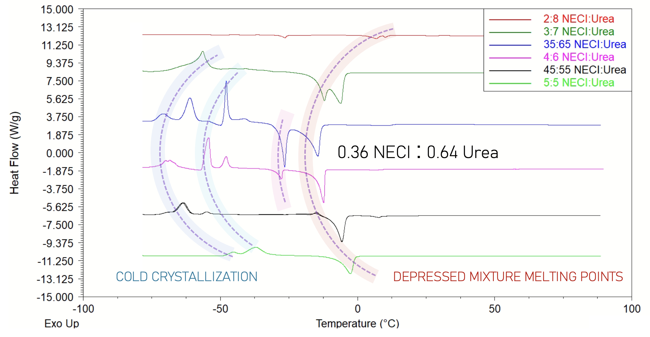
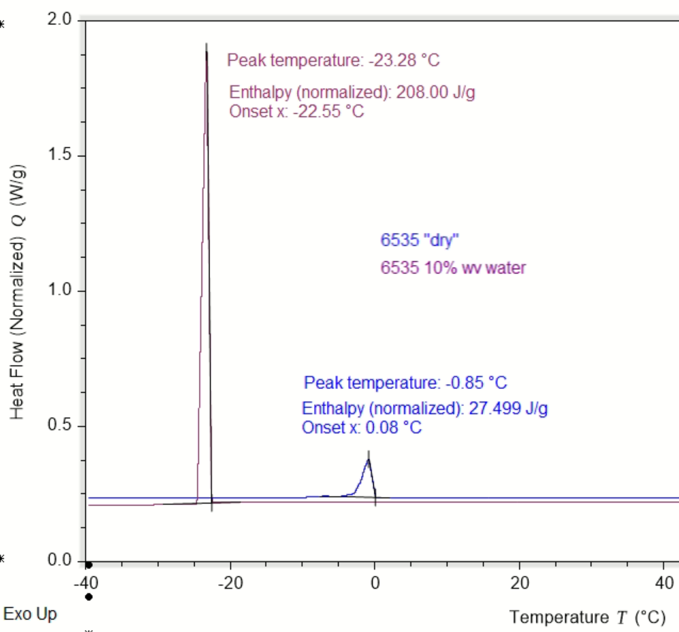
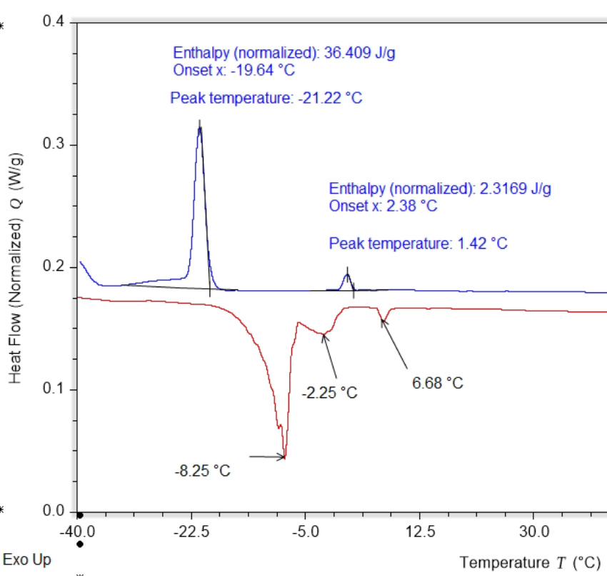
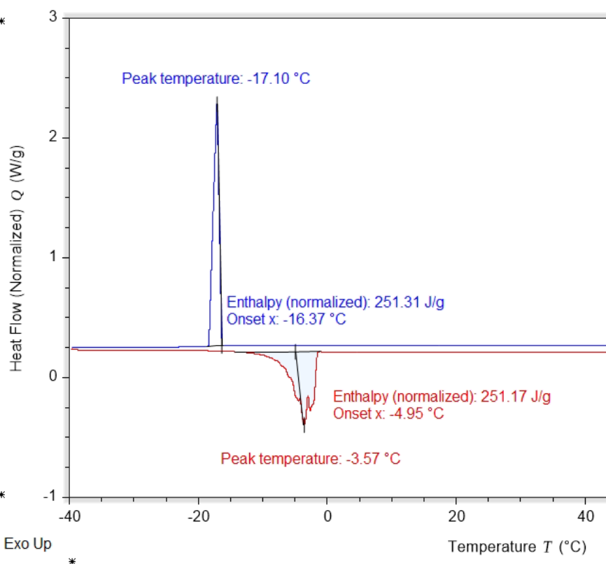
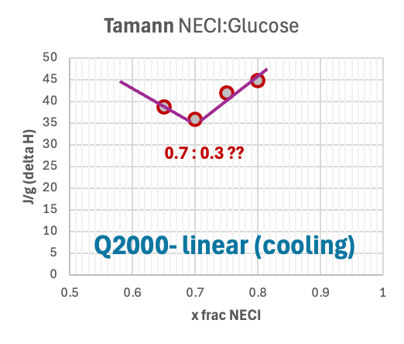
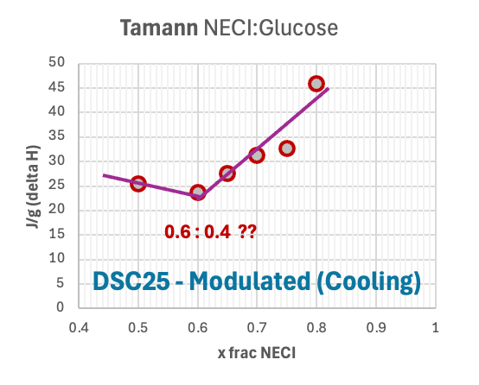
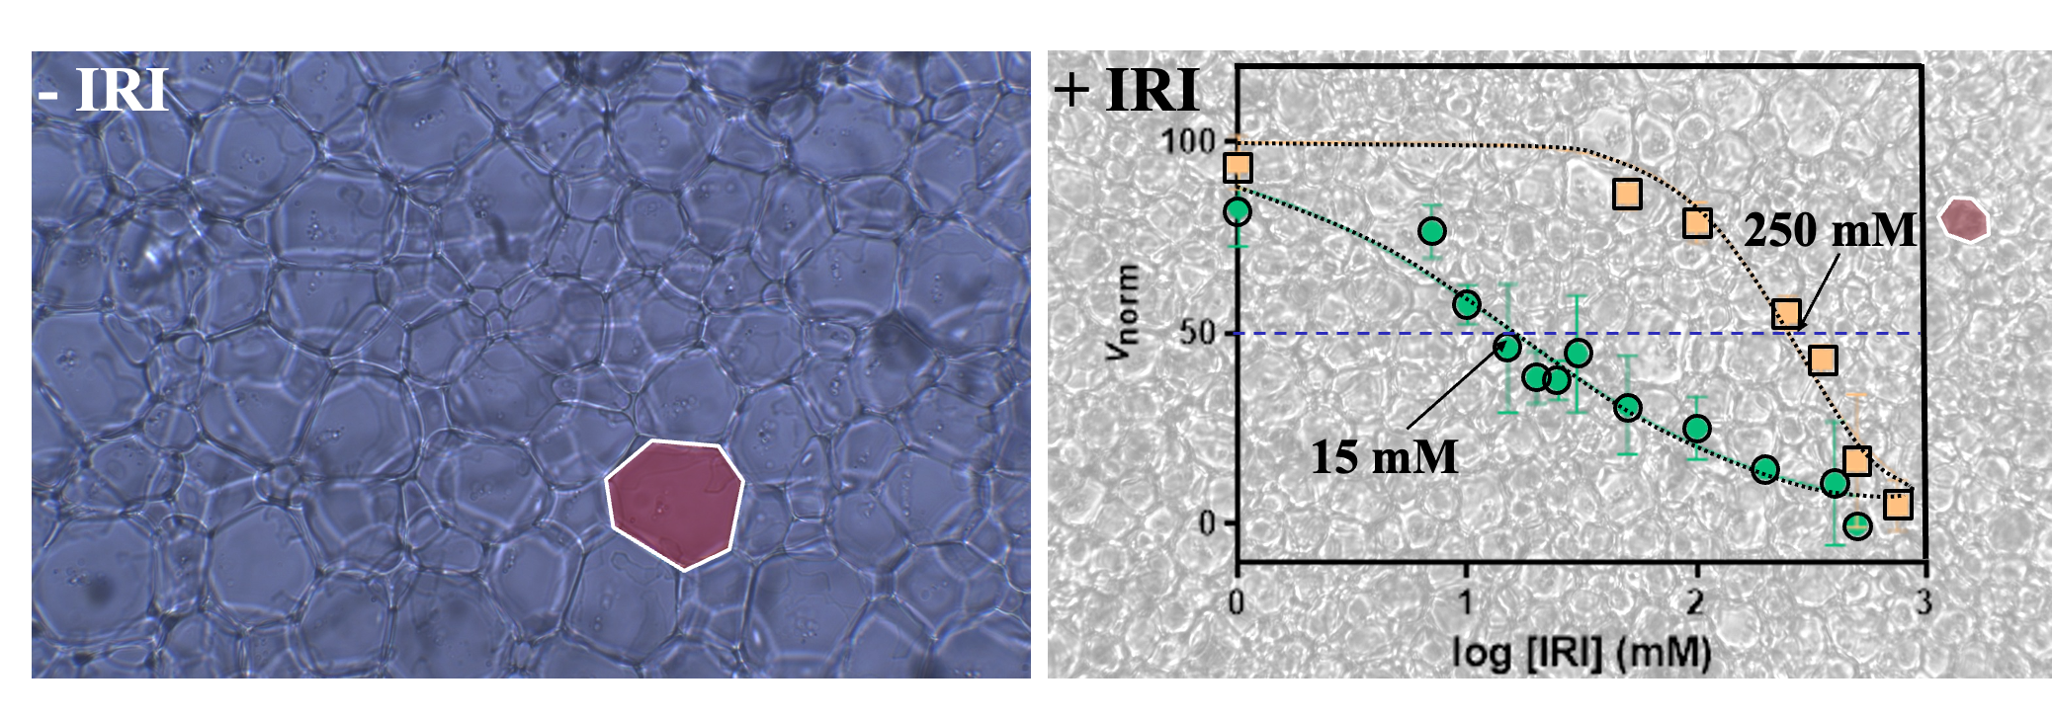
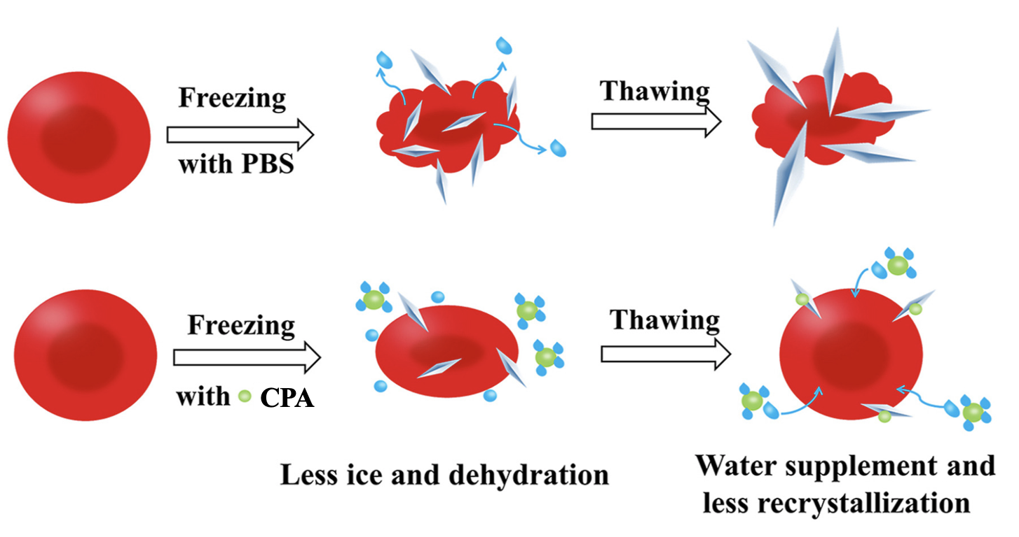
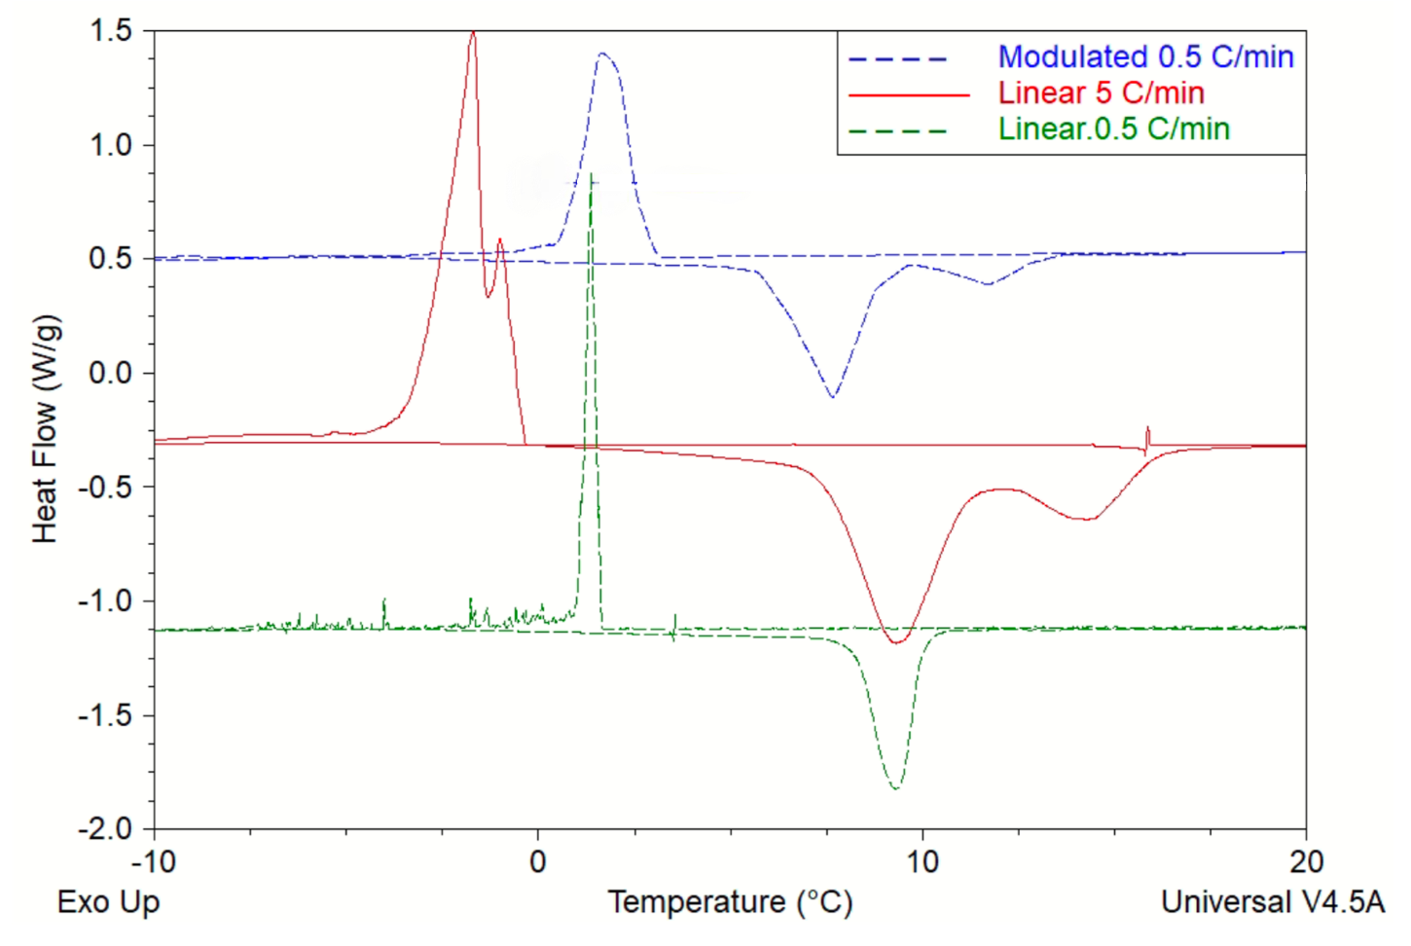
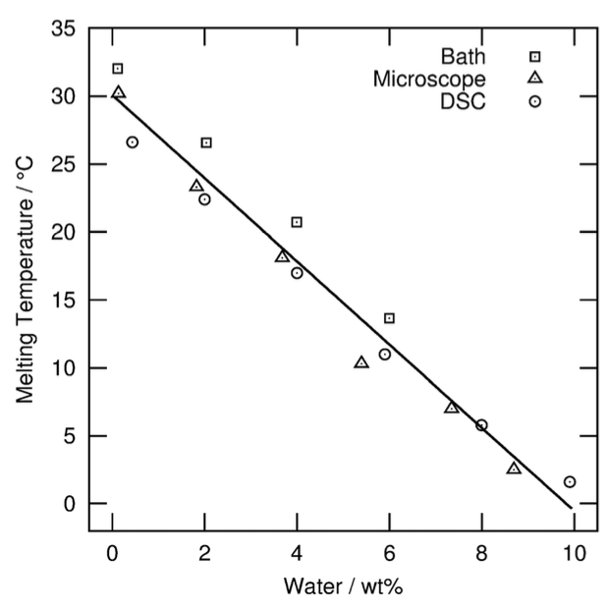
Novel Eutectic Mixtures for Cryopreservation
Kaylee Murphy¹, Dr. John Tsavalas^{1,2}, Departments of Chemical Engineering¹ and Chemistry², University of New Hampshire
Elly Walsh, Dr. Robert Ben, Department of Chemistry and Biomolecular Sciences, University of Ottawa
Introduction
Methods
Results (Impact of H₂O on DES)
Deep eutectic solvents (DES) form a mixture that exhibits lower melting and freezing points than its individual components. They are biocompatible, cost effective, and have low toxicity.¹
This project aims to make a biocompatible cryoprotectant utilizing a ChCl derivative, NECI
DES show cryopreservation potential but lack ice recrystallization inhibition (IRI) activity. This project adds NECI, a ChCl-derived IRI, to address that gap.
Figure 1: (left, blue) control IRI assay, (right, gray) 200mM NECI IRI assay, IC₅₀ overlay showing NECI (green) vs ChCl (orange)
DES in cryomedia are made with 5-10% w/v¹, but mixtures over 51 wt% water create aqueous solutions.³
Figure 2: graphic showing how ice can impact red blood cell preservation: damaged (top), protected (bottom)⁴
Preparing eutectic mixture w/out H₂O:
Add desired molar ratio of NECI and urea (or glucose) to mortar
Grind with pestle for 10 mins
Prepare ~2 mg sample for DSC
Preparing eutectic mixture w/H₂O:
Add desired molar ratio of NECI and urea (or glucose) to mortar
Add either 10% w/v water or 10 wt% water
Grind with pestle for 10 mins
Prepare ~2 mg sample for DSC
Differential Scanning Calorimetry (DSC) Methods:
Linear: equilibrate at 90°C for 30 mins, cool at 5°C/min to -40°C, hold for 5 mins, heat at 5°C/min to 90°C
Modulated: same as linear method except during cooling and heating, temp modulates ±2°C every 2 mins
Too much water dilutes the DES, creating an aqueous solution. Some DES is maintained, but water dilutes the H-bonding in the DES. Small amounts of water conserved and enhanced eutectic properties.
65:35
NECI:Glucose
NECI:Glucose
ChCl
NECI
Figure 5: overlay of DSC runs for various NECI:Urea ratios
Figure 9: 65:35 dry NECI:Glucose compared to 65:35 NECI:Glucose in 10% w/v H₂O
IC₅₀ = 235mM
IC₅₀ = 16mM
Results (NECI:Glucose)
Analyzing the melting peaks for NECI:Glucose proved to be inconclusive. However, analyzing the freezing peaks showed more promising results.
80:20
80:20
Using the modulated DSC temperature method and the data from the freezing peaks, the eutectic ratio for NECI:Glucose appears to be either 3:1 or 3:2 These values differ from the ChCl:Glucose eutectic ratio 1:1⁶
Note: pure H₂0
ΔH_{f} = 335 J/g
T_{m} ChCl= 300 ∘C
T_{m} Urea = 135 ∘C
T_{m} Reline = (0-30) ∘C
Results (NECI:Urea)
Figure 10: (left) 80:20 NECI:Glucose with 9 wt% H₂O, (right) 80:20 NECI:Glucose with 10% w/v (90 wt%) H₂O
By analyzing the melting peaks, the eutectic ratio between NECI:Urea was found to be 35:65 using the linear heating method
Figure 3: graph showing the correlation between molar fraction of NECI in DES and temperature
Figure 4: graph showing the correlation between molar fraction of NECI in DES and change in enthalpy
This is close to the tabulated eutectic ratio for ChCl:Urea, which is 33:67⁵
Conclusions
ChCl
NECI:Urea eutectic molar ratio is 35:65 (i.e. 1:2)
Modulated heating/cooling DSC method gives more useful results than linear heating/cooling
NECI:Glucose eutectic molar ratio is either 3:1 or 3:2
Mixing DES and water makes a tri-component DES
Too much water causes that tri-component DES to act like an aqueous (homogeneous) solution
Smaller amounts of water promote H-bonding in the DES and maintain eutectic with lower T_{m}
avg.
crystal
size
avg.
crystal
size
Figure 6: (left) correlation between molar fraction of NECI in DES and enthalpy using linear DSC method, (right) relationship between molar fraction of NECI in DES and enthalpy using modulated DSC method
NECI
There were difficulties in observing the eutectic point by DSC for NECI:Glucose using the linear temperature method on one of DSC instruments (DSC25). However, running with the modulated temperature method produced great results on both DSC instruments.
Next Steps
Begin testing NECI with glucose derivatives to find their eutectic points relative to that with glucose
Test other choline derivatives with urea to determine the impact of halogen type on the eutectic ratio
Redo the NECI:Urea analysis using modulated DSC
Explore range of different wt% water to see which ratio of DES:water is ideal (and suited to cryo apps)
70:30 NECI:Glucose
Figure 7: 70:30 NECI:Glucose overlay of different DSC methods
Objectives
Water that is used to prep the cryoprotectant likely impacts H-bonding within the DES. Small amounts of water have been shown to incorporate into the DES lattice via H-bonding and improve the eutectic properties.
Determine the eutectic point between NECI and Urea
Determine the eutectic point between NECI and Glucose, and glucose derivatives
Determine how water impacts the eutectic mixture
References
1. Jesus, A. R., Meneses, L., Duarte, A. R. C., & Paiva, A. (2021). Natural deep eutectic systems, an emerging class of
cryoprotectant agents. Cryobiology (Vol. 101, pp. 95–104). essay, ScienceDirect. Ref 1 Link
2. Hammond, O. S., Bowron, D. T., & Edler, K. J. (2016). Liquid structure of the choline chloride-urea deep eutectic solvent
(reline) from neutron diffraction and atomistic modelling. Green Chemistry, 18(9), 2736-2744. Ref 2 Link
3. Hammond, O. S., Bowron, D. T., & Edler, K. J. (2017). The effect of water upon deep eutectic solvent nanostructure: An
unusual transition from ionic mixture to aqueous solution. Wiley Online Library. Ref 3 Link
4. de Vries, R. J., Tessier, S. N., Banik, P. D., Nagpal, S., Cronin, S. E., Ozer, S., ... & Uygun, K. (2019). Supercooling extends
preservation time of human livers. Nature biotechnology, 37(10), 1131-1136. Ref 4 Link
5. Meng, X., Ballerat-Busserolles, K., Husson, P., & Andanson, J.-M. (2016a). Impact of water on the melting temperature of
urea + choline chloride deep eutectic solvent. New Journal of Chemistry, 40(5), 4492–4499. Ref 5 Link
6. Idenaga, S., Hosoya, T., & Miyafuji, H. (2024a). The possibility of chemical transformation of glucose in choline
chloride/glucose deep eutectic solvent with thermal instability. RSC Advances, 14(24), 17022–17031. Ref 6 Link
7. Bathke, E. K. (2024). Structures and Solvation in Deep Eutectic Solvents. Department of Chemistry, Lund University. Ref 7
Link
Contacts
Figure 8:graph of DES ChCl:Urea melting temp changing due to wt% of water⁵
Kaylee.Murphy@unh.edu, John.Tsavalas@unh.edu

