Slide 1

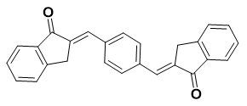
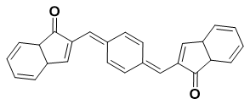
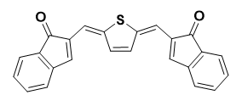
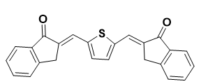
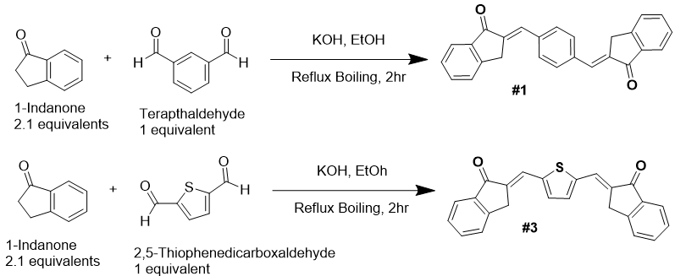
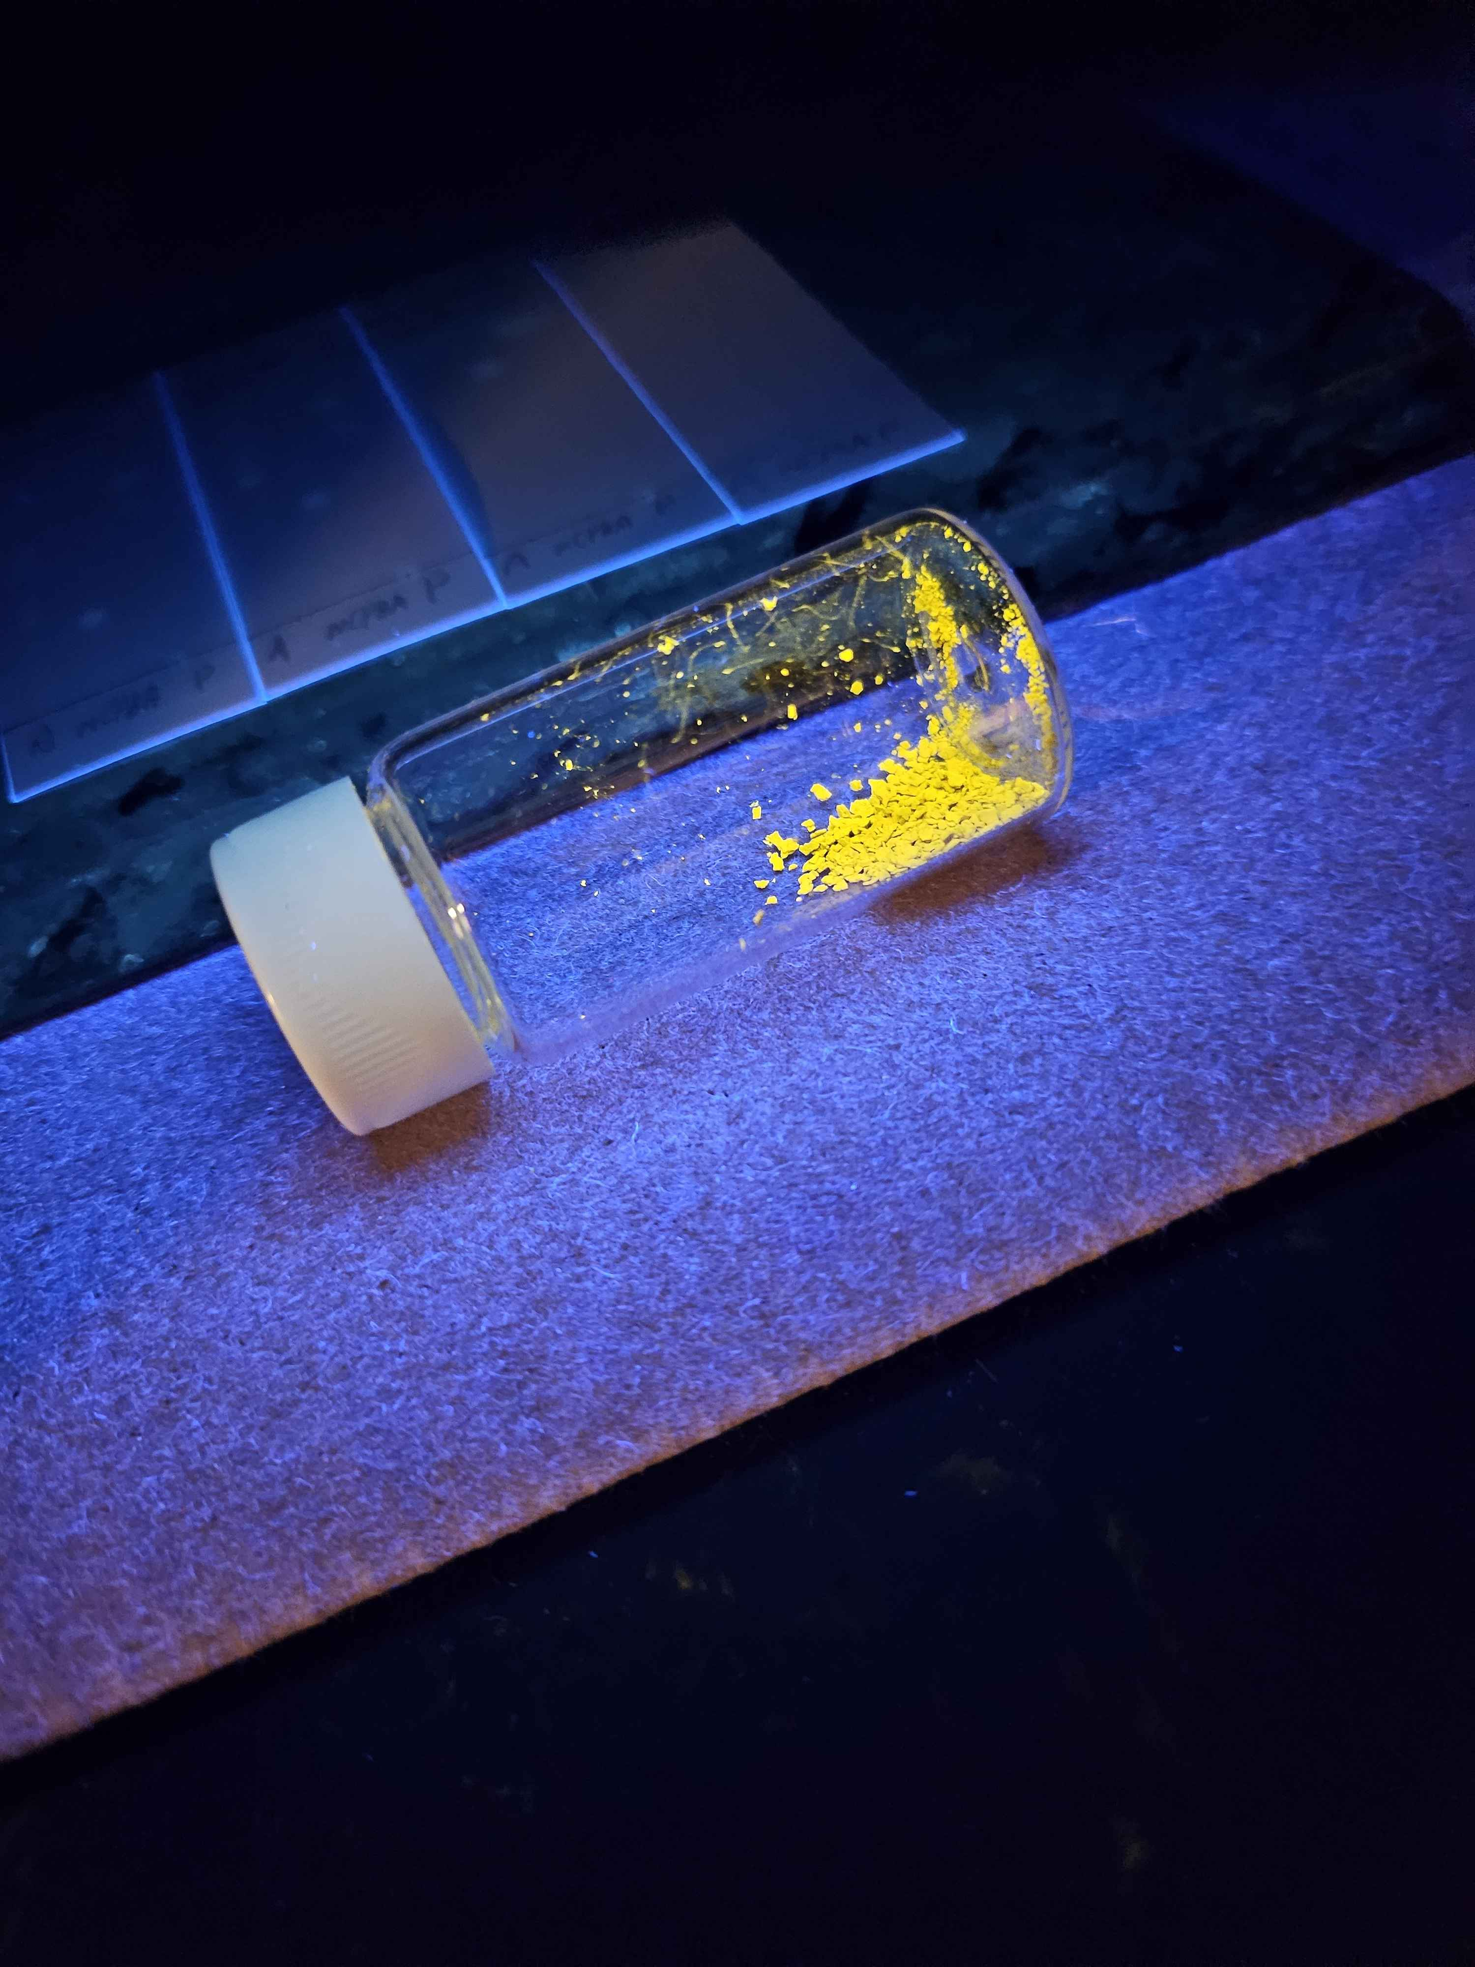
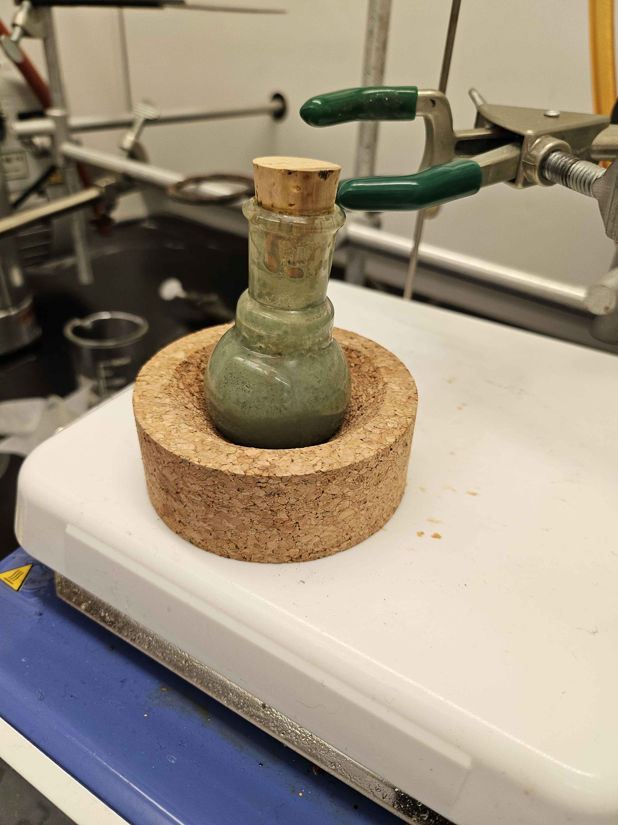
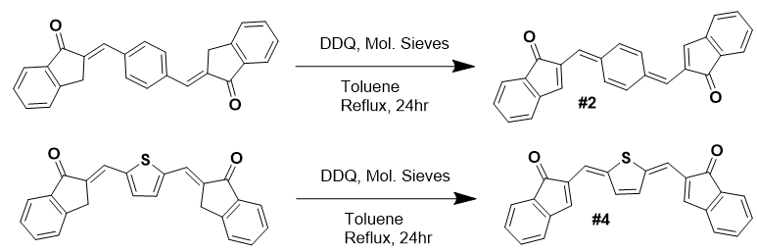
Synthesis of Highly Conjugated Molecules for use as Organic Semiconductors
Ethan McFee, Glen Miller*
Department of Chemistry, University of New Hampshire, Durham, NH 03824
Introduction
Target Compounds
Results & Conclusions
Semiconductors have properties between conductors and insulators and are used for components like diodes, transistors, and photovoltaics. Usually made from silicon, two different kinds can be made depending on what they’re doped with. P-type semiconductors use group III elements to create electron “holes”; N-type use group V elements to add free electrons. Due to Carbon’s conductivity and ability to form Pi Bonds, Organic materials can be used for both kinds of semiconductors. The interest in doing this lies in Organic semiconductors being easier to make, cheaper to produce and better for the environment. By focusing on the conjugation and aromaticity of an organic molecule, “holes” can be put into the material. This results in a comparable gap between the Highest Occupied Molecular Orbital (HOMO) and Lowest Unoccupied Molecular orbital (LUMO) when compared to a traditional Silicon semiconductor.
Compound # | Structure | LUMO (eV) | HOMO (eV) | Gap (eV)
#1 |  | -3.00 | -6.40 | 3.40
#2 |  | -3.54 | -5.26 | 1.72
#3 |  | -3.11 | -6.19 | 3.08
#4 |  | -3.43 | -5.38 | 1.95
Both #1 and #3 were successfully synthesized. This was confirmed with proton and C13 NMR spectra of both. While #1 was initially not very clean, #3 was very clean. Every time the reaction for #3 was repeated, the NMR spectra of the crude product showed that it was the only product that formed. Both products, due to their conjugation, fluoresced under UV light. Neither of these compounds appear in any published papers.
#2 and #4 were a different story. Despite letting the reaction run for 24+ hours at reflux in high boiling solvents and TLC suggesting that a product formed, NMR Spectra showed that it was only a partially reacted product. #2 and #4’s reluctance to form is believed to be due to the dehydrogenated compounds being oxidized when dried and exposed to air and light. This is common among compounds with many SP² hybridized carbons. The small HOMO-LUMO gap means that the pi electrons can excite easily under light. This allows for them to readily start bonding with oxygen when exposed to air. It is the same reason why Pentacene and its derivatives, which are often used in Organic Semiconductor applications, are very air sensitive. While higher boiling solvents like Dichlorobenzene were experimented with, this did not yield any better results. Future attempts at similar dehydrogenations should be kept in an inert atmosphere and kept out of the light as much as possible.
Methodology & Synthesis
Some target compounds were identified for their conjugation and aromatic character. To verify that these compounds were worth synthesizing, Spartan’s 6-31G* Density Functional Theory was used to calculate the HOMO-LUMO gap. The ideal HOMO-LUMO gap is >2 eV, and two of the compounds have this, with the other two being precursors. Both precursor compounds were successfully synthesized. #3 had an exceptionally high purity, not requiring any further purification techniques. #1 was recrystallized to remove side products. The dehydrogenation with DDQ was attempted a few different times with both #1 and #3. However, they were not successful. For one attempt for synthesizing #2, Dichlorobenzene was used for it’s higher boiling point. This was not successful either. The synthetic steps for all target compounds are detailed in their respective schemes.
Reaction Schemes
Precursor Reactions: #1 and #3
Gallery
Acknowledgements
Crude Product #3 Under UV light
Crude Product #1
I would like to thank Dr. Glen Miller and the whole Miller Group for their help in this project, especially Qian Liu. I would also like to thank my friends and family for their constant support throughout this whole endeavor.
Dehydrogenation Reactions: #2 and #4
References
John D. Crounse, Lasse B. Nielsen, Solvejg Jørgensen, Henrik G. Kjaergaard, and Paul O. WennbergThe Journal of Physical Chemistry Letters 2013 4 (20), 3513-3520 DOI: 10.1021/jz4019207
Maliakal, Ashok; Raghavachari, Krishnan; Katz, Howard; Chandross, Edwin; Siegrist, Theo (2016). Photochemical Stability of Pentacene and a Substituted Pentacene in Solution and in Thin Films. ACS Publications. Journal contribution. https://doi.org/10.1021/cm049060k.s001
Athans, Andreas John, "Fullerene-acene chemistry: Part I Studies on the regioselective reduction of acenes and acene quinones; Part II Progress toward the synthesis of large acenes and their Diels-Alder chemistry with [60]fullerene" (2007). Doctoral Dissertations. 363. https://scholars.unh.edu/dissertation/363

