Slide 1
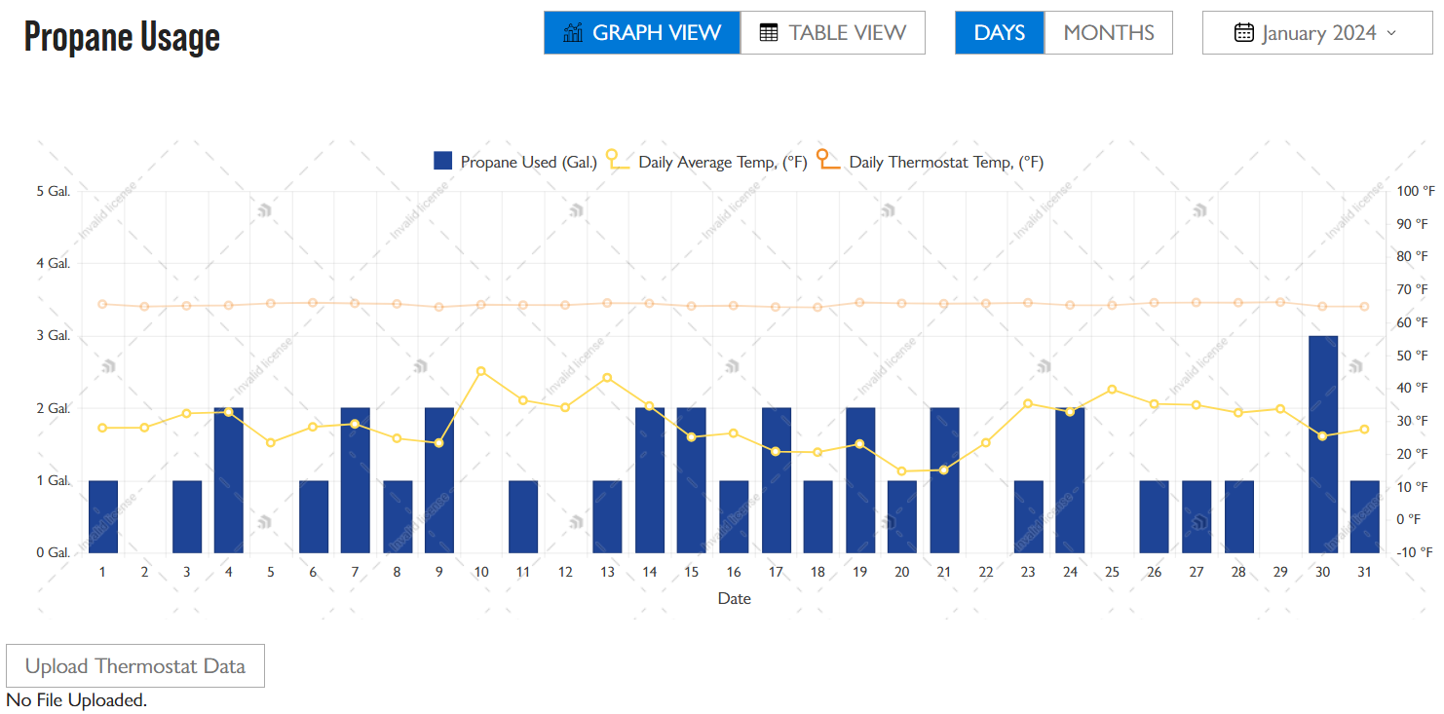
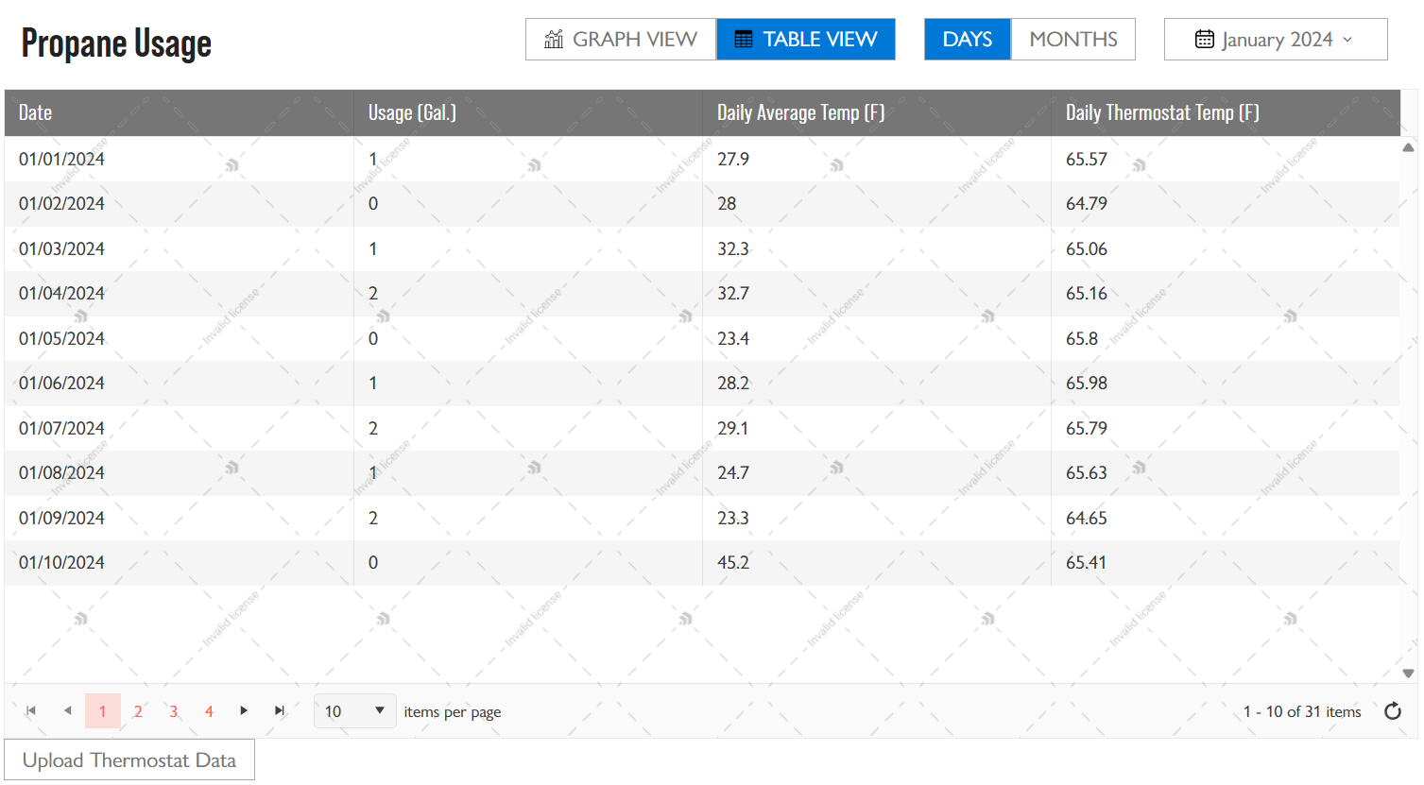
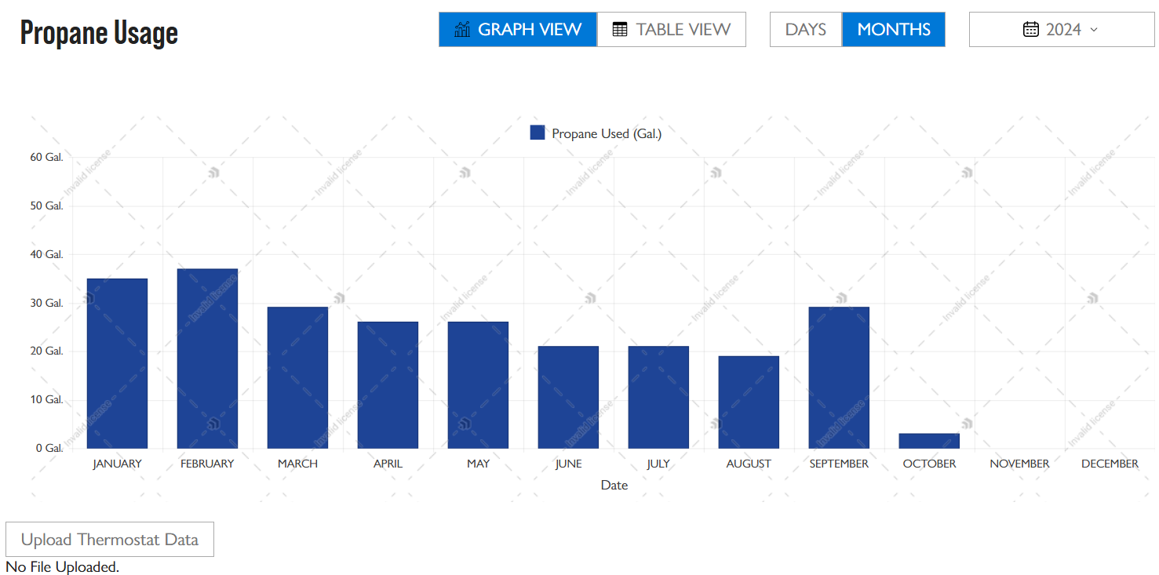
Visual Graphs and Insights for Home Heating Fuel Consumption
Benjamin Borges, Daniel Bocash, Stella La Vallee, Ashley Lingley, Valentine Schelkin
Department of Computer Science, University of New Hampshire, Durham, NH 03824
Introduction
Requirements
Design
Our sponsor SilverTech, a digital experience consulting company, is currently working with the company Palmer Gas and Oil to implement a revamped UI implementation of viewing user information. Currently, customers cannot view their fuel usage in a concise way. We have created a view on their webpage to allow customers to easily view their propane usage, as well as temperature and thermostat data.
Our Vision: Create a process that retrieves data on a customer’s daily propane usage and creates a user interface to display the following: graphs of propane consumption over time, local weather conditions, and thermostat settings. The project aims to provide insight to Palmer Gas and Oil customers who could lower the amount of fuel a customer might use depending on the season by providing statistics depending on the customers' thermostat temperature.
The project will be successful if customers can view daily/monthly propane use, weather data, and thermostat data all together in a visual graph in under 4 clicks.
Functional:
User can track consumption patterns by viewing a graph of daily propane usage over time.
Users can view data in table format alongside daily temperatures.
Users can filter propane usage data by date range to make decisions based on specific time periods.
Non-Functional:
Usability: User interface should be simple for navigate for users, with buttons large enough to find quickly.
Security: Handled and managed by SilverTech.
The details on component functionality were largely left to the team to make the UI easy to navigate and interact with. Examples of this include large buttons that alter the view of the graph and table as well as a dynamic dropdown list menu that allows users to select a specified month and/or year to view their propane usage.
Technologies Used
Conclusions
Testing + Results
Our MOV:
The project will be successful if customers can view daily/time-based propane use, weather data, and thermostat data all together in a visual graph in under 4 clicks by May 2025.
Impact:
Provide customers with propane usage data to visualize the data.
Future work:
Implement fuel usage predictions based on weather and temperature forecasts.
Retrieve thermostat readings from users via a CSV file to display thermostat temperatures.
Gitlab, Azure DevOps, Kendo UI, NodeJs, TypeScript, VS Endpoints Explorer, .NET API, Postman, SQL Server, xUnit
Testing + Results:
To display the data on the frontend, the backend team implemented and maintained API endpoints for the frontend to use.
The endpoints underwent unit testing to validate data accuracy and expected behavior
Tests pass with 90% test coverage
Credits
Limitations/Challenges
Sponsor and Helpful Associate:
Derek Barka, Brock Floyd (SilverTech),
Sponsor's Client: Palmer Gas & Oil
Advisor: Craig Smith (Computer Science Department)
The development environment was initially a complicated environment with a difficult set-up process with frequent issues.

Slide 2
Abstract
Palmer Gas is a local gas and oil provider that emphasizes the experiences of their customers. In their current customer portal, they are lacking a visual aid to show users their gas usage. To remedy this, Palmer Gas is working with SilverTech, a digital experience consulting company, to add new features to their customer portal and enhance the user experience. Our team is working with SilverTech to create the portion of the user interface that will dynamically display the customer’s fuel usage, thermostat data, and weather data specific to their location. This new UI will provide insights to the customers about their fuel usage to help them lower fuel costs and more accurately predict how much fuel they will need for future months based on their past usage data. On the front-end, this project utilizes a JavaScript/TypeScript framework for our components called Stencil, Axios as our HTTP client, and Kendo UI for our visual components. On the back-end, the project utilizes the .NET architecture for API endpoints, a SQL database hosted with Azure, and Postman to manually test API endpoints. The result of this project will be a fully functional, easily navigable web interface that displays personalized fuel usage, weather, and thermostat data to the customer in just a few clicks.

