Slide 1
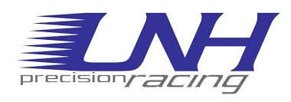
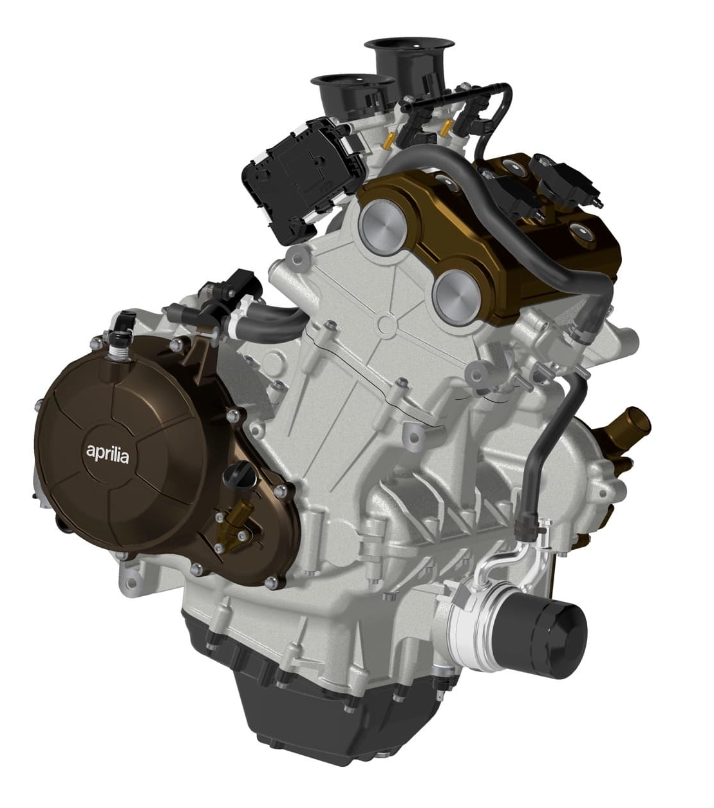
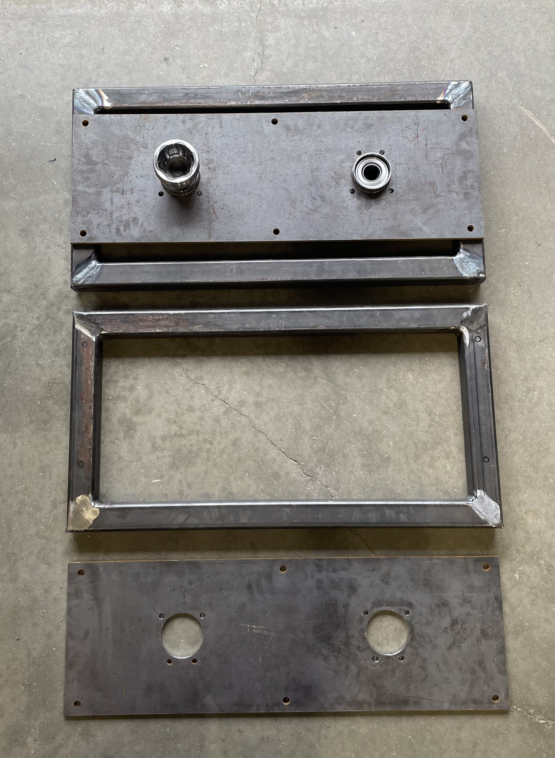
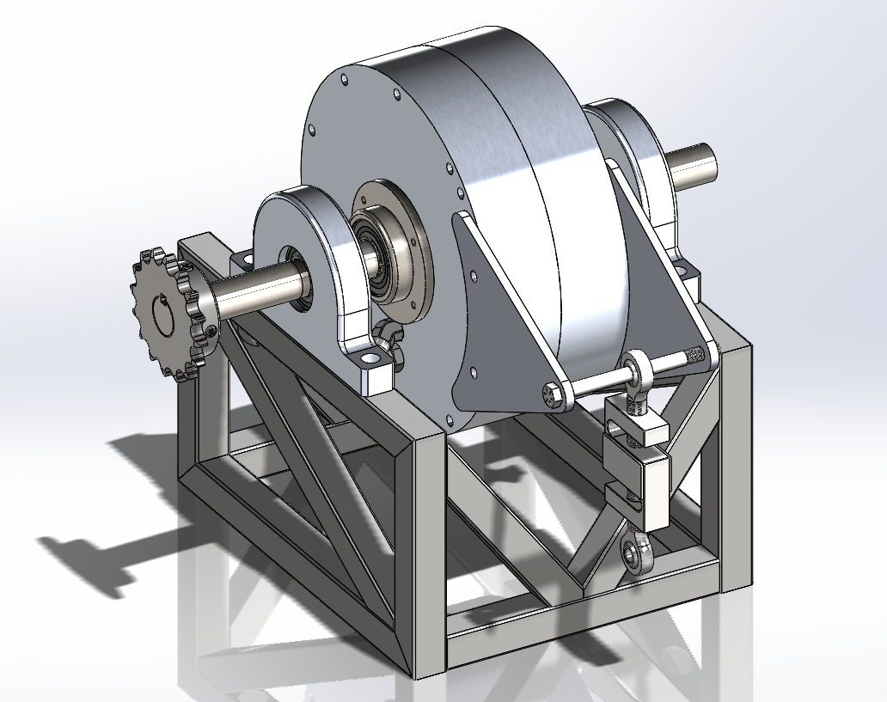
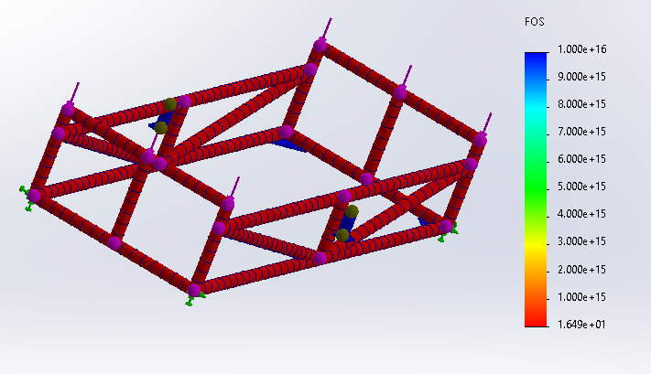
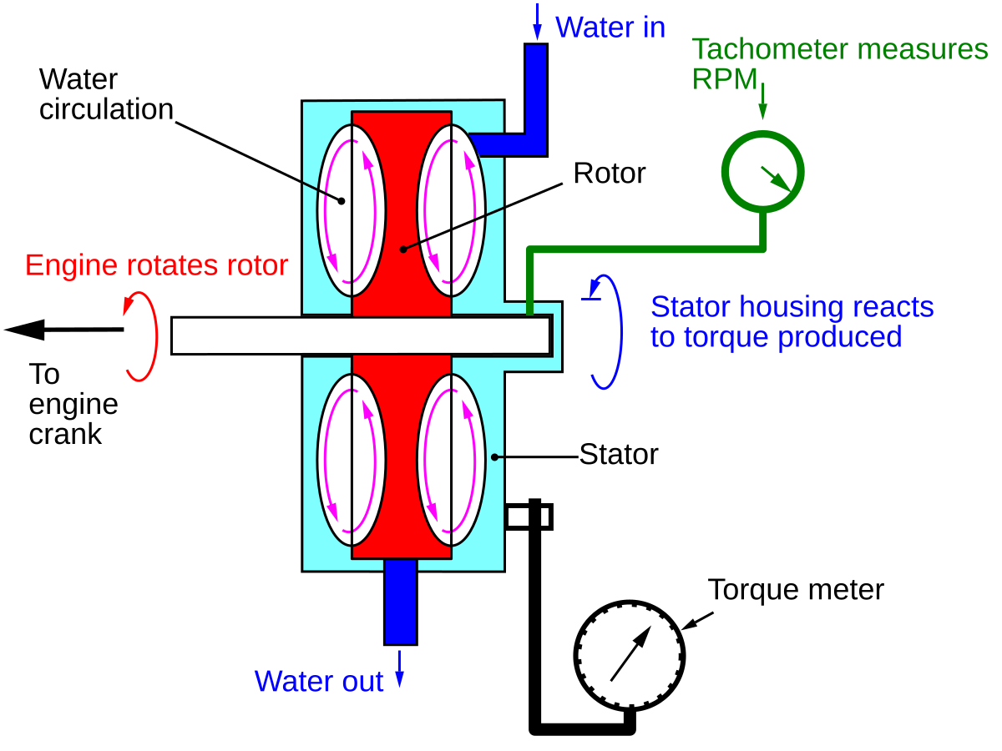
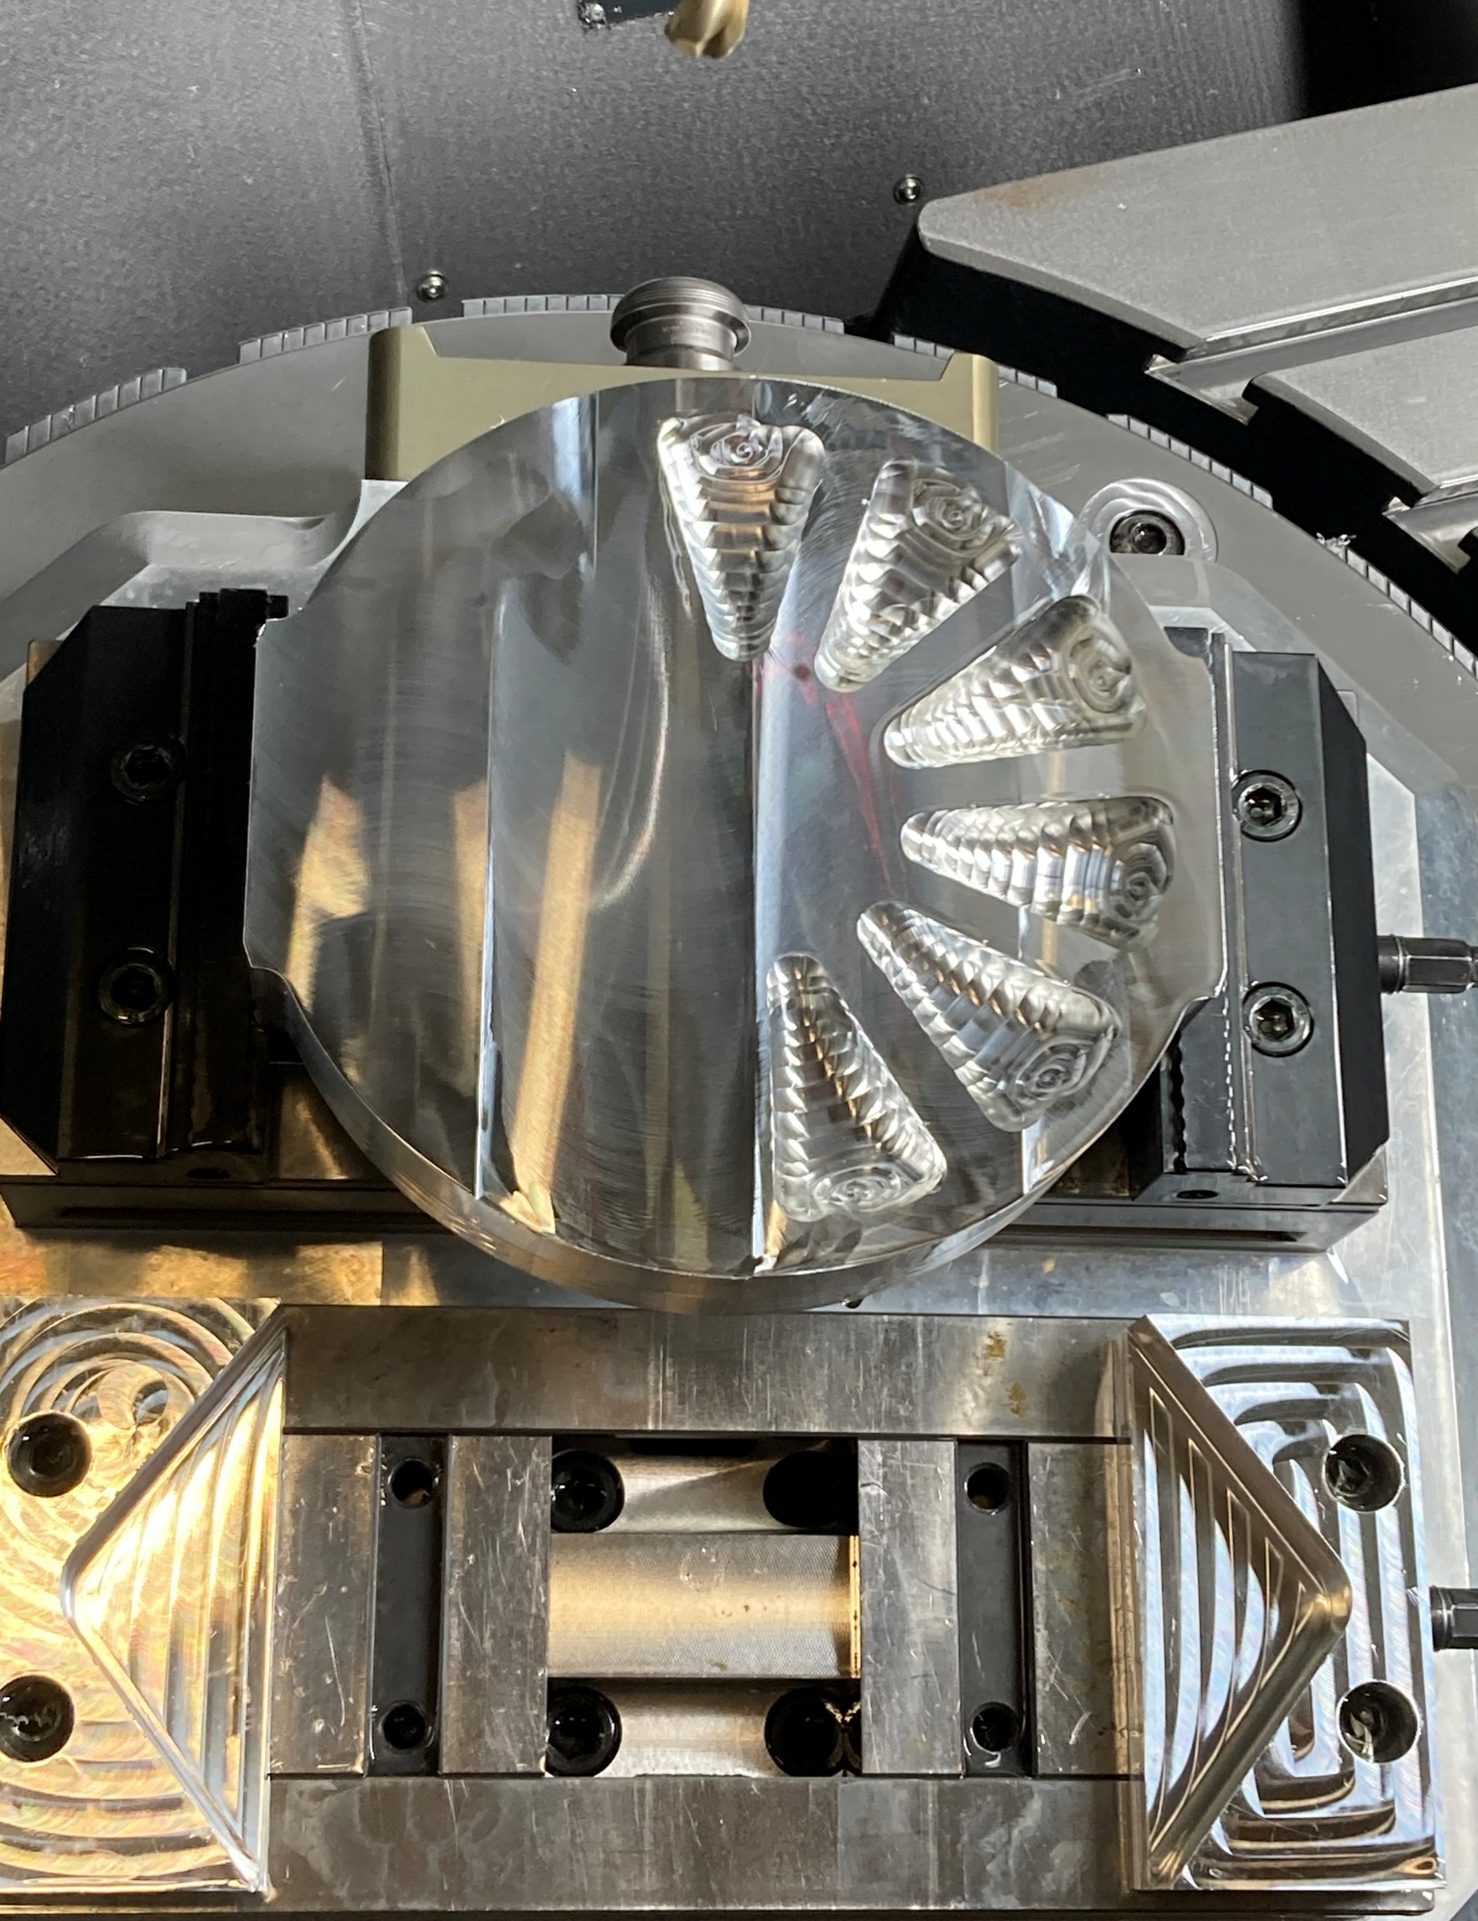
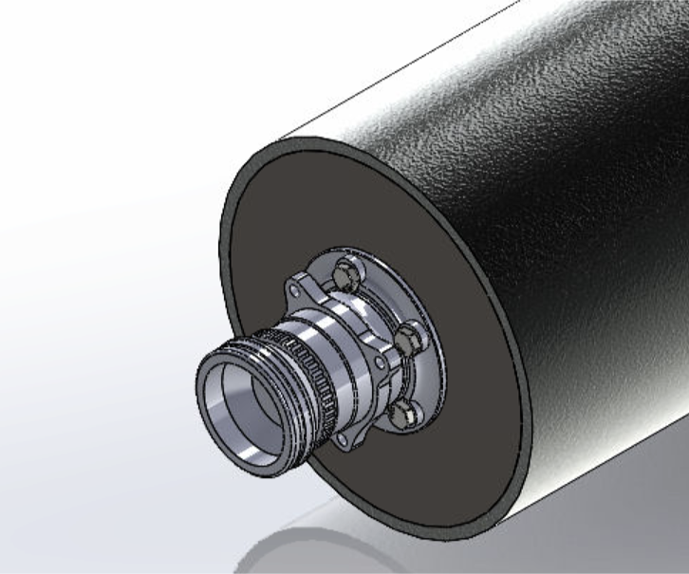
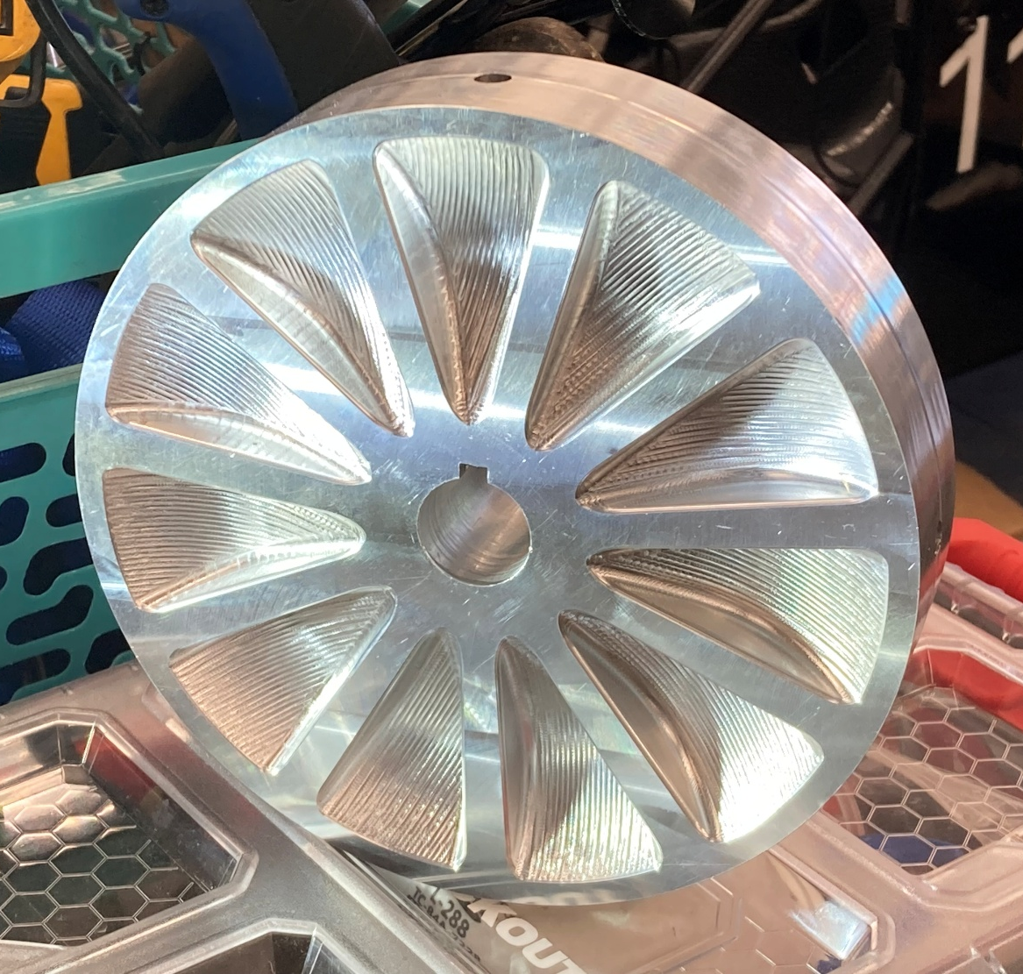
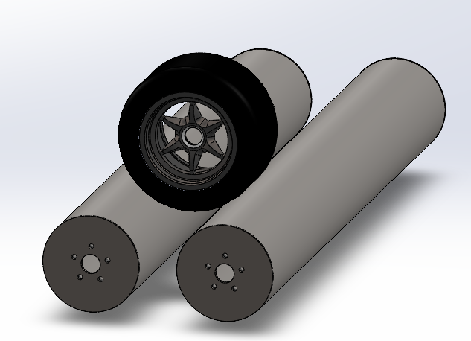
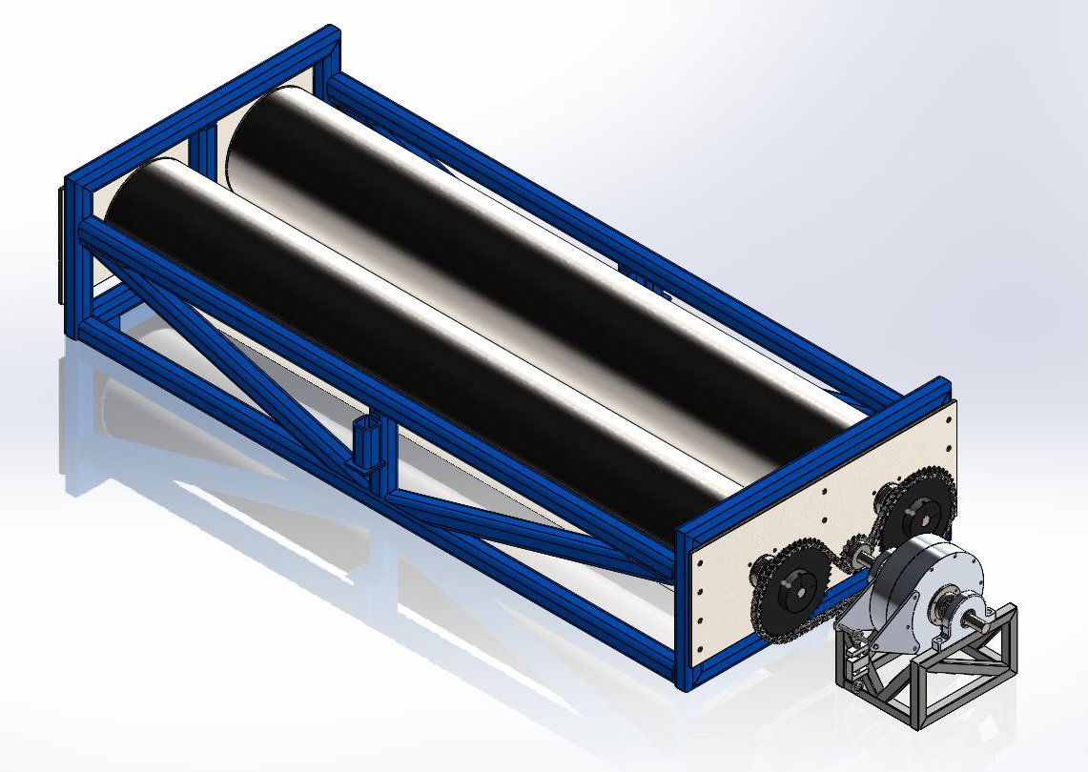
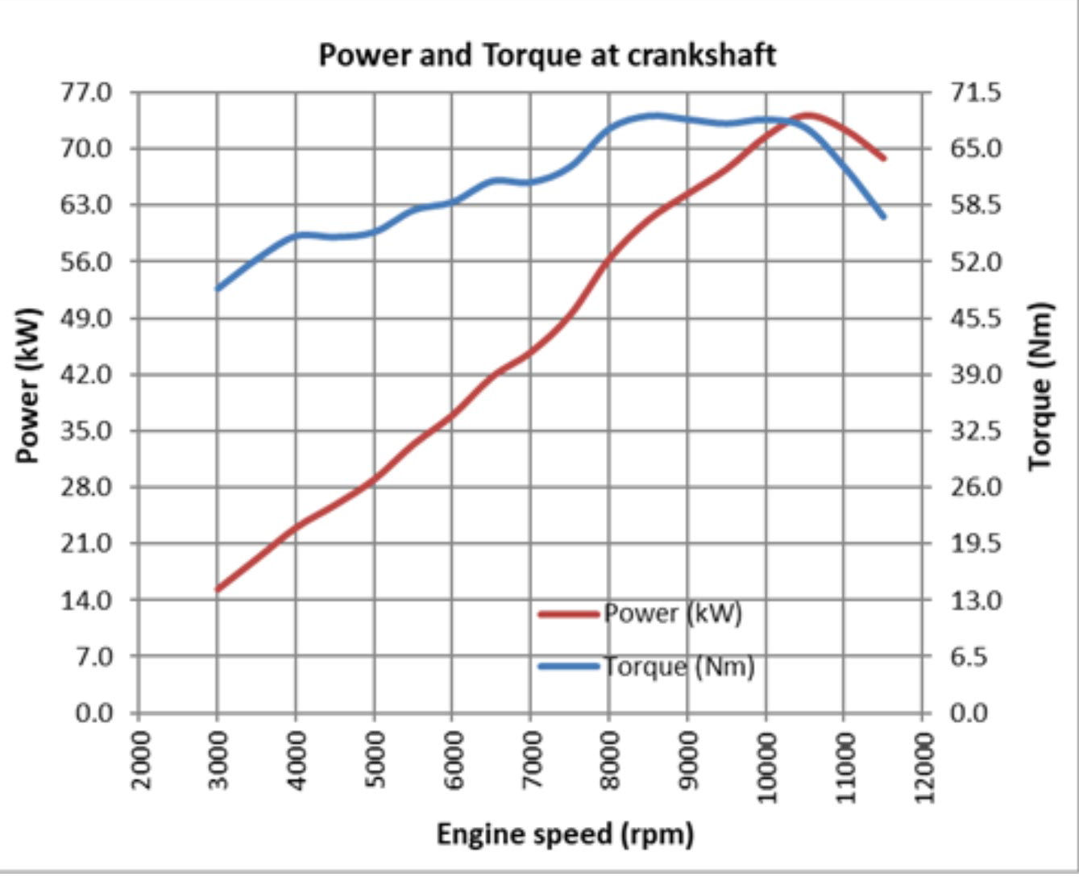
FSAE DYNAMOMETER
Sam Haigh , Noah Quirolgico
INTRODUCTION
F
ROLLER ASSEMBELY
WATER BRAKE
New Aprilia RS 660 powertrain
Measure torque and horsepower
Dynamic and steady state tuning
Justify future modifications
Furthering team independency and capabilities
2000lb Capacity
Factor of Safety of 8
Maximum wheel speed of 110 mph
High precision water jet end plates
Professionally balanced rollers
Utilize 5 axis CNC mill
Custom vise jaws to secure work piece
7.5 Inch rotor diameter with 11 pockets
Maximum operatable speed of 9000 RPM
Theoretical maximum torque load of 233 lb-ft
METHODOLOGY
Water Brake Retarder
Rotor housed inside stator halves
Analytically derived rotor diameter
Low flow rate requirement
$T=KN^{2}D^{5}$
Completed water brake model
FEA on Chassis Frame showing a FOS of 16 for 1000lb load
Dual Roller Design
Safer design
Larger contact patch
Lower concentration of stress on tire
45:16 Chain driven connection
Roller bearing and mounting design
Completed metal work for chassis frame as of 4/14/2025
Machined water brake rotor
Completed water brake stator half machining as of 4/14/2025 with custom vise jaws
Expected Results
Dynamometer Power Transfer Sequence
Stowable design
Semiportable
Power delivery modularity
Peak torque and power values
Plot relating RPM to torque and power
Drivetrain efficiency
Acknowledgements
Technical Service Center:
Noah MacAdam
Scott Campbell
FSAE Club Members:
Sam Harms
Noah Keefe
Advisors:
Juan Carlos Cuevas Bautista Elvis Marin
Professional Manufacturers:
Hi – Tek Balancing
John Olson Manufacturing Center
Notes:
Intro
New Car w/ new engine

