Slide 1
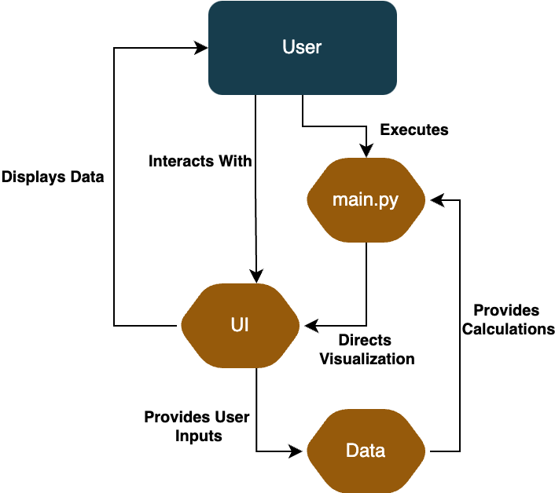
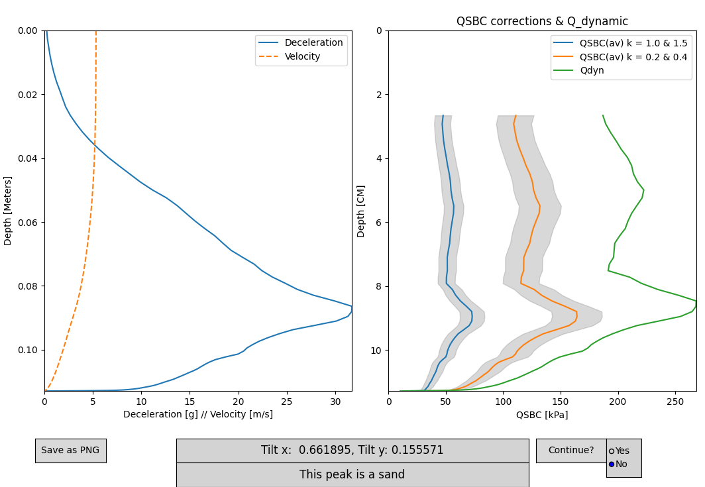
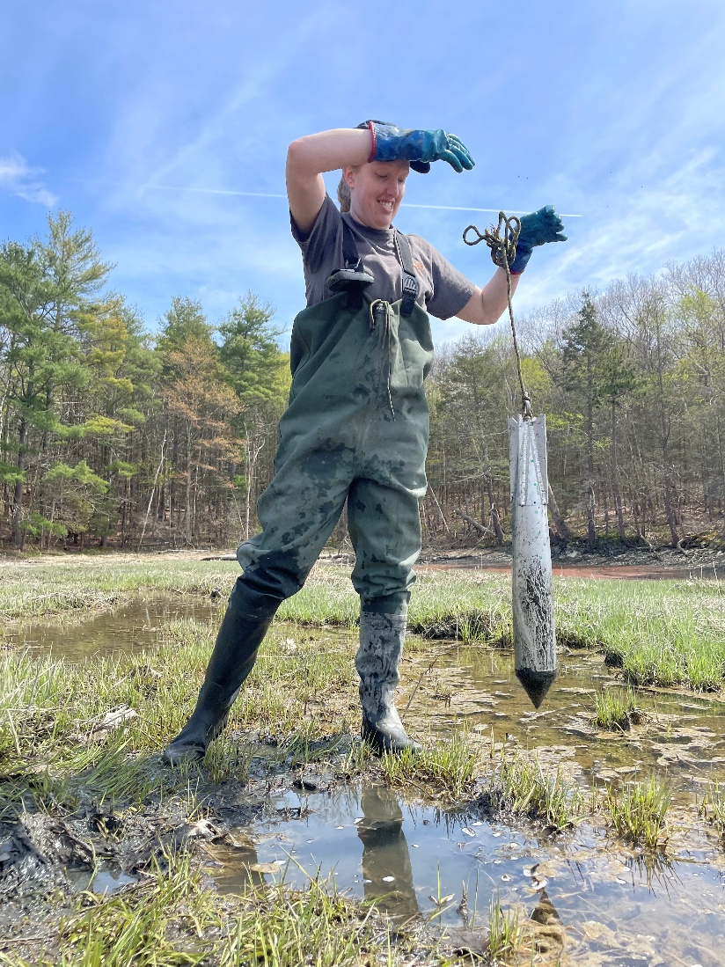
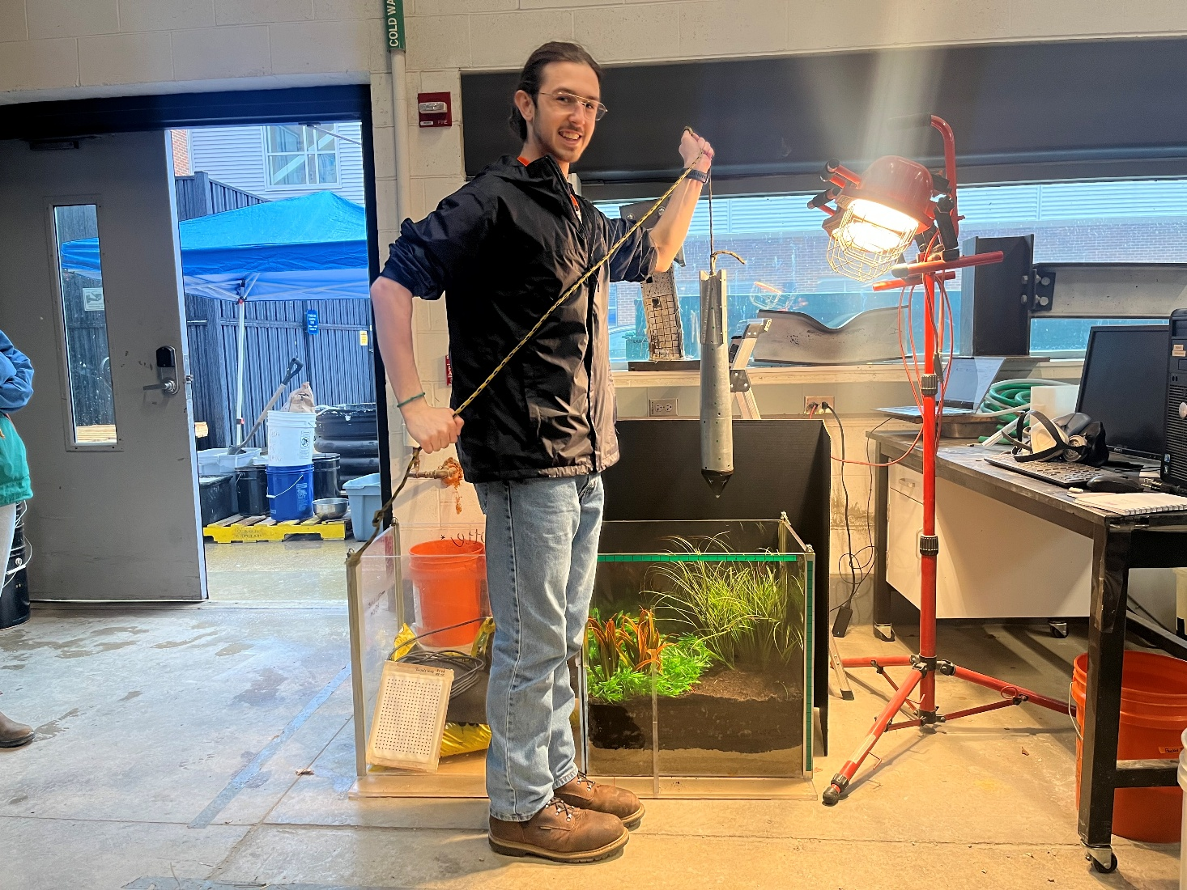
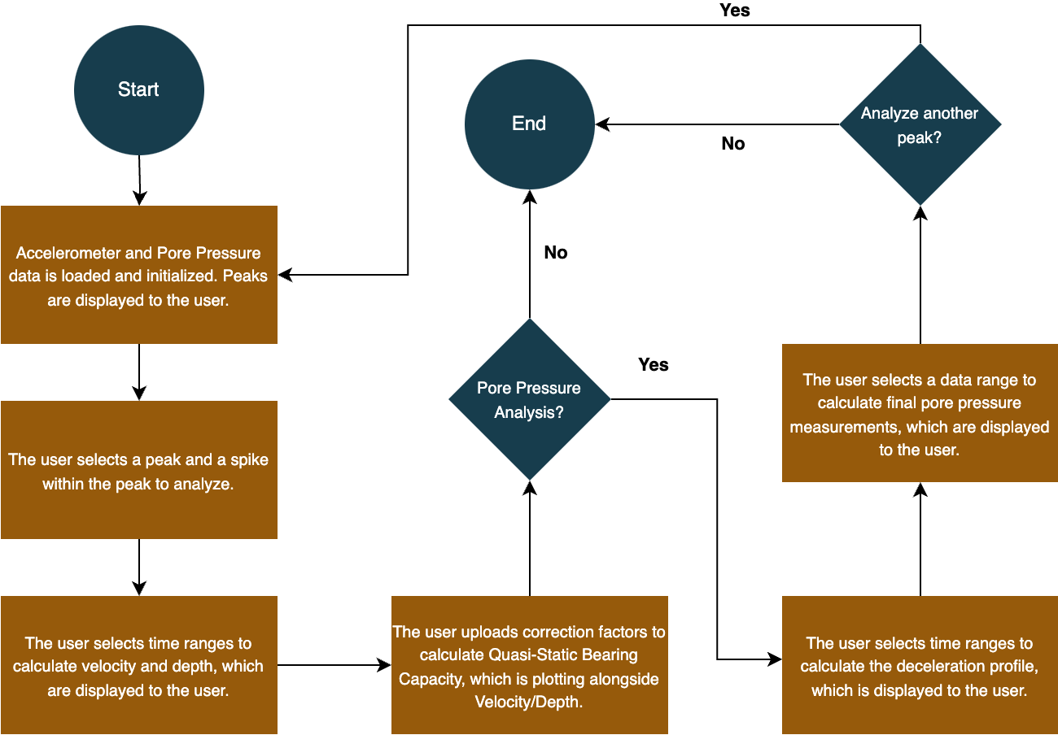
Free Fall Penetrometer Data Analysis Application
Kabir Bardai, Boyd Crapo, Connor Harrington, Brandon Kady, Austin Snow,
Department of Computer Science, University of New Hampshire
Introduction
Implementation
Testing
Free Fall Penetrometers are small devices that are dropped off boats, into the water, to measure soil strength and pore pressure. These measurements are analyzed to characterize soil sediment, which is an important task in offshore site development. The existing data analysis methods used by ocean researchers lack a graphical user interface, are spread across multiple tools and programming languages, and do not provide any validation of user input. Our goal was to develop a desktop application that combined all existing data analysis functionality with a graphical user interface. This application would need to be efficient, easy to interact with, and most importantly accurate.
Our project uses Python 3.10+ with NumPy, SciPy, matplotlib, pandas, and Tkinter for computation, visualization, and GUI development. These tools were best for unifying all existing functionality in a modular way that is easy to understand and be improved on, and using Python was the best choice to allow the project to be packaged as a complete application.
We successfully generated and validated graphical outputs, ensuring consistency with existing MATLAB, Excel and Python results by directly comparing graphs and numeric data. We have also created new unit tests to help future contributors change the code and ensure they do not introduce errors to the existing functionality. Soil classification functionality was added as well and was tested against existing processed data provided by the project sponsor.
Design
Evaluation & conclusion
A unified application was created that provides accurate data analysis and important visuals, which users interact through a graphical user interface. Users can choose to analyze multiple files at the same time to improve data processing efficiency compared to existing applications. Additionally, input validation and plotting limits data entry errors and prevents them from corrupting a data analysis session. These factors allow ocean engineers to focus on the results of the data analysis rather than the analytical process itself.​
A.
B.
C.
Requirements
Functional:
Choose a file, or set of files, of penetrometer data to be selected through file explorer
Drop points can be selected from visualized data
Can analyze data using all three appropriate correction types
Outputs appropriate bearing capacity graph based on user-inputted values
Appropriately classify soil type
Analyze data to visualize pore pressure
Non-Functional:
Intuitive user experience with no terminal usage
Only valid inputs are processed
User inputs are visualized before being accepted
User input to data output is under three seconds
Future Work
Implement additional penetrometer data analysis modules based on geotechnical strength properties
Add more soil characterization models to the system
More complex and accurate models that consider variance of data
Models to predict additional types of soil
Extend analysis of pore pressure data
Simplified Architecture Diagram displaying the major system components (main.py, UI, and Data) and their interactions within the application.
Image of User Interface after calculating Quasi-Static Bearing Capacity
Flow chart describing the main user interactions with the application
ACKNOWLEDGMENTs
Sponsor: Julie Paprocki CEE Grad Student: Emma Dennis
Faculty Advisor: David Benedetto

