Slide 1

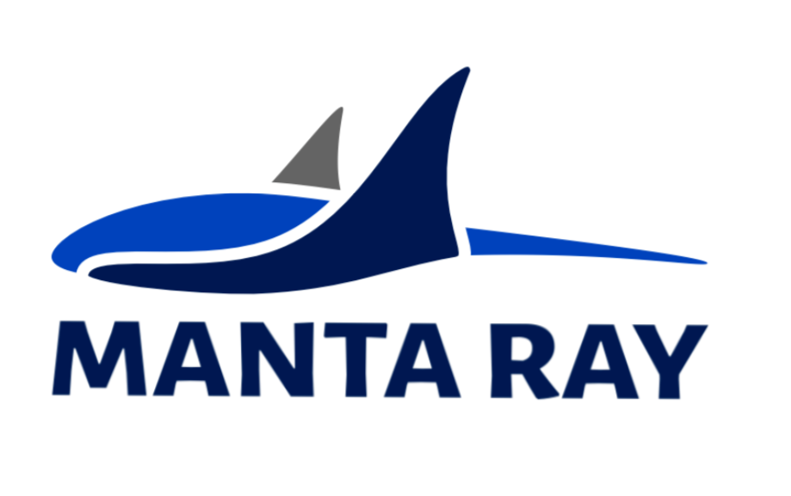




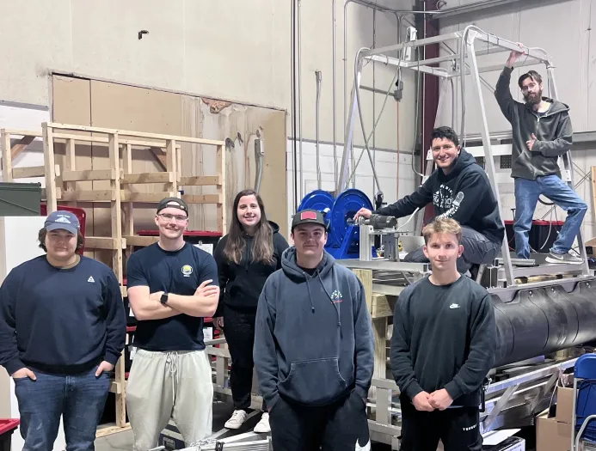
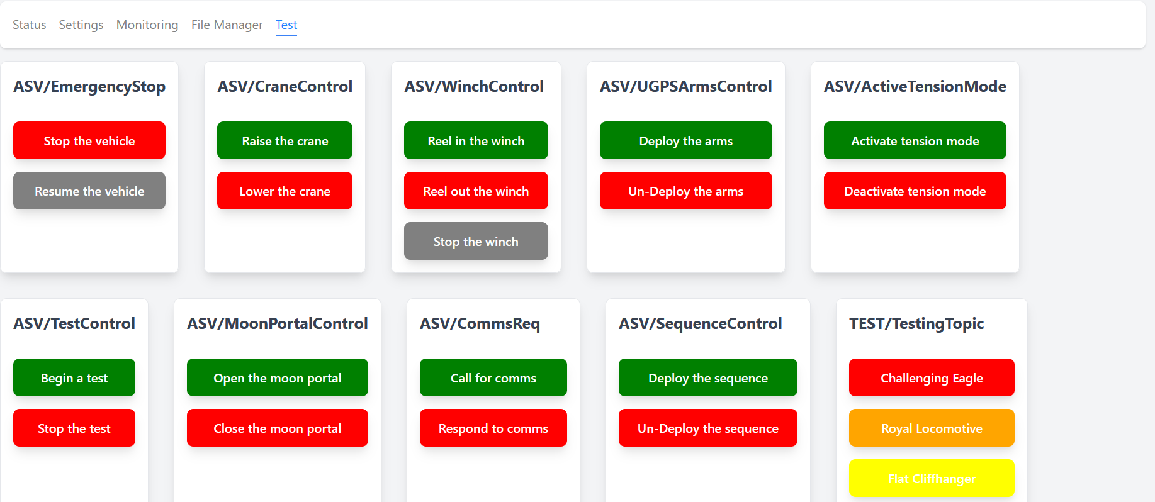
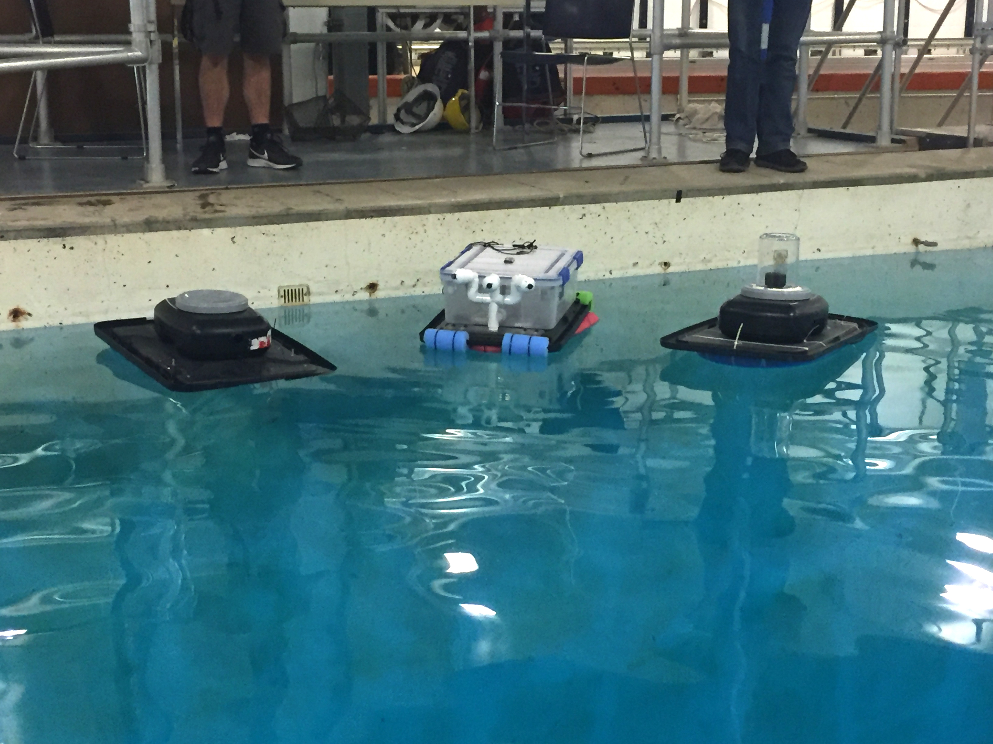
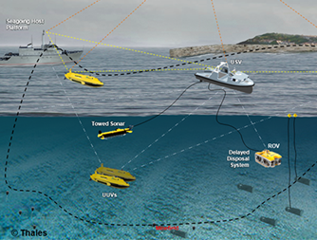
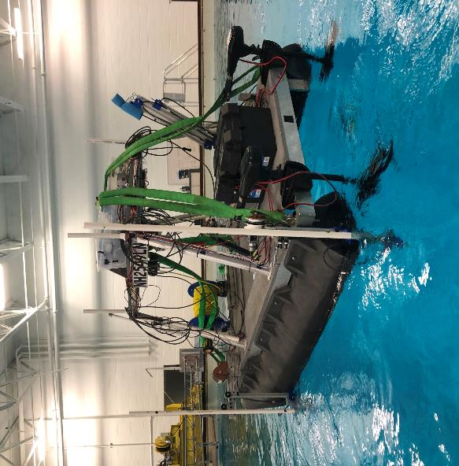
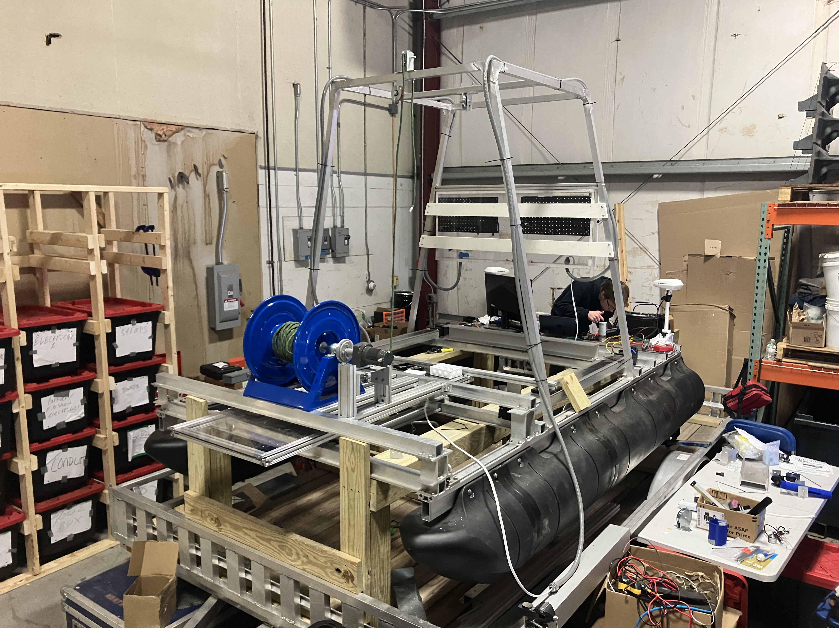
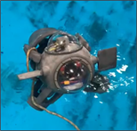
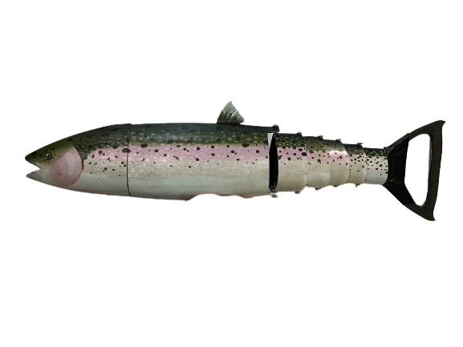
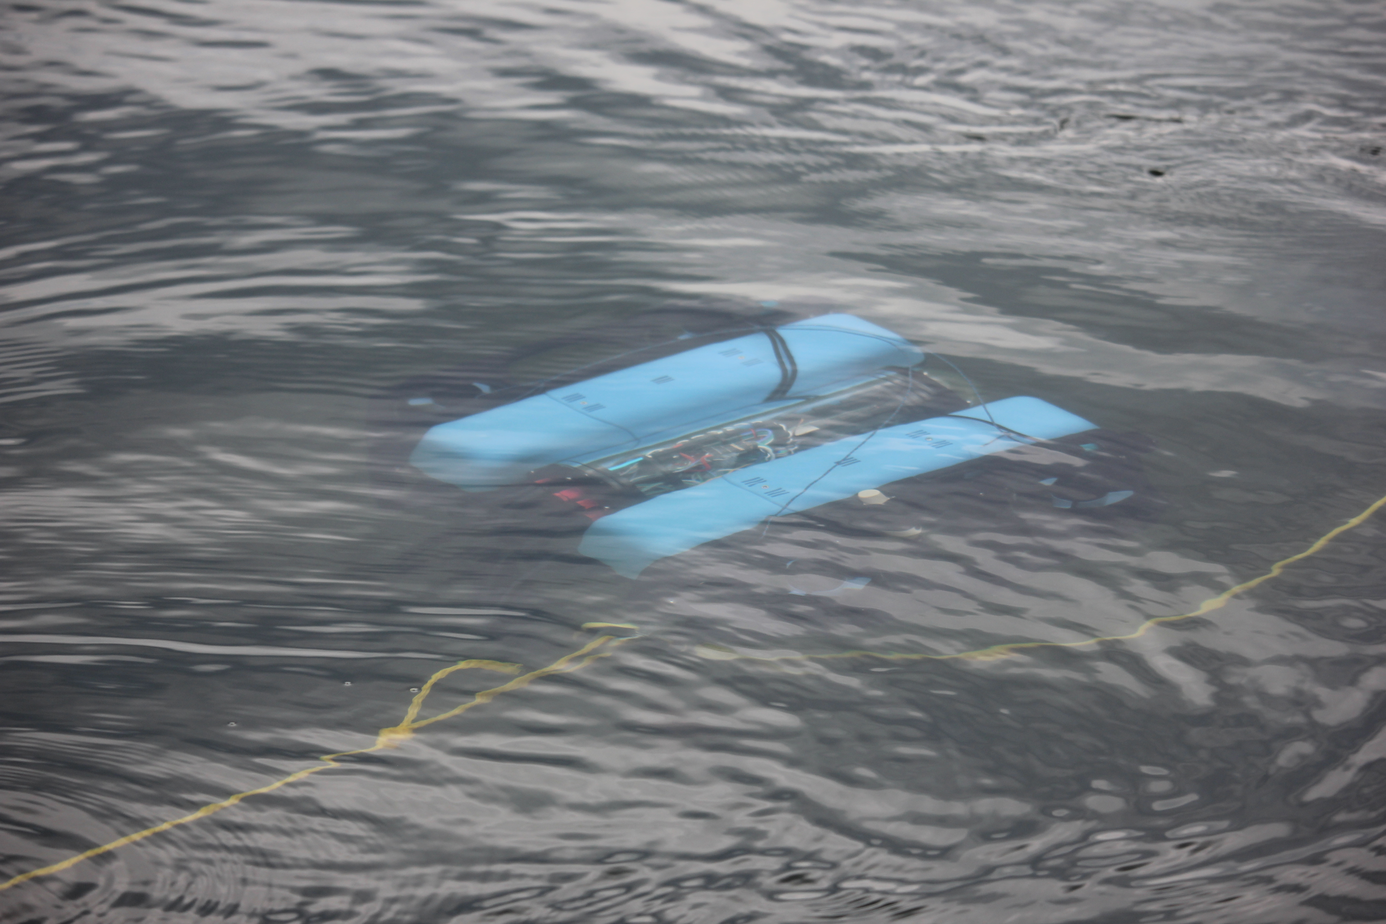
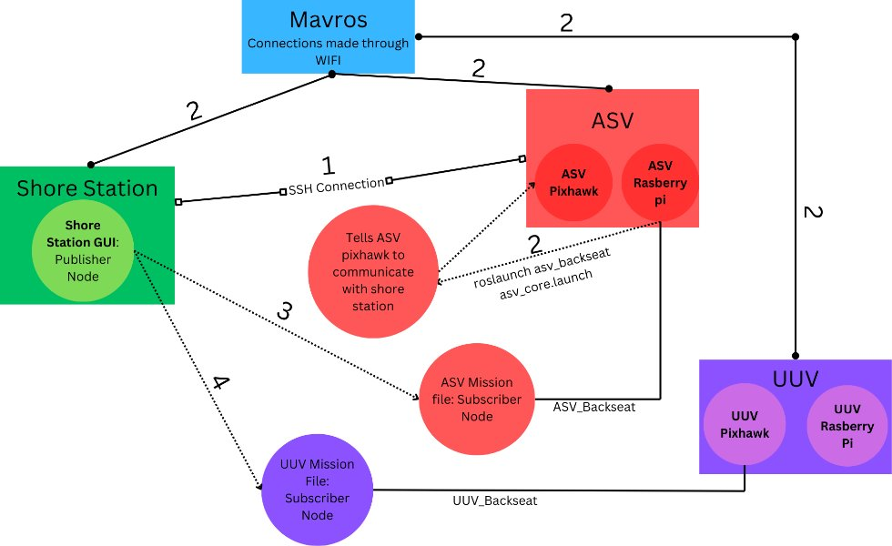
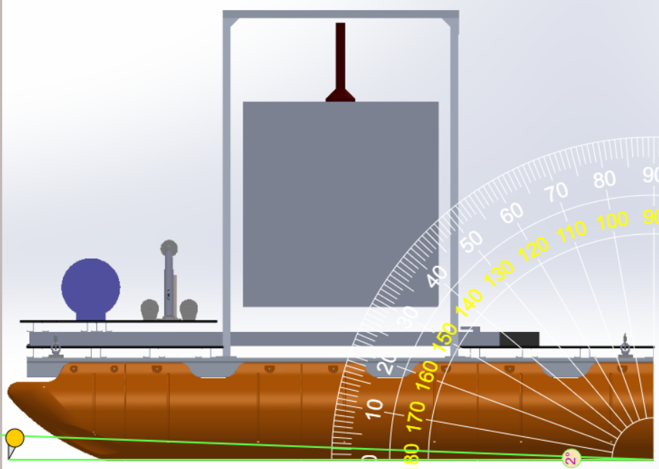
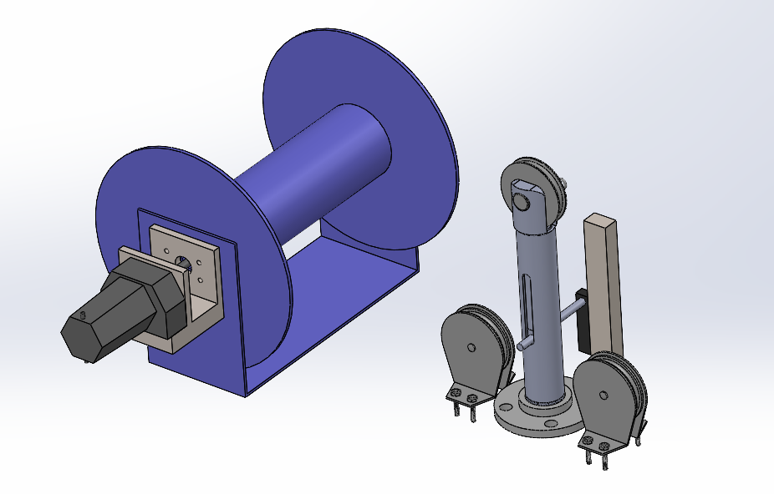
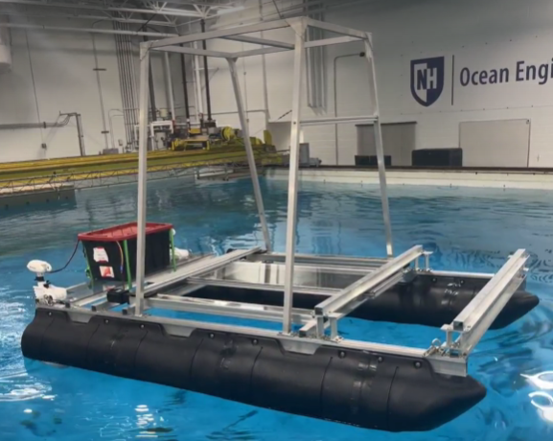
MANTA RAY - Marine and Naval Technological Advancements for Robotic Autonomy
Autonomous Surface Vehicle 2 (ASV2)
Project Advisors: Dr. May-Win Thein, Dr. Elizabeth Fairchild, Dr. Yuri Rzhanov
Graduate Advisors: Nick Custer, Hannah Arnholt, Margaret Enderle, Derrek Perham, Clifton Sullivan, and Alex Cook
Team Members: Caleb Allen, Shanna McGrath, Andrew Coco, Alex Hernandez, Max McKenney,
Layton Martinez, and Zach Bialous
Computer Science Team Members: Seth Rossman, Kyle Ropp, Aidan Boucher, and Ben Gonzales
Team MANTA RAY Mission
ASV2 Design & Construction
Autonomous Control
Team MANTA RAY is an interdisciplinary project dedicated to creating, maintaining, and expanding a network of marine robots for seafloor mapping and underwater perception. The network began as just the Autonomous Surface Vehicle (ASV) and Uncrewed Underwater Vehicle (UUV) but has expanded to include a prototype of the ASV, named TUPPS, and two kinds of remotely operated vehicles, the Ghost Unpiloted Performance Platform Submersible (GUPPS) and KRILL, in addition to the Safe Whale Tagging (SWaT) device designed for safe and non-invasive whale tracking/observation. With these systems, students work to develop improve communication between vehicles, develop autonomous behaviors and algorithms, and upgrade existing mechanical systems to improve precision and performance.
Design Requirements:
All data (GPS position, operating modes, active commands, etc.) published through Robot Operating System (ROS) topic
Raspberry Pi (Pi, onboard computer) sends commands over ROS to the Arduino microcontroller
Topics published over ASV's onboard Wi-Fi network
Missions started through GUI that publishes topics
Arduino controls subsystems based on ROS command from Pi
Command ASV2 to navigate to a GPS location from a given .plan file
Deploy UUV upon arrival of mission location
Support payload UUV up to:
  Dimensions of 40" x 36" x 42"
  Weight of 150 lbs
Maintain a center of buoyancy that will prevent tipping or a rocking effect
Achieve propulsion speed of 3 knots
Autonomously deploy and retract payload UUV
Support deployment of onboard underwater localization system
Design for modularity to support current and future MANTA RAY UUVs
TUPPS
ASV
Figure 4: ASV2 Mechanical & Ocean Team - 2025
Mechanical Specs:
Twin pontoon catamaran style body
Welded aluminum superstructure:
  Support UUV
  Elevate electronics above the waterline
Center moon pool for UUV clearance
Winch motors rated 2000lbs
TTS winch motor assembly made from Aluminum and modular sliders.
KRILL
GUPPS
UUV
Figure 9: RoboSphere GUI
Figure 1: MANTARAY Mission
Figure 5: Constructed ASV structure with TTS and Moon Pool Door
ASV2 Mission
Subsystems
The ASV2 mission for the 24'-25' academic year is to construct an autonomous surface vehicle that is capable of autonomous travel in sea state 0. The ASV2 will support the necessary subsystems to autonomously deploy, localize, and recover several types of MANTA RAY Uncrewed Underwater Vehicles (UUVs), one of which is developed by White River Technologies (Lebanon, NH) for the purpose of magnetically detecting, categorizing and localizing underwater UneXploded Ordinances (UXOs). The ASV2 will also act as a command and communications relay between all MANTA RAY marine vehicles and the shore station operations site.
The Tether System (TTS)
Underwater GPS (UGPS) Deployment
The tether system maintains between 5-20lbs tension in the line between the UUV and the ASV. Linear and rotary encoders measure the force and length of the tether to determine whether the winch is to deploy or retract tether depending on the changes in tension from UUV movements.
The UGPS incorporates acoustic nodes that triangulate the underwater 3-DOF UUV location and allows for real-time tracking information that is relayed to the shore station. Deployment is facilitated by a winch and line attached to the UGPS arm.
Testing & Data
Buoyancy Calculations
Figure 10: Software Architecture
Center of gravity (CG): ∑ (Mix⋅Xi)/∑Mi
Center of buoyancy: (xmid, ymid, D/2)
Local center of buoyancy (LCB) geometric constant
Metacentric radius (BM): geometric constant
Height of buoyancy (KB): geometric constant
Height of CG (KG): geometric constant
Metacentric height (GM): (KB+BM-KG)
Listing = CG-LCB
Trim = arctan(List/GM) = 2 degrees
Moon Pool Bay Door
RoboSphere
  A linearly retractable door controlled by two 1400 mm ball-screw linear actuators supports and aids in UUV deployment. The Moon Pool Bay Door is fully closed when the UUV is inactive and during transportation so that the UUV can rest on the door. When ready for deployment, the TTS raises the UUV, and the Moon Pool Door fully opens for the duration of the mission.
RoboSphere is a server that the ASV and any of the deployed vehicles can run that communicates with any computer through a browser. Robosphere is able to send messages to the vehicle through ROS2 topics, monitor all ROS2 signals sent to or from the vehicle, edit files remotely, and send terminal commands to the onboard Raspberry Pi. A yaml file is used to describe how to create the necessary dashboard for a specific vehicle. Each button on the dashboard publishes information to the ROS2 nodes to control the vehicle or test subsystems.
Figure 2:
LiPo Battery Testing
Figure 7: SolidWorks assembly of TTS components
Time trial performed on LiPo batteries connected to a trolling motor at full throttle
Batteries - must remain above 10% charge and last for at least 2 hours
Power and Propulsion
Acknowledgements
The twin trolling motors on the rear of ASV2 are powered by a 24V 230ah LiFePO4 battery. LiPo batteries are used to power the additional subsystems and their corresponding motors.
This work was funded in part by New Hampshire Sea Grant's Workforce Development Project E/WFD-3, pursuant to National Oceanic and Atmospheric Administration Award No. NA24OARX417C0037 and by the Naval Engineering Education Consortium (NEEC) and NAVSEA (N00174-23-1-0010). Special thank you to our NEEC advisor Dr. Martin Renken (Naval Undersea Warfare Center Division Keyport), White River Technologies (WRT), Department of Mechanical Engineering, Chase Ocean Engineering Lab, the Olson Advanced Manufacturing Center, Alex Watkins, and Rose Shore.
Figure 3: LiPo battery percentage charge over time under continuous load
Figure 8: ASV Moon Pool door

