Slide 1
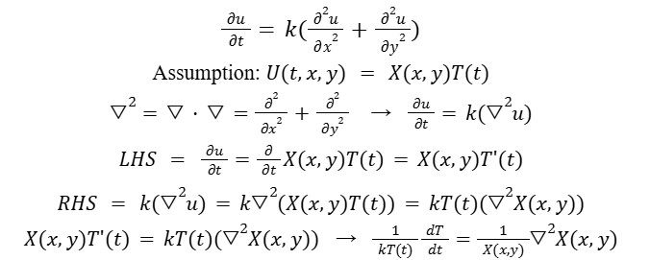
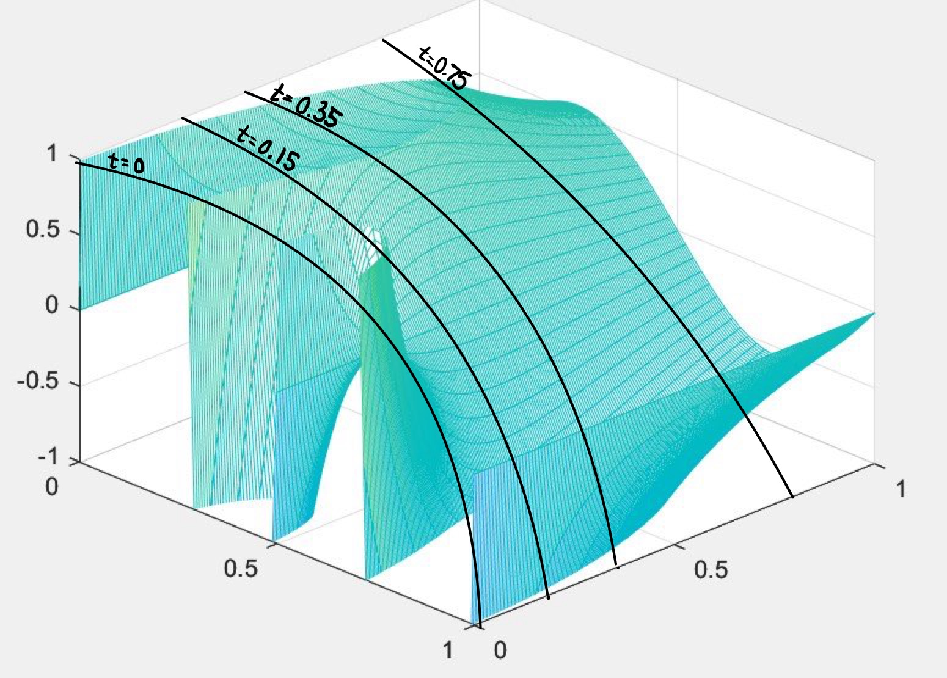
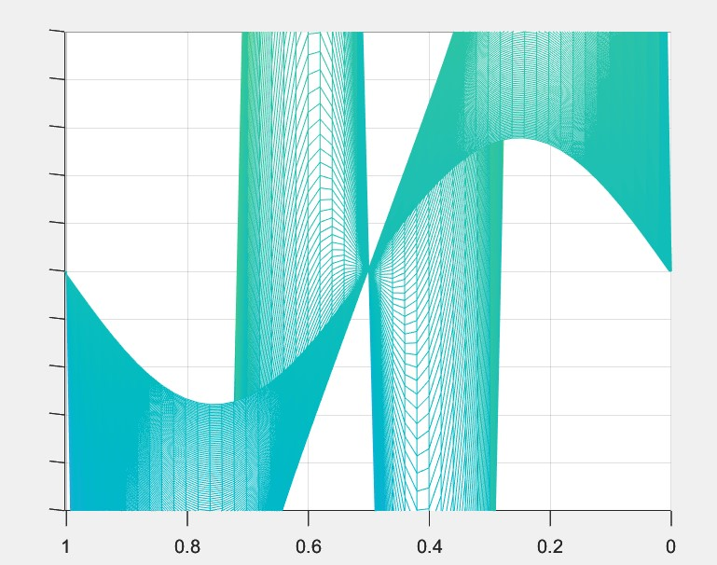
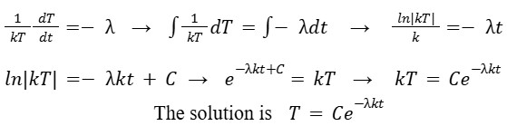
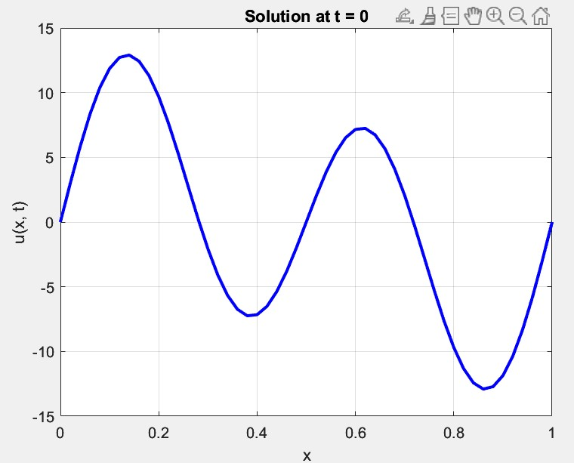
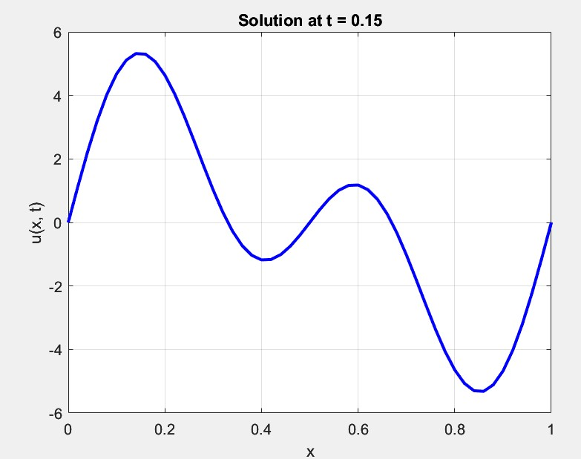
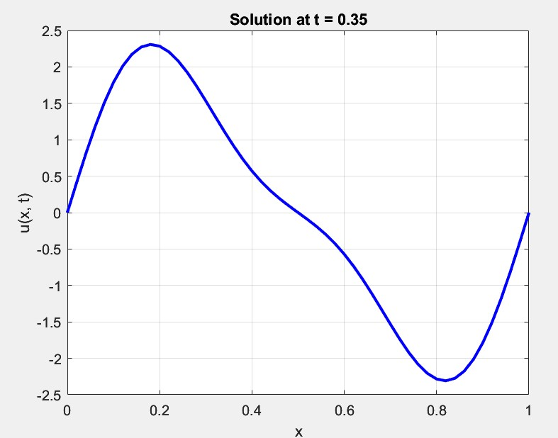

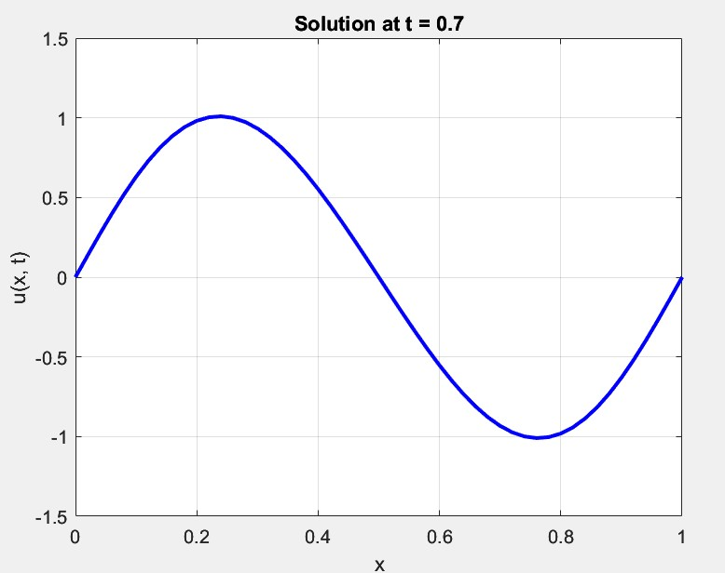
Order of the Convergence of the Partial Differential Equation for Heat Diffusion
Dasha Piotrowski
Department of Mathematics and Statistics, University of New Hampshire, Durham, NH 03824
Advisor: Dr. John McClain
Background
Analytical vs. Theoretical Solution
Results
Ordinary Differential Equations (ODES) are equations that explain the relationship between functions and their derivatives
Partial Differential Equations (PDES) explain the relationship between a function and its partial derivatives that are taken with respect to multiple variables
The heat equation is a PDE whose solution u(x, t) gives the temperature of an object at position x at time t
Numerical Analysis methods can be used to approximate solutions through explicit and implicit methods
Explicit methods (Forward Euler) is where the state of the system at a later time is found using known values from previous times. These can be solved with matrix multiplication.
Implicit methods (Backwards Euler) can be thought of in the form f(y(t), y(t + Δt)) = 0. This involves using both known and approximated values to solve the equation to get y(t + Δt). This can be solved as Ax = b problem.
To solve this PDE, we use an assumption that it is a product of two functions to solve as a separation of variables problem.
U(x, 0) = 10*sin(4*pi*x) + 4*sin(2*pi*x) with boundary condition U(0, t) = U(1, t) = 0, time steps of 200 and space steps of 50. Left image shows the full graph and right image shows a front view of the graph to show decay as time decreases.
We can see that there will be exponential decay of heat over time. The goal is to ensure that the graphs match this.
Sketched lines on the top left image show time slices for the 2D graphs. These illustrate the exponential decay of the combination of sin functions until only sin(2*pi*x) function remains.
The results of our space equation (x) show us that the solution is in the form of cyclical sine and cosine waves.
Objective
Acknowledgements
For different modes, the decay rate changes based on the wavelength of the sin(x) equation. This is because the angular frequency is used as the value k in the exponent of the solution and a higher negative exponent causes the equation to decrease to zero faster as t goes to infinity. Sin(4*pi*x) decreases 16 times faster than sin(2*pi*x).
To explore the general behavior of solutions to the heat equation using analytical and numerical solutions and to see the convergence of explicit vs. implicit methods.
Dr. John McClain - advising
Dr. Adam Boucher - assistance with formulating project idea
Numerical Analysis by Timothy Sauer - code formulation

