Slide 1
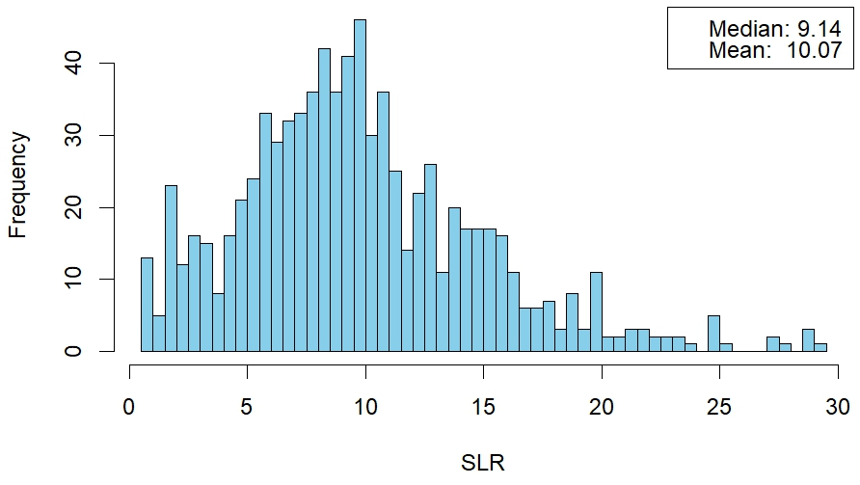
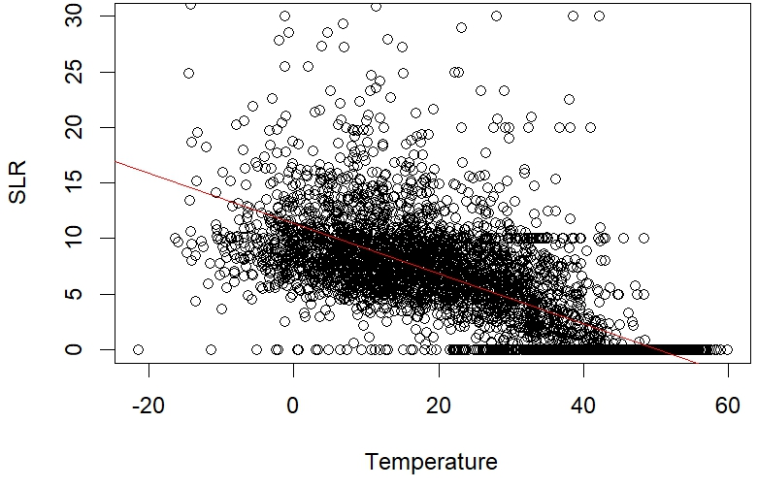
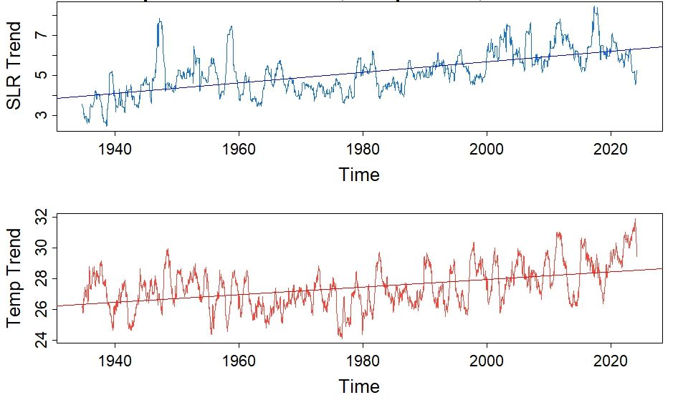
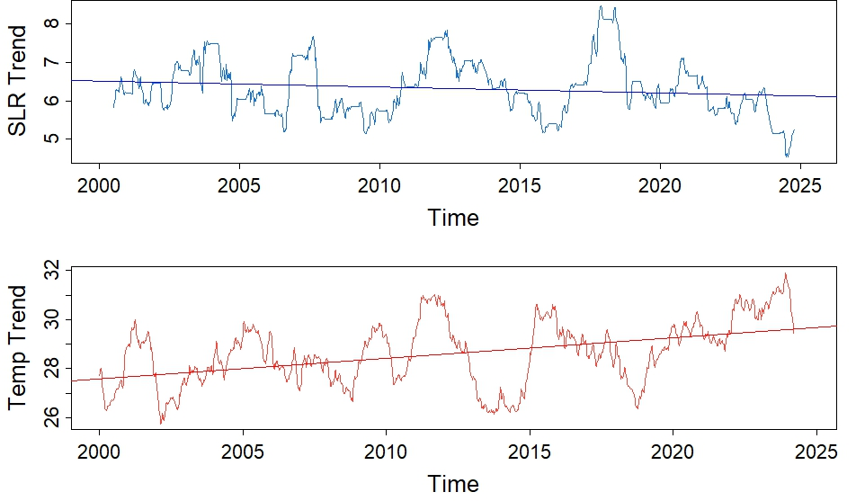
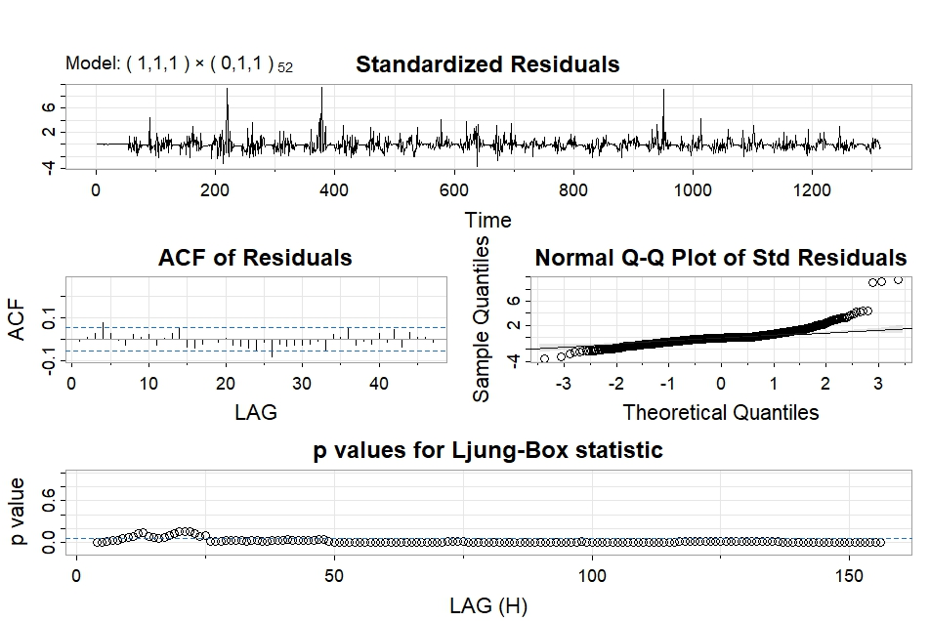
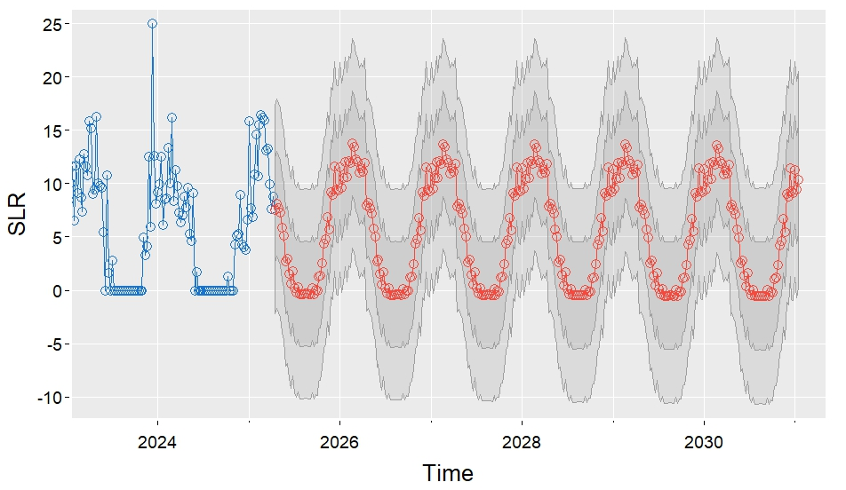
Analyzing Trends in New Hampshire Snow Density Ethan Cline Department of Mathematics and Statistics, University of New Hampshire
Introduction
Initial Analysis
Data
New Hampshire is known for its winters. There has been much research on the warming and shortening of winters, but comparatively little on changing snow quality. Analyzing snow density may provide deeper insights into changing winter conditions than what can be provided by temperature and snowfall measurements alone.
Weekly Average SLR Values Since 2000
Temperature Regressed on SLR
Data used from the Mt. Washington Observatory goes back to 1934.
Weekly averages used to avoid estimation error and frequent zeros.
Snowfall under ½ inch was excluded.
Data over 25 years old was not used for forecasting due to frequent estimations, decreased variability, and clustering around the 10-to-1 ratio.
There is a skewed distribution centered around a median value of 9.14.
There is a strong negative correlation between temperature and SLR.
Calculating Density: What is SLR?
Trends in Temperature and Snow Density
Results and Conclusions
The standard measurement of snow density is called the “Solid-to-Liquid Ratio” or “SLR”.
It is an inverse of density which divides snowfall by its liquid water equivalent.
The National Weather Service sets the standard SLR value as 10-to-1.
Quantitative Precipitation Models use SLR estimates to forecast snowfall.
SLR and Temperature Since 1934
Recent Trends in SLR and Temperature
The median SLR for the last 25 years is 9.14, denser than the NWS standard.
Expected inverse relationship between temperature and SLR.
Snow density is highly seasonal.
High random variability in SLR due to individual weather patterns.
Long term coincident increase in temperature and SLR.
The last 25 years show increasing temperature and stable-decreasing SLR
The final SARIMA model used for forecasting was of the order (1,1,1), (0,1,1). It had the lowest AIC and BIC among candidate models.
Removing seasonal variation shows a confusing coincident increase.
Seasonally adjusted trends show increasing temperature and stable or decreasing SLR.
Goals and Methodology
Seasonal ARIMA Forecasting
I used R to make several time series and linear regression models for SLR, snowfall, and temperature.
I investigated how snow density has changed over the last 90 years, how it changes by season, its relationship to temperature, and predictive models.
This research may be useful to climatologists and meteorologists who issue snowfall predictions, storm warnings, and avalanche advisories.
Model Diagnostics
SLR Forecast
Acknowledgements
MWOBS Observer Charlie Peachey for the data
MWOBS Interns Mees Fransen and Marin MacDonald for helping with the SLR research
My advisor, Professor Michelle Capozzoli
Professor Linyuan Li for help with time series
There is significant random variation, especially in high SLR events.
The forecast (orange) predicts slightly decreasing SLR with high seasonal variation.

