Slide 1
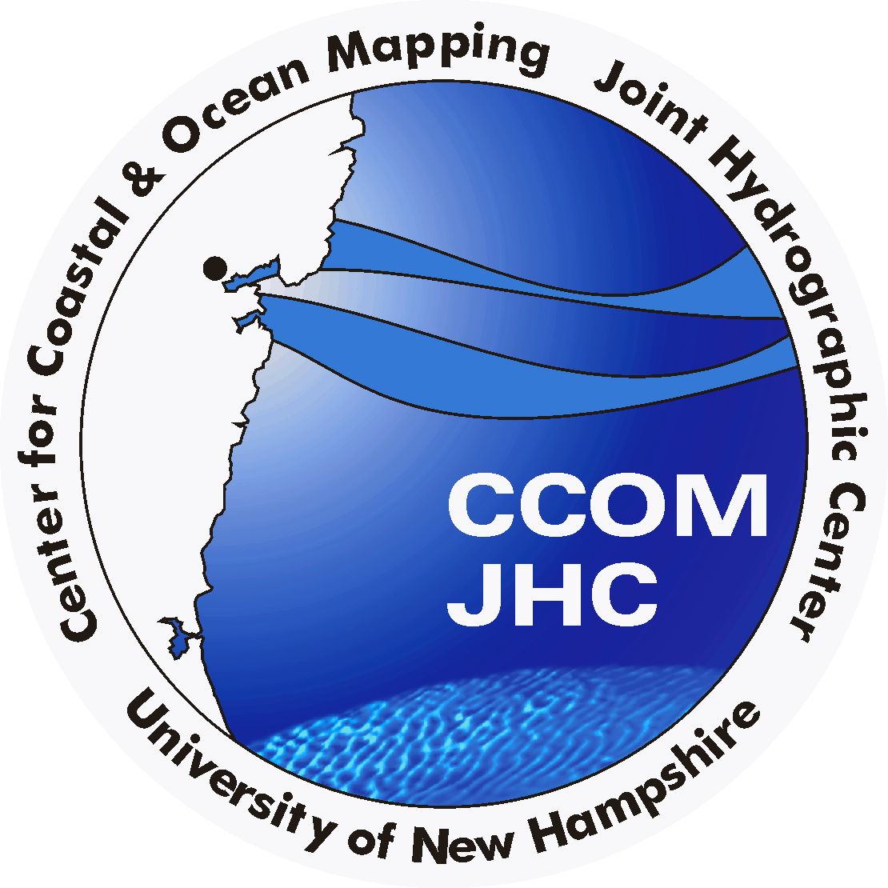

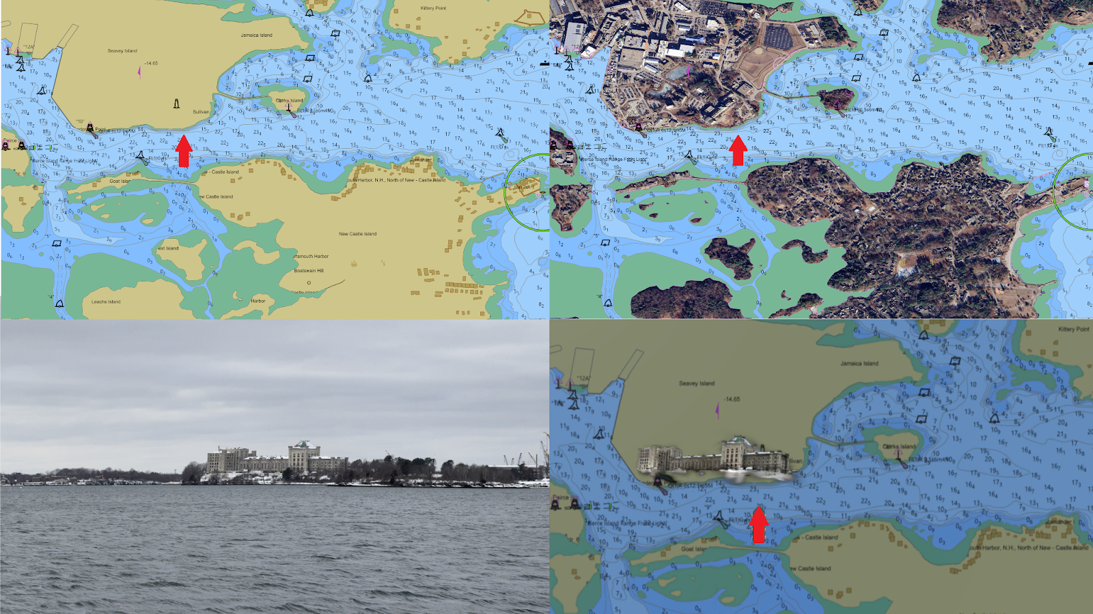
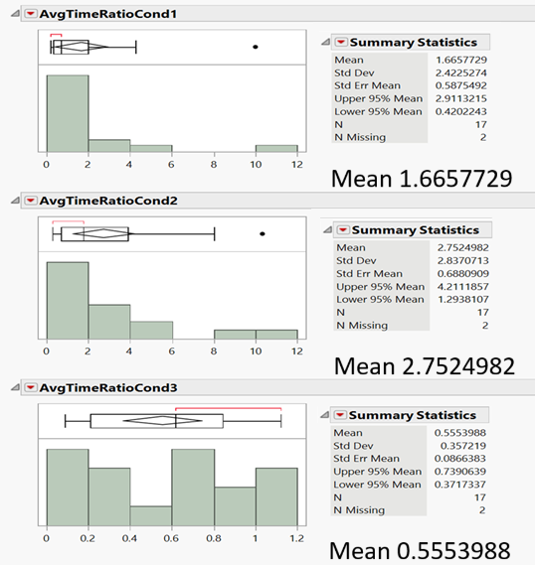
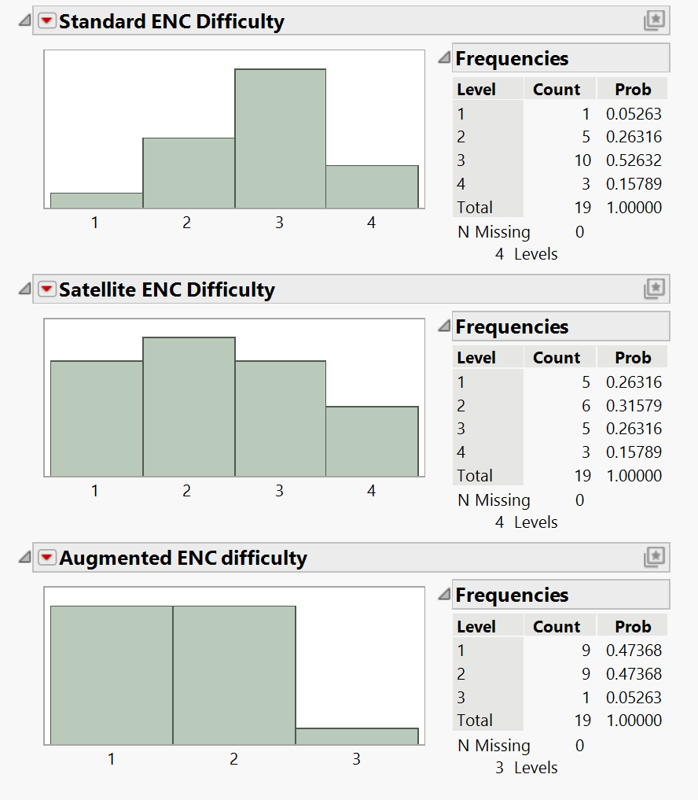
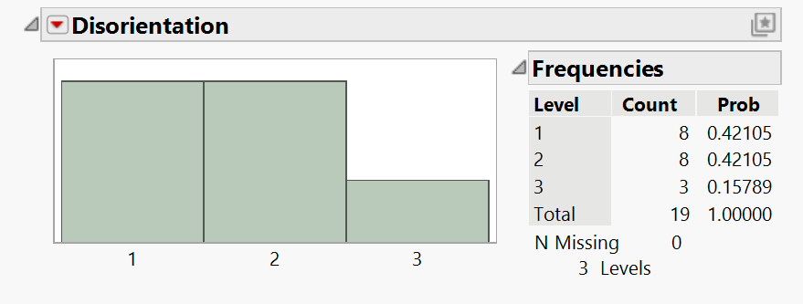
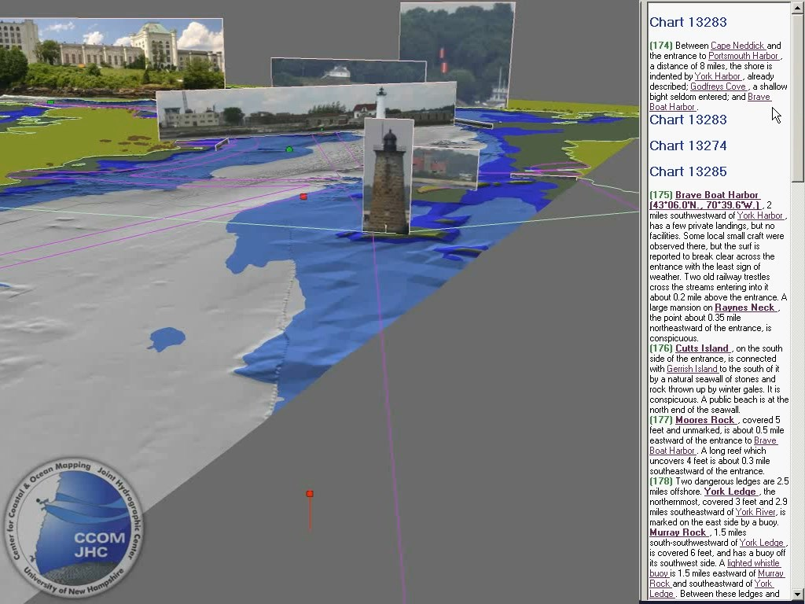
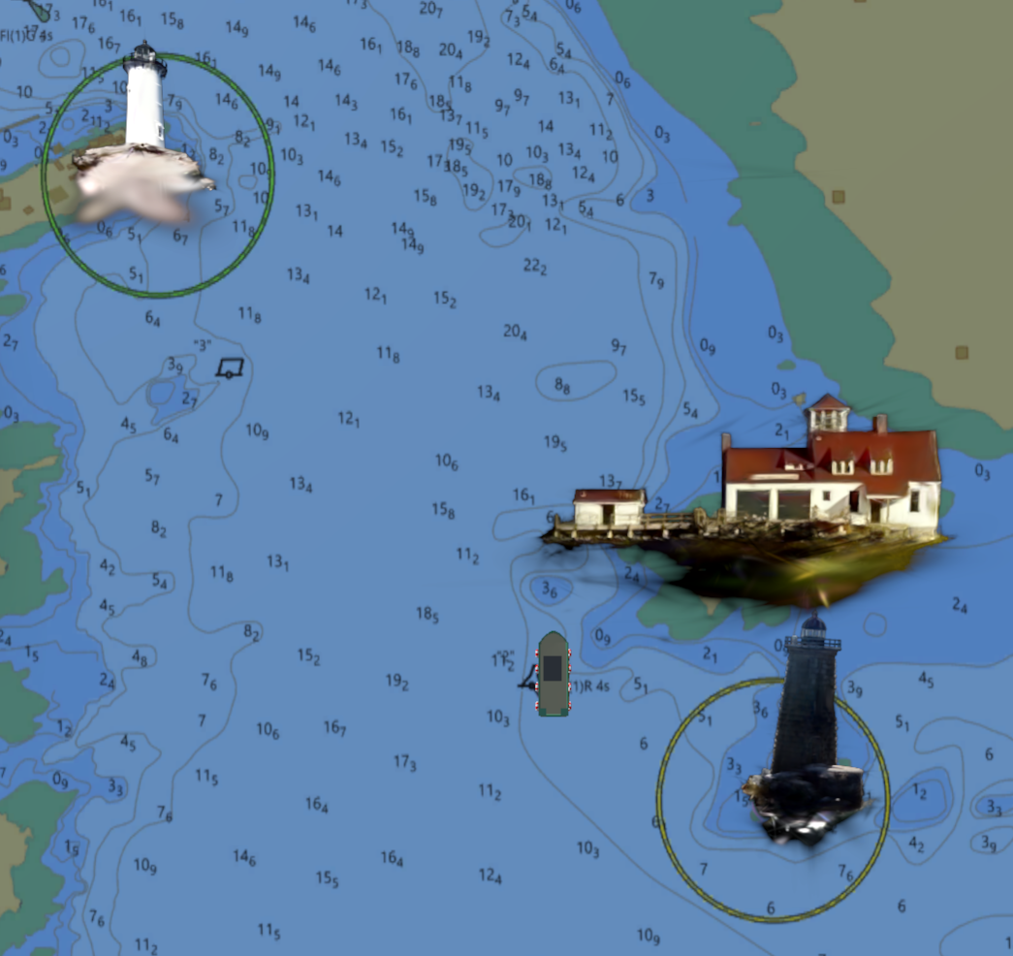
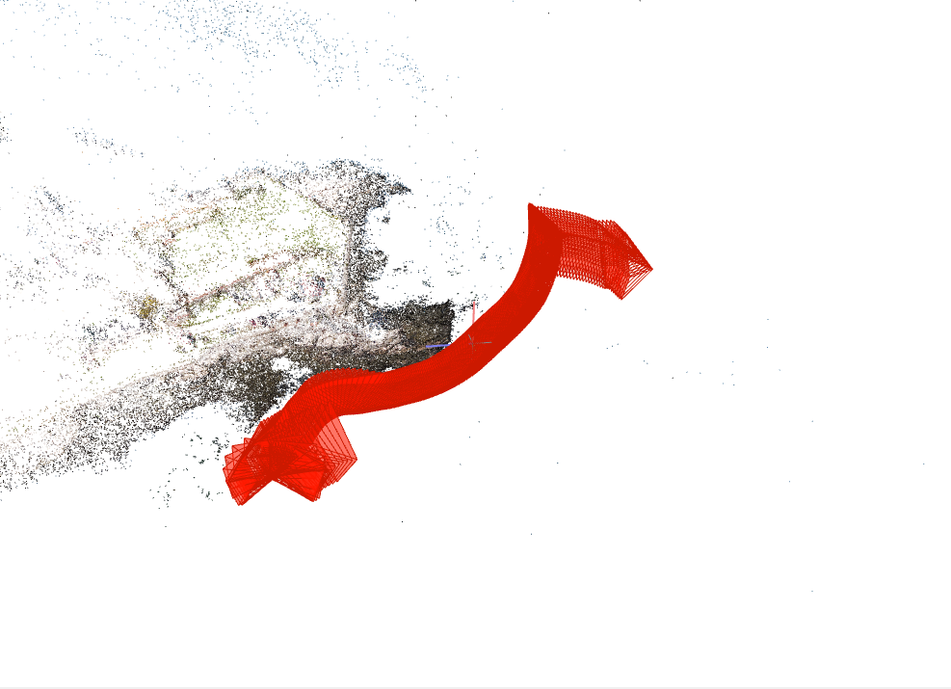
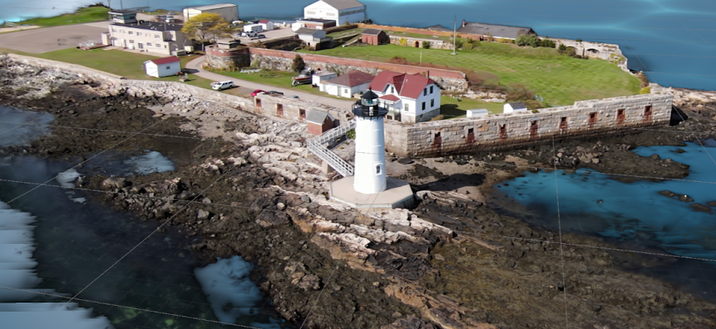
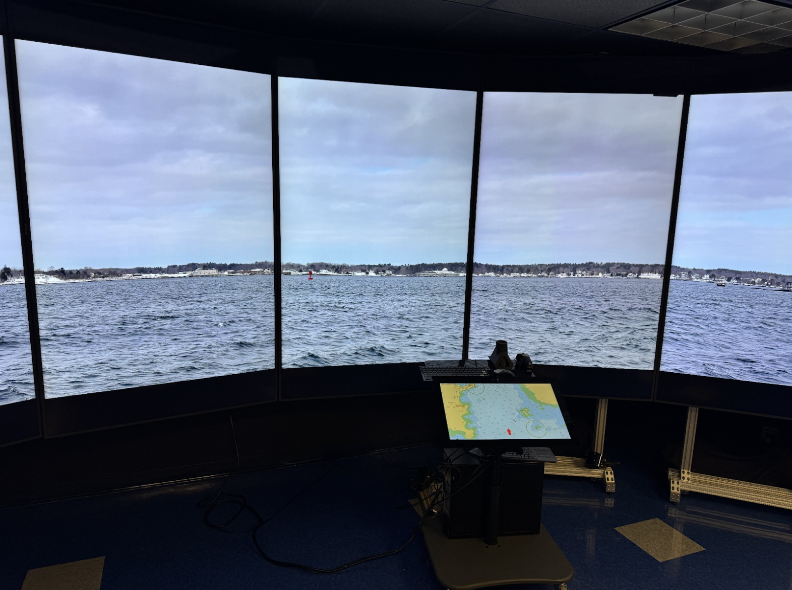
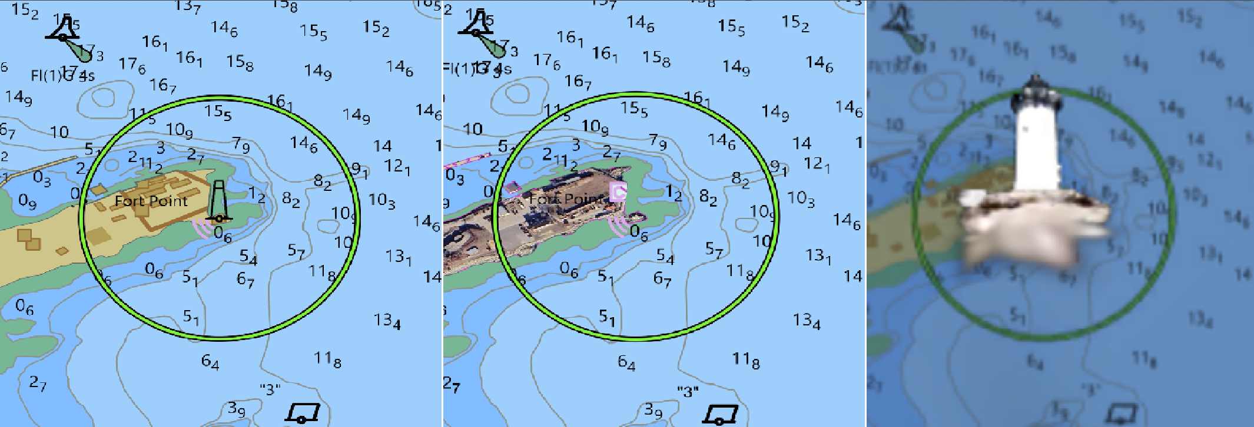
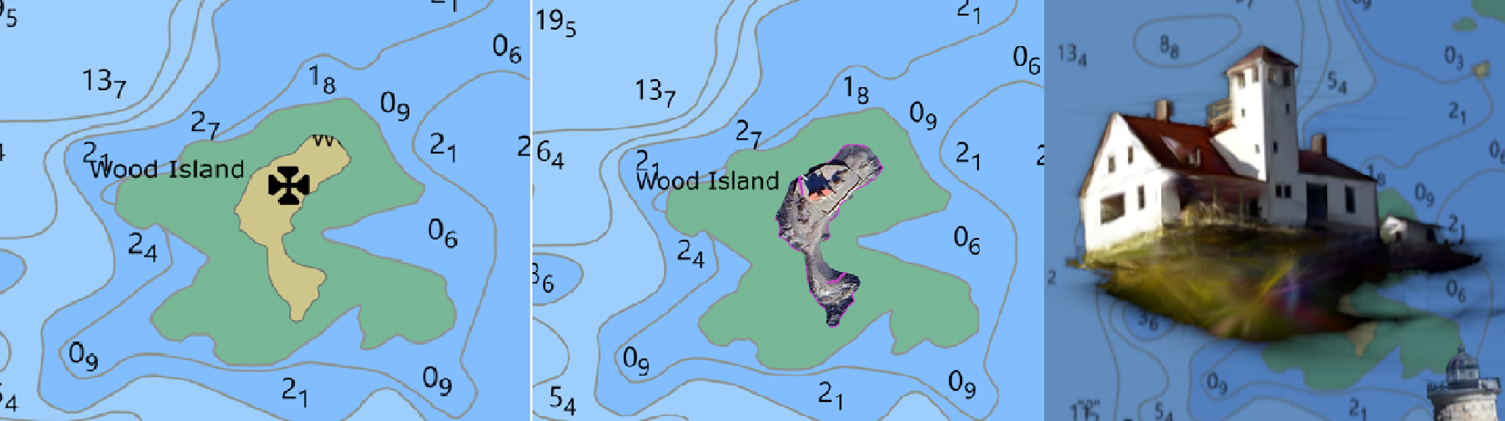
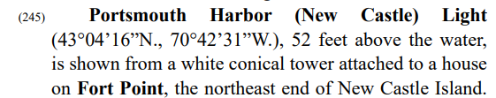
Augmenting Landmarks on Electronic Navigational Charts
Using Real-Time 3D Gaussian Splatting
  Jonathan George
  Undergraduate, Department of Computer Science
  University of New Hampshire
Introduction
System Design
Results and Conclusions
3D Gaussian Splatting is a relatively new computer graphics technique that allows for conversion of standard image and video files into computer generated three-dimensional imagery. The generated Gaussian Splat Clouds are designed to create novel views of real-world objects while maintaining real-time framerates. Electronic Navigational Charts (ENC) provide a graphic representation of water depths, the shoreline, prominent topographic and man-made features, aids to navigation and other navigational information useful to mariners.
This research sets out to show two things, firstly, that there is room for improvement regarding the portrayal of landmarks on Electronic Navigational Charts, and secondly, that 3D Gaussian Splatting can be used to provide realistic views of landmarks that dynamically adjust to show how they appear from different viewing locations on the water.
ENC
Satellite
Photo
Splats
Our Electronic Navigational Chart Landmark Augmentation system was designed to be capable of rendering multiple high-quality Gaussian Splat Cloud reconstructions of real-world landmarks onto the screen at any given time while maintaining real-time framerates.
The system was partially developed using an open source Unity3D renderer entitled UnityGaussianSplatting, which dramatically shortened the time required to develop functional visualizations compared to using the standard implementation of Gaussian Splatting.
Data sets for this system were gathered by capturing high resolution photographs and videos from aboard UNH Center for Coastal and Ocean Mapping’s research vessel in the Portsmouth, NH harbor. This source data was transformed into splats using a software called PostShot, which shortened the pipeline by doing both the structure-from-motion and the splatting steps of the implementation, as well as contained tools for processing splats via splat deletion.
A major departure from existing 3D Gaussian Splatting work is the use of transformation matrices to mathematically warp the presentation of the Gaussian Splat Clouds to show each landmark as it would be seen by the boat’s current position, rather than from the actual camera’s position, e.g. top-down perspective.
Quantitative data on the average times that it took participants to recognize landmarks on both ENC’s and in panoramic images, lower means correspond to faster recognition times.
Qualitative feedback regarding perceived difficulty of recognizing landmarks in each condition (1 = no difficulty, 4 = extreme difficulty).
Goals and Previous Work
ENC’s are sparse, and landmasses are mostly empty with only simple icons to represent landmarks. Our goal was to highlight limitations of the standard in which modern nautical navigation information is presented, and to prototype an improvement on these limitations.
In the past, attempts were made to merge photos and panoramic imagery in navigational charts, with limited results, due to the challenges of integrating static 2D images into rotating or 3D scenes. Gaussian Splatting was chosen for its ability to render novel high-quality views of objects from any viewing direction.
How disorienting dynamic landmarks were: (1 = none, 4 = extremely disorienting).
Previously: 2D Photos
The average time it took participants to find a landmark on both an ENC and in a corresponding panoramic image, using our system was reduced by 44%, with the average time for locating in an ENC having a 35% reduction, and the average time for panoramic images having a 33% reduction.
Though the sample size was adequate (n=19), the number of trials were limited by the time required to convert landmarks into Gaussian splat clouds, and the limited number of suitable landmarks in Portsmouth Harbor. Thus, our results did not achieve statistical significance. However, the results from our study show that our Gaussian Splatting method had a large reduction in the average time that it took participants to recognize landmarks on an ENC and then find the same landmark on a panoramic image of the area, compared to standard ENCs. This improvement, in conjunction with the results that most participants found the dynamic 3D Gaussian Splat presentation to be more useful than other conditions of the charts, justifies future studies with more trials.
New: 3D Splats
Structure-from-Motion Reconstruction Process
Boat position splats
are rendered from
Final Gaussian Splat Cloud
Experimental Design
Participants had to locate landmarks on both Electronic Navigational Charts and in panoramic images of the area. Participants who self-described as extremely knowledgeable about the area or extremely knowledgeable in the use of Electronic Navigational Charts were excluded.
Participants did a series of semi-randomized trials, that included three distinct conditions: Standard ENCs, ENCs with satellite imagery over land areas, and ENCs with Gaussian Splat landmarks. We recorded the time it took participants to find the landmarks on each. Qualitative feedback was solicited on how disorienting the dynamic splat clouds were, and perceived difficulty in locating landmarks in the different conditions of ENCs.
Examples of the three conditions of landmark portrayal used in the experiment, for Portsmouth Lighthouse and Wood Island Lifesaving Station:
Our study was developed to assess how well novice navigators, with very little exposure to nautical navigation, or more experienced navigators with little knowledge of the testing area, could find landmarks using ENCs in their current form, compared to ENCs augmented with satellite imagery or 3D Gaussian splats.
We hypothesized that adding 3D Gaussian Splat Clouds to ENCs would be more effective than standard ENC landmark icons and an alternative method of filling land area with satellite imagery.
To collect data on the effectiveness and viability of our augmentation system, we designed an experiment where participants were timed on their ability to locate specific landmarks, when given a textual description of the landmark and area from the NOAA Coast Pilot manual. Example text description
Standard ENC Satellite Imagery Gaussian Splats
The testing environment for our study, with ENC’s on an angled monitor, and Panoramas on a large tiled display.

