Slide 1
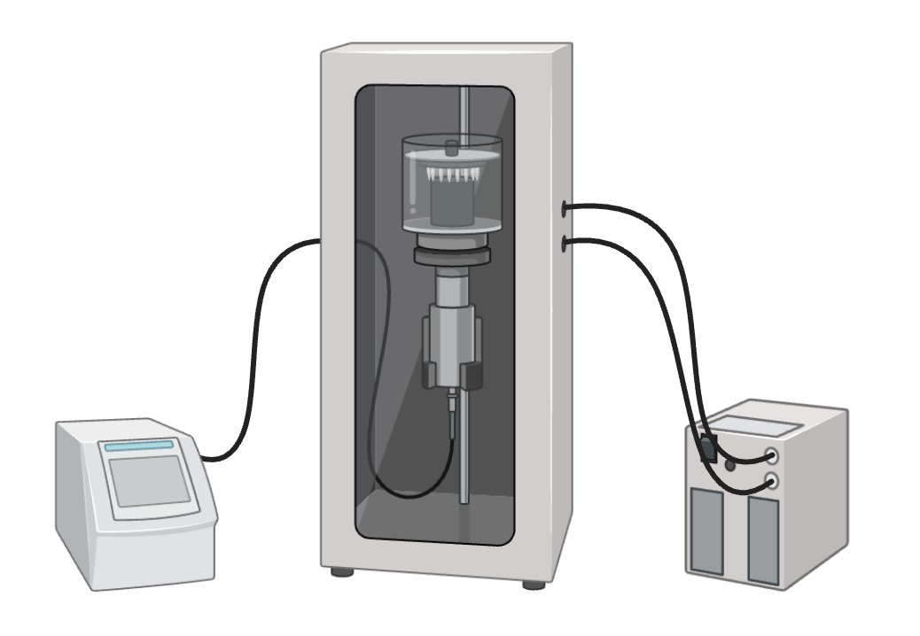
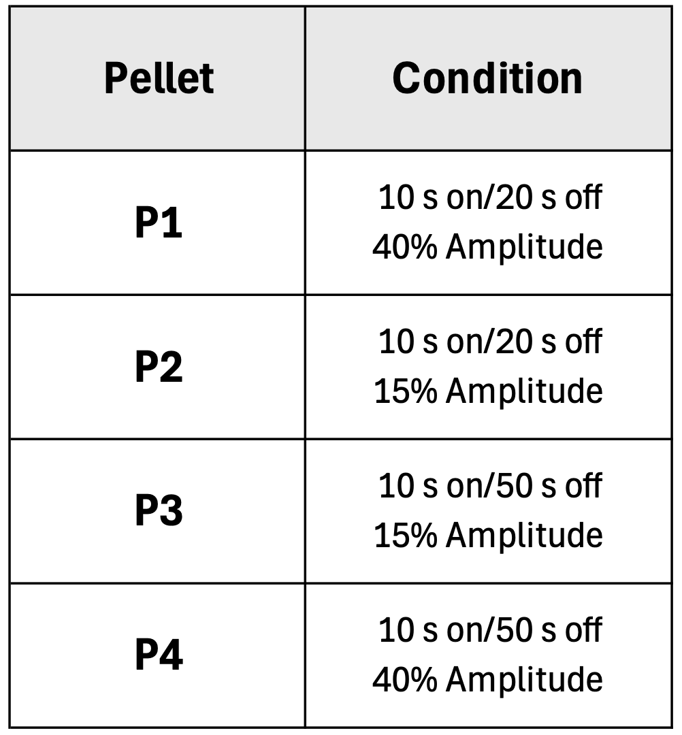
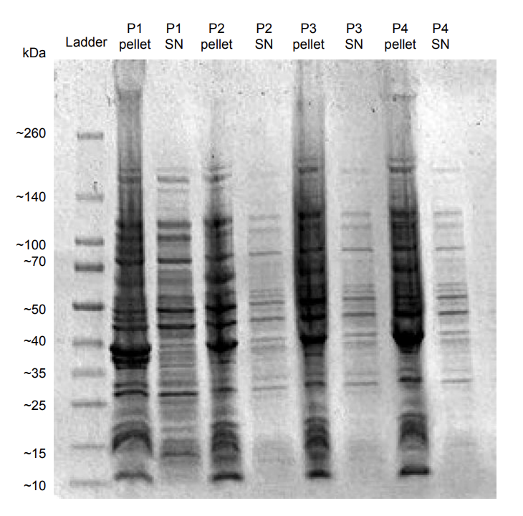
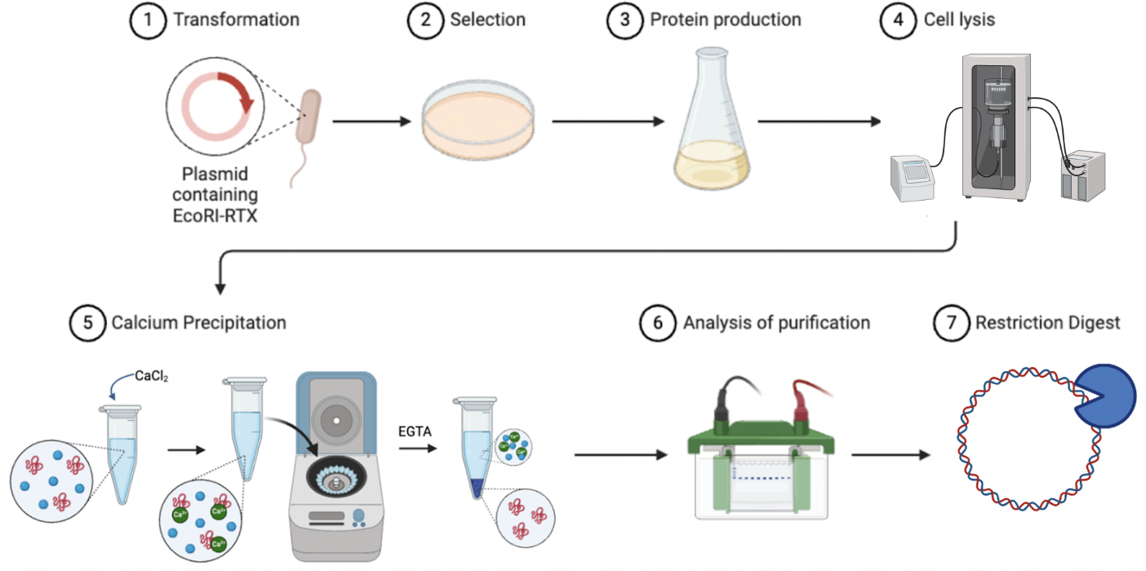
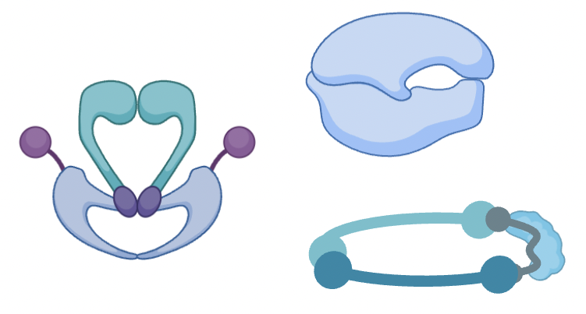
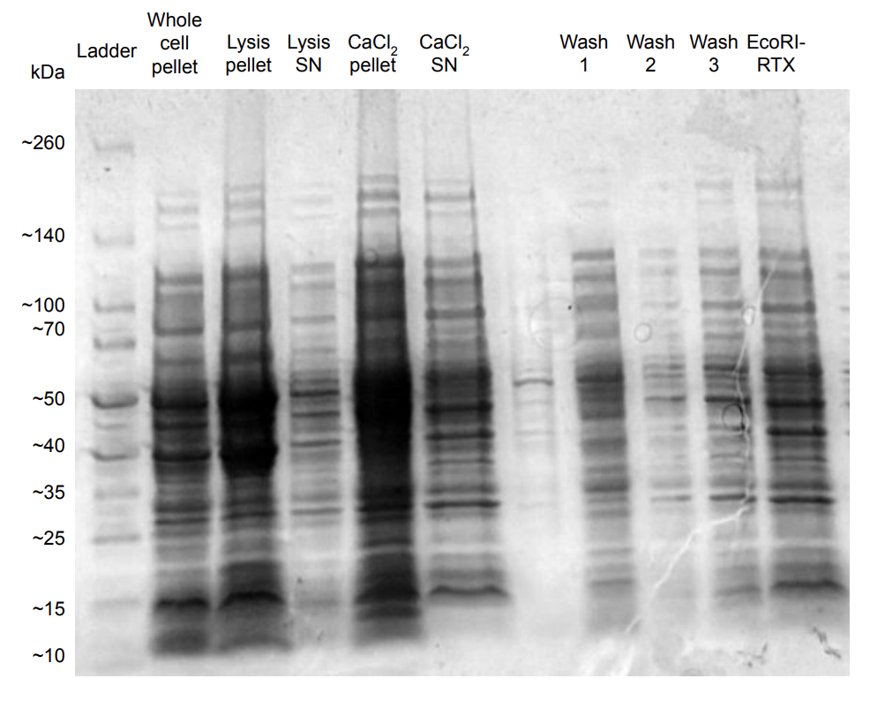
Purification of EcoRI-RTX Through Calcium Precipitation
Lauren Y. Barnes,ª Wynter A. Paiva, Samuel E. Ashooh, Dr. Nathan J. Oldenhuisª
ªDepartment of Chemistry, University of New Hampshire, 23 Academic Way, Durham, NH 03824
dsDNA as a Polymer
EcoRI-RTX
Sonication Troubleshooting
6.85
Table 1. 3 cycles of each condition were tested to optimize lysis.
Double stranded DNA (dsDNA) is a semiflexible polymer that comes in many sizes, and retains water solubility at all sizes, making it a viable option for biomaterials, such as hydrogels (Fig. 1). Current sources of dsDNA are incompatible with the scale necessary for bulk material production. To address this, we developed a simple, scalable and unified method that produces gram-scale quantities of plasmid DNA (pDNA) for use as a generic polymer (Fig. 2).
Figure 4. EcoRI is a Type II restriction endonuclease that cleaves DNA sequences at GAATTC regions, leaving sticky ends behind.
Figure 5. The RTX tag causes a conformational change in proteins in the presence of calcium allowing for easy purification through calcium precipitation.³
Figure 8. Depiction of sonication for mechanical lysis. Image made using BioRender.com.
Figure 1. Depiction of a hydrogel made from dsDNA.
Methods
Figure 9. SDS-PAGE analysis of lysates after sonication under different conditions. Many proteins are in the insoluble fraction. Centrifugation time for separation of soluble and insoluble proteins will be reduced to prevent undesired pelleting of proteins. Alternate lysis methods will be explored if issue persists.
Figure 2. Overview of the process of bulk pDNA production. pDNA is produced in a 7 L bioreactor vessel through fed-batch fermentation and purified using alkaline lysis and anion exchange chromatography.¹
Future Work
Common DNA Enzymes
We will work to optimize our lysis procedure to yield a pure and functional EcoRI-RTX. We will then move onto expression and purification of other DNA altering enzymes, such as DNA topoisomerase II, condensin, RNA polymerases, and gyrase (Fig. 10).
The goal of this work is to create a large toolbox of enzymes that will allow us to reliably, predictably, and selectively alter the topological state of DNA. DNA enzymes of interest include topoisomerase (relieves supercoiling) ligase (repairs the sugar-phosphate backbone) gyrase, (induces supercoiling), and restriction enzymes (site selective double-stranded nicking) (Fig. 3).² The ultimate goal is to make the use of these enzymes more cost-effective and to produce enzymes that can effectively alter the properties of DNA-based biomaterials at scale.
Figure 6. Overview of methods for EcoRI-RTX purification. Plasmid containing EcoRI-RTX is transformed into DH5⍺ cells and used to inoculate a liquid bacterial culture. Following lysis, solid CaCl₂ was added to a concentration of 50 mM to precipitate EcoRI-RTX. The pellet was then washed before being resolubilized using EGTA. Image made using BioRender.com.
Figure 10. Depiction of gyrase, RNA polymerase II, and condensin. Image made using BioRender.com.
Analysis of Purification
Acknowledgements
A.
B.
C.
Figure 7. SDS-PAGE analysis of EcoRI-RTX purification. The protein appears to only be present in the insoluble fraction (lysis pellet, red box). None of our target protein was present in the supernatant, which was used for the CaCl₂ precipitation, thus preventing purification of EcoRI-RTX. Cell lysis will need to be optimized prevent aggregation of protein.
We would like to thank the following people: Noelle Honan, April Weeks, Matt Currier, Lola Fadairo, Shaina Hughes, Patrick Strobel, Tran Truong, Julia Heroux, Amy Di Vito, Kaelin Marshall, Laura Hills, Madigan Jennison-Henderson, Brynna Hone, Aubrianna Dobbins, Pearson Franz, Kate Lussier, and Dylan Sager. This research is funded by NSF Career 2340569.
References
Figure 3. A) Depiction of how restriction enzymes work. B) Depiction of how ligases work. C) Depiction of how topoisomerase and gyrase work. Image made using BioRender.com.
1. Paiva et al. Adv. Mater. 2024.
2. Flatt, P.M. Biochemistry – Defining Life at the Molecular Level. 2019. 9, XX.
3. Hendrix et al. ACS Publications. 2014, 3.
Notes:
4

