Slide 1
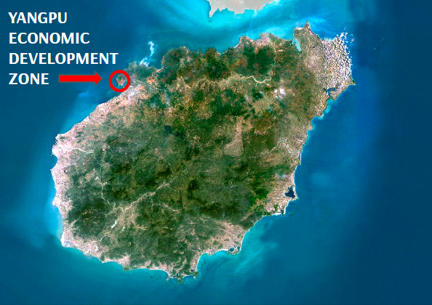
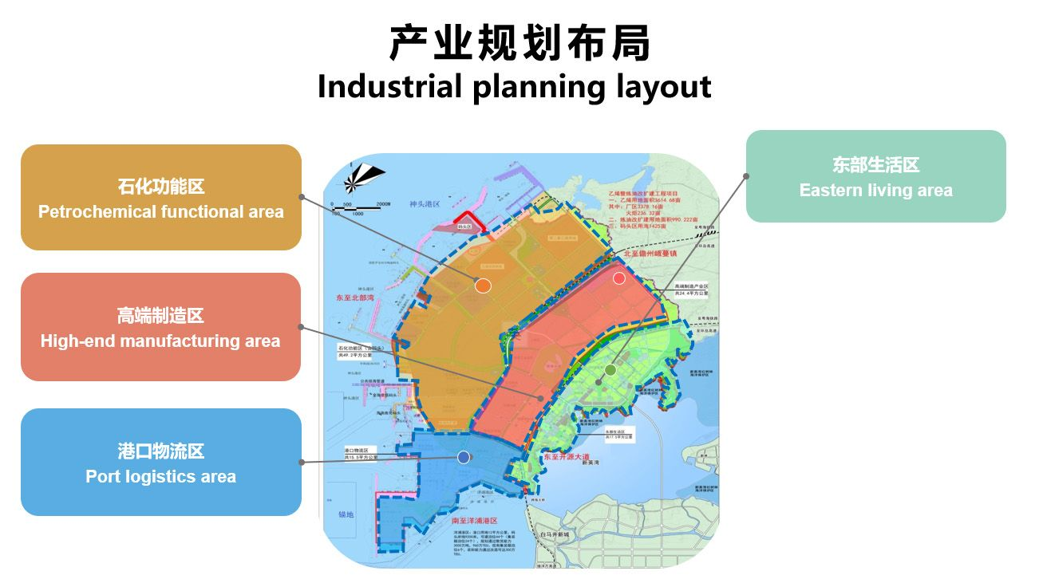


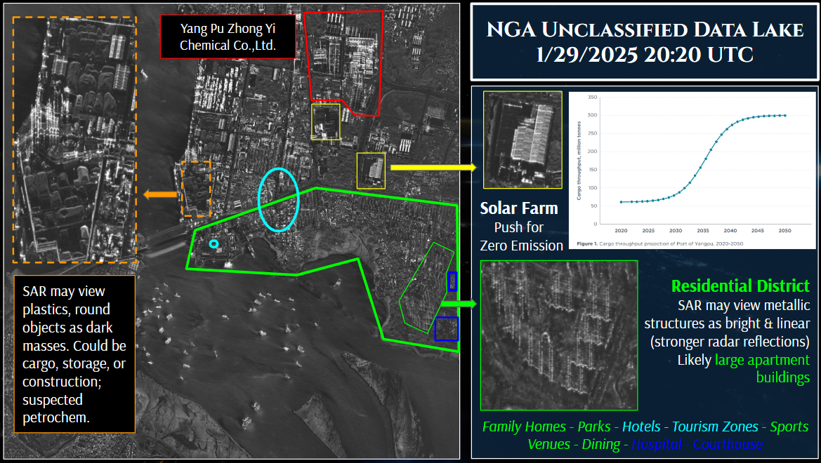
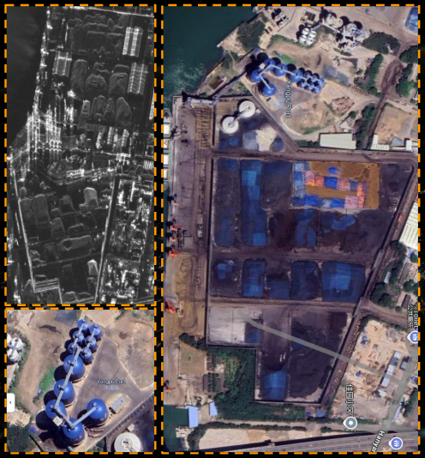
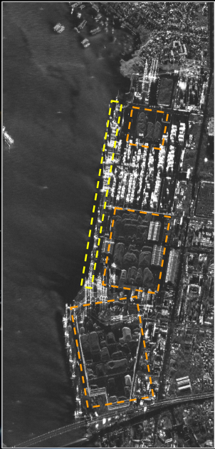
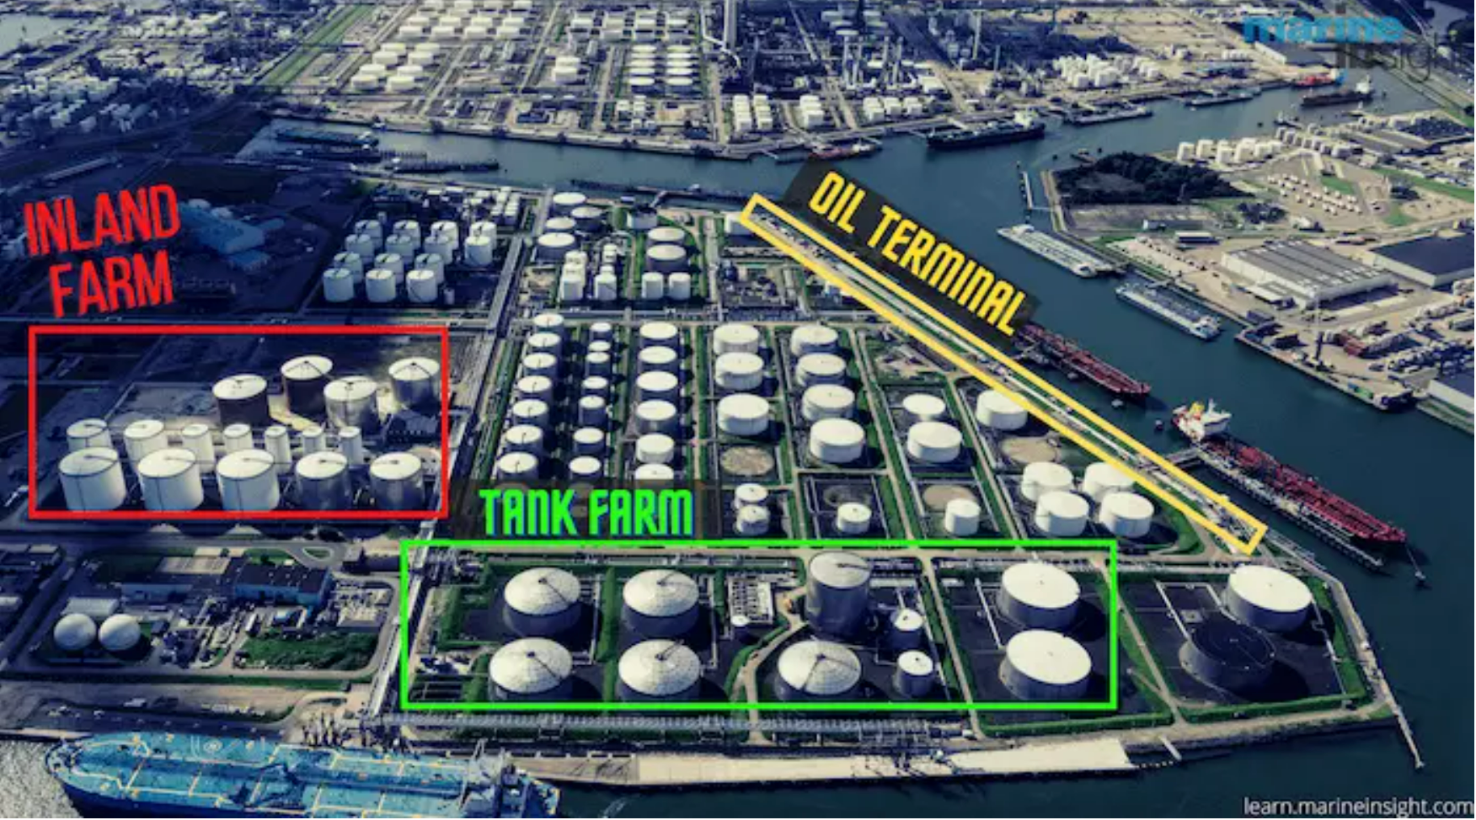
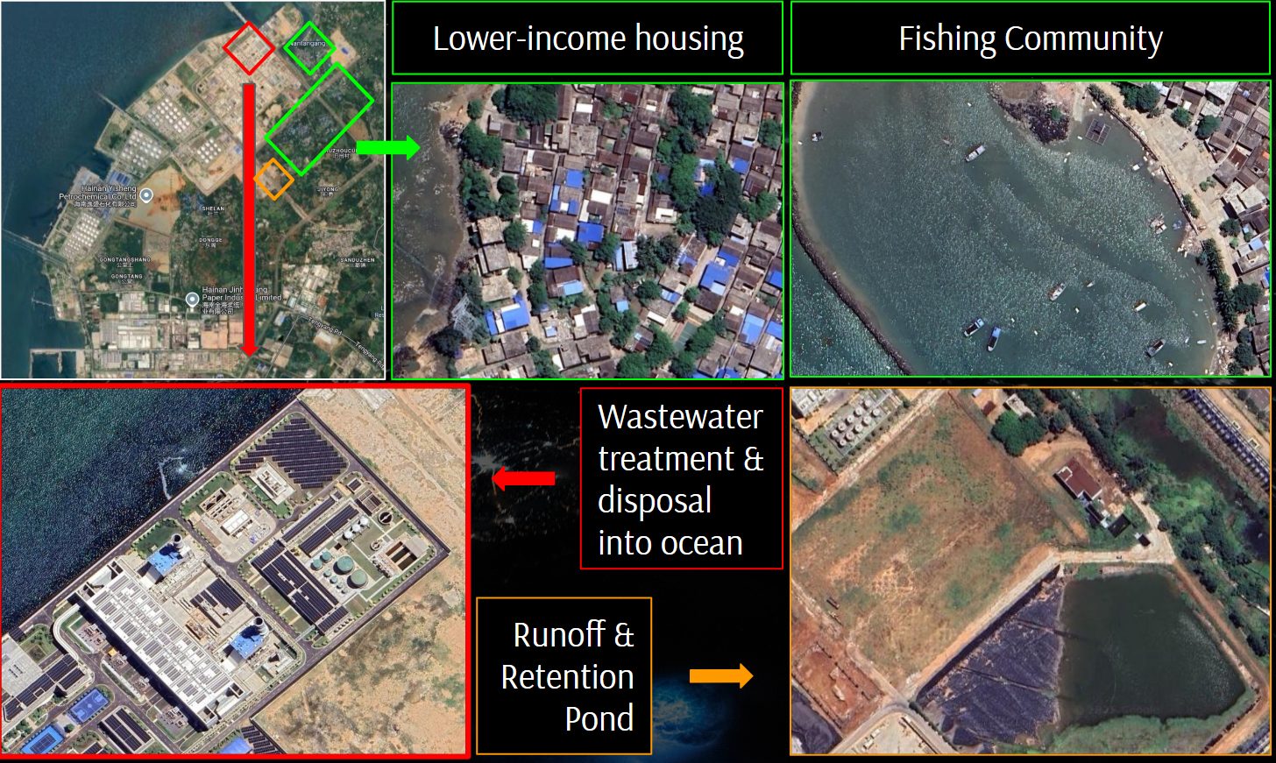

The Chinese Petrochemical Industry in the Yangpu Economic Development Zone
Phase II: Human Security
International food processing industry
  Grand Farm Hainan Central Kitchen
    100,000 tons of imported beef and mutton
  SinoGrain, Longda Food, Jiangxi Huangshanghuang Food, Beijing Capital Agribusiness & Foods Group
  3-5 year trajectory to surpass 50 billion yuan
Vegetable & Melon Farming
Yangpu riverside connection project, Huangpu River
Island is main producer of tropical agriculture products and tilapia
Autumn Bedell – Katelyn Smith - Christopher Bonney Thomas McAndrews - Dr. John Borek
University of New Hampshire
Department of Security Studies
University of Massachusetts Lowell
Center for Terrorism and Security Studies
Abstract
Phase III: Environmental Security
China’s Yangpu Economic Development Zone represents a critical case in understanding the intersection of industrial growth and environmental risk. This study integrates satellite imagery and policy analysis to assess the region’s petrochemical expansion, revealing regulatory gaps and rising human security concerns. Findings underscore the need for enhanced monitoring, transparency, and international collaboration to ensure sustainable development.
Water Pollution in Yangpu Region
  Persistent Heavy Metal & PAH Pollution
  Adverse effects for humans and ecosystems
  Worst with urbanization, industrial zones, coastal areas
Fresh Water Deficiency in Yangpu EDZ
  Natural climate deficiency
  Development zone needs high water supply
  Need to expand wastewater processing
3. Yangpu is Winter Haven for Birds
Methodology
Conduct a case study of the Yangpu EDZ to identify relevant stakeholders across:
  The petrochemical industry
  Human security (housing, schools, recreation, hospitals, etc.)
  Ecosystem and environmental zones
Collect geospatial intelligence (GEOINT) from NUDL and Google Earth to identify vulnerable stakeholders and project risk of disaster fallout from local petrochemical industries
3. Document preventative, regulatory, and monitoring policies related to the petrochemical industry during the course of the case study
Policy Analysis
Air Pollution Prevention and Control Law
Water Pollution Prevention Law
  Marine Ecological Red Line Policy
Hazardous Waste Control Law
  Distance from residential zones
“Dual Carbon” Policy
  Peak by 2030
  Neutrality by 2060
Recommendations for Future
Phase I: Identify Key Players
Bolster port ability to conduct emissions inventories
  Port electrification projects
  Roadmap to decarbonize by 2050
  Environmental Impact Assessments
Wastewater Treatment Project
  But “will cause site-specific adverse environmental impacts” and generate pollution
Petrochemical Disaster Prevention
  Learn from partner nations (reduce # of employees per plant, workplace safety)
Sinopec Hainan Petrochemical
8 million-ton capacity
17 production units
Over 25 million-ton output
Sinopec Yangpu Oil Terminal
China’s largest petroleum reserve
15 million-ton oil turnover
27.41 million-ton capacity
Hainan Jinhai Pulp & Paper Co.
3,500,000 tons of output
40% of Hainan’s total
RMB 23.9 billion investment from APP China
Full Paper and References
Please scan QR code for final paper
and all references!

