Slide 1
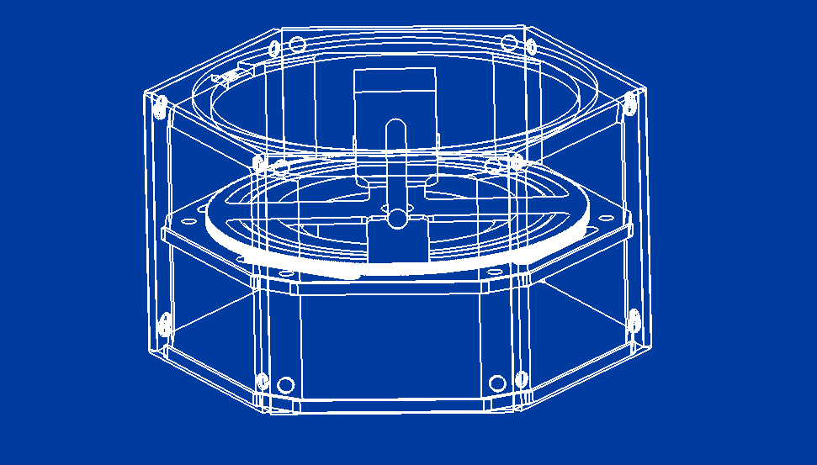
The Geometric Sand Art Generator By Michael Paradis
Overview
Design
The Generator is a machine that continuously creates sand art patterns based on uploaded user images.
The goal of which is to create a sense of satisfaction and calming to the user.
The design utilizes:
A circular gantry system.
Marble attached to a stepper motor via magnetism.
Electronics bay.
Container for the sand.
Software
The software is a website that:
Allows a user to upload a file to a directory.
Turns the image black and white.
Determines the edge of a shape given a brightness tolerance. And stores inside a matrix.
Creates a toolpath for the machine based on the matrix.
Runs the machine and resets it.
Currently, the Generator takes an image and determines its shape boundaries. Then it creates a set of points that when fed to an algorithm act on those points to create the art. Its major limitation is the resolution of the image in the sand. It is far more effective at symmetrical patterns than full on images.
Try the machine out!
(As long as it still has power)

