Slide 1

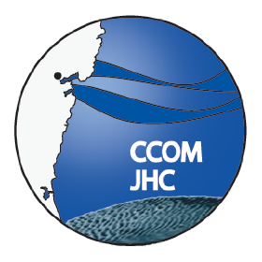
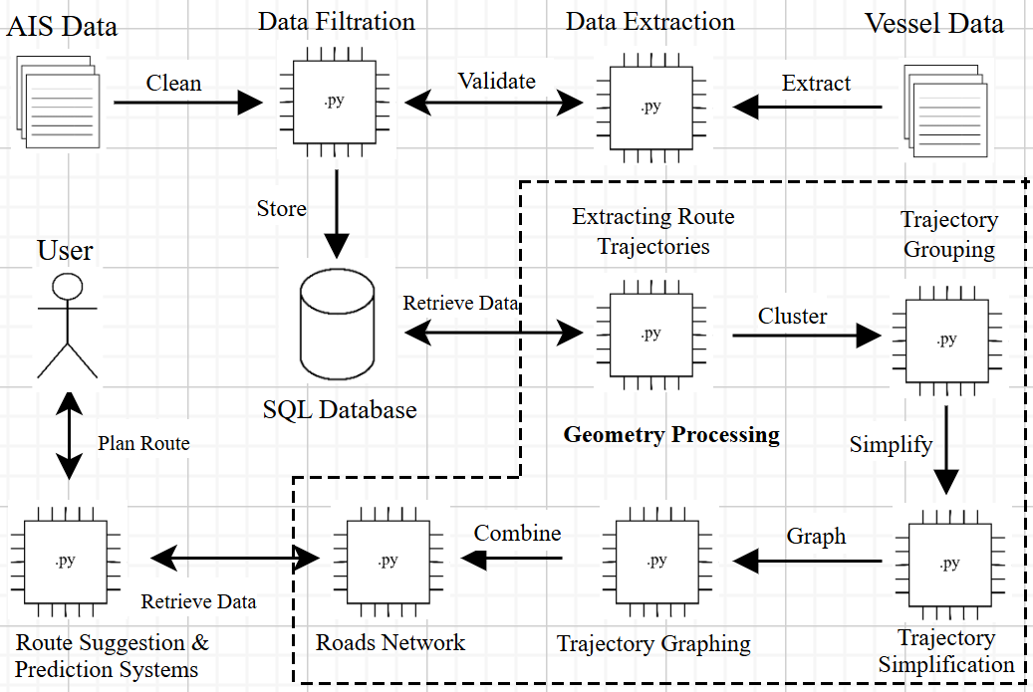
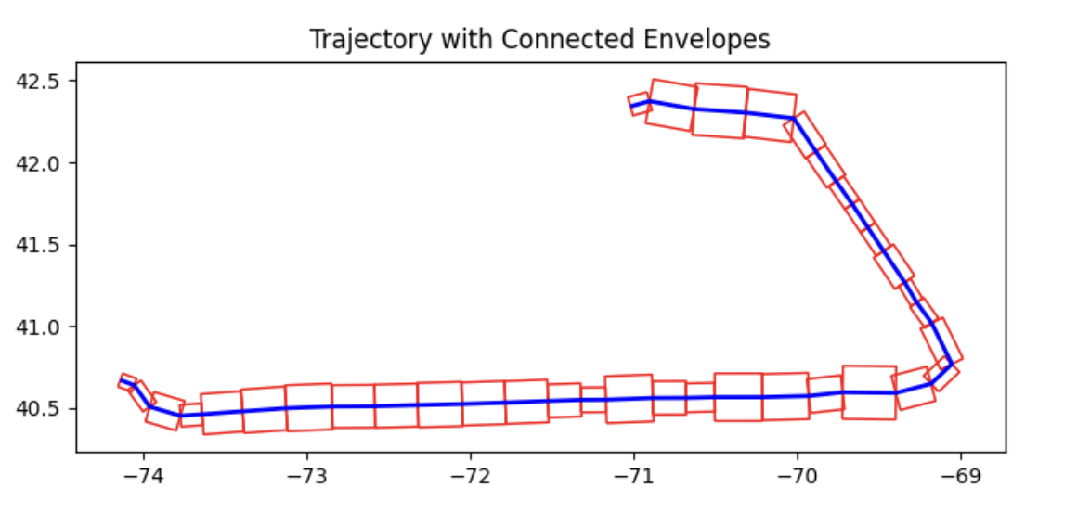
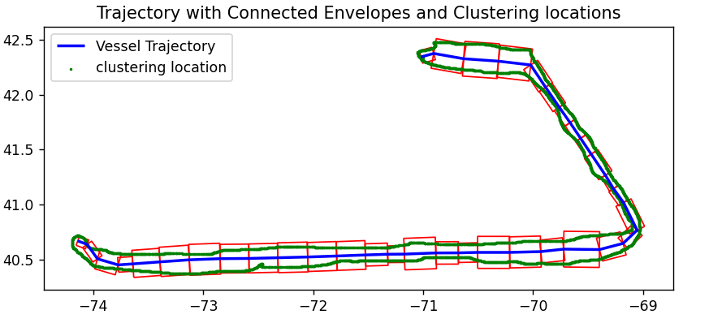
Roads of the Sea
Jacob Copp, Shuxian Guo, Nicolas Karpf, Kyle Melville, Kevin Terwilliger
UNH Department of Computer Science, UNH Center for Coastal and Ocean Mapping
Introduction
Design
Requirements
As a multi-year project, the Roads of the Sea (ROTS) project's goal is to generate individualized and optimized route predictions for given vessels between arrival and departure ports.
The goal for this year (24-25') was to define ocean corridors for known ocean pathways by utilizing Automatic Identification System (AIS) data, as well as the need for establishing a database containing vessel particulars for future years of implementation.
Utilizing AIS data, the previous year's implementation effectively filters data points and stores them as necessary in the teamwide PostgreSQL database. Alongside this, this year's efforts toward web-scraping and importing vessel information into the database also occurs. Finally, corridor generation is handled with the new data. All these efforts are handled in Command Line.
Functional Requirements:
The project will use the EnvClus* approach to accurately generate individualized route predictions and will utilize a PostgreSQL database for interaction on vessel particulars.
Nonfunctional Requirements:
The application must minimize outliers in the data being used and must generate routes that align with the most common routes in the data.
Testing
Methodology
Envelope Generation
This year's testing of corridor generation was based on our sponsor's provided geometric shapefiles of specific pathways. Comparing generated shape outputs of the corridor generation against the provided files helped guide whether our approaches were valid.
Alongside this, web-scraping and PostgreSQL database populating was trial-and-error, with utilizing any command line print statements for any errors that occurred. Using the printed information, updates to the applications would occur as needed.
Corridor generation occurs in a two-part process when analyzing AIS data, being:
The bounding of nearby datapoints to one another, called envelope generation. This ensures that further efforts for corridor generation are not altered by possible nearby data interference.
Identifying high and low values within the envelopes, called route clustering. In doing so, an accurate width is determined and invalid data is effectively eliminated from the route predictions.
This figure showcases the envelopes generated in the first step of corridor generation. The blue line represents the baseline trajectory and the red squares represent the bounding boxes for clustering.
Conclusions
Data
Route Clustering
The vessel populating of the teamwide database was a success and will benefit future endeavors of ROTS by having adequate data to experiment with when attempting to individualize routes for different ships. Alongside this, corridor generation is close to being deemed successful. Proper envelopes were generated for different test files therefore establishing the expected bounds for our route generation, and the data points inside these envelopes were properly clustered to define bounds for the expected vessel trajectories. However, currently only one possible route is consulted rather than the intended whole.
The two main pieces of data that were utilized in this project were generated geometric shapefiles provided by the sponsor and cleaned AIS data from the previous year's development team.
AIS is a vessel tracking system that it used to track a ship throughout its charted route. This automated process generates a data point for the given vessel in discrete time intervals and are utilized by the team to correctly define oceanic pathways between ports.
Geometric shapefiles assist in this process, giving the team access to visualized route prediction on a world-wide map. This is possible by using QGIS software, which visualizes geospatial information.
Utilizing the envelope generation, we can see the points inside the envelopes are clustered to create a proper width in which our vessel can safely travel its departure-to-destination ports (as represented by the green lines).
Acknowledgements
Graph #1 Caption Here
Project Sponsor: Christos Kastrisios
Project Advisor: Lisa Henry
UNH CS and UNH CCOM Department

