Slide 1




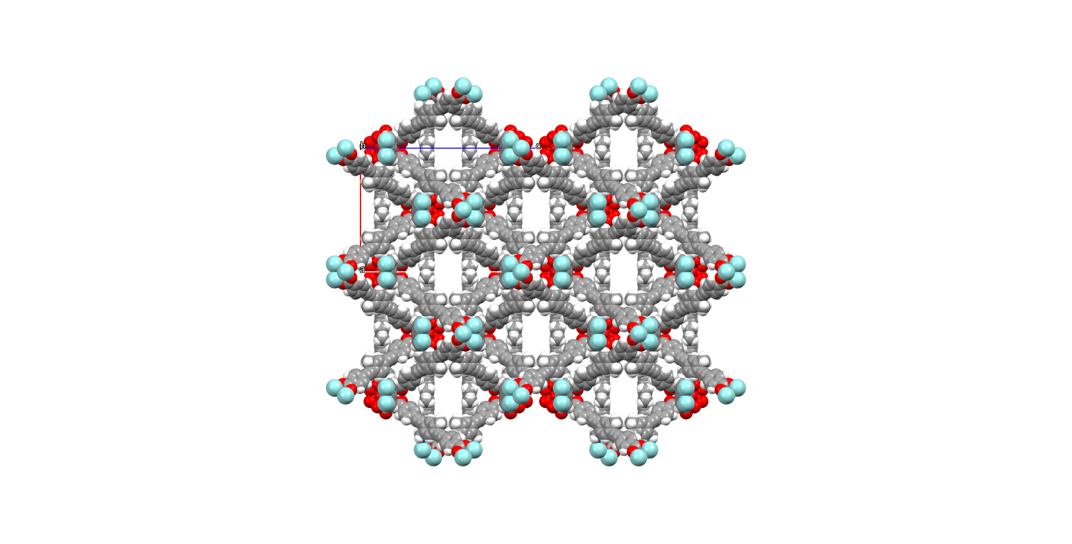

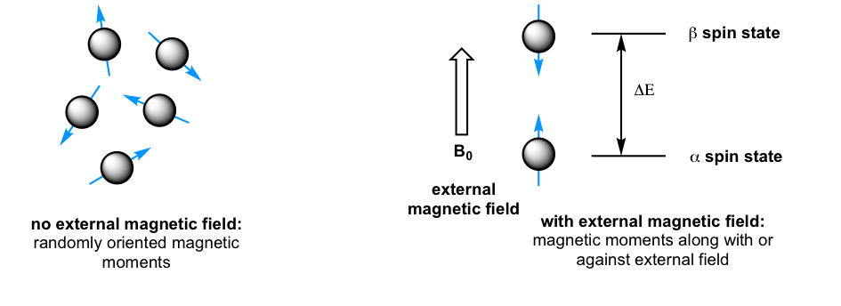
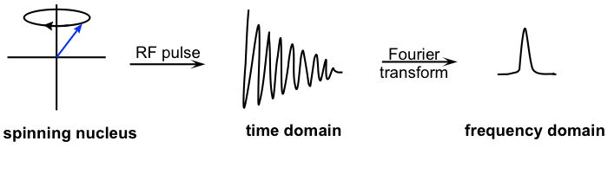
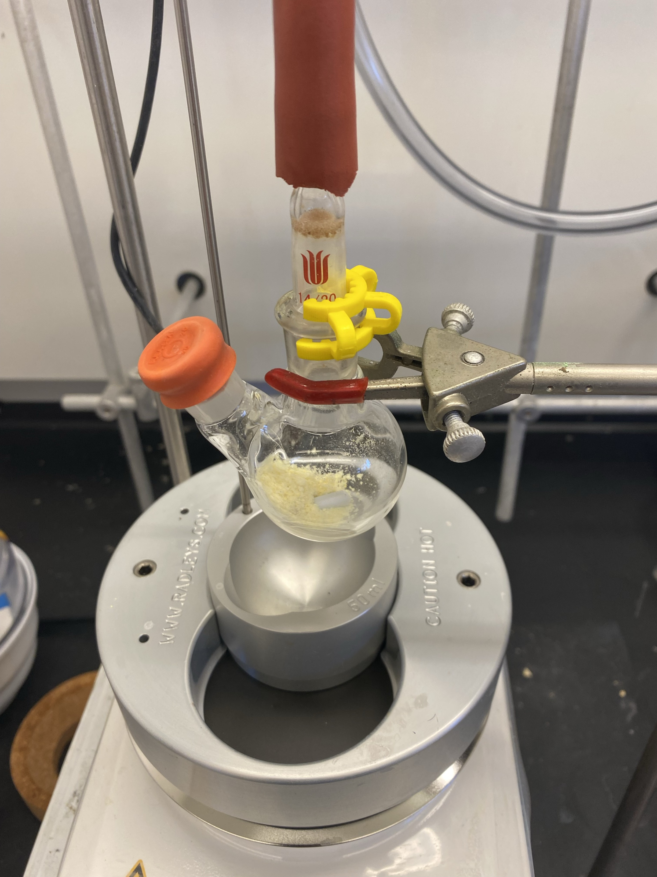
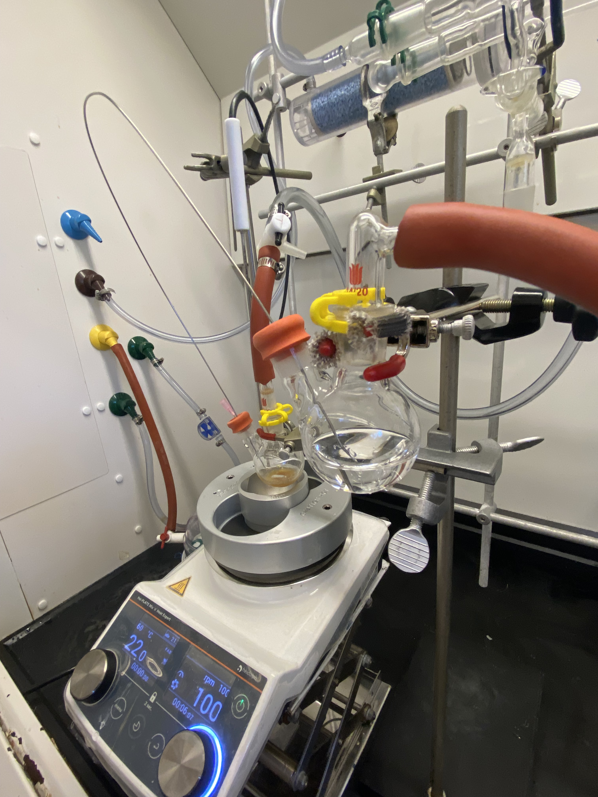
Sonigashira Coupled Ligand for Improved Functionalization of
Metal-Organic Framework Drug Delivery System
Lucas Laventure, Patrick Strobel, Dr. Aylin Aykanat
Department of Chemistry, University of New Hampshire, Durham, NH 03824
Introduction
Molecular Design
Future Work
Cancer remains one of the leading causes of death worldwide, with an estimated 2 million new cases expected in the United States this year alone. Cancer involves the unchecked and rapid process of cell division, which can lead to the formation of a tumor. Treatment options for cancer include chemotherapy, radiation, hormonal therapy, and surgery. While these treatments can be effective, they each come with limitations, such as their cost, and their poor selectivity for tumor cells.
Metal and Covalent-Organic Frameworks (MOFs/COFs) both show promising potential for drug delivery applications. Along with their ability to self assemble, these complex crystalline nanocarriers made up of organic building blocks can be highly functionalized to respond to stimuli. This high tunability can be utilized for design of a drug delivery system with a selectivity for the chemical environment found in cancer cells.
A tripeptide known as glutathione (GSH) can be exploited in tumor cells as a drug releasing agent. This is possible thanks to the cysteine residue on the peptide and its ability to cleave disulfide bonds. A unique property of tumor cells when compared to their healthy counterparts is that their glutathione concentrations is factorially greater. These characteristics influenced our schematic design of a chemotherapeutic prodrug tethered via a disulfide bond to a highly rigid MOF.
Our objective is to deliver chemotherapeutics with disulfide tethered Metal-Organic Frameworks to induce apoptosis in cancer cells.
Methyl
4-ethynylbenzoate
After Successfully synthesizing our rigid organic ligand, the next step is to coordinate it to Zirconium metal. MOF formation relies on the high reversibility of bonds to crystalize from a single nucleation point. In order to increase the reversibility of our solvothermal reaction, an acidic modulator must be added to slow down the coordination.
Figure 5: A schematic showing the importance of an acidic modulator in improving MOF formation.
Once the zirconium network is formed, it can be characterized using powder X-Ray Diffraction (pXRD). Once this step is successful, we will begin to functionalize our linker with a free thiol group. This will allow for desirable drug tethering to our network and target the reductive properties of GSH to use as an effective chemotherapeutic delivery system. The purpose of the tethering is to navigate the difficulties of accessing the MOFs porous structure, and to provide a more effective payload release. An effective formation of our tethered MOF will allow us to begin preliminary cellular studies with both cancer and non cancer cells to quantify our delivery system.
1,4-Dibromobenzene
Sonigashira-Coupled Linker
Slow formation
Zr
Zr
MOFs
COFs
Increased
Crystalinity
Zr
Zr
Zr
metal
organic linker
building blocks that self-assemble
No Free Rotation
x
x
Increased Crystallinity
Figure 2: A chemical synthetic scheme showing the Sonigashira coupling of our two aromatic precursors as well as the solvothermal formation of a Zirconium coordinated MOF with the activated rigid linker.
Glutathione
(GSH)
Glutathione Disulfide
(GSSR)
Nuclear Magnetic Resonance (NMR)
Drug Tethering Studies
CDCl₃
c
a
b
c
a
b
=
a
b
CDCl₃
a
b
(6MP)
Disulfide-tethered linker
d
d
Figure 6: Chemical Structure of 6-Mercaptopurine (6MP). A common and inexpensive chemotherapeutic compatible with disulfide tethering.
Figure 3: Stacked ¹H NMR Spectra of both the synthesized organic linker, and the alkyne starting material. 500 Hz
ppm
Experimental Methods
Infrared Spectroscopy (IR)
Acknowledgements
I would like to Thank Dr. Aykanat for all their help in this project. I’d also like to especially thank Pat Strobel and the rest of FEM Lab for all their encouragement and guidance.
Infrared Light
Vibrational
Energy
1714
1104
References
Product
Cancer Disparities - NCI. https://www.cancer.gov/about cancer/understanding/disparities (accessed 2024-07-23)
Chakraborty, S.; Rahman, T. The Difficulties in Cancer Treatment. Ecancermedicalscience 2012, 6, ed16. https://doi.org/10.3332/ecancer.2012.ed16.
Gong, M., Yang, J., Li, Y., & Gu, J. (2020). Glutathione-responsive nanoscale MOFs for effective intracellular delivery of the anticancer drug 6-mercaptopurine. Chemical Communications, 56(47), 6448–6451. https://doi.org/10.1039/D0CC02872J
Liu, X. (2021). 6.5 NMR Theory and Experiment. https://kpu.pressbooks.pub/organicchemistry/chapter/6-5-the-nmr-theory/
1700
1107
Bond Vibration
Light Absorption
3240
Starting material
Figure 1: Images showcasing the air free process of the Sonigashira Cross Coupling reaction.
Figure 4: Stacked IR spectra of our starting material and product measuring absorbance

