Slide 1

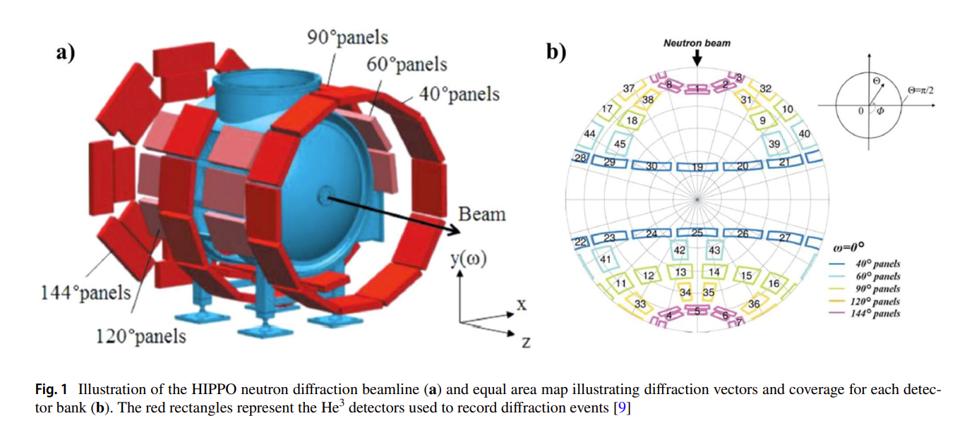
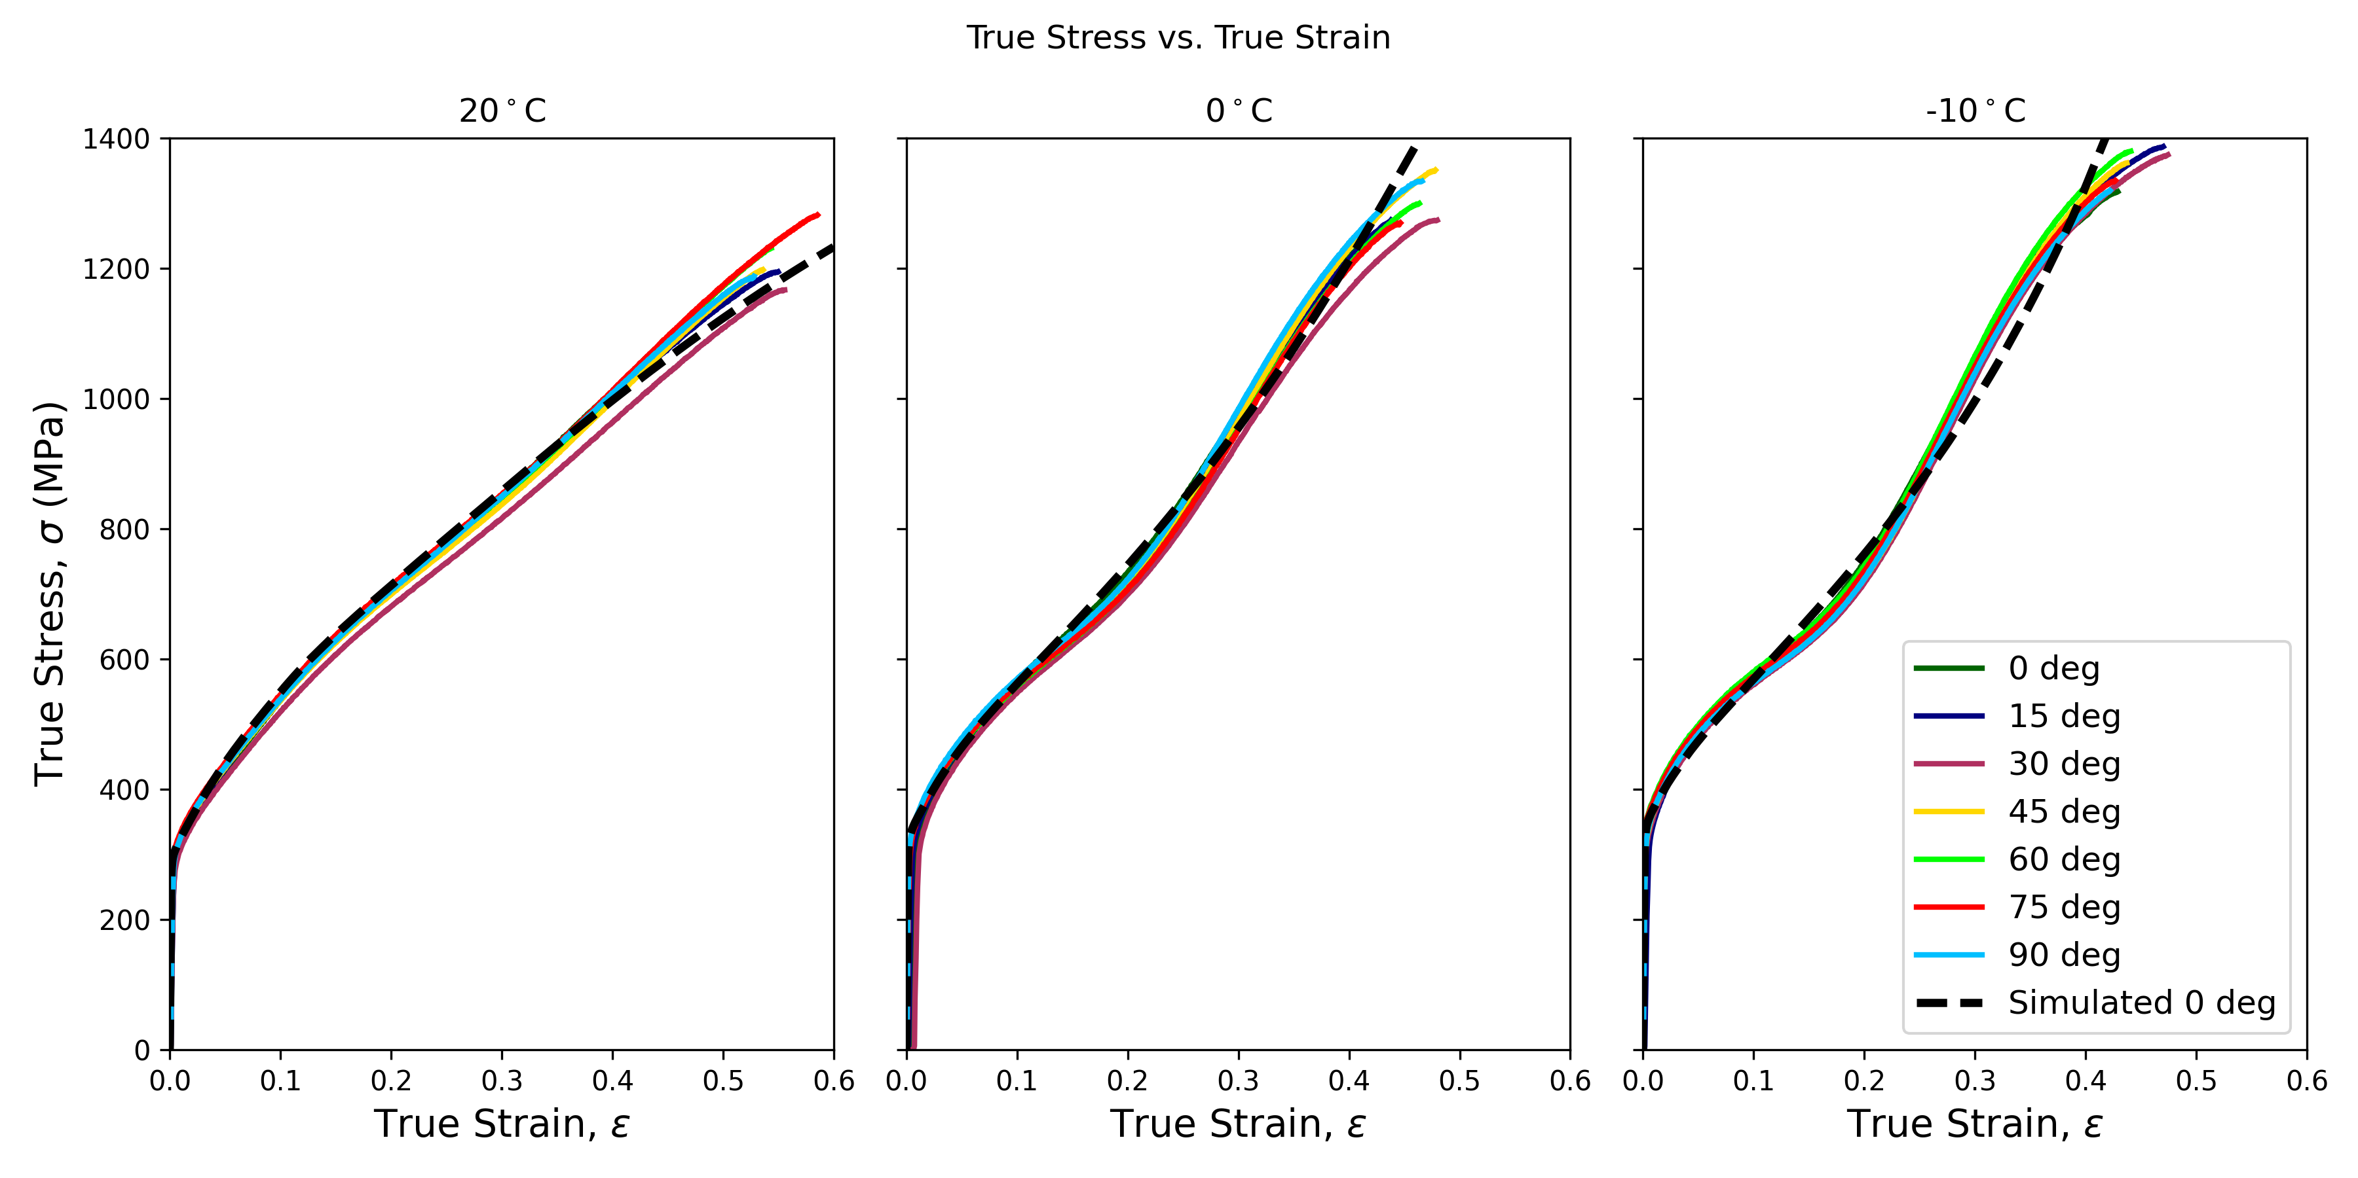
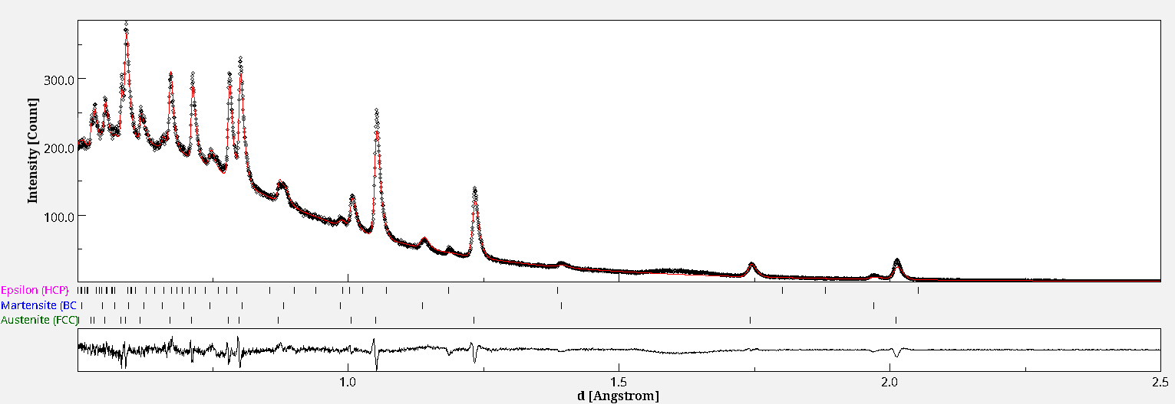
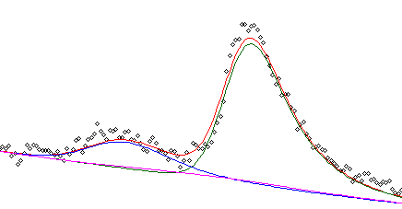
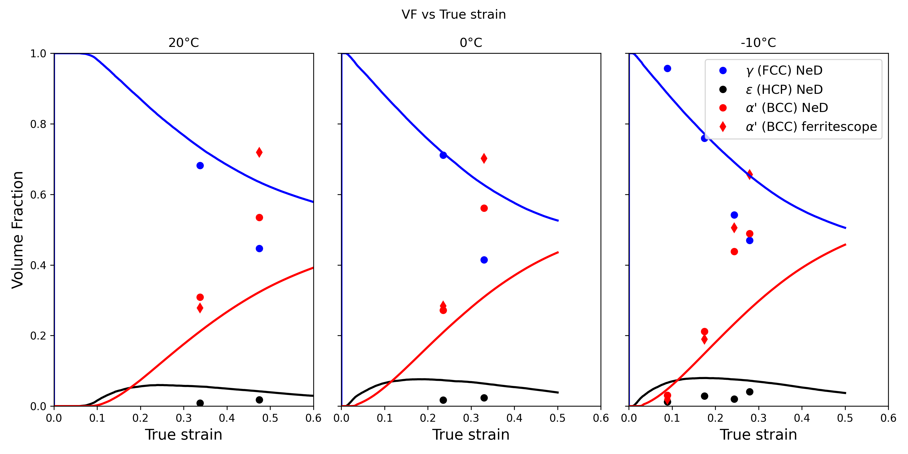
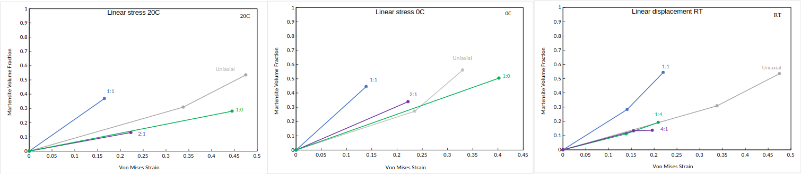
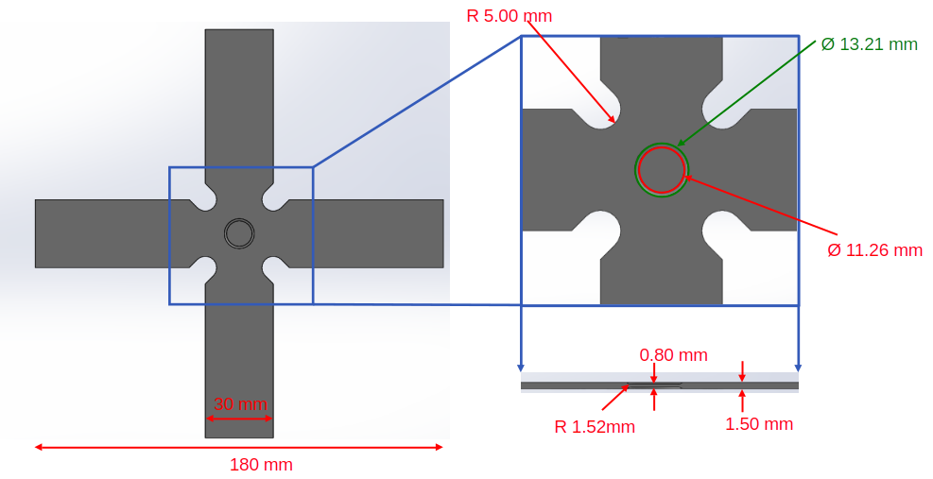
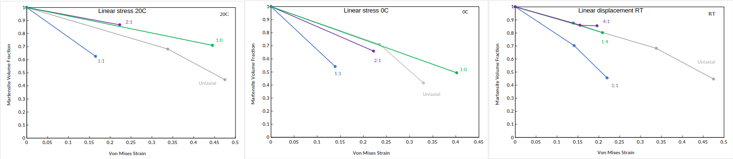
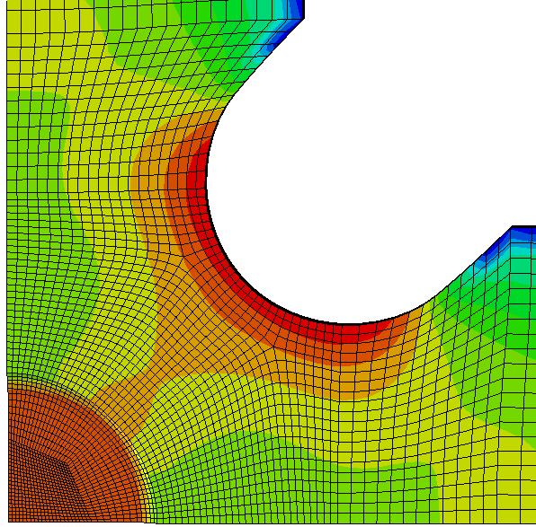
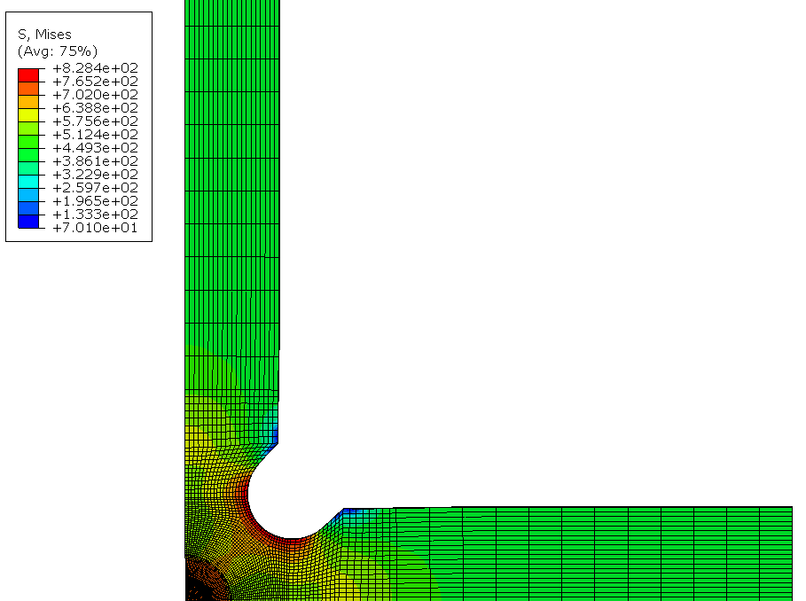
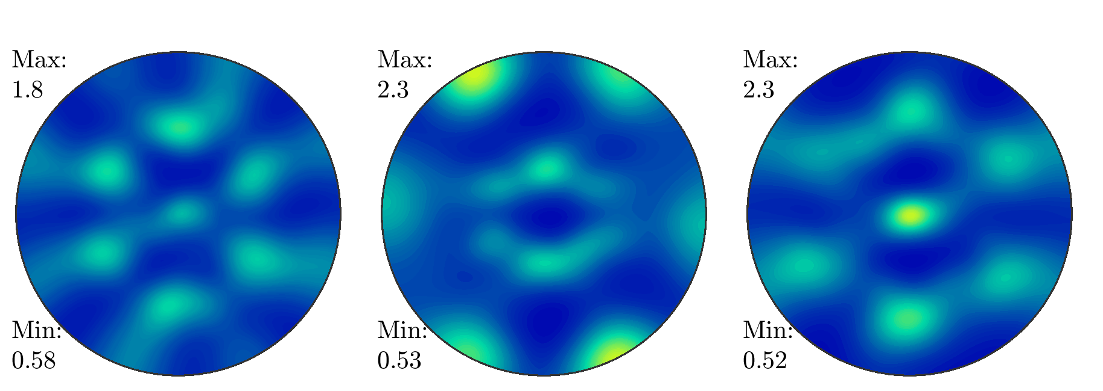
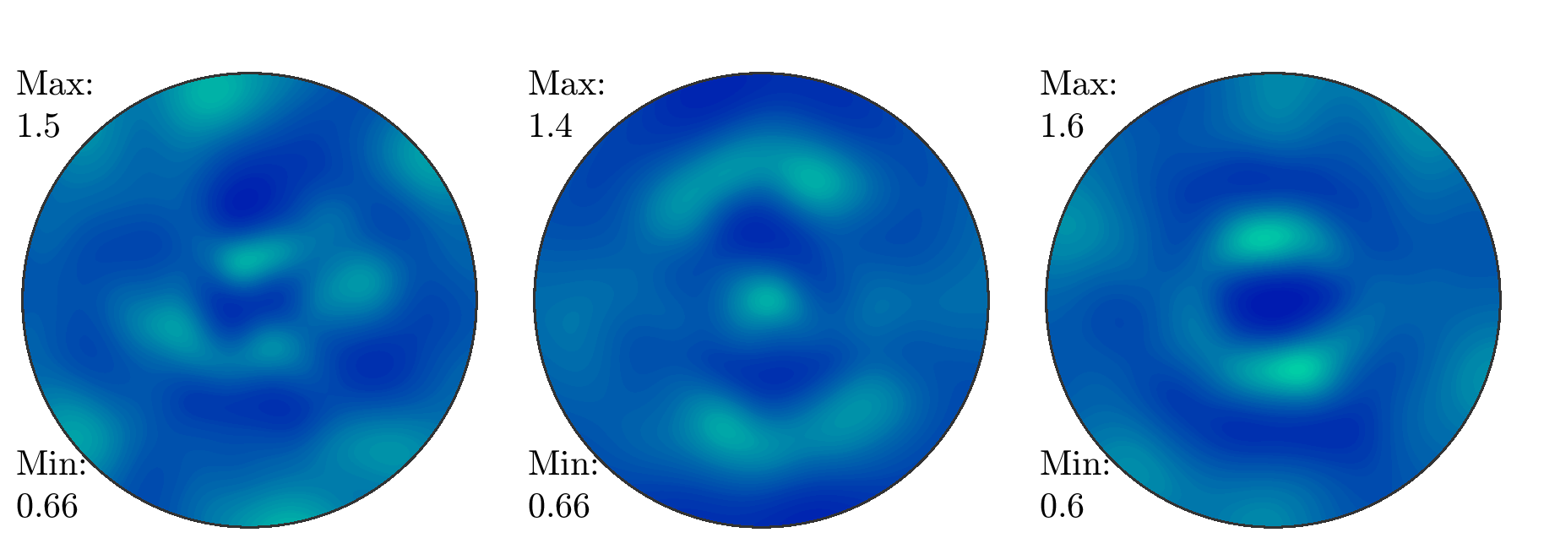


Influence of multiaxial deformation and temperature on strain-induced martensitic transformations in 304L steel sheets: Experiments and crystal plasticity modeling
Ezra Munholand (student), Prof. Marko Knezevic (advisor), University of New Hampshire Department of Mechanical Engineering
Background
Neutron Diffraction Analysis
Uniaxial Calibration
Materials are essential for technological advancement
Simulations using FEA are industry standard
Microstructure influences material behavior
Microstructure modeling offers more insight to material behavior
Multi-axial stress state is important for:
  sheet metal forming
  cylinders with inner pressure and axial stretching
  Goal: create a stress-state, microstructure sensitive model of 304L stainless steel with EPSC UMAT
Neutron diffraction data done by Los Alamos National Laboratory
Neutron diffraction analysis done with Maud. Need to fit 5*3=15 datasets simultaneously
Method
Red line is a sum of all three phases.
Blue line is for γ-aust (FCC).
Green line is for α’-mart (BCC).
Pink line is ε-mart. (HCP). Very small influence on fit.
Uniaxial and biaxial data collected (by previous graduate students)
Analysis of Neutron Diffraction data
Calibrate model one element uniaxial case
Simulate with 3D geometry coupled with FEA software
Bank 144
Experimental Setup
Experimental testing was done at UNH Olson Center by a previous graduate student.
Each leg displaced by linear strain or linear stress
DIC captured strain
From data analysis: α’-martensite and γ-austinite volume fractions
Current Work: Biaxial FE Model
Plasticity simulation in Abaqus
Couple Abaqus with UMAT
Model different strain/stress ratios
Compare prediction to experimental data and literature
Pole figure for 1:1, linear stress
FCC Austenite
X, RD
BCC Martensite
Acknowledgments
{001} {011} {111}
Z, ND
Y, TD
{001} {011} {111}
Supported by UNH Summer Undergraduate Research Fellowship
This work was based on a project supported by the U.S. National Science Foundation under a GOALI grant CMMI – 2147122.
Sources: https://link.springer.com/article/10.1007/s40192-021-00224-5
ε = 0.165, 20C

