Slide 1
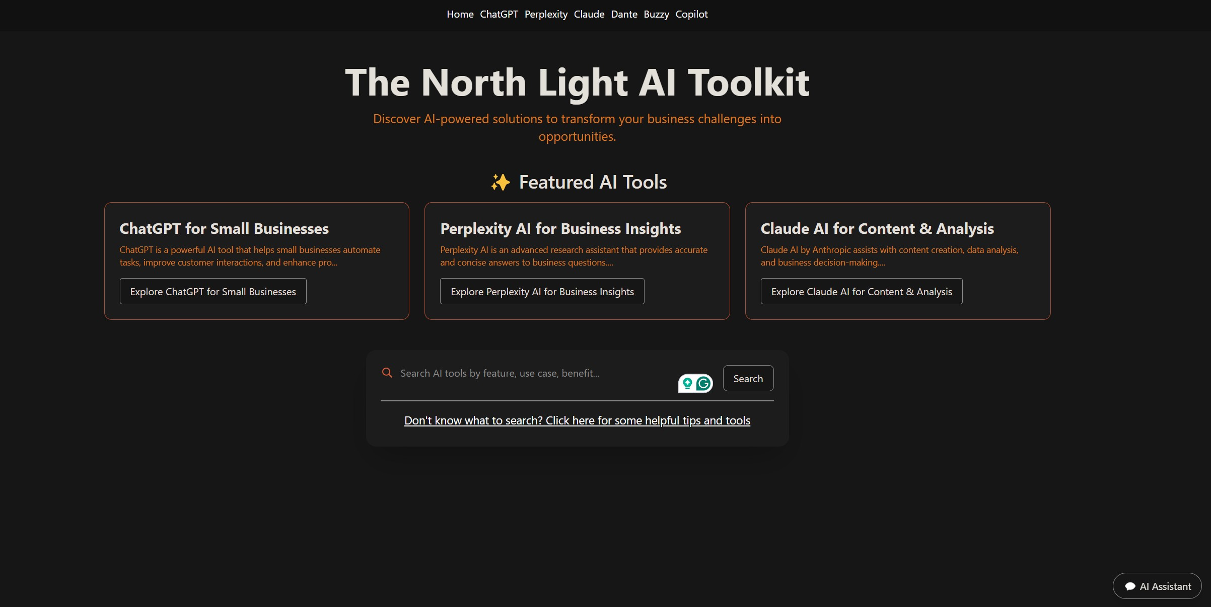
Small Business AI ToolKit Ambrose O’Neil, Justin Evanza, Bing Yi Liu Department of Computer Science, University of New Hampshire, Durham, NH 03824
Place your Project Logo Here
Introduction
UI Design
Results
The Small Business AI Toolkit is a web-based platform designed to bridge the gap between artificial intelligence (AI) technologies and the unique needs of Small and Medium-sized Businesses (SMBs). Our platform empowers SMBs to utilize AI solutions in marketing, operations, and customer support by interacting with a specialized knowledge base, while also providing students with hands-on experience in AI integration and real-world problem-solving.
Platform Utility: SMBs effectively utilized AI tools to streamline operations, with measurable improvements in customer support and marketing.
Student Impact: Students gained hands-on experience in AI tool integration and real-world problem-solving.
Feedback: Positive user feedback highlighted the platform’s usability and effectiveness.
Next Steps
Requirements
Expand the Toolkit: Integrate additional AI tools and features.
User Feedback Sessions: Conduct regular feedback loops for refinement.
AI Partnerships: Collaborate with AI tool developers for continuous updates and innovation.
User Input Handling: Enable users to input business challenges.
Solution Recommendation: Recommend AI tools tailored to the user’s needs.
Tool Information: Provide detailed descriptions of AI tools, including use cases and capabilities.
Resource Integration: Offer additional resources like documentation and direct links to tools.
Scalability: Ensure the platform can handle many concurrent users.
Cross-Browser Compatibility: Ensure seamless functionality across all major web browsers.
Design & Implementation
Architecture:
Search Interface: Users input business challenges.
AI Engine: Processes queries and matches them with relevant AI tools.
Dataset: Structured database of AI tools and use cases.
Result Display: Shows AI-powered solutions with detailed tutorials.
Modular Design: Allows for easy updates and scalability.
Conclusions
The platform demonstrates practical AI solutions, bridging the gap between AI capabilities and SMB needs. Future enhancements include expanding functionality, integrating additional tools, and deepening partnerships with AI developers.
Testing
Technology
Unit Testing: Validated individual components like input handling and solution matching.
Feature Testing: Ensured accurate AI tool recommendations.
System Testing: Tested integration across frontend, backend, and database.
User Testing: Conducted with SMB owners and students to evaluate usability and performance.
Frontend: HTML, CSS, JavaScript, React.js
Backend: Node.js, Deno Runtime
Database: MariaDB
AI Tools Integrated: Claude 3.5, GitHub Copilot, ChatGPT, Perplexity AI, Buzzy AI, Dante AI
Sponsors
Andrew Mitchell – Project Sponsor Lisa Henry – Advisor

