Slide 1

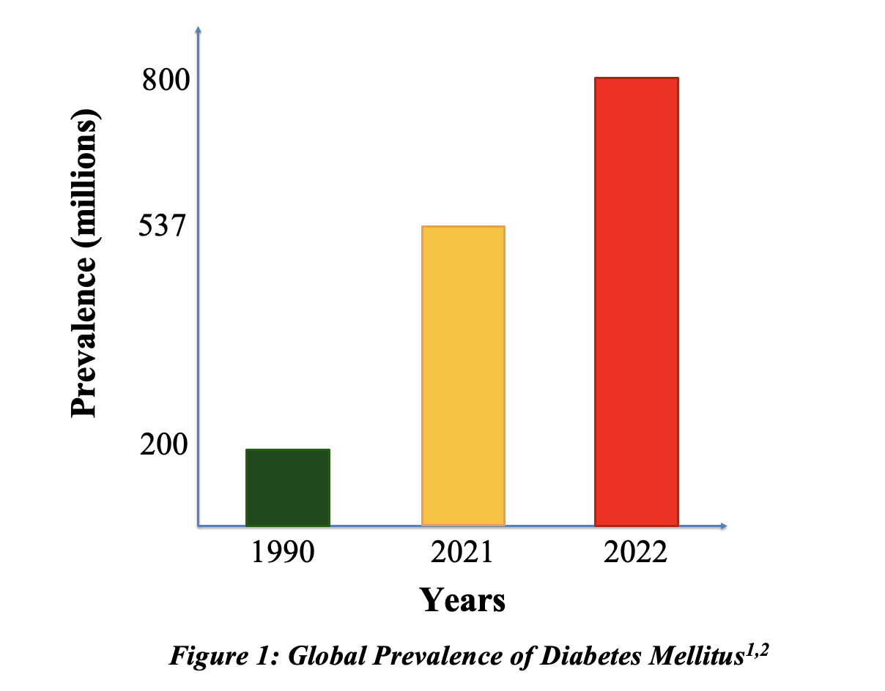
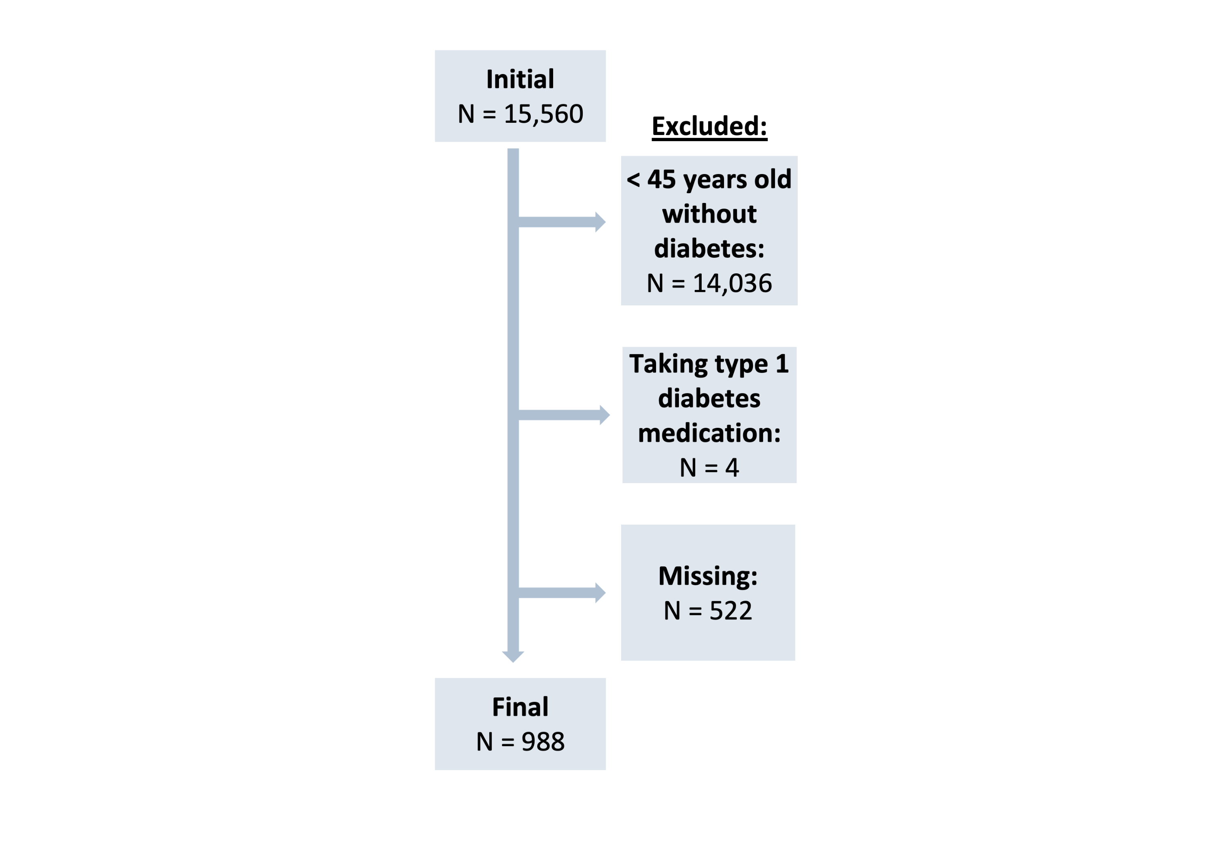
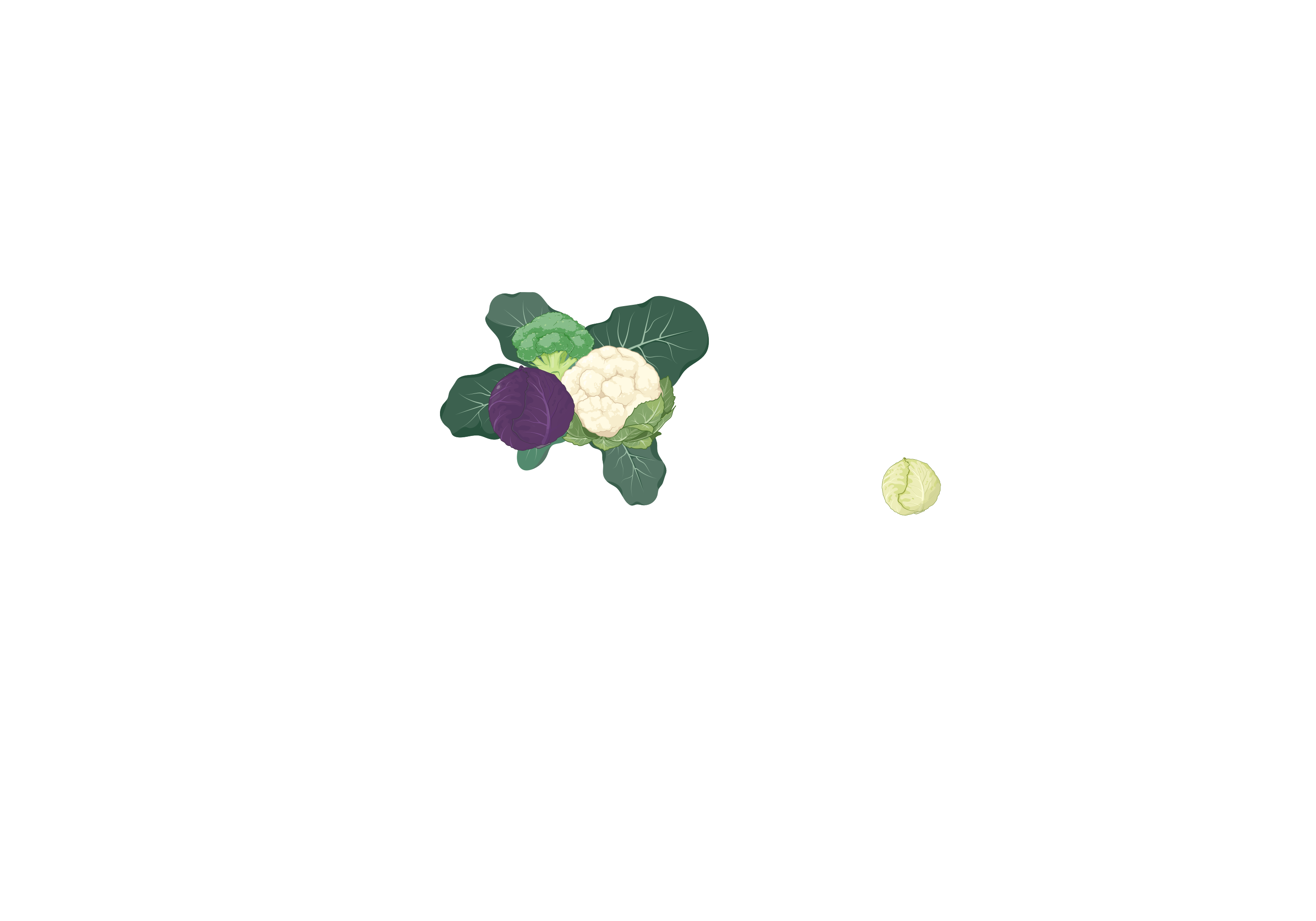
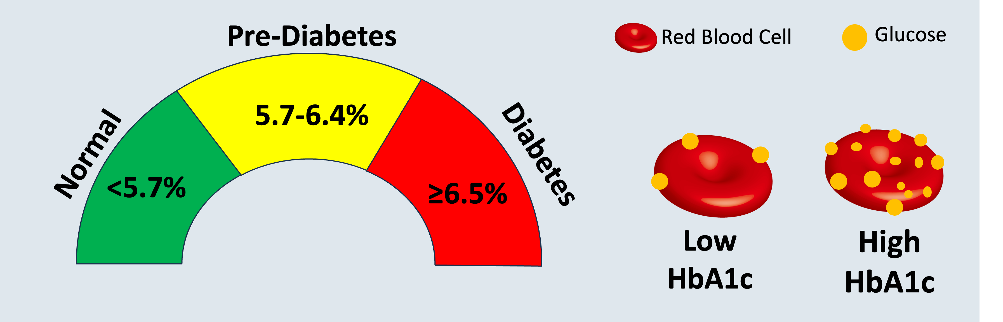
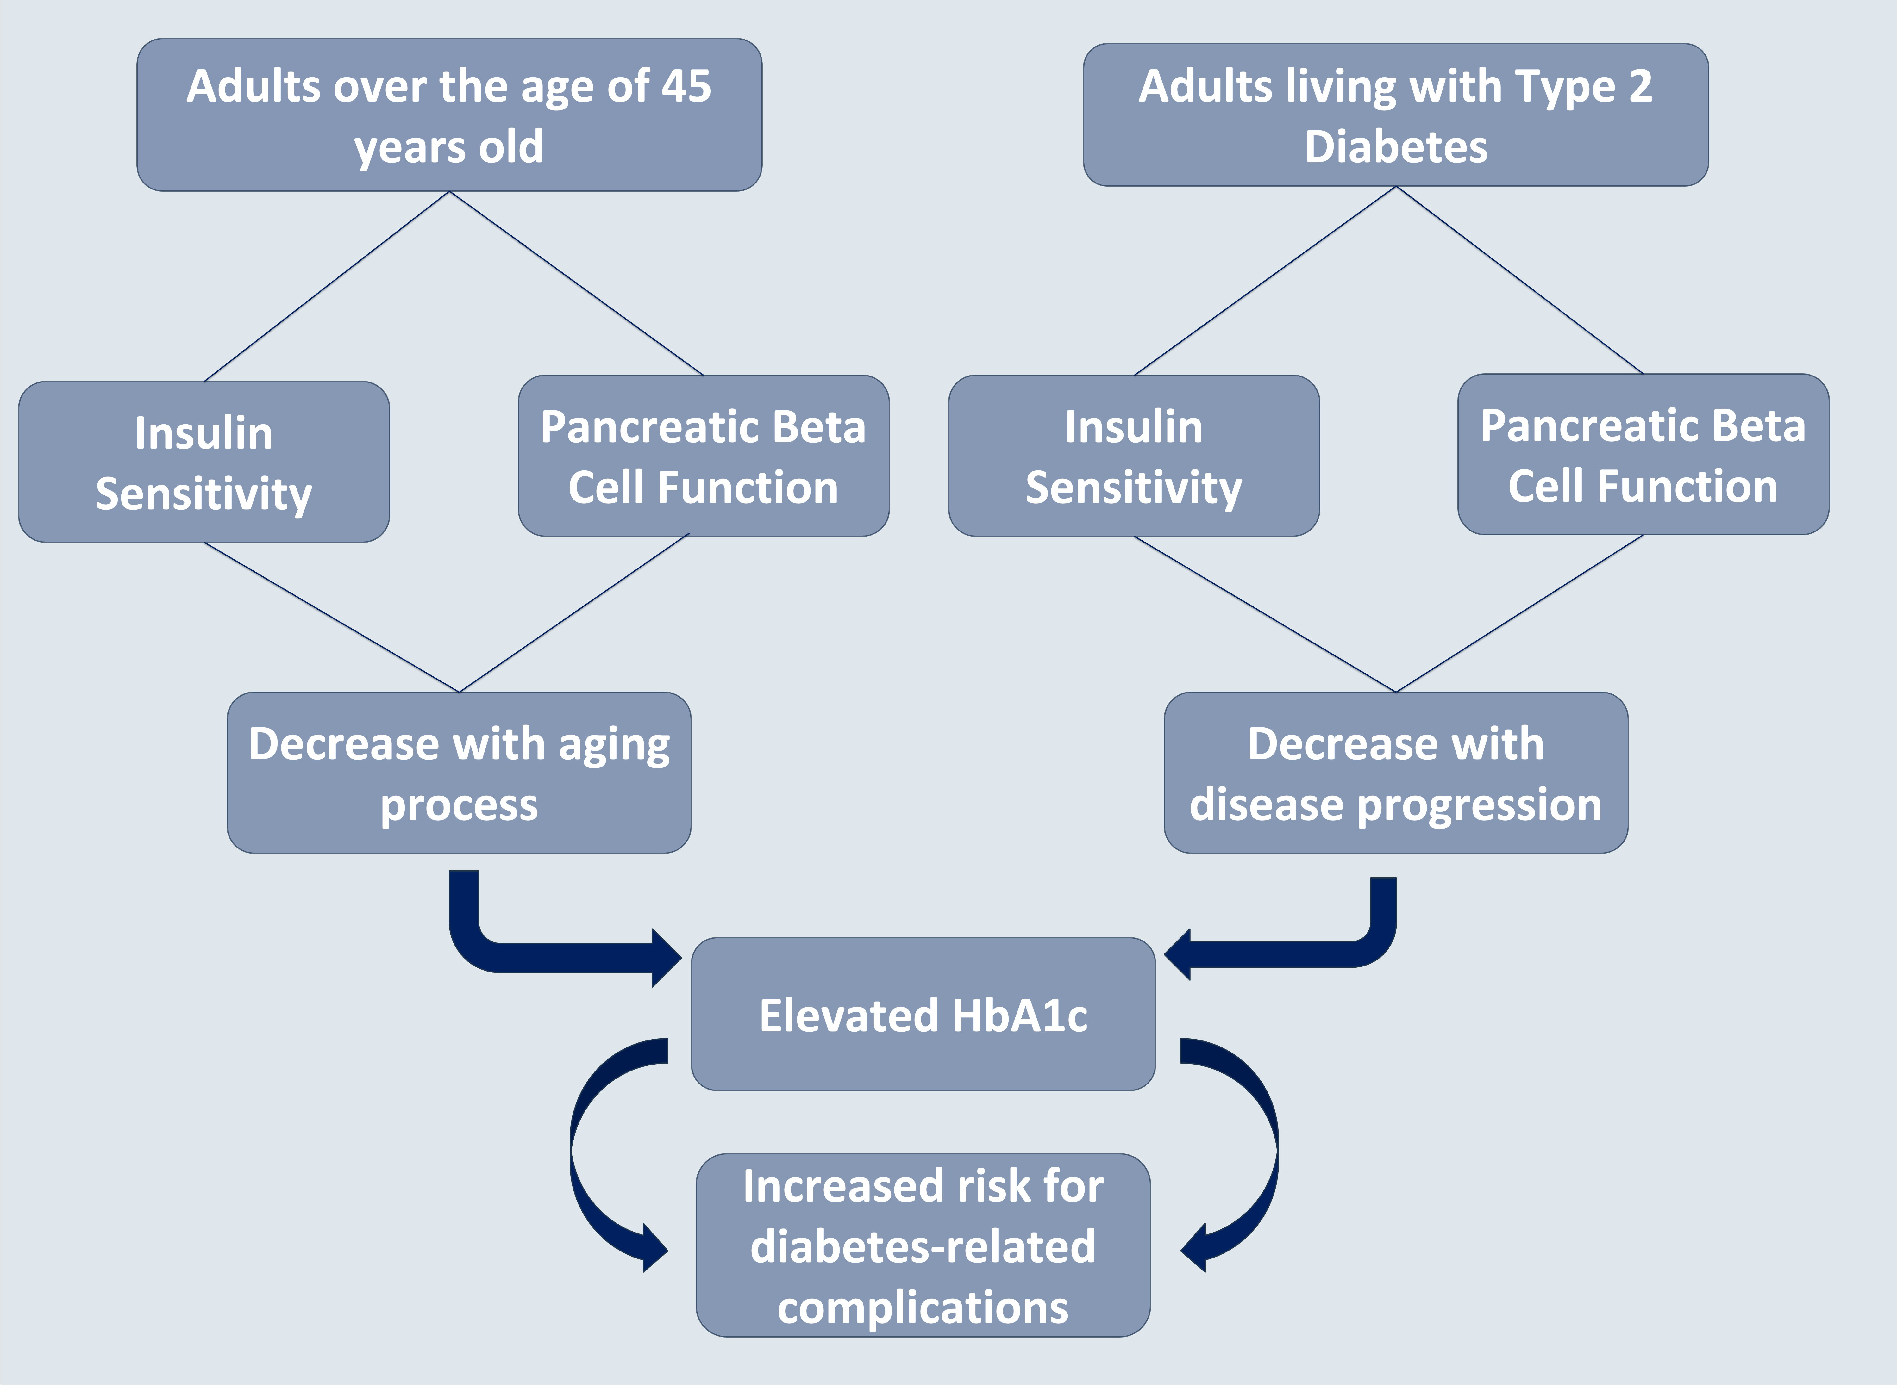
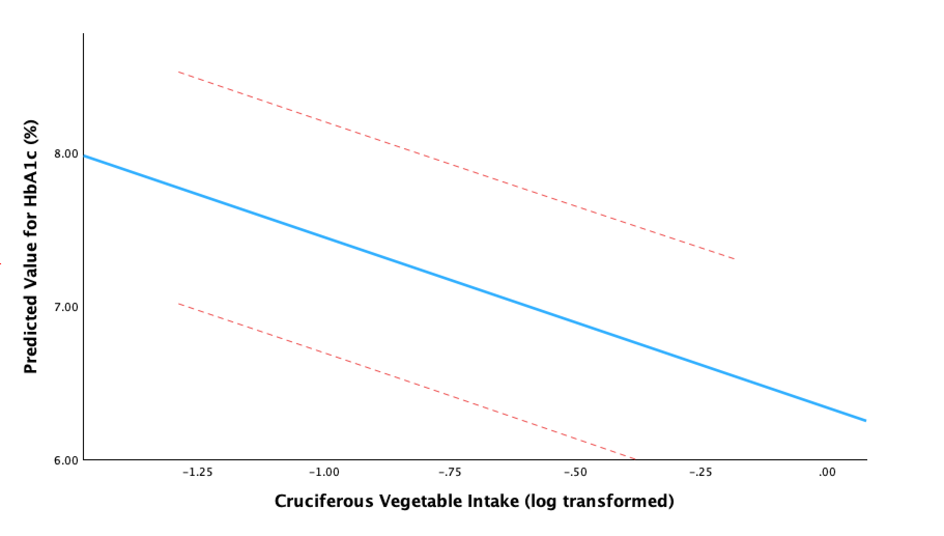

Association between Cruciferous Vegetable Intake and Glycosylated Hemoglobin Levels among United States Adults with Type 2 Diabetes Mellitus Using Data from NHANES 2017 – Pre-pandemic 2020
Alexandra Old, BS, Maria Carlota Dao, PhD, Sherman Bigornia, PhD
Department of Agriculture, Nutrition, and Food Systems, University of New Hampshire, Durham, NH, 03824
Presenting Author: Alexandra Old, Alexandra.old@unh.edu
Background
Methods
Conclusion
Diabetes mellitus (DM) affects 800 million people globally, with Type 2 DM (T2DM) constituting 95% of all diabetes cases.¹⁻³
T2DM increases risk for cardiovascular diseases (the global leading cause of death).⁴
Higher glycosylated hemoglobin (HbA1c) levels correlate with increased risk of T2DM related complications.⁵
Study Design:
Cross-sectional study design with data sourced from the 2017-2020 pre-pandemic National Health and Nutrition Examination Survey (NHANES).
Primary exposure:
Cruciferous vegetable intake measured from
24-hour recalls (cup equivalents per day).
Measurable outcome:
Glycosylated hemoglobin (HbA1c)
reported as a percentage.
Analysis:
SPSS used for analysis. Linear regression
models were run, adjusting for potential
confounding variables (age, gender, BMI,
hypertension status, alcohol consumption,
family history of DM, and
antihyperglycemic medication use).
Results Summary: There is a statistically significant, inverse association between cruciferous vegetable intake and glycohemoglobin (HbA1c) levels among people living with T2DM. If an individual doubles their CV intake (100% increase), HbA1c decreases by approximately 0.866 percentage points (p=0.008). This model was adjusted for age, BMI, whole vegetable consumption, antihyperglycemic medication, hypertension status, family history of DM, and alcohol consumption.
Key Takeaways: This relationship highlights the
need for further research investigating CVs as a
possible dietary intervention for glycemic control
among individuals living with T2DM.
Limitations:
Cross-sectional design: Unable to assess temporal associations between CV intake and HbA1c levels.
Population: NHANES does not stratify DM by type, therefore unable to say with certainty that dataset truly includes only participants who are living with T2DM.
Figure 1: Prevalence of diabetes mellitus¹⁻²
Figure 4: Inclusion/exclusion criteria
Results
Figure 2: Glycosylated hemoglobin & DM diagnostic criteria^{3,6}
Table 1. Population Characteristics
Variable | n | Value
Age (years) | 998 | 64.87 ± 9.65
Gender (% female) | 460 | 46.1
BMI (kg/m²) | 998 | 32.89 ± 7.55
Total diabetes mellitus (%) | 998 | 100
Glycosylated hemoglobin (%) | 998 | 7.43 ± 1.53
Diagnosed with DM by doctor (%) | 939 | 94.1
Taking Prescription Antihyperglycemic Medication (%) | 743 | 74.4
Family history of DM (%) | 764 | 76.6
Hypertension status (%) | 746 | 74.7
Whole vegetable consumption (cup equivalents) | 998 | 1.37 ± 0.43
Cruciferous Vegetable Intake (cup equivalents) | 998 | 0.111 ± 0.052
Alcohol consumption (grams) | 998 | 6.31±8.58
Table 2. Multiple Linear Regression Models with HbA1c Levels as Dependent Variable
Model* | β ± SD | p - value
Model 1 (Cruciferous vegetable intake) | -1.224 ± 0.324 | 0.001
Model 2 (M1 + age & BMI) | -0.945 ± 0.327 | 0.004
Model 3 (M2 + whole vegetable intake) | -0.870 ± 0.329 | 0.008
Model 4 (M3 + antihyperglycemic medication & hypertension status) | -0.826 ± 0.329 | 0.012
Model 5 (M4 + family history of DM) | -0.839 ± 0.328 | 0.011
Model 6 (M5 + alcohol intake) | -0.866 ± 0.326 | 0.008
Dietary modification is crucial for T2DM management due to its cardiometabolic nature.⁷
Cruciferous vegetables (CV) are of interest because they contain isothiocyanates (including sulphoraphane) that may improve insulin sensitivity.⁸⁻¹¹
Target Population: Adults ≥ 45 years old with type 2 diabetes mellitus
Association between CV intake and HbA1c levels
*Models using log transformed cruciferous vegetable intake
Figure 3: Adults ≥ 45 years old face increased risk for T2DM-related complications¹²
- - - -
Fit Line
Acknowledgements
References
Objective
CI 95%
I would like to thank Dr. Sherman Bigornia for providing academic guidance as well as the data to support this research. I would also like to thank Dr. Maria Carlota Dao for her instruction and support through this project, and the NHANES participants for providing this invaluable data.
To investigate the association between cruciferous vegetable intake and glycosylated hemoglobin levels among U.S. adults aged 45 years and older living with T2DM.
Predicted Value for HbA1c Levels (%)
Hypothesis
Hypothesis: Among U.S. adults who are 45 years of age or older living with type 2 diabetes mellitus, HbA1c levels decrease as cruciferous vegetable intake increases, suggesting an inverse relationship between CV intake and HbA1c levels.
Log Transformed Cruciferous Vegetable Intake (cup equivalents)
Figure 5: Multiple linear regression model 6 adjusted for age, BMI, whole vegetable consumption, antihyperglycemic medication, hypertension status, family history of DM, and alcohol intake
Scan for References

