Slide 1
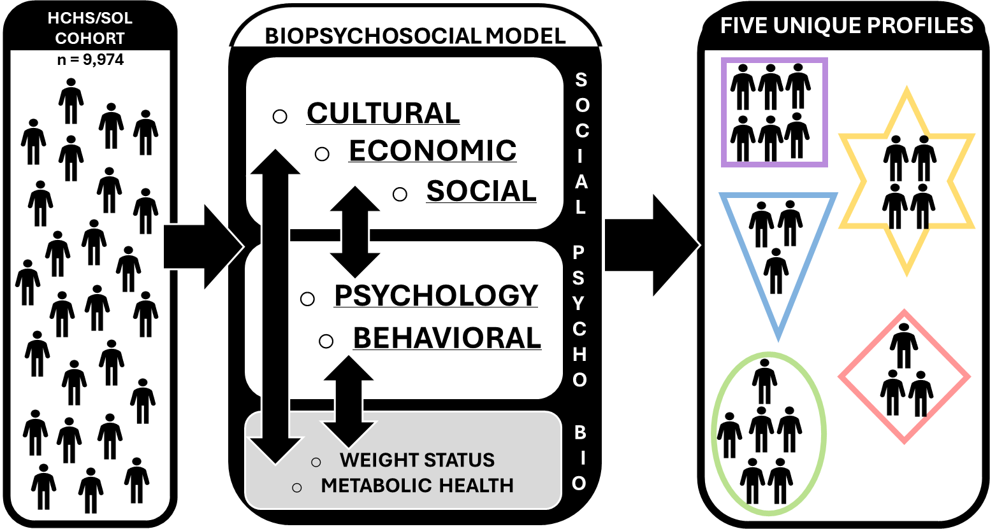
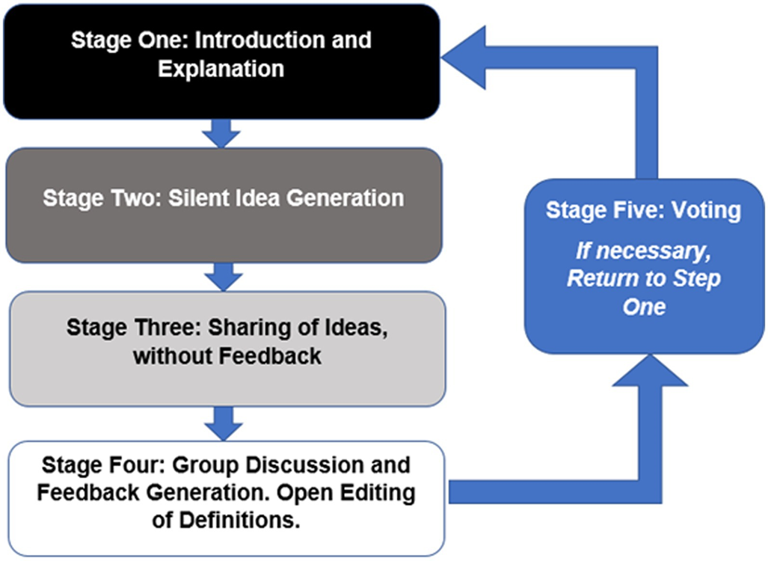
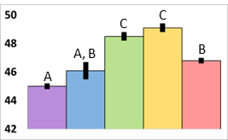
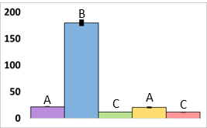
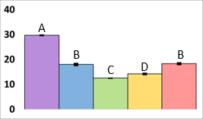
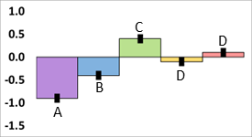
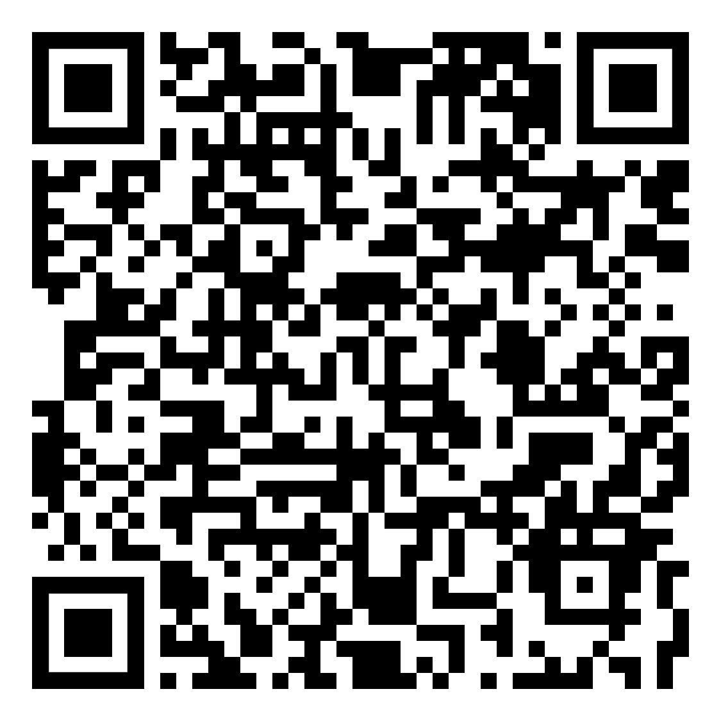
Using Cluster Analysis to Identify Typologies Relevant to Weight Management in the Hispanic Community Health Study/Study of Latinos
Nicholas Clarke, BS, Maria Carlota Dao, PhD, Kenny Mendoza, PhD
Department of Agriculture, Nutrition, and Food Systems, University of New Hampshire, Durham, NH, 03824
Abstract
Hispanic/Latino adults in the United States experience disproportionately high rates of obesity (46%) and related chronic diseases.¹ This study applied cluster analysis to data from the Hispanic Community Health Study/Study of Latinos (HCHS/SOL) (n=9,974) to identify distinct subgroups based on behavioral, psychological, socioeconomic, and cultural factors. Five clusters with unique characteristics were identified. Typology definitions will be developed using stakeholder input via virtual nominal group technique. This research aims to inform more effective, culturally-tailored weight management interventions.
Methods
Study Design: Sequential explanatory mixed-methods approach Secondary analysis of HCHS/SOL cohort data using k-means cluster analysis Virtual nominal group technique (vNGT) with key informants Study Population: 9,974 Hispanic/Latino adults from four U.S. communities (Bronx, NY; Chicago; IL; Miami, FL; San Diego, CA) Exclusion criteria: underweight BMI, diabetes treatment, prevalent cardiovascular disease, cancer, missing variables of interest Data Analysis:
Conclusion
There was concerning prevalence of obesity & cardiovascular disease risk factors present in all clusters and poor diet quality throughout our sample; representative of the US H/L population. The wide variation in non-biological variables between clusters illustrates the complex interplay of behavioral, psychological, socioeconomic, and cultural factors affecting weight management in Hispanic/Latino adults. The identified typologies provide a foundation for developing more targeted and culturally appropriate interventions.
Study Objective
Group Hispanic/Latino adults by non-biological characteristics to derive behavioral profiles for targeted weight management interventions
CLUSTER
ANALYSIS
Next Steps
Define profiles based on their most striking characteristics using a vNGT with relevant stakeholders Identify preferences for fiber rich foods between clusters to inform tailored interventions Compare fecal gut microbiome signatures between clusters and examine how unique the cluster characteristics influence microbiome composition
Background
Current behavioral interventions for weight management show limited effectiveness in U.S. Hispanic/Latino populations.²⁻⁴ Few programs address the unique needs and constraints of Hispanic/Latino communities.⁴ Understanding the interrelation of behavioral, psychological, cultural, and socioeconomic factors is critical for tailored weight management interventions.
Figure 1. Infographic of Clustering Methodology
Results
Table 1. Clinical Characteristics of Clusters
Variable | Cluster 1 (28.5%) | Cluster 2 (6.1%) | Cluster 3 (36.8%) | Cluster 4 (13.5%) | Cluster 5 (15.0%)
BMI (kg/m²)* | 29.4 ± 0.2 ^{A} | 28.6 ± 0.5 ^{A, B} | 28.6 ± 0.1 ^{B} | 28.3 ± 0.2 ^{B} | 29.6 ± 0.2 ^{A}
Waist circumference (cm)* | 96.8 ± 0.5 ^{A, C} | 94.9 ± 1.3 ^{A, B, C} | 95.2 ± 0.3 ^{B} | 95.3 ± 0.5 ^{A, B} | 97.3 ± 0.5 ^{C}
Metabolic syndrome (%)** | 25 | 15 | 33 | 24 | 32
Hypertension (%)** | 12 | 5 | 18 | 10 | 17
Dyslipidemia (%)** | 33 | 28 | 40 | 41 | 33
*Mean ± SE shown. ANOVA: Different letters denote statistically significant differences.
**Statistically significant differences in strata proportion across clusters (χ2 or Fisher's exact test).
Theoretical Framework
Variables (n=17) were chosen in accordance with the ADOPT Core Measures Project and biopsychosocial model.^{5,6} Emphasizes investigating the interrelation of multiple factors: Behavioral (diet, physical activity, sleep) Psychological (anxiety, depression) Cultural (acculturation, food preferences) Socioeconomic (education, years in U.S.)
Diet Quality (aHEI) | Recreational Physical Activity (min/d) | Years Lived in the US | Preference for Hispanic Foods Score
Figure 3. Virtual Nominal Group Technique Session Flow
Figure 2. Select Non-Biological Variables By Cluster
References
Bryan, S. et al. (2021); doi:10.15620/cdc:106273. McCurley et al (2017); PMID: 27989451 Perez, L. G. et al. (2013); PMID: 23597822 Lindberg, N. M. et al. (2013); PMID: 23533725 MacLean, P. S. et al. (2018); PMID: 295755780 Gask, L. (2018); PMID: 29685
Table 5. Nutrient Intake According to Cluster
 | Cluster 1 |  | Cluster 2 |  | Cluster 3 |  | Cluster 4 |  | Cluster 5
Nutrient | Mean | SE | Mean | SE | Mean | SE | Mean | SE | Mean | SE
Fiber (g/d) | 16.5 | 0.2 | 18.3 | 0.4 | 18.2 | 0.1 | 20.9 | 0.2 | 16.4 | 0.2
Total saturated fat (g/d) | 24.2 | 0.2 | 27 | 0.5 | 22 | 0.2 | 26.8 | 0.2 | 20.7 | 0.2
Total trans-fatty acids (g/d) | 3.1 | 0.1 | 3.5 | 0.1 | 2.5 | 0.1 | 3.3 | 0.1 | 2.4 | 0.1
aHEI Score* | 45 | 0.2 | 46.1 | 0.6 | 48.5 | 0.3 | 49.1 | 0.3 | 46.8 | 0.2
Means pertaining to continuous variables across clusters were compared using ANOVA tests (p<0.05). Between group significance not denoted. *aHEI Score of <51 are classified as a “poor” diet

