Slide 1

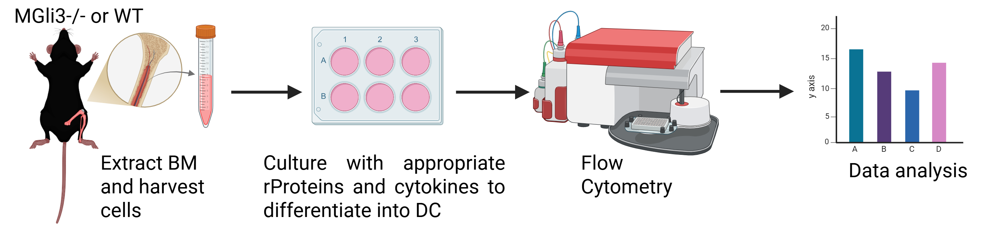
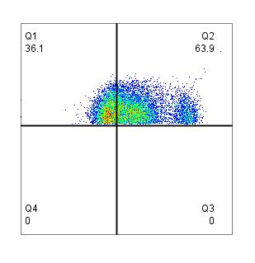
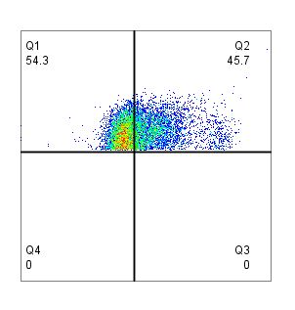
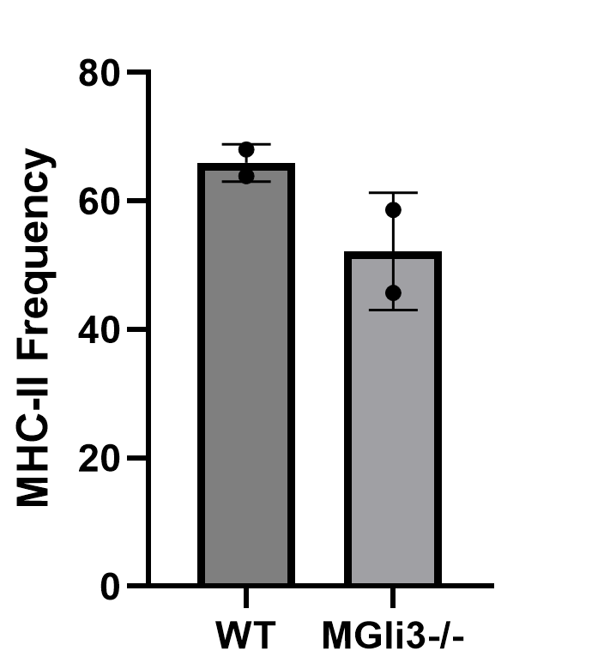
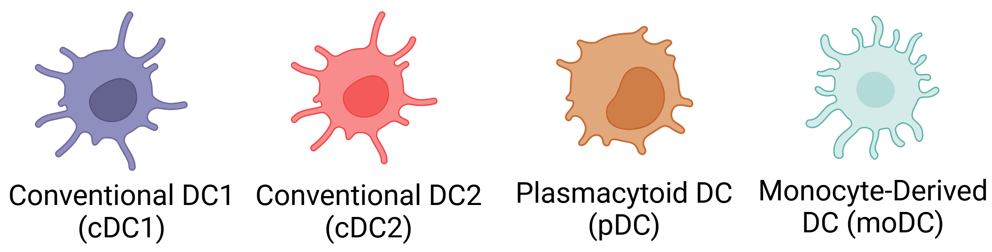
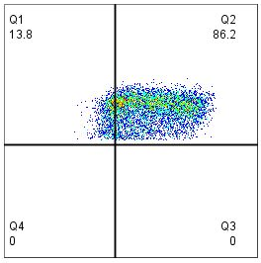
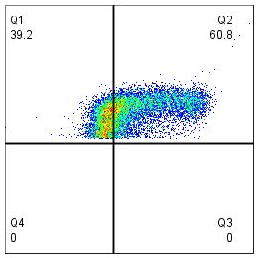
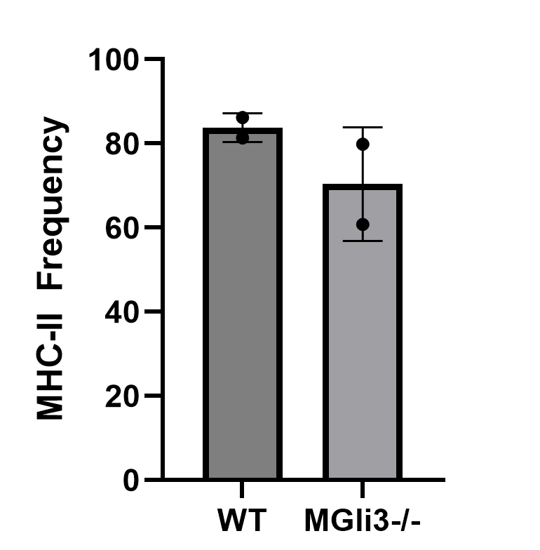
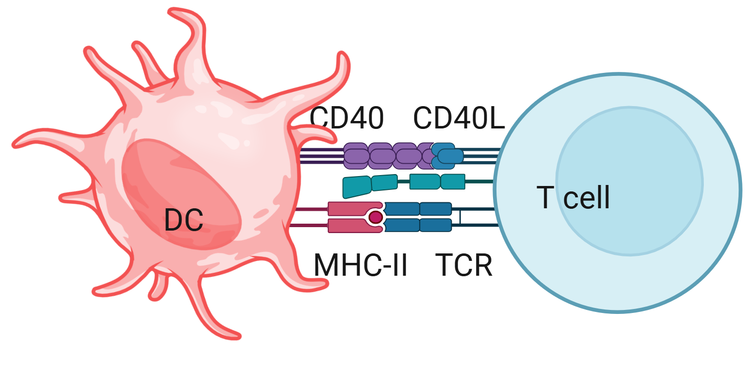


Gli3 Regulates MHC II Expression in Dendritic Cell Subsets
Chukwuebuka Nkwocha and Sherine F. Elsawa
Department of Molecular, Cellular, and Biomedical Sciences, University of New Hampshire, Durham, NH 03824
Abstract
Methods
Discussion
Dendritic cells (DCs) are professional antigen-presenting cells that link innate and adaptive immune responses. The transcription factor Gli3, a component of the Hedgehog signaling pathway, is known to regulate tissue homeostasis and cellular differentiation. However, its role in dendritic cell function remains poorly understood.
In this study, we utilized Gli3 conditional knockout mice to explore the impact of Gli3 deletion on the expression of major histocompatibility complex class II (MHC II) molecules in DC subsets. Flow cytometric analysis showed that the frequency of MHC II was 20% lower in conventional DC2 (cDC2) and monocyte-derived DCs (moDCs) derived from Gli3-deficient mice compared to wild-type controls. These findings suggest a potential role for Gli3 in regulating the antigen-presenting capacity of specific dendritic cell subsets and set the stage for further exploration into Gli3's role in immunoregulatory mechanisms.
Mice: Gli3^{fl/fl} mice were crossed with LysM-Cre transgenic mice to generate myeloid-specific Gli3 knockout mice. Wild-type (WT) littermates were used as controls.
DC Generation: Bone marrow (BM) cells were isolated and differentiated into DCs. For moDCs differentiation, BM cells were cultured in RPMI media supplemented with 20 ng/mL GM-CSF for a period of 8 days, with media replenishment every 3 days. cDC2 was generated by culturing BM cells in RPMI media supplemented with 200ng/mL Flt3L, 10ng/mL LIF, and 100ng/mL IL-10.
Flow Cytometry: Cells were stained with antibodies against CD11c and MHC II (for moDCs), and CD172α and MHC II (cDC2). MHC II expression was quantified using mean fluorescence intensity (MFI).
Data Analysis: Flow cytometry data were analyzed using FlowJo and results generated was graphed using Graphpad Prism.
These findings suggest that Gli3 plays a role in regulating the expression of MHC II molecules in moDCs and cDC2.
The observed reduction, while modest, may have functional consequences for antigen presentation and T cell activation, particularly CD4⁺ T cell.
Given that Gli3 is known to repress gene expression in the absence of Hedgehog signals, its deletion might result in dysregulation of genes critical for MHC II transcription, stability, or surface expression.
Future studies will investigate the molecular basis of this regulation, including promoter analysis and transcriptional profiling.
Conclusion
Gli3 deletion in myeloid cells caused a decrease in MHC class II expression in cDC2 and moDCs.
These results show a possible immunoregulatory role for Gli3 in dendritic cells and open new avenues for understanding transcriptional control of antigen presentation.
Understanding how Gli3 modulates DC function could provide insights into immune responses in infection, cancer, and autoimmune diseases.
Fig. 3. Experimental Approach: Mice were euthanized, and tibias and femurs were extracted. BM cells were differentiated into moDCs and cDC2. The cells were harvested and MHC II expression was analyzed by flow cytometry. Data generated was analyzed in Flowjo.
Background
DCs present antigens to T cells through MHC II (1), and the surface expression of MHC II correlates to DC’s capacity to activate T cells (2).
Gli3 impacts some activities of antigen presenting cells (APCs), including polarization and TLR signaling in macrophages (3, 4).
However, the role of Gli3 in various DC subsets, which are the most efficient APCs remains unclear.
Results
WT
M-Gli3^{-/-}
References
Guermonprez, P., Valladeau, J., Zitvogel, L., Théry, C., & Amigorena, S. (2002). Antigen presentation and T cell stimulation by dendritic cells. Annual review of immunology, 20, 621–667.
Meyer zum Bueschenfelde, C. O., Unternaehrer, J., Mellman, I., & Bottomly, K. (2004). Regulated recruitment of MHC class II and costimulatory molecules to lipid rafts in dendritic cells. Journal of immunology, 173(10), 6119–6124.
Matissek, S. J., Karbalivand, M., Han, W., Boutilier, A., Yzar-Garcia, E., Kehoe, L. L., Gardner, D. S., Hage, A., Fleck, K., Jeffers, V., Rajsbaum, R., & Elsawa, S. F. (2022). A novel mechanism of regulation of the oncogenic transcription factor GLI3 by toll-like receptor signaling. Oncotarget, 13, 944–959.
Boutilier, A. J., Raad, M., Paar, K. E., Matissek, S. J., Banks, C. E., Carl, A. L., Murray, J. M., Metzler, A. D., Koeppen, K. U., Gupta, M., & Elsawa, S. F. (2024). GLI3 Is Required for M2 Macrophage Polarization and M2-Mediated Waldenström Macroglobulinemia Growth and Survival. International journal of molecular sciences, 25(23), 13120.
Cd11c
DC Subsets
MHC-II
Fig. 4. MHC-II Expression by moDCs: ~20% decrease in MHC-II expression in M-Gli3^{-/-} compared to the WT. Gating was done on viable Cd11c⁺ cells.
Fig. 1. The four major DC subsets in mice and humans
WT
M-Gli3^{-/-}
Fig. 2. DC presents antigens to T cell through MHC II: Antigen presentation is the first signal required for T cell-mediated adaptive immune response.
Cd172α
MHC-II
Acknowledgements
Fig. 5. MHC-II Expression by cDC2: ~20% decrease in MHC-II expression in M-Gli3-/- compared to the WT. Gating was done on viable Cd172α⁺ cells.

