Slide 1
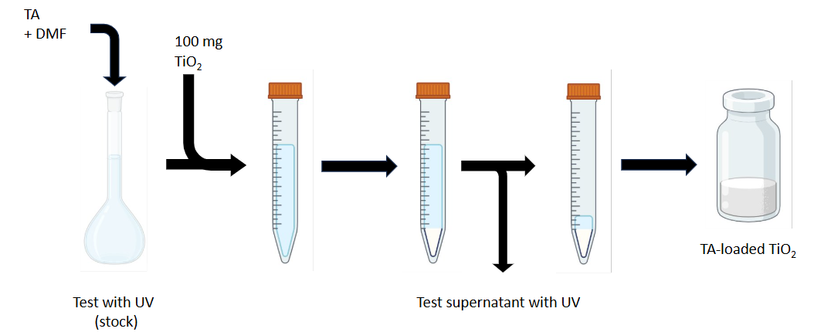
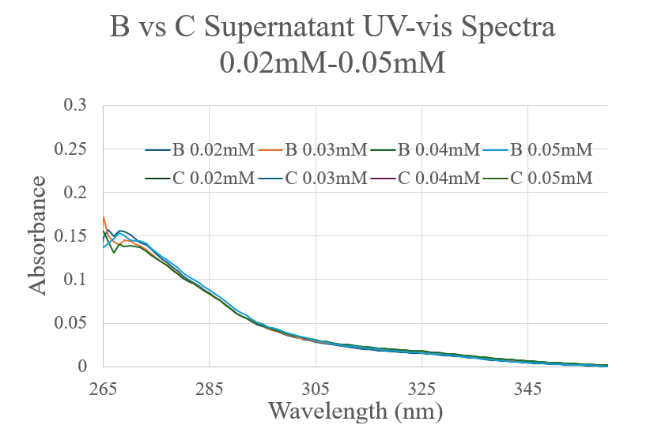
Surface Functionalization of Titanium Dioxide Nanoparticles For Enhanced Interaction with a Guest-Functionalized Catalyst Tim Murphy, Charles Wilson, Dylan Stolba, Christine A. Caputo* Department of Chemistry, University of New Hampshire, Durham, NH 03824
Introduction
General TiO₂ Loading Procedure
Discussion
In the fight against climate change, many energy alternatives have been explored to reduce carbon emissions and continue to produce the energy we need to thrive. Solar photocatalysis is one such avenue, primarily in the production of clean fuels like hydrogen, which can be burned whilst avoiding carbon dioxide generation. One method to generate H₂ exploits electron transfer from a light-absorbing photosensitizer to a proton reducing transition-metal complex.
In the Caputo Group, Titanium Dioxide (TiO₂), a semi-conducting nanoparticle, is the chosen photosensitizer for surface functionalization. Previously, a macrocyclic carboxylic acid-functionalized pillar[5]arene (CAP[5]) has been loaded onto TiO₂ to test host-guest self assembly with a guest-functionalized cobaloxime hydrogen generation catalyst. CAP[5] is formed through a multi-step synthetic route, which raised the question of whether the anchoring of commercially available, non-macrocyclic compounds might lead to similar non-covalent interactions, and ultimately result in a similar catalytic activity.
Research Question:
Will surface functionalization with terephthalic acid promote non-covalent interactions with bipyridinium-functionalized cobaloxime catalysts?
Samples B and C are both capable of photocatalytic H₂ generation via guest-functionalized catalyst.
Sample C gave a higher loading Sample B, on average, however it produced lower H₂ generation, implying that terephthalate may have a lower maximum loading amount that is viable for photocatalysis
Photocatalytic results showed similar H₂ generation for all 4 samples at the loading levels obtained. More concentrated loading solutions are needed to increase the loading since this is most likely due to the catalyst simply being reduced by bare TiO₂ (likely that the loaded compounds were present at levels below monolayer coverage).
Terephthalic Acid
Decant
Dry
Stir for 24hr
Centrifuge at 10,000rpm for 1 hour
WP-Pillar[5]arene
General procedure for TiO₂ loading
Terephthalic Acid (B) Loading vs Terephthalate (C) Loading
Future Work
Determine the optimal loading concentrations for B and C on TiO₂ needed to achieve monolayer coverage on the surface.
Test the dependence of the photocatalytic hydrogen generation on the loading of A, B, and C.
Test the dependence of the hydrogen generation on the concentration of catalyst used.
Test photocatalytic stability by pushing the system longer than 4 hours.
Attempt generation of other products using different guest-functionalized catalysts
Sample | Loading using 0.25mM solution (nmol/mg TiO₂)
A | 24.5
B | 20.7±5.56
C | 19.6±0.857
Hypothesis
Commercially available terephthalic acid can promote non-covalent π-π stacking and electrostatic interactions with bipyridinium cobaloxime. A similar TiO₂ surface loading and hydrogen generation is possible when compared to threading with CAP[5].
Acknowledgements
Photocatalytic H₂ Generation from A, B, C, and D at 0.25mM
Thank you so much to everyone who has supported me on my research journey the past 2 years! Many thanks to Dr. Caputo and the entire Caputo Group for their constant support and advice. As always, special thanks to my friends and family!
Sample | TON_{4h} (mol H₂/mol Co) | TOF
A | 3±0.074 | 0.75
B | 3±0.166 | 0.75
C | 2±0.098 | 0.5
D | 4±0.114 | 1
References
Stolba, Dylan. “Assembly of a Supramolecular Host Guest System for the Production of Solar Fuels”. MS Thesis, University of New Hampshire, Durham NH, May 2024
Zhao, Peiyuan. “Non-Covalent Anchoring Strategies for Hybrid Electrocatalytic Systems”. PhD Dissertation, University of New Hampshire, Durham NH, September 2023
Ogoshi, Tomoki, Masayoshi Hashizume, Tada-aki Yamagishi, and Yoshiaki Nakamoto. “Synthesis, Conformational and Host Guest Properties of Water-Soluble Pillar[5]Arene.” Chemical Commun. 2010, 46, 3708.
Photocatalysis Conditions:
SRI 8610C Gas Chromatograph, Mol. Sieve Column
Argon Carrier Gas with TCD Detector Stirred under UV radiation ≥300nm AM 1.5G
All solutions prepared with 1 mg surface functionalized
TiO₂ in 4 mL of 10% v/v H₂O:TEOA.
Catalyst concentration was 0.2 µM in 4 mL solution
Experiments were run in triplicate. Average and std dev values presented.
A – CAP[5] B – Terephthalic Acid C – Terephthalate D – Blank TiO₂

