Slide 1






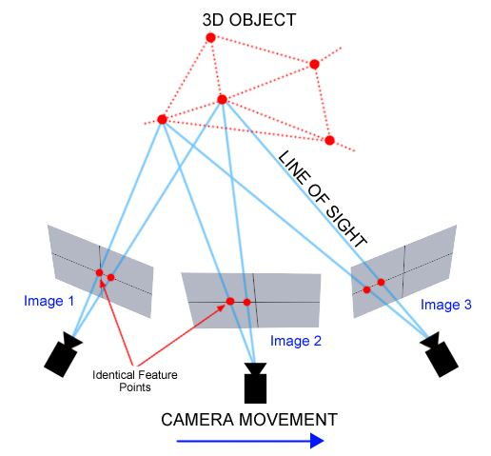
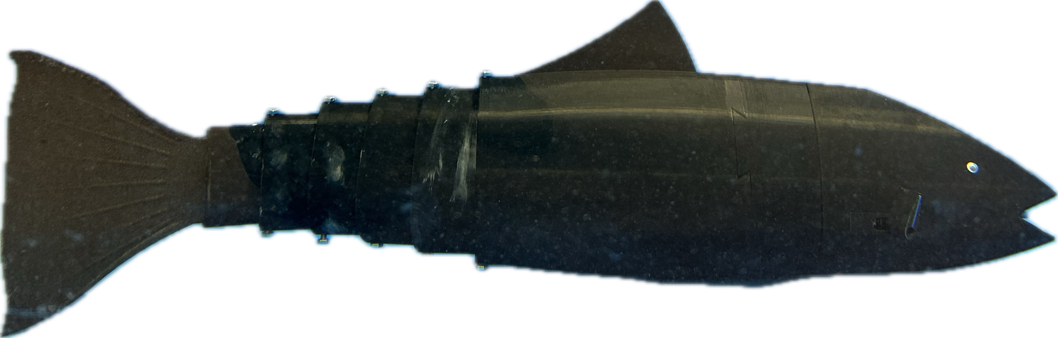
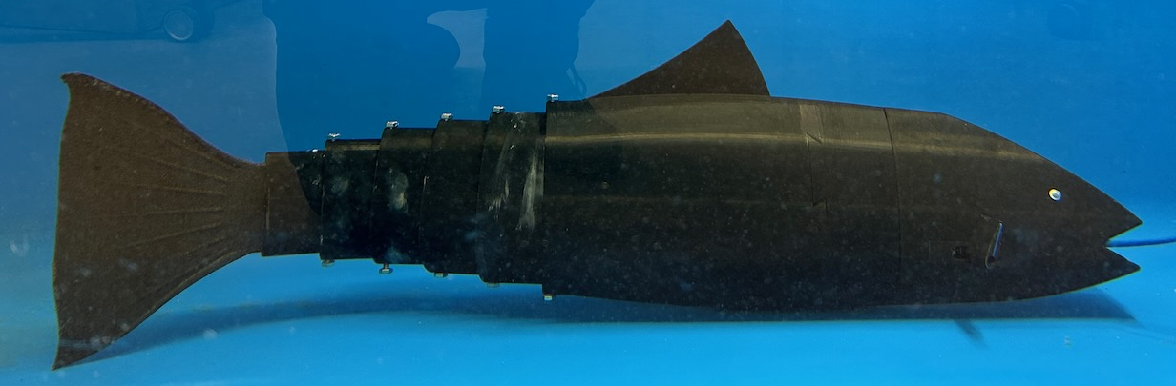
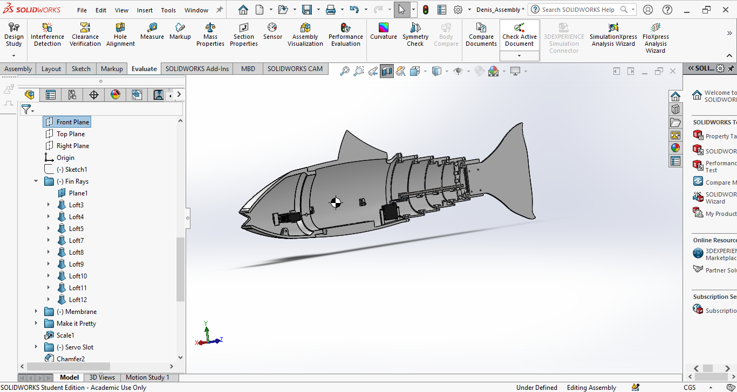
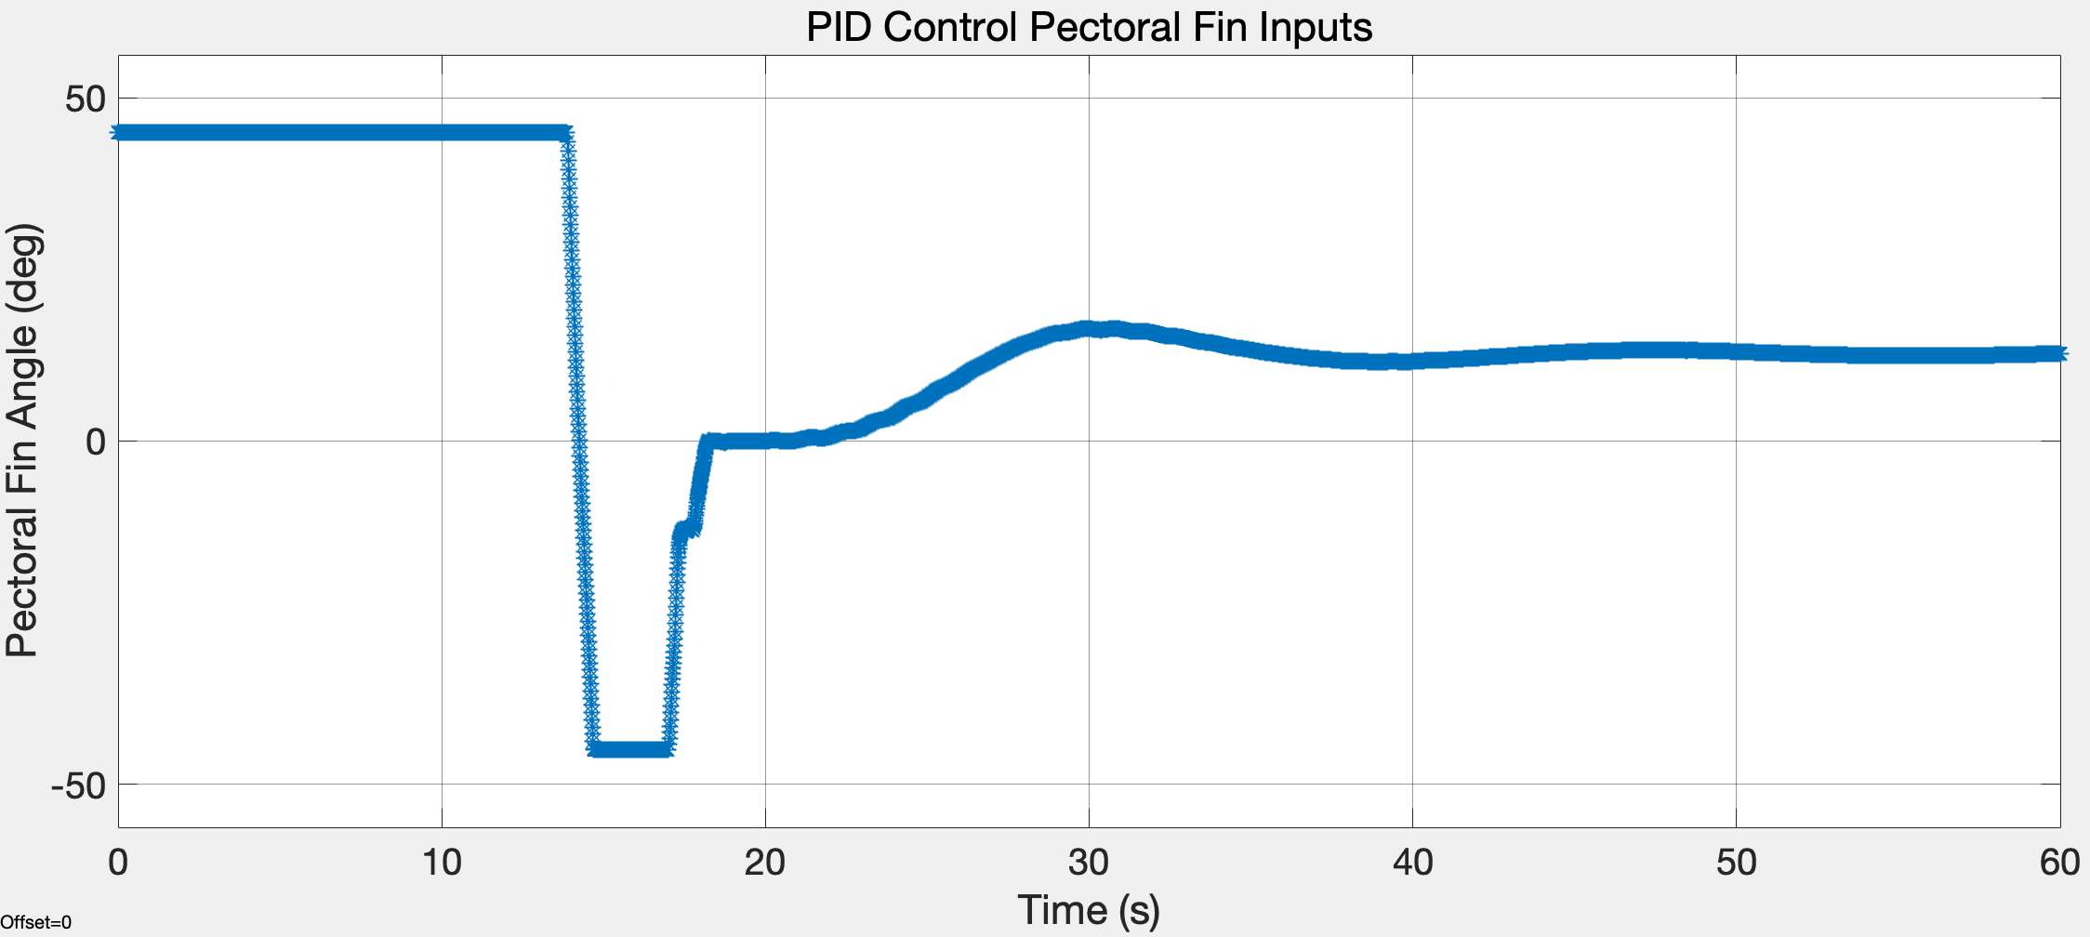
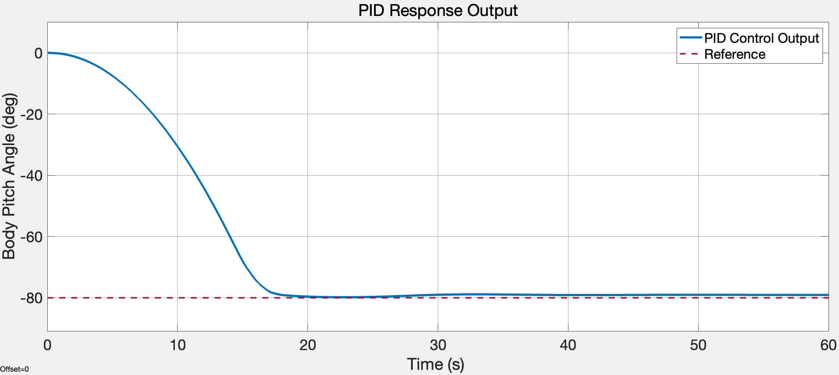
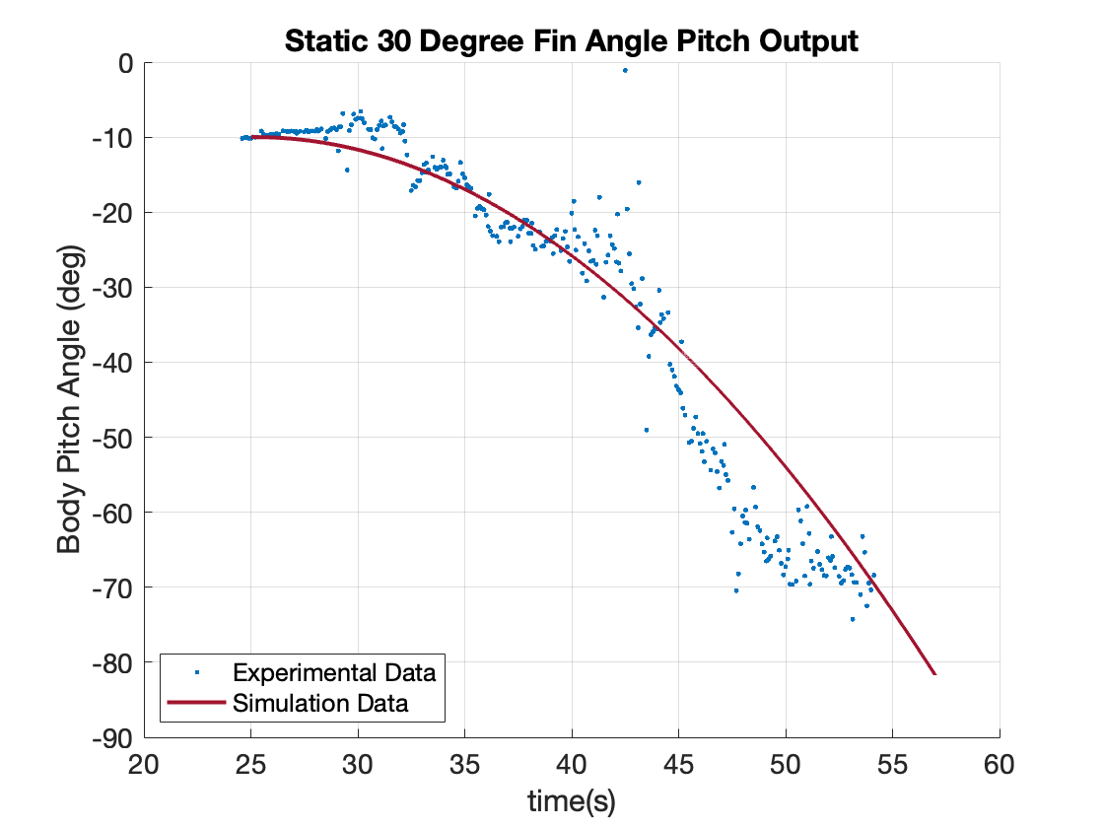
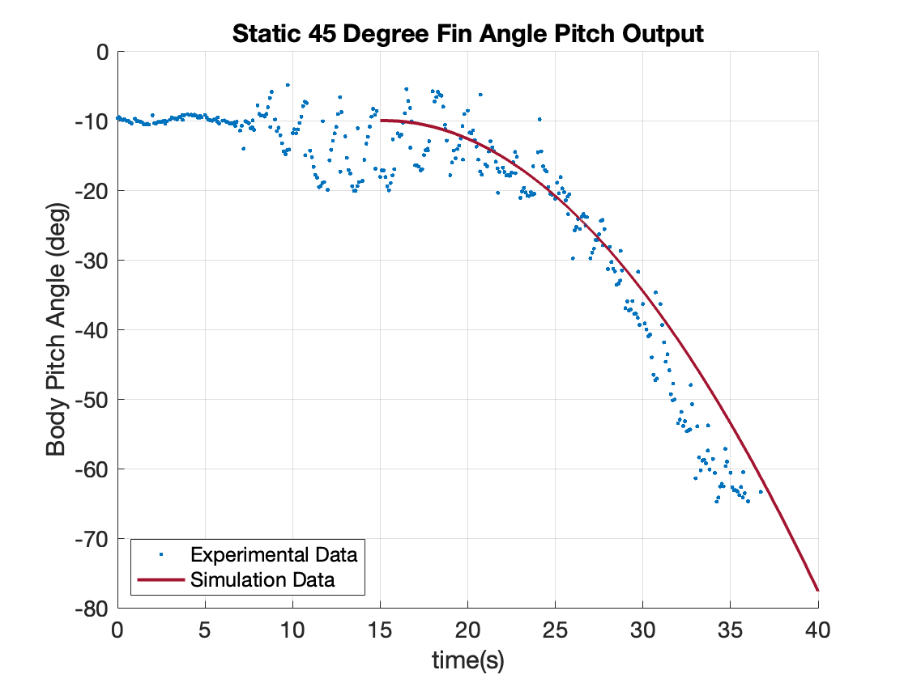
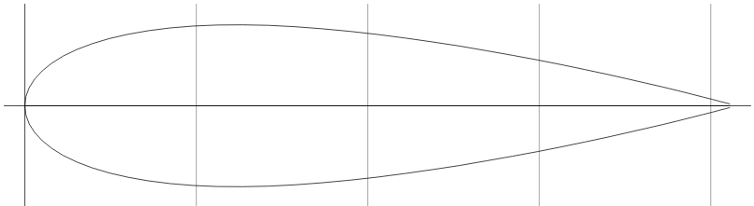
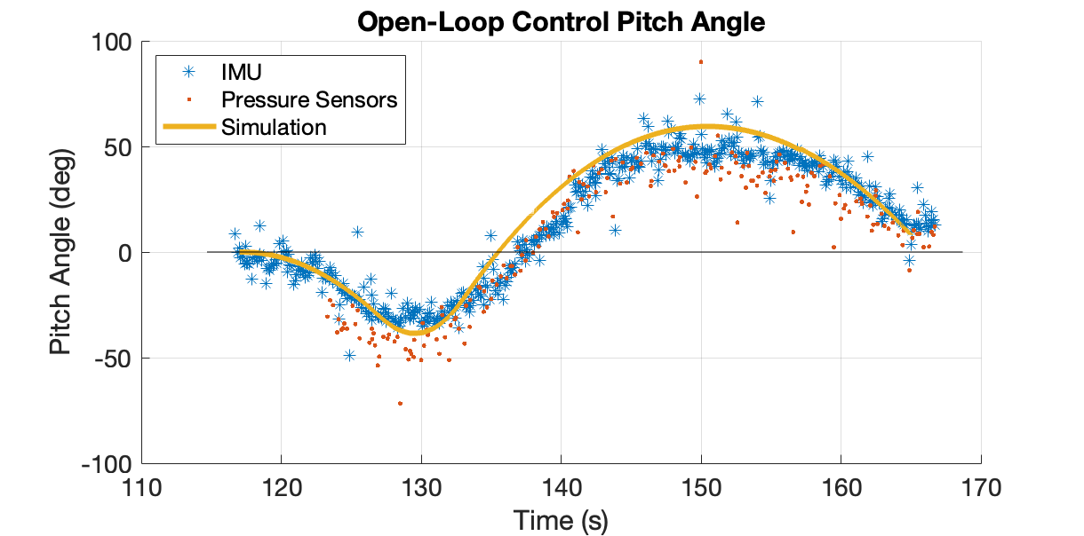
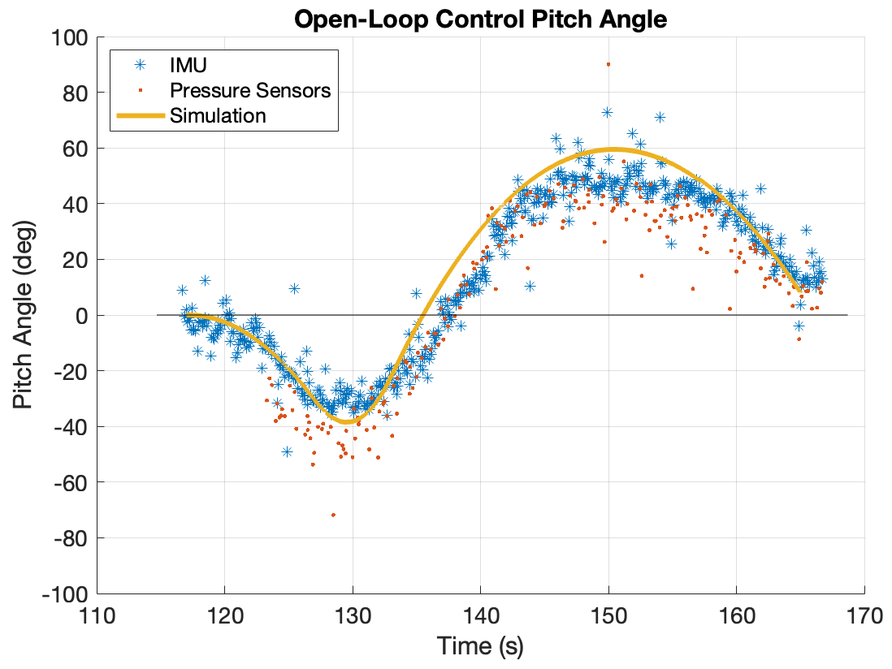
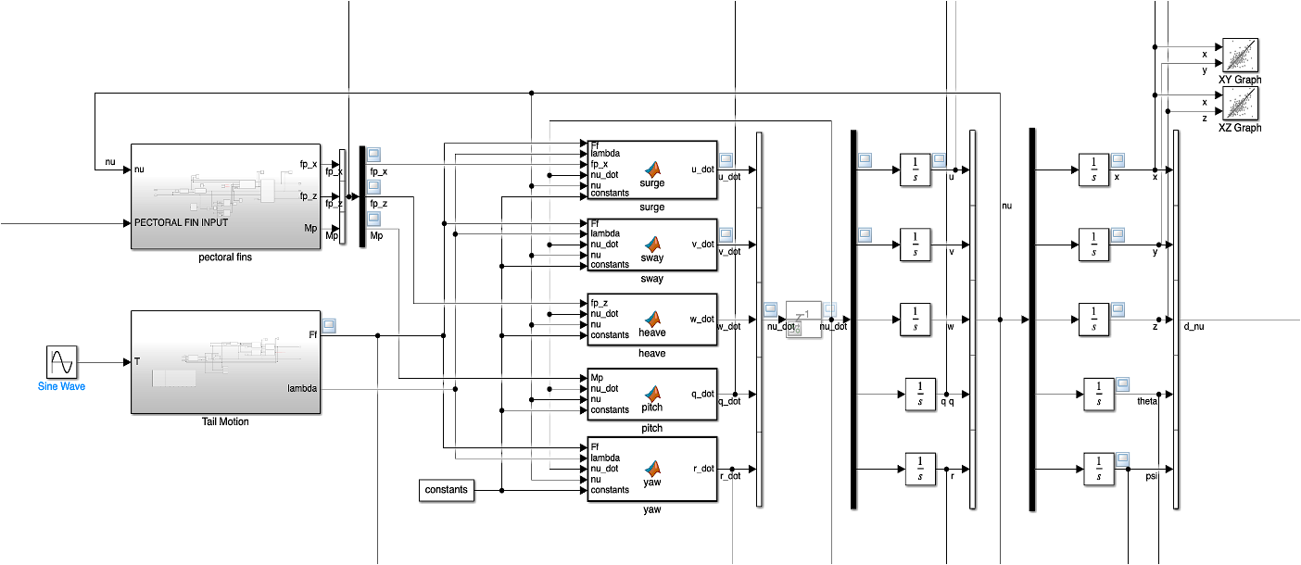
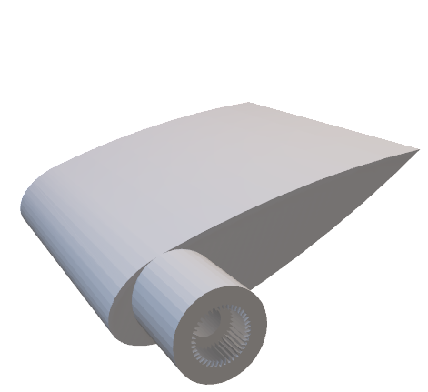

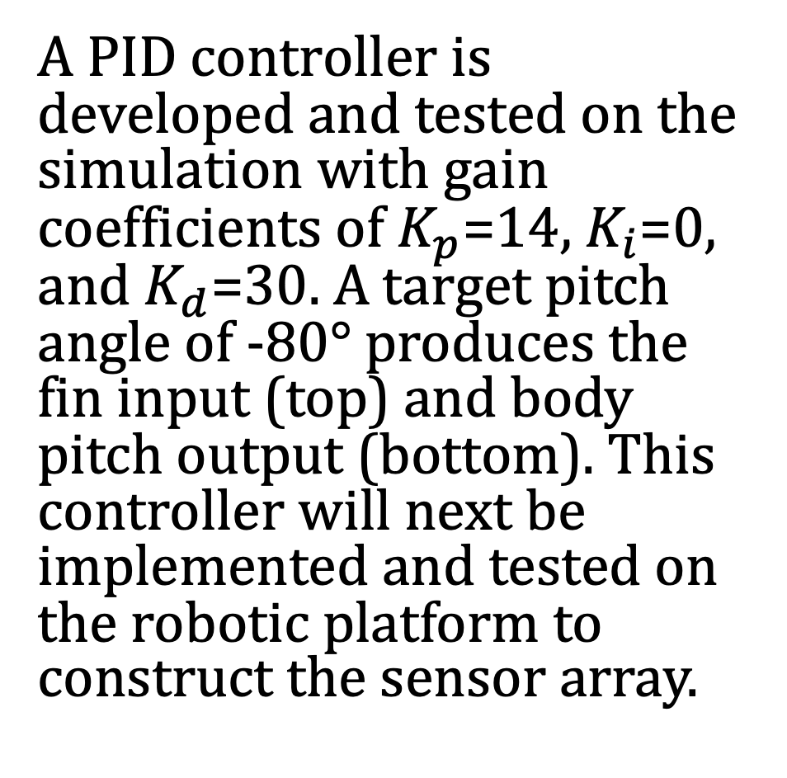





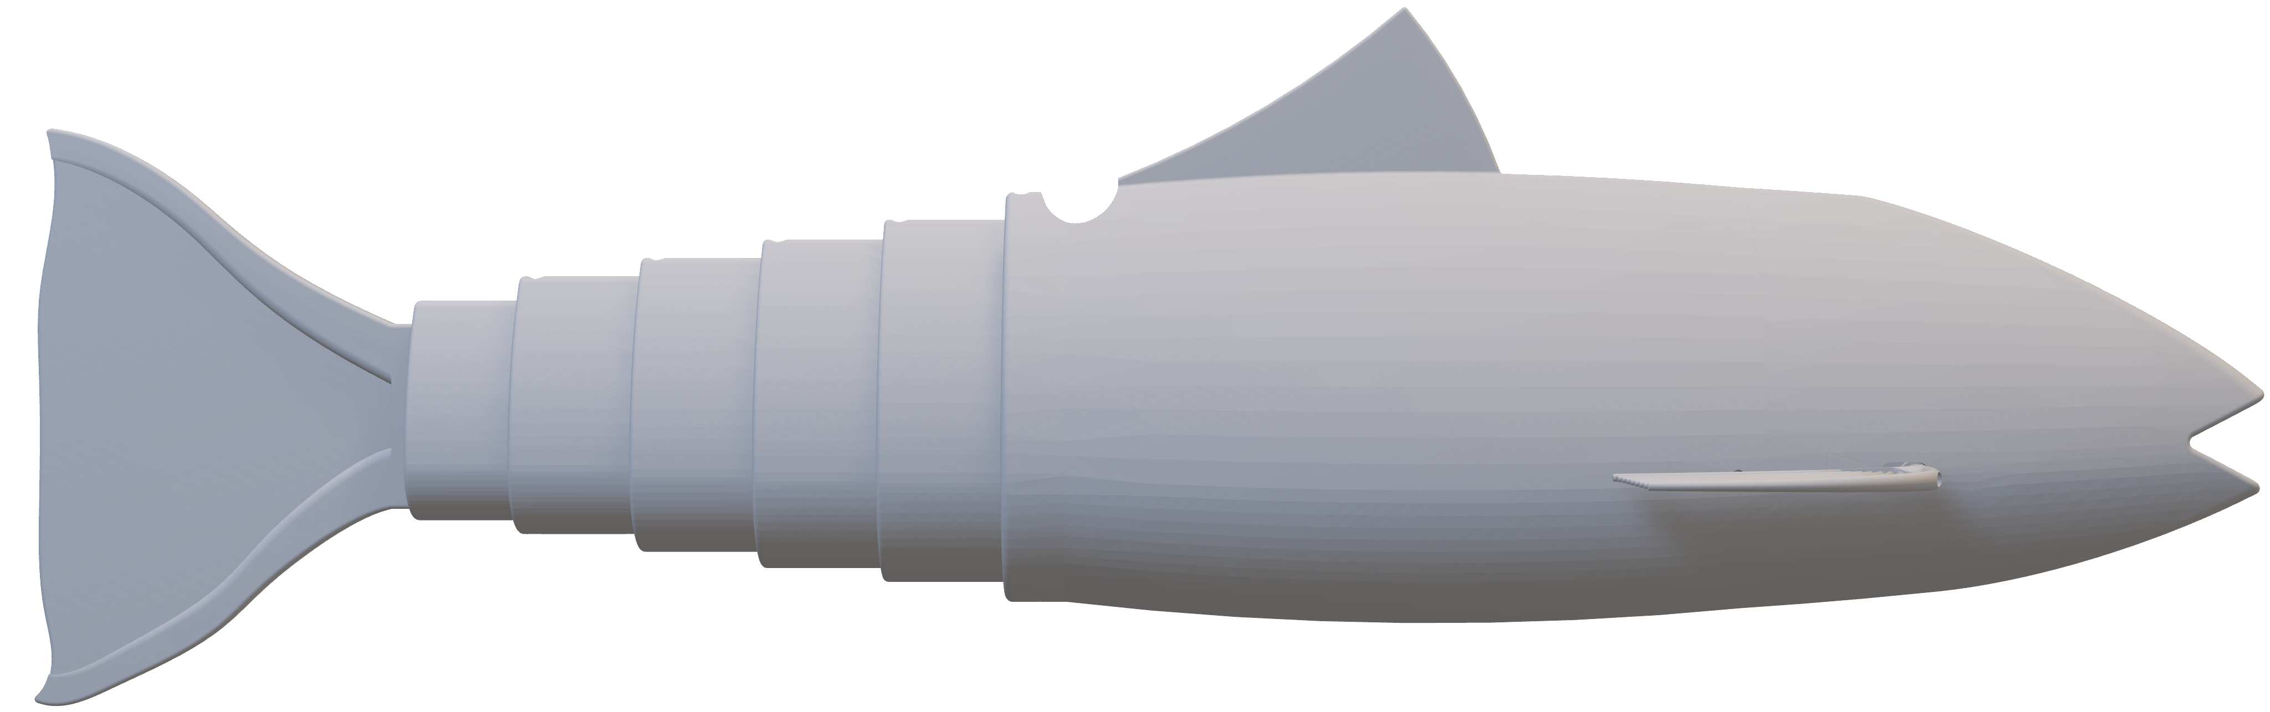



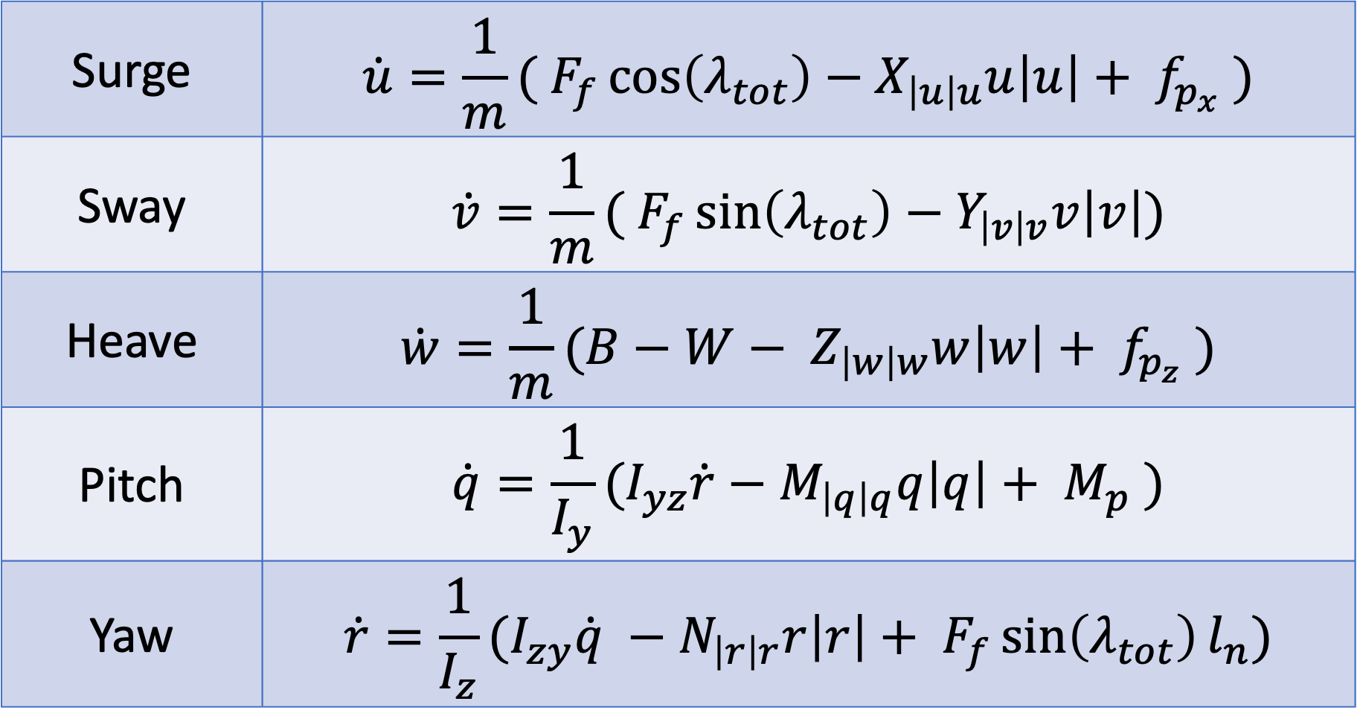

Pitch and Heading Control of Biomimetic Robotic Fish
Margaret Enderle Advisor: Dr. May-Win Thein
Ocean Engineering, University of New Hampshire, Durham, NH 03824
Introduction
Five Degree-of-Freedom Simulation Model
Multi-Modal Sensor Array
Effective underwater object detection requires high-performance perception, achieved through strategically placed sensors. Without a static array, Uncrewed Underwater Vehicles (UUVs) must adjust their orientation to gain a 3D vantage point, making precise Angle of Attack (AoA) control essential for accurate detection across various object sizes and positions.
To enable unobtrusive observation, biomimetic robotic fish modeled after Steelhead Trout were developed. A dynamic simulation model was created to predict their motion using nonlinear control surfaces. However, simulations often fail to replicate real-world movement, requiring experimental validation. Refining these models ensures accurate AoA control through pitch and yaw adjustments, optimizing object tracking classification.
Surge | $$\dot{u}=\frac{1}{m}( F_{f}\cos\left(λ_{tot}\right)−X_{\left|u\right|u}u\left|u\right|+ f_{p_{x}} )$$
Sway | $$\dot{v}=\frac{1}{m}( F_{f}\sin\left(λ_{tot}\right)−Y_{\left|v\right|v}v\left|v\right|)$$
Heave | $$\dot{w}=\frac{1}{m}(B−W− Z_{\left|w\right|w}w\left|w\right|+ f_{p_{z}} )$$
Pitch | $$\dot{q}=\frac{1}{I_{y}}(I_{yz}\dot{r}−M_{\left|q\right|q}q\left|q\right|+ M_{p} )$$
Yaw | $$\dot{r}=\frac{1}{I_{z}}(I_{zy}\dot{q} −N_{\left|r\right|r}r\left|r\right|+ F_{f}\sin\left(λ_{tot}\right)l_{n})$$
$$λ_{1}$$
Caudal Fin
With AoA control, multiple GUPPS platforms can be used to create a multi-modal sensor array to gather information about an unidentified object in three dimensions. Future work will include experimentally measuring AoA to implement a
$$λ_{2}$$
$$λ_{3}$$
$$λ_{tot}$$
$$F_{F}$$
$$λ_{4}$$
Pectoral Fin
$$f_{p,x}=−D_{p}cos\left(α_{p}−δ_{p}\right)+L_{p}sin\left(α_{p}−δ_{p}\right)$$
$$f_{p,z}=−D_{p}sin\left(α_{p}−δ_{p}\right)−L_{p}cos\left(α_{p}−δ_{p}\right)$$
$$M_{p}=l_{x,p}⋅f_{p,z}$$
$$δ_{p}$$
controller for pitch and heading angles. Experimental work will also help verify and update the mathematical simulation to better understand the fish’s motion.
Experimental Platform
The Ghost Uncrewed Performance Platform Submersible (GUPPS) is approximately 91 cm long and 25 cm tall. Its width varies based on the equipped pectoral fins, spanning from 20 cm to 31 cm. The caudal fin is driven by an 80kg servo motor mounted at the back of the body
PID Simulation Control
and a driving arm from the fourth tailpiece to the motor. The pectoral fins are driven symmetrically by two mini-servo motors. A waterproof enclosure mounted in the body houses a Raspberry Pi, controlling all three servos using GPIO pins and receiving feedback from two pressure sensors and the IMU. A tether is routed from the housing through a port at the top of the body to a top-side computer.
Tether
Driving Point
A PID controller is developed and tested on the simulation with gain coefficients of $K_{p}$=14, $K_{i}$=0, and $K_{d}$=30. A target pitch angle of -80° produces the fin input (top) and body pitch output (bottom). This controller will next be implemented and tested on the robotic platform to construct the sensor array.
Pectoral Fin Servos
Adjusting Pitch
To adjust pitch angles, Steelhead Trout use their pectoral fins to generate turning moments about their lateral axis. To mimic this through robotics, pectoral fins were placed toward the front of the fish body based on ichthyology. Multiple fin shapes and sizes have been tested. The first fins tested have a cross-section of a NACA 0024 airfoil which has known and verified drag and lift coefficients. Other fin shapes and larger sizes have proven more effective but are more challenging to model analytically.
Caudal Fin Servo
Simulation Verification
Using static pectoral fin inputs, the simulation is compared to the experimental results. Both trials follow the expected simulation results. The discrepancies toward the end of each are theorized to be caused by the observed negative buoyancy of the experimental platform.
Acknowledgements
Thank you to UNH Faculty and Staff, UNH SMSOE, and the UNH MANTA RAY Project, to our NUWC Keyport NEEC (Grant N00174-20-1-0006), and NURP Sponsors (Grant N0014-23-1-2451).
References
$$δ$$
G. O. Koca, C. Bal, D. Korkmaz, M. C. Bingol, M. Ay, Z. H. Akpolat and S. Yetkin, "Three-dimensional modeling of a robotic fish based on real carp locomotion," Applied Sciences, vol. 8, no. 2, 2018.
H. Dong, Z. Wu, D. Chen, M. Tan and J. Yu, "Development of a Whale-Shark-Inspired Gliding Robotic Fish with High Maneuverability," IEEE/ASME Transactions on Mechatronics, vol. 25, no. 6, pp. 2824-2834, 2020.
M. Enderle and M.-W. Thein, "Mathematical Model of Subcarangiform Robotic Fish," in OCEANS, Halifax, NS, Canada 2024.
M. Enderle, S. Rossman H. Arnholt and M.-W. Thein, "Experimental Pitch and Heading Control of Subcarangiform Robotic Fish for Underwater Perception Arrays," submitted to OCEANS, Brest, Brittany, France 2025.
The MathWorks, Inc. (2024). Simulink version: 9.4 (R2024b). Available: https://www.mathworks.com.
T. I. Fossen, "Marine Control Systems: Guidance, Navigation and Control of Ships, Rigs and Underwater Vehicles," Marine Cybernetics, 2002.
S. Gumpina, S. Lee, J.-H. Kim, H. C. Park and T. Kang, "Simulation and controller design for a fish robot with control fins," Biomimetics, vol. 9, no. 6, 2024.
Adjusting Heading
Open Loop Pitch Control
Steelhead Trout generate thrust by oscillating their caudal fin symmetrically along the centerline, inducing forward motion. To change direction, they shift the oscillation axis, creating a thrust imbalance that adjusts their heading.
With open-loop control via ethernet tether interface, input angles of 45°, -45° and 40° are sent to the fins with the resulting pitch output from the IMU and dual pressure sensor pitch calculations are plotted with the expected simulation output in time.
$$ω$$
$$ω$$
Left
Forward
Right

