Slide 1


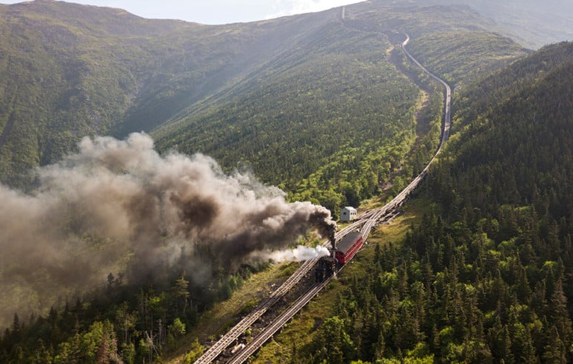
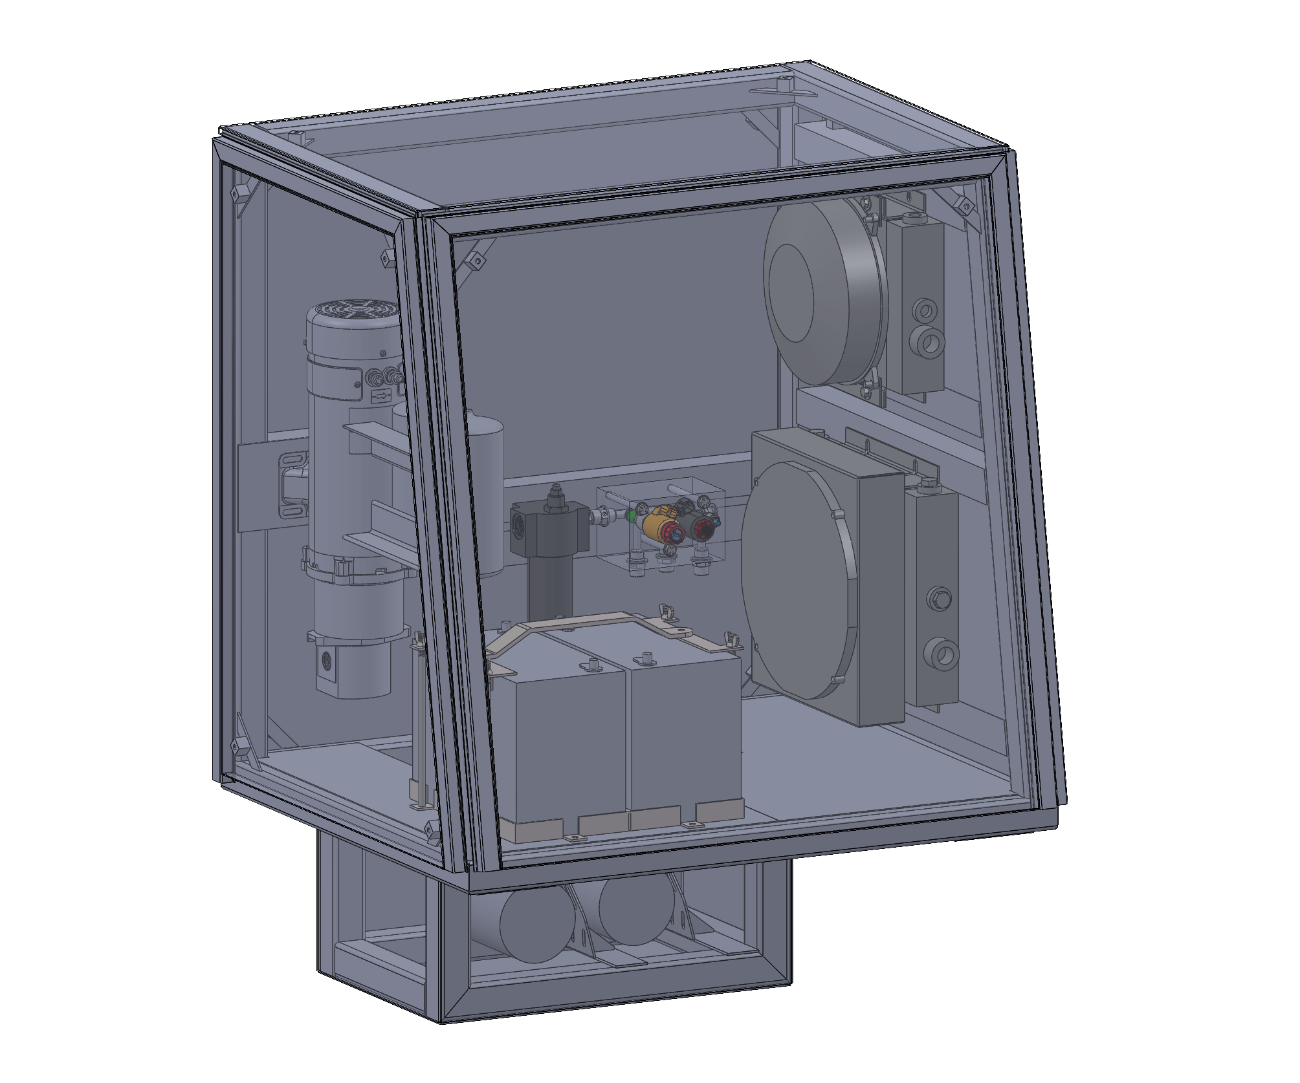
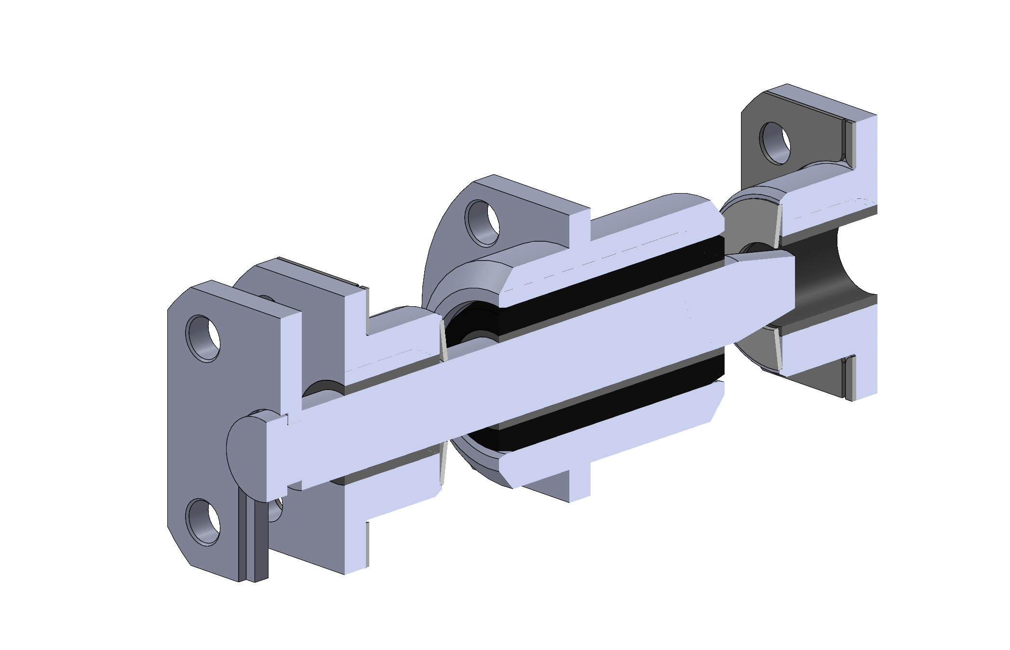
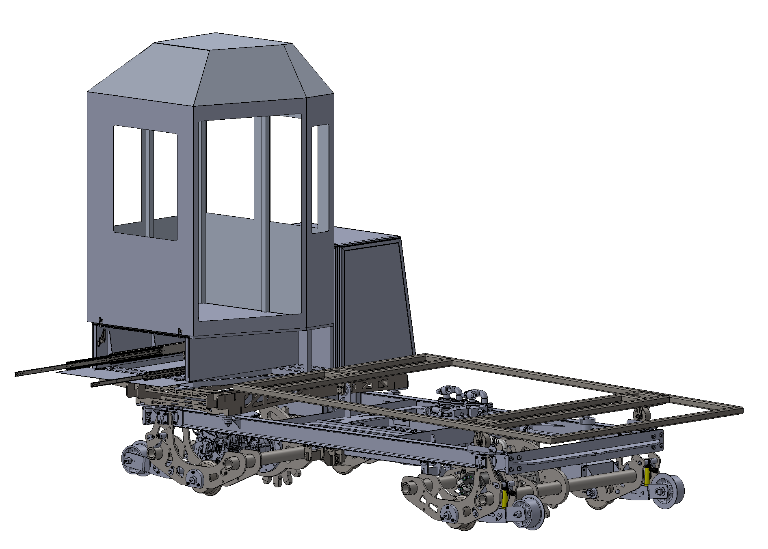
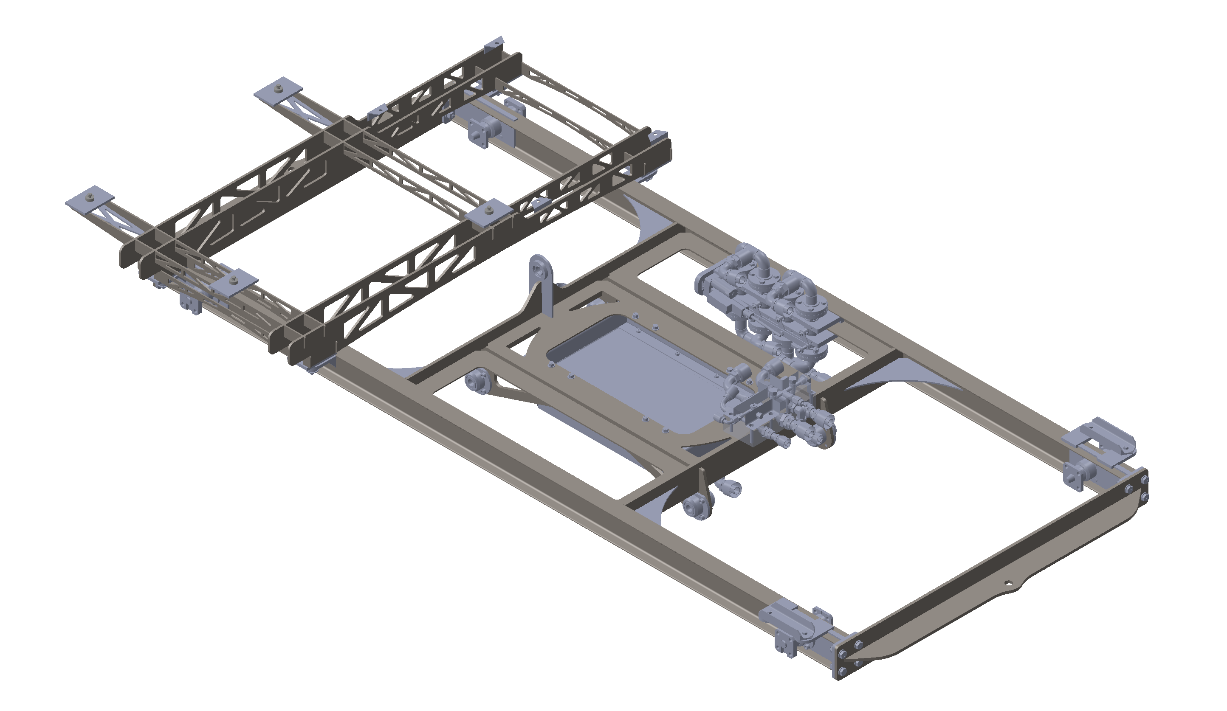
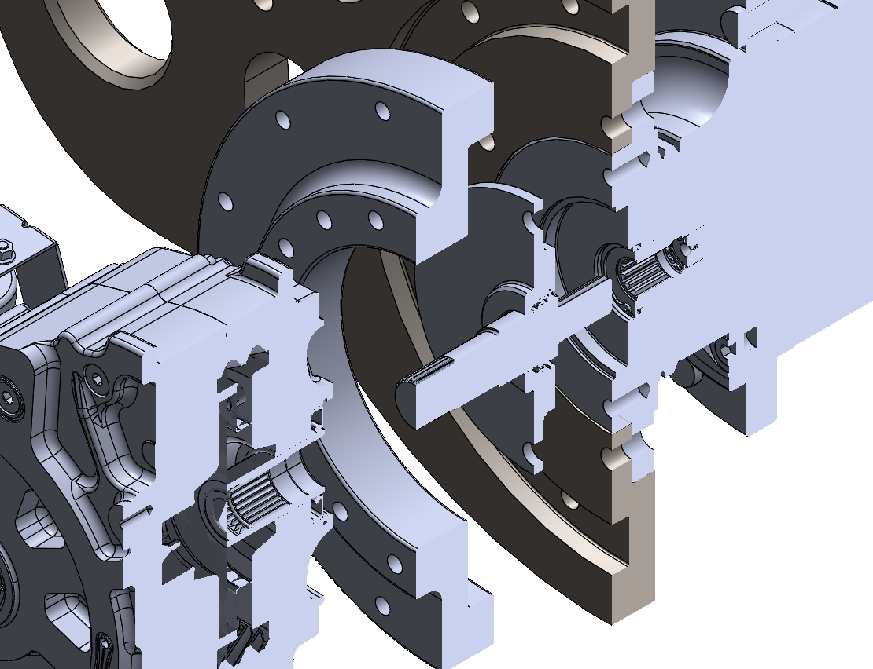
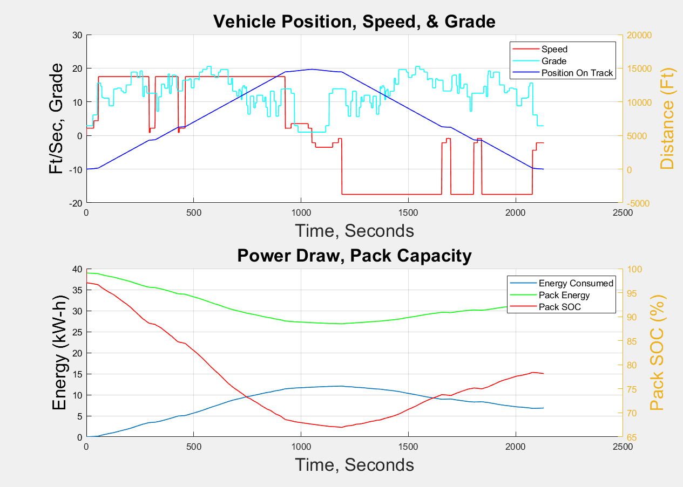
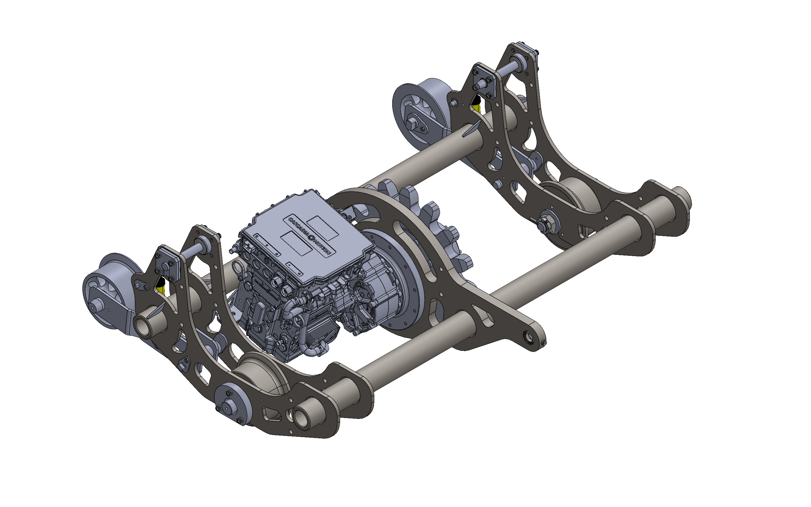
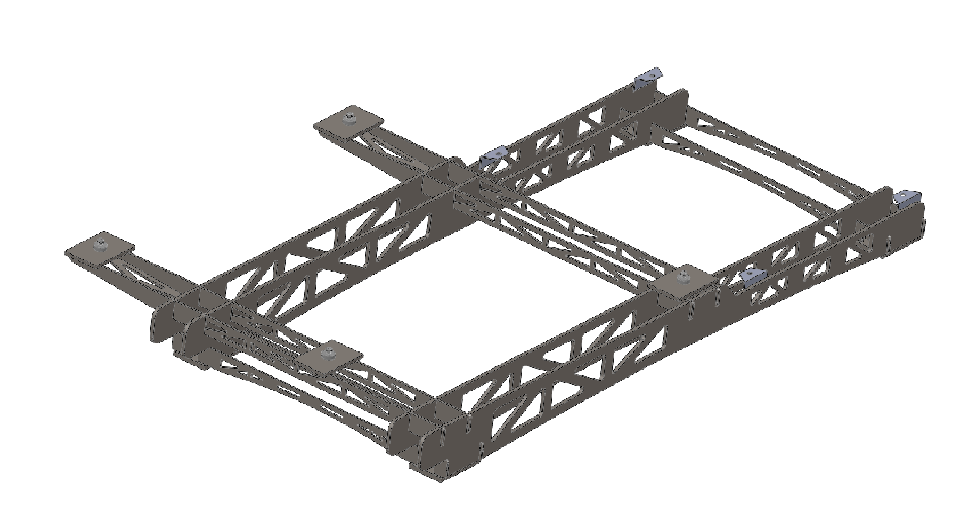
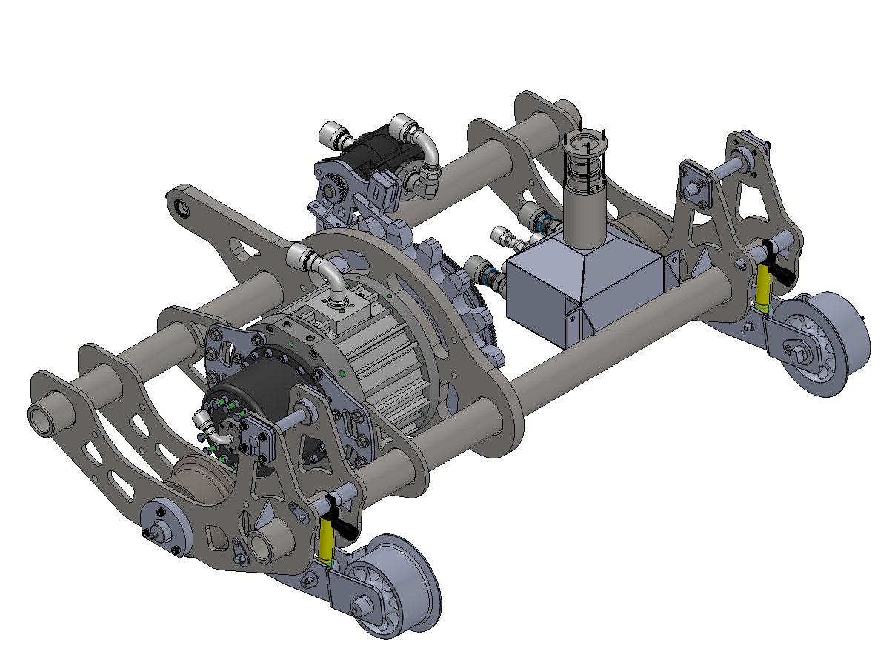
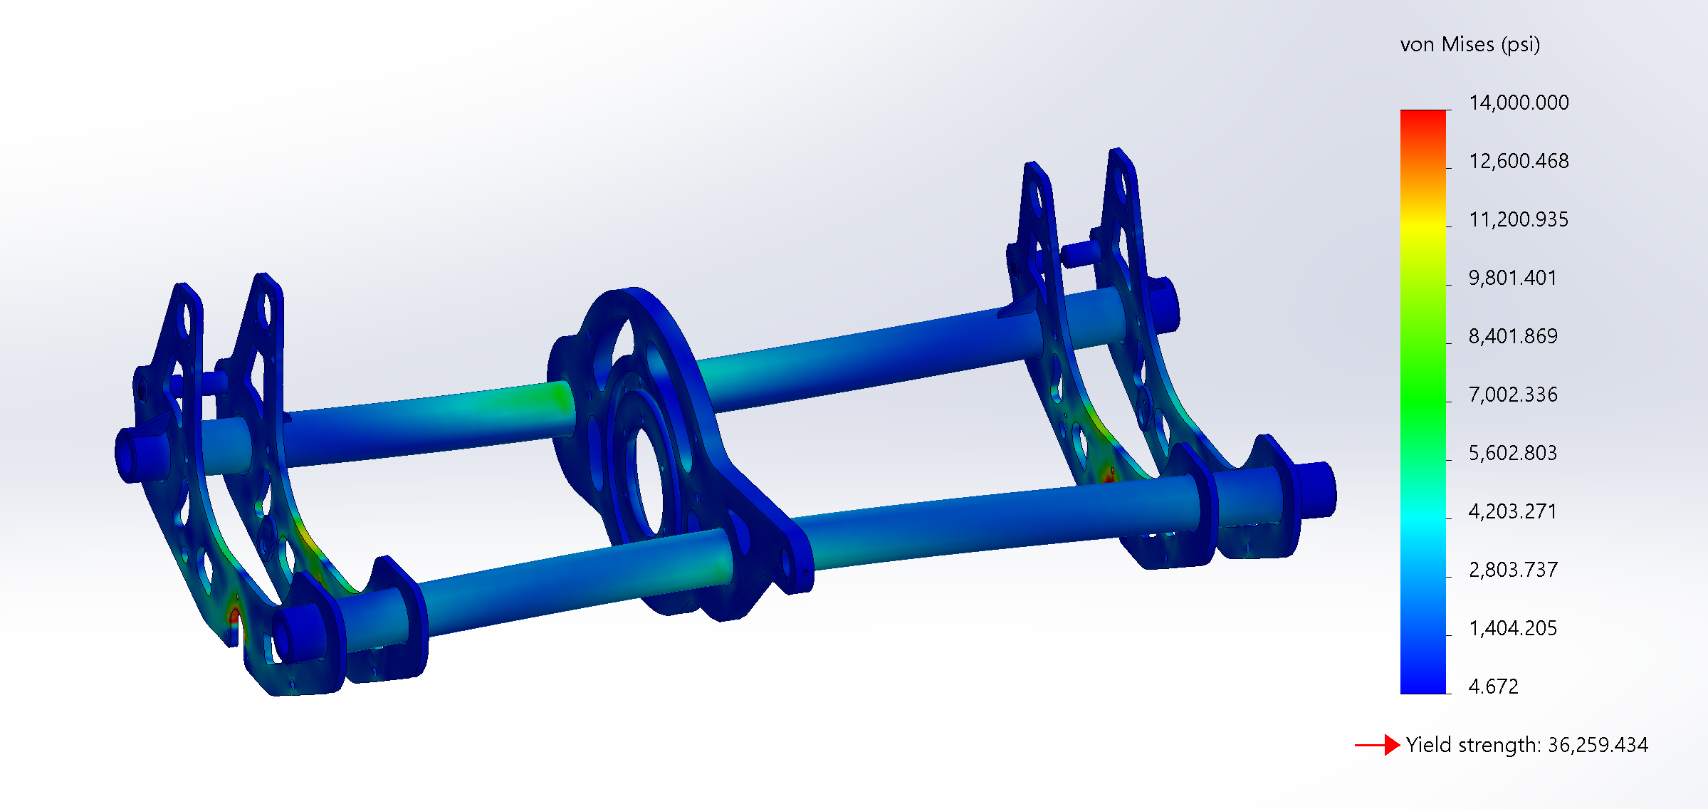
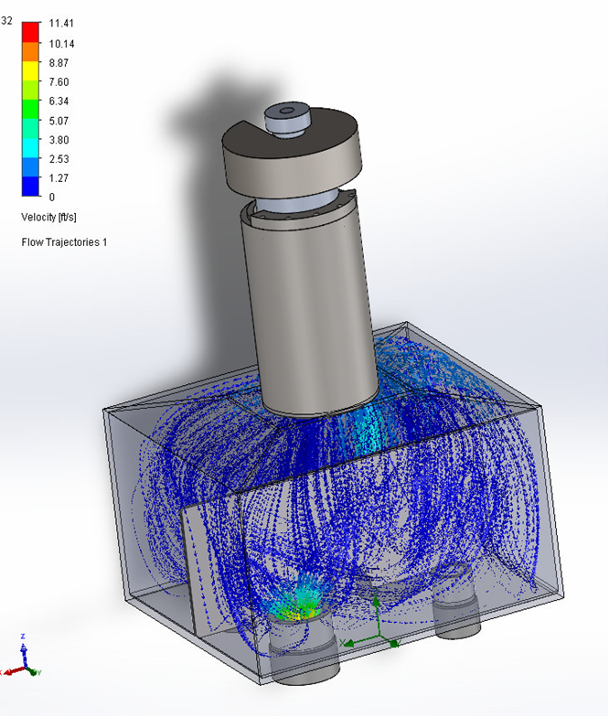
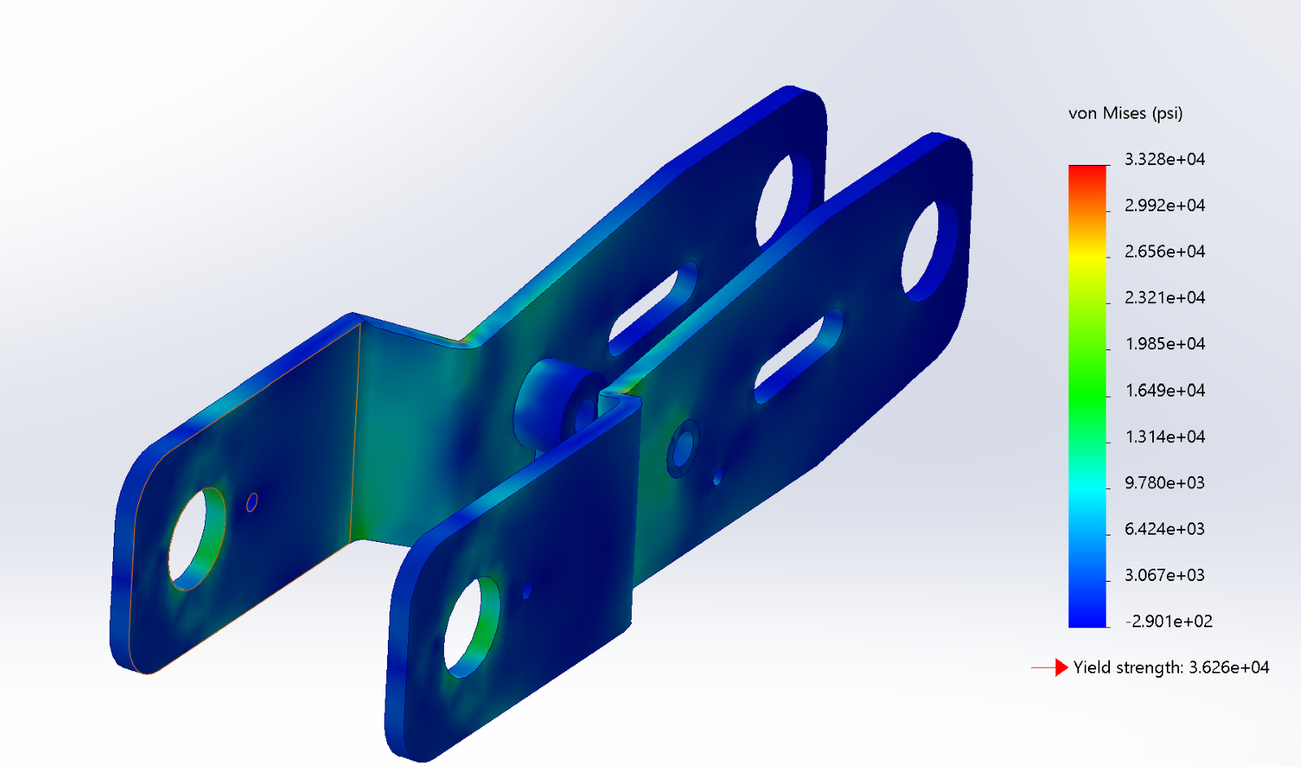
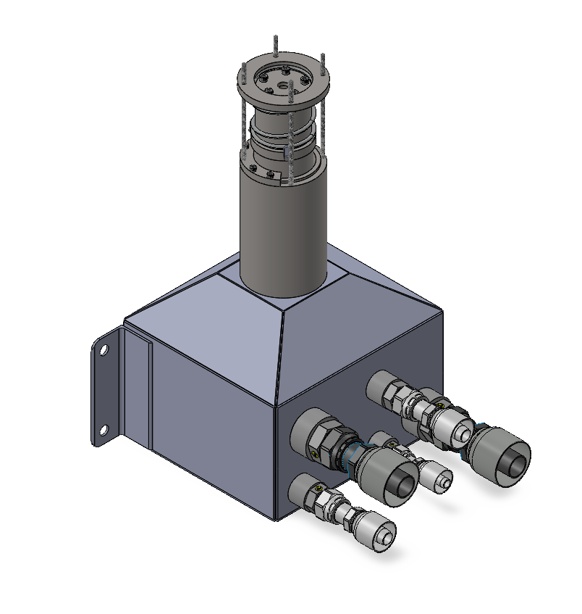
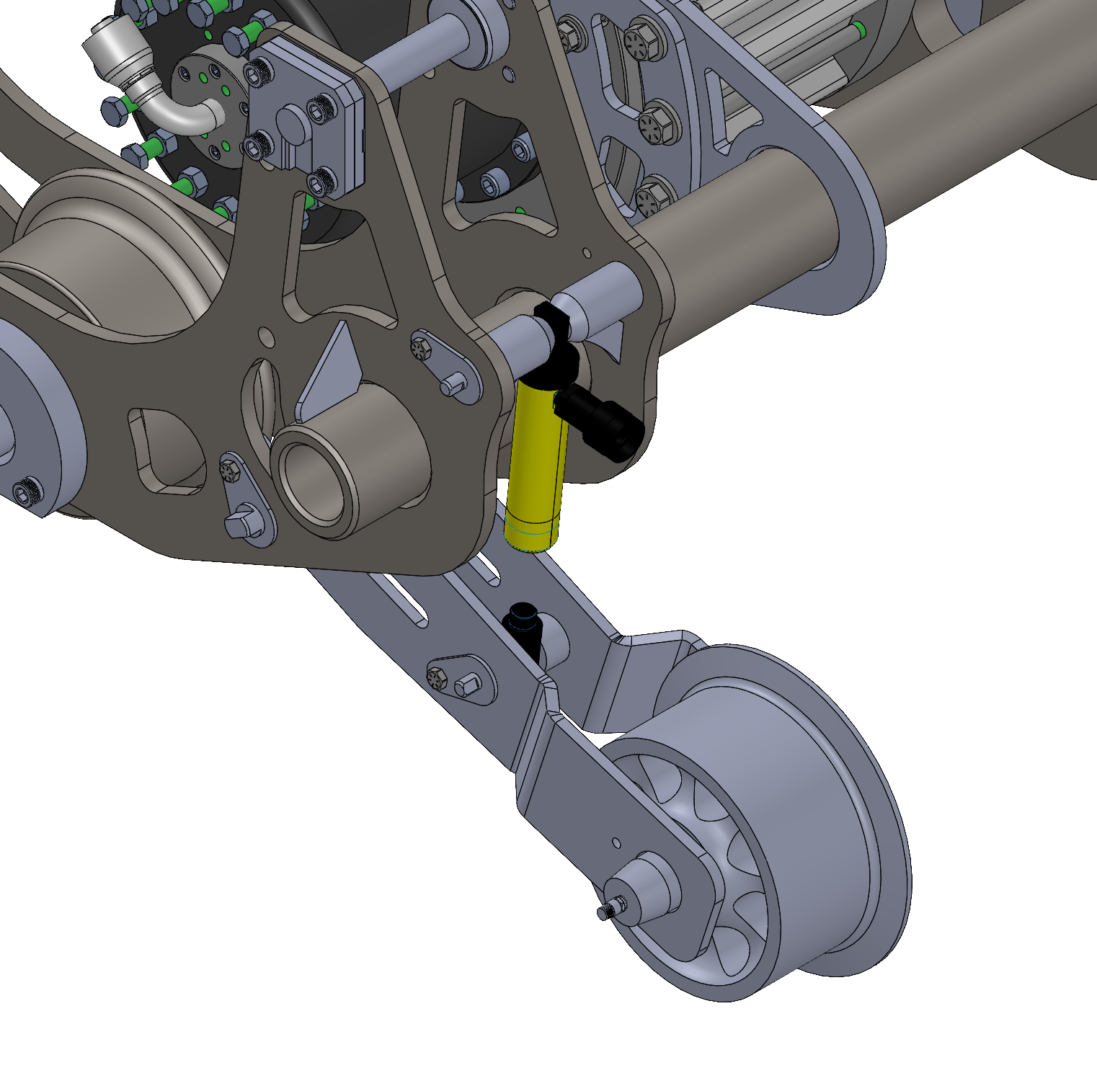
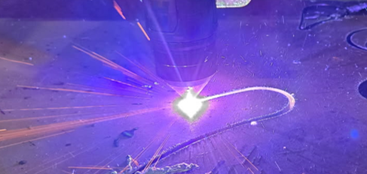
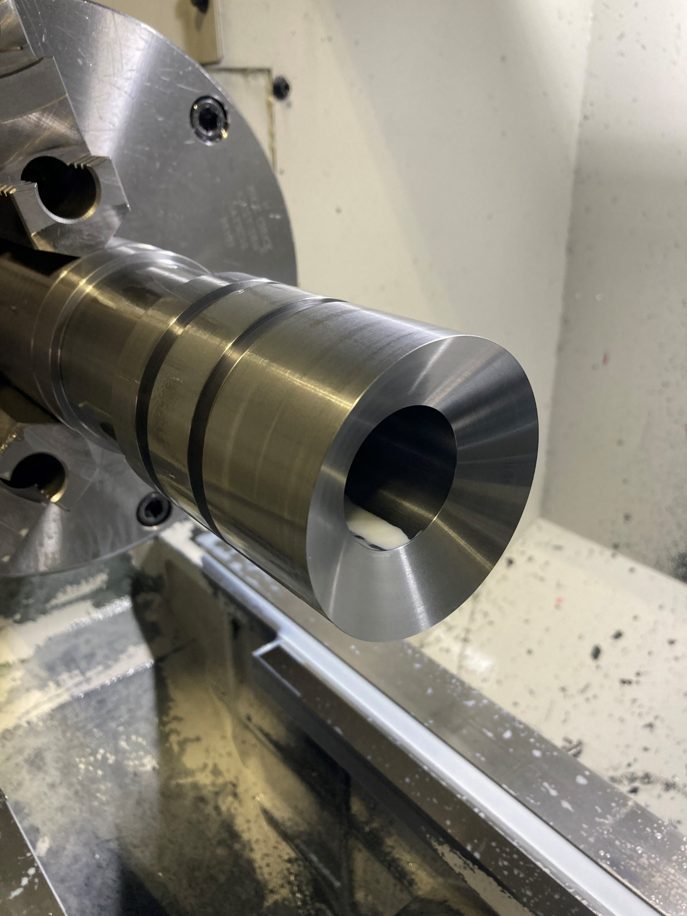
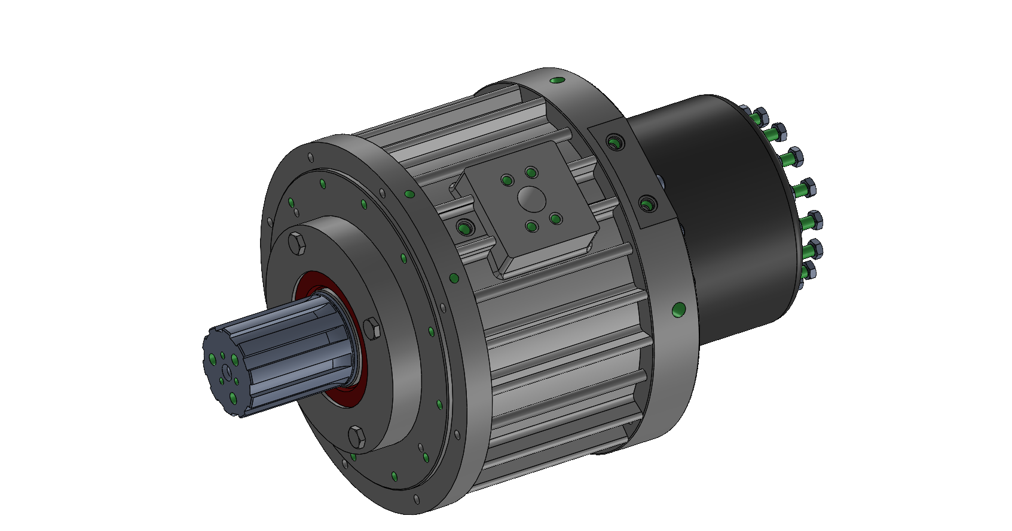
Cog Railway EV-1: Fully Electric Locomotive
William Callery, Nathan Facteau, Alex Mills, Joseph Bailey, Tatum VanSicklen
Project Manager: Caleb Gross Advisor: Prof. Ivaylo Nedyalkov
Project overview
Component Enclosure
Houses and supports key components such as pumps, radiators, batteries, and hydraulic manifolds
Chassis Bushings
Vibration-damping system for EV-1; Shore 60A durometer bushings allow 1/16” radial displacement under load
Drive system
Supporting the Cog Railway’s initiative to electrify its diesel-hydraulic fleet
EV-1 is a first-of-its-kind electric prototype for future locomotive development
Engineered for versatility: maintenance, breakdown response, and search & rescue
Goals:
Power transmission:
Battery Bank Inverter Motor Spur Gearbox Splined Driveshaft Planetary Gearbox Cog Gear
Component | Steady State | Peak Demand
Cog Gear | 100 HP @ 2673 ft-lb | 204 HP @ 5445 ft-lb
Motor | 111 HP @ 71 ft-lb | 227 HP @ 145 ft-lb
Splined Driveshaft
EV-1’s most stress-critical component; requires precise heat treatment and grinding to meet B92.1-1996 standards
Chassis
Designed to flex under dynamic loading; center frame supports brake manifolds and cooling
Vehicle Weight < 9000lbs
Ascent Time < 15 minutes
Regenerative Braking
Extreme weather-resistance
Brake system
Emergency brake: full speed → stop < 1.5 seconds
5500 ft-lbs of torque at 200 HP
Custom unit utilizes oil-shear technology
High-flow flushing powered by vehicle motion
Control and cooling integrated into single hydraulic circuit
Scalability
System architecture enables future scalability with minimal redesign
Custom MATLAB tool simulates vehicle behavior across various locomotive sizes and mission profiles
DM Subframe
Provides mounting for cab, battery pack, and enclosure for auxiliaries
Control System
Centralized control system designed for seamless integration into future electric locomotives
Parker MD5 Master Controller and integrated XC-43 extension module controls all powered components and returns diagnostics via IQAN
UM Truck
Designed to house EV-1’s brake system: oil shear brake, hydraulic reservoir, and cog gear-driven flushing pump
Analysis
Hydraulic Reservoir
Supplies fluid for both brake control and flushing circuits, and incorporates spring-loaded hydraulic cylinder for protection against under and over-pressuring of valving and hosing
DM Truck
Designed to house EV-1’s electric drivetrain: motor, inverter, gear reductions, and splined adapter
DM Truck Stress Analysis
Manufacturing/fabrication
Raw material plasma-cut and precision machined based on detailed manufacturing drawings
Machining split between the Cog Railway and UNH; all components undergo rigorous safety testing
Reservoir Flow
Simulation
Rescue Skate Stress Analysis
Project outlook
Project to be continued by the next Capstone Team
Targeting vehicle completion by July 2026
Rescue Skates
In the event of a vehicle breakdown, removable rescue skates can lift EV-1 off the tracks to safely descend
Oil Shear Brake
Provides 100% duty-cycle emergency braking; internal springs preloaded for instant hydraulic engagement
Collaboration/Acknowledgments
Plasma-cutting truck wheel plates
CNC turning of Reservoir Piston
Caleb Gross, Prof. Ivaylo Nedyalkov, Earl Duval, Wayne Presby, Cog Railway Shop Crew, TURBOCAM Int.
Notes:
Project Overview (Tatum)
Scalability (Joey)
Batteries (Will)
Vehicle Structures (Alex/Joey)
Introduction w/ chassis and trucks (Alex)
Enclosure (Alex)
Subframe (Alex)
Bushings (Joey)
Drive System (Alex/Will)
Brake System (Nathan)
Control System (Will)
Rescue Skates (Will)
Machining/Fabrication (Nathan/Tatum)
Machine Drawings/Plasma Cutting/Machining (Nathan)
Fabrication Drawings/Fabrication Table (Tatum)
Project Outlook (Tatum)

