Slide 1


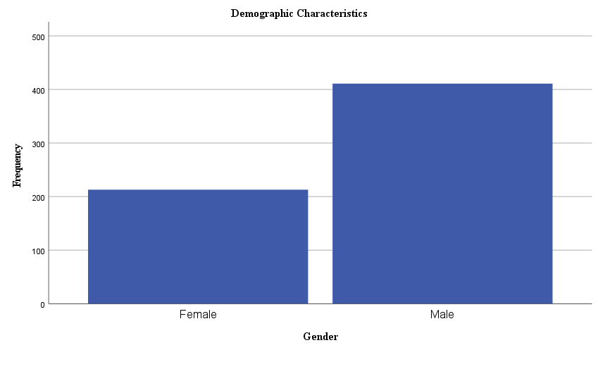
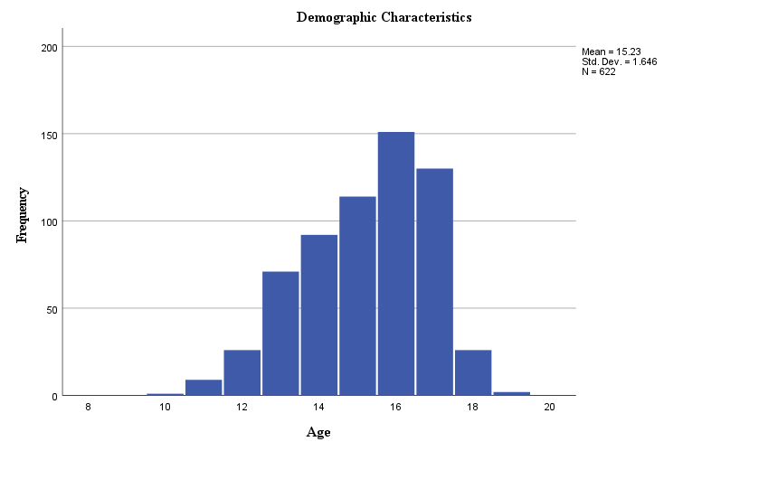
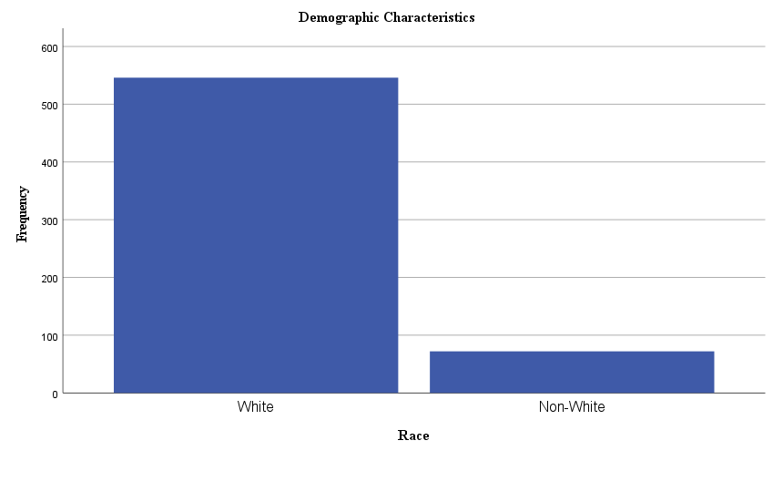
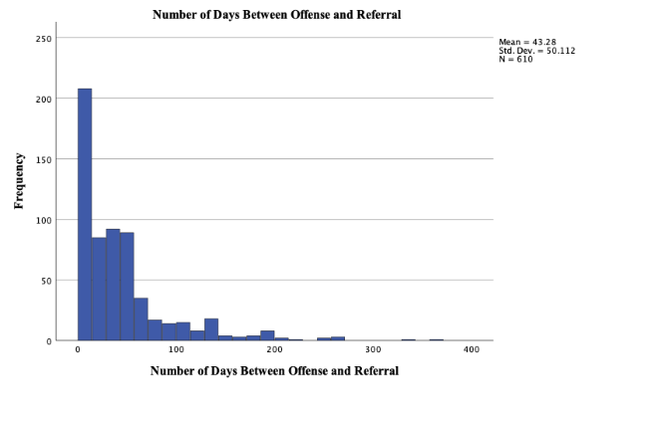
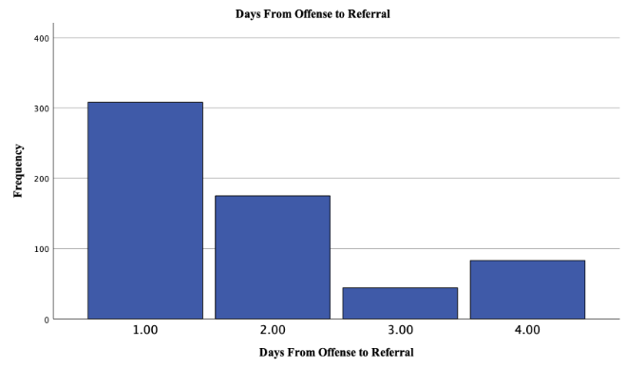
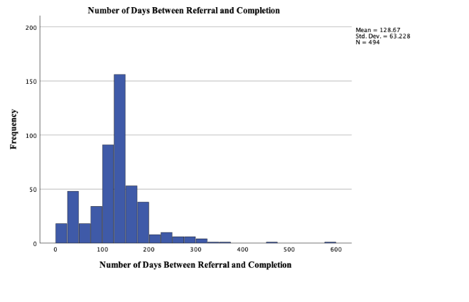
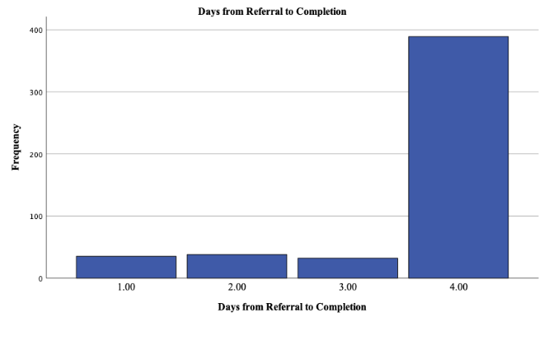
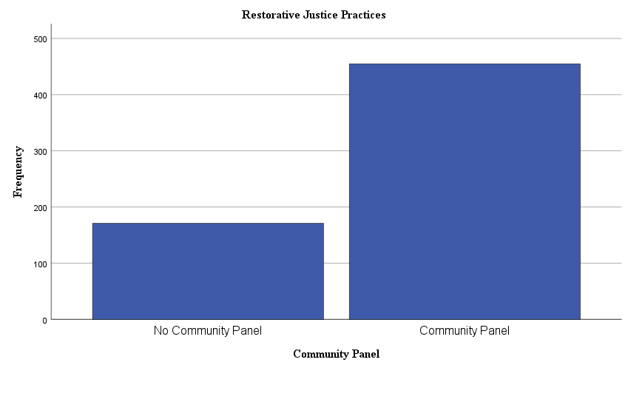
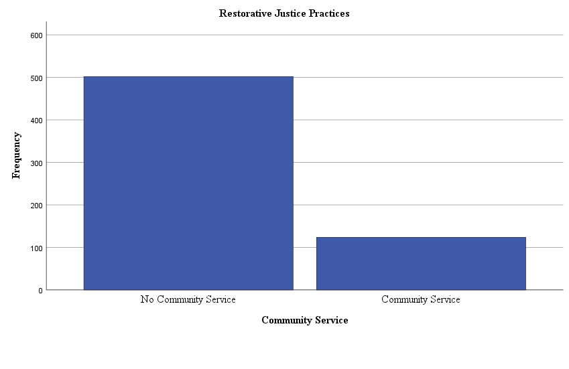
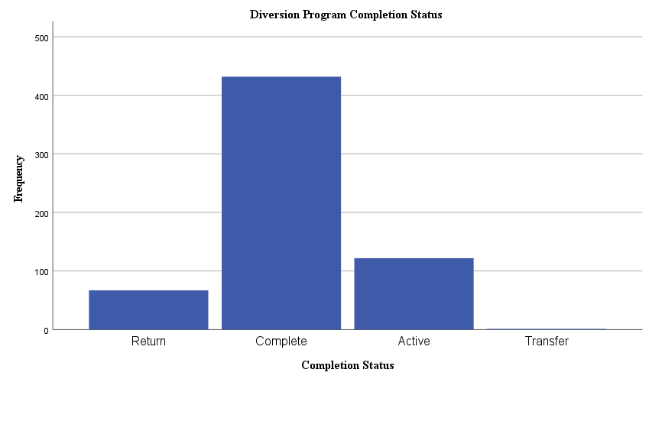
New Hampshire Juvenile Court Diversion Network:
Substance Use, Mental Health, and Factors that
Predict Program Completion
Kayley Mikuleza, Kacey Fleming, Rachel Long, Natalie Mandes
Under the Supervision of Donna M. Perkins, Ph.D.
Justice Studies Program
Introduction
Methods
Results
Mental Health and Juvenile Diversion
  94% Justice-Involved Juveniles have MH Issues¹
  30% Incarcerated Youth MH Issues³
    Severity for Immediate, Significant Treatment
  Incarceration Exacerbates MH Symptoms²
    Lack of Treatment, Separation from Support
    Diversion Effective Addressing MH Issues⁴
      Improved Psychosocial Functioning Longitudinally
      Reduced Recidivism⁵
New Hampshire Juvenile Court Diversion Network
  REDCap Database (N = 626).
Independent Samples t-Tests
Differences Diversion Program Completion Status
Variable | Completed Program |  | Not Completed Program |  | t | df | p | Cohen’s d
 | M | SD | M | SD
Age | 15.24 | 1.68 | 15.16 | 1.65 | -.35 | 496 | .363 | -.05
Offense to Referral | 41.82 | 48.12 | 61.36 | 72.96 | 2.11 | 74 | .019 | .38
Offense to Completion | 173.80 | 87.46 | 188.72 | 90.70 | 1.14 | 470 | .128 | .17
Referral to Panel | 40.24 | 27.14 | 49.27 | 31.45 | 2.09 | 464 | .019 | .33
Referral to Completion | 131.65 | 60.57 | 121.02 | 78.45 | -.93 | 56 | .179 | -.17
Panel to Completion | 94.96 | 69.46 | 91.37 | 41.44 | -.38 | 423 | .352 | -.05
Little Interest, Pleasure | 1.03 | 1.02 | .69 | 1.03 | -2.17 | 453 | .015 | -.33
Feeling Down, Depressed | 1.04 | 1.01 | .67 | .94 | -2.45 | 453 | .007 | -.37
Better Off Dead, Hurting Self | .15 | .50 | .24 | .56 | 1.18 | 57 | .122 | .19
Tobacco Use | .29 | .71 | .80 | 1.12 | 3.09 | 53 | .002 | .66
Vaper Use | 1.43 | 1.08 | 1.57 | 1.06 | .85 | 452 | .197 | .13
Alcohol Use | 1.24 | 1.12 | .83 | 1.03 | -2.39 | 449 | .009 | -.37
Marijuana Use | 1.35 | 1.10 | 1.15 | 1.13 | -1.24 | 449 | .108 | -.19
Prescription Drug Use | .05 | .32 | .04 | .20 | -.29 | 452 | .386 | -.04
Illegal Drug Use | .04 | .29 | .08 | .45 | .89 | 449 | .186 | .14
Inhalants Use | .02 | .14 | .06 | .24 | 1.09 | 56 | .141 | .20
Herbs, Synthetic Use | .02 | .20 | .02 | .14 | .03 | 449 | .487 | .01
Binary Logistic Regression
Differences in Completion Status
based on
Days from Offense to Referral Controlling Demographic Characteristics, Offense Level, Referral Source
Variable | B | SE | p | Exp(B) | CI for Exp(B)
Block 1
Age | .03 | .08 | .750 | 1.03 | [.905, 1.254]
Gender Female | .08 | .29 | .771 | 1.09 | [.525, 1.656]
Race White | -.62 | .49 | .205 | .539 | [.689, 4.777]
Block 2
Age | .08 | .09 | .391 | 1.08 | [.924, 1.304]
Gender Female | .04 | .30 | .894 | 1.04 | [.539, 1.746]
Race White | -.59 | .50 | .239 | .55 | [.635, 4.625]
Offense Level Felony |  |  | .119
Offense Level Violation | -.96 | .66 | .146 | .38 | [.797, 2.982]
Offense Level Misdemeanor | -.31 | .60 | .611 | .74 | [.607, 7.970]
Additional Charges | .62 | .42 | .140 | 1.86 | [.248, 1.292]
Referral Source Law Enforcement |  |  | .005
Referral Source Court | -1.04 | .56 | .064 | .35 | [.484, 20.184]
Referral Source JPPO | -1.15 | .35 | .001 | .32 | [.162, 11.030]
Referral Source Other | -1.06 | .92 | .248 | .35 | [.176, 8.599]
Block 3
Age | .09 | .09 | .303 | 1.10 | [.921, 1.304]
Gender Female | -.00 | .30 | .988 | 1.00 | [.553, 1.791]
Race White | -.58 | .51 | .257 | .56 | [.207, 1.523]
Offense Level Violations |  |  | .038
Offense Level Misdemeanors | -1.18 | .67 | .076 | .31 | [.083, 1.134]
Offense Level Felonies | -.32 | .60 | .589 | .72 | [.223. 2.343]
Additional Charges | .58 | .42 | .172 | 1.78 | [.778, 4.086]
Referral Source Law Enforcement |  |  | .039
Referral Source Court | -.59 | .61 | .331 | .55 | [.167, 1.829]
Referral Source JPPO | -1.00 | .36 | .005 | .37 | [.182, .745]
Referral Source Other | -.87 | .93 | .350 | .42 | [.068, 2.589]
Days Offense to Referral | -.01 | .00 | .019 | .99 | [.989, .999]
Independent Samples t-Tests
Differences by Restorative Justice Practice of Community Panels
Variable | Community Panel |  | No Community Panel |  | t | df | p | Cohen’s d
 | M | SD | M | SD
Age | 15.12 | 1.71 | 15.54 | 1.41 | 3.11 | 358 | .001 | .26
Offense to Referral | 46.14 | 47.62 | 35.58 | 55.71 | -2.32 | 608 | .010 | -.21
Offense to Completion | 190.76 | 78.23 | 100.05 | 89.78 | -9.21 | 138 | .001 | -1.12
Referral to Panel | 41.68 | 26.50 | 39.84 | 32.12 | -.61 | 530 | .273 | -.07
Referral to Completion | 143.69 | 53.06 | 68.76 | 65.23 | -10.59 | 132 | .001 | -1.35
Panel to Completion | 99.67 | 65.87 | 64.30 | 49.11 | -5.12 | 479 | .001 | -.57
Little Interest, Pleasure | .99 | 1.02 | .49 | .79 | -5.75 | 226 | .001 | -.51
Feeling Down, Depressed | 1.00 | 1.00 | .51 | .75 | -5.89 | 231 | .001 | -.52
Better Off Dead, Hurting Self | .14 | .48 | .18 | .49 | .80 | 565 | .212 | .08
Tobacco Use | .32 | .75 | .58 | .92 | 2.81 | 157 | .003 | .33
Vaper Use | 1.38 | 1.10 | 1.48 | .95 | .92 | 199 | .179 | .09
Alcohol Use | 1.17 | 1.09 | .76 | 1.05 | -3.64 | 564 | .001 | -.38
Marijuana Use | 1.34 | 1.10 | 1.13 | 1.10 | -1.86 | 564 | .032 | -.19
Prescription Drug Use | .05 | .29 | .08 | .42 | .76 | 565 | .224 | .08
Illegal Drug Use | .05 | .31 | .03 | .23 | -.40 | 563 | .346 | -.04
Inhalants Use | .01 | .11 | .06 | .33 | 1.51 | 122 | .067 | .26
Herbs, Synthetic Use | .02 | .19 | .03 | .21 | .28 | 561 | .390 | .03
Binary Logistic Regression
Differences in Completion Status
based on
Days from Referral to Completion Controlling Demographic Characteristics, Offense Level, Referral Source
Variable | B | SE | p | Exp(B) | CI for Exp(B)
Block 1
Age | .18 | .09 | .046 | 1.20 | [1.003, 1.425]
Gender Female | .16 | .33 | .616 | 1.18 | [.621, 2.238]
Race White | -.64 | .55 | .240 | .53 | [.181, 1.533]
Block 2
Age | .25 | .10 | .010 | 1.29 | [1.062, 1.560]
Gender Female | .13 | .34 | .706 | 1.14 | [.585, 2.210]
Race White | -.68 | .56 | .232 | .51 | [.168, 1.540]
Offense Level Violations |  |  | .848
Offense Level Misdemeanors | -.42 | .74 | .576 | .66 | [.155, 2.823]
Offense Level Felonies | -.24 | .63 | .708 | .79 | [.230, 2.710]
Additional Charges | .75 | .45 | .100 | 2.11 | [.866, 5.141]
Referral Source Law Enforcement |  |  | .001
Referral Source Court | -1.64 | .59 | .005 | .20 | [.062, .613]
Referral Source JPPO | -1.52 | .39 | .001 | .22 | [.102, .465]
Referral Source Other | -1.48 | .93 | .112 | .23 | [.036, 1.410]
Block 3
Age | .25 | .10 | .014 | 1.28 | [1.052, 1.563]
Gender Female | .10 | .34 | .770 | 1.11 | [.564, 2.169]
Race White | -.75 | .58 | .199 | .48 | [.152, 1.478]
Offense Level Violations |  |  | .896
Offense Level Misdemeanors | .13 | .79 | .866 | 1.14 | [.244, 5.337]
Offense Level Felonies | -.09 | .64 | .893 | .92 | [.261, 3.229]
Additional Charges | .73 | .47 | .120 | 2.07 | [.827, 5.185]
Referral Source Law Enforcement |  |  | .001
Referral Source Court | -1.65 | .60 | .006 | .19 | [.060, .620]
Referral Source JPPO | -1.58 | .39 | .001 | .21 | [.095, .442]
Referral Source Other | -1.40 | .95 | .138 | .25 | [.039, 1.568]
Days Referral to Completion | .01 | .00 | .016 | 1.01 | [1.001, 1.014]
Substance Use and Juvenile Diversion
  6.3% Juveniles meet Criteria for SUD⁶
  Disproportionate Justice-Involved Juveniles
  Diversion Effective for SUD Issues Longitudinally⁶
      33% Decreased SU v. 17% Court Processed
      32% Rearrested v. 60% Court Processed
Restorative Justice and Juvenile Diversion
  Restorative Justice Practices Emphasize⁷
    Repairing Harm Caused
    Offender Accountability and Responsibility
    Reconcile w/Harmed Party/Community
  Outcomes of Restorative Justice Practices
  Reduction in Juvenile Filings⁷
  Reduction in Recidivism⁸⁹¹⁰¹¹
  Improved Social Functioning¹¹
Independent Samples t-Tests
Differences by Restorative Justice Practice of Community Service
Variable | Community Service |  | No Community Service |  | t | df | p | Cohen’s d
 | M | SD | M | SD
Age | 15.43 | 1.55 | 15.18 | 1.67 | -1.48 | 620 | .069 | -.15
Offense to Referral | 49.45 | 48.75 | 41.78 | 50.37 | -1.50 | 608 | .067 | -.15
Offense to Completion | 206.15 | 86.29 | 165.11 | 87.30 | -4.00 | 489 | .001 | -.47
Referral to Panel | 40.05 | 22.94 | 41.69 | 28.53 | .57 | 530 | .286 | .06
Referral to Completion | 151.44 | 62.96 | 123.74 | 62.27 | -3.78 | 492 | .001 | -.44
Panel to Completion | 94.00 | 78.23 | 91.47 | 60.67 | -.34 | 479 | .368 | .04
Little Interest, Pleasure | .72 | .97 | .94 | 1.01 | 2.19 | 568 | .014 | .22
Feeling Down, Depressed | .68 | .93 | .97 | .98 | 2.93 | 567 | .002 | .30
Better Off Dead, Hurting Self | .27 | .68 | .12 | .41 | -2.45 | 148.83 | .002 | -.33
Tobacco Use | .51 | .84 | .33 | .78 | -2.07 | 185.08 | .015 | -.22
Vaping Use | 1.18 | 1.11 | 1.47 | 1.05 | 2.68 | 566 | .004 | .27
Alcohol Use | .68 | .95 | 1.20 | 1.11 | 5.13 | 220.62 | .001 | .48
Marijuana Use | .98 | 1.04 | 1.39 | 1.10 | 3.76 | 202.42 | .001 | .37
Prescription Drug Use | .07 | .36 | .06 | .31 | -.30 | 565 | .386 | -.03
Illegal Drug Use | .07 | .40 | .04 | .26 | -.93 | 563 | .176 | -.10
Inhalants Use | .02 | .15 | .02 | .19 | -.09 | 567 | .463 | -.01
Herbs, Synthetic Drug Use | .02 | .20 | .02 | .20 | -.21 | 561 | .418 | -.02
Binary Logistic Regression
Differences in Completion Status
based on
PHQ Numeric Score Controlling Demographic Characteristics, Offense Level, Referral Source
Variable | B | SE | p | Exp(B) | CI for Exp(B)
Block 1
Age | .11 | .09 | .238 | 1.11 | [.932, 1.326]
Gender Female | .42 | .34 | .213 | 1.52 | [.786, 2.947]
Race White | -.67 | .54 | .217 | .511 | [.176, 1.483]
Block 2
Age | .17 | 1.00 | .080 | 1.19 | [.980, 1.435]
Gender Female | .37 | .35 | .282 | 1.45 | [.735, 2.877]
Race White | -.69 | .56 | .220 | .50 | [.166, 1.510]
Offense Level Felony |  |  | .417
Offense Level Violation | -1.04 | .80 | .191 | .35 | [.074, 1.683]
Offense Level Misdemeanor | -.68 | .69 | .328 | .51 | [.131, 1.972]
Additional Charges | .88 | .44 | .044 | 2.40 | [1.024, 5.645]
Referral Source Law Enforcement |  |  | .001
Referral Source Court | -1.40 | .58 | .016 | .25 | [.080, .774]
Referral Source JPPO | -1.34 | .39 | .001 | .26 | [.122, .564]
Referral Source Other | -1.35 | .94 | .151 | .26 | [.042, 1.630]
Block 3
Age | .17 | .10 | .082 | 1.19 | [.978, 1.440]
Gender Female | .34 | .35 | .335 | 1.40 | [.705, 2.790]
Race White | -.62 | .57 | .281 | .54 | [.176, 1.657]
Offense Level Violations |  |  | .379
Offense Level Misdemeanors | -1.11 | .81 | .169 | .33 | [.068, 1.601]
Offense Level Felonies | -.72 | .70 | .303 | .49 | [.124. 1.915]
Additional Charges | .86 | .44 | .051 | 2.35 | [.996, 5.551]
Referral Source Law Enforcement |  |  | .001
Referral Source Court | -1.45 | .58 | .013 | .23 | [.075, .733]
Referral Source JPPO | -1.32 | .40 | .001 | .27 | [.124, .582]
Referral Source Other | -1.32 | .95 | .165 | .27 | [.041, 1.726]
PHQ Numeric Score | .38 | .18 | .029 | 1.47 | [1.040, 2.063]
One-Way Analysis of Variance
Number of Days from
Offense to Referral
and
Referral to Completion
based on
Offense Level
 |  | Number of Days from Offense to Referral
Offense Level | N | M | SD
Violation | 141 | 19.18^{ab} | 29.57
Misdemeanor | 424 | 50.02ª | 52.07
Felony | 38 | 58.71^{b} | 61.25
Binary Logistic Regression
Differences in Completion Status
based on
S2BI Numeric Score Controlling Demographic Characteristics, Offense Level, Referral Source
Variable | B | SE | p | Exp(B) | CI for Exp(B)
Block 1
Age | .11 | .09 | .238 | 1.11 | [.932, 1.326]
Gender Female | .42 | .34 | .213 | 1.52 | [.786, 2.947]
Race White | -.67 | .54 | .217 | .51 | [.176, 1.483]
Block 2
Age | .17 | 1.00 | .080 | 1.19 | [.980, 1.435]
Gender Female | .37 | .35 | .282 | 1.45 | [.735, 2.877]
Race White | -.69 | .56 | .220 | .50 | [.166, 1.510]
Offense Level Felony |  |  | .417
Offense Level Violation | -1.04 | .80 | .191 | .35 | [.074, 1.683]
Offense Level Misdemeanor | -.68 | .69 | .328 | .51 | [.131, 1.972]
Additional Charges | .88 | .44 | .044 | 2.40 | [1.024, 5.645]
Referral Source Law Enforcement |  |  | .001
Referral Source Court | -1.39 | .58 | .016 | .25 | [.080, .774]
Referral Source JPPO | -1.34 | .39 | .001 | .26 | [.122, .564]
Referral Source Other | -1.35 | .94 | .151 | .26 | [.042, 1.630]
Block 3
Age | .20 | .10 | .047 | 1.22 | [1.003, 1.484]
Gender Female | .36 | .35 | .300 | 1.44 | [.725, 2.843]
Race White | -.69 | .56 | .217 | .50 | [.167, 1.501]
Offense Level Violations |  |  | .548
Offense Level Misdemeanors | -.88 | .80 | .273 | .42 | [.086, 1.999]
Offense Level Felonies | -.62 | .69 | .369 | .54 | [.140. 2.078]
Additional Charges | .90 | .44 | .041 | 2.45 | [1.037, 5.802]
Referral Source Law Enforcement |  |  | .003
Referral Source Court | -1.36 | .58 | .020 | .26 | [.083, .805]
Referral Source JPPO | -1.27 | .40 | .001 | .28 | [.128, .610]
Referral Source Other | -1.37 | .94 | .145 | .26 | [.041, 1.601]
S2BI Numeric Score | -.19 | .16 | .228 | .83 | [.603, 1.128]
Factors that Predict Diversion Completion
  Criminal History¹²¹³
    More Prior Arrests, Less likely Complete¹³
  Number of Conditions Imposed¹²
    More Conditions Imposed, Less likely Complete
      Due to Developing Executive Functioning
    Caution Imposing Too Many Conditions
      3-5 Maximum to Avoid Overwhelming Juveniles
      May be Confounded with Risk Level
  Participant Involvement¹⁴
    Inconsistent Engagement, Less likely Complete
 |  | Number of Days from Referral to Completion
Offense Level | N | M | SD
Violation | 110 | 88.05^{ab} | 80.18
Misdemeanor | 349 | 139.47ª | 50.77
Felony | 35 | 148.66^{b} | 63.51
Discussion
Conclusion
Efforts be made to refer juveniles to diversion programs as soon as possible after they commit an offense to increase the likelihood that they will complete the program. However, once they are referred to the diversion program, imposing targeted and a limited number of restorative justice practices may be more beneficial for program completion.
Imposing mental health and substance use screening, and addressing issues identified by the screening are beneficial for program completion. It appears that the longer they are in the program receiving mental health and substance use interventions is effective in terms of getting juveniles to stay in the program and, ultimately, complete the program. However, caution should be taken in the number of restorative justice requirements imposed on juveniles as it may increase the likelihood of noncompliance.
Future Research
This project was exploratory in nature and will be continued over the next few years. The Justice Studies department will be continuing research efforts with the addition of future data. Future directions include gender differences in mental health issues as they effect program completion, further research in the effects of the number of days from referral to program completion, and more.
¹ Moran et al. (2024)
² Zettler & Craig (2024)
³ LeBelle et al. (2024)
⁴ Hodges et al. (2011)
⁴ Hodges et al. (2011)
⁵ Cuellar et al. (2005))
⁶ Belenko et al. (2022)
⁷ Moran et al (2024)
⁸ Zettler & Craig (2024)
⁹ LeBelle et al (2024)
¹⁰ Hodges et al. (2011)
¹¹ Cuellar et al (2005)
¹² NeMoyer et al (2020)
¹³ Campbell & Retzlaff (2000)
¹⁴ Ozturk et al. (2022)

