Slide 1


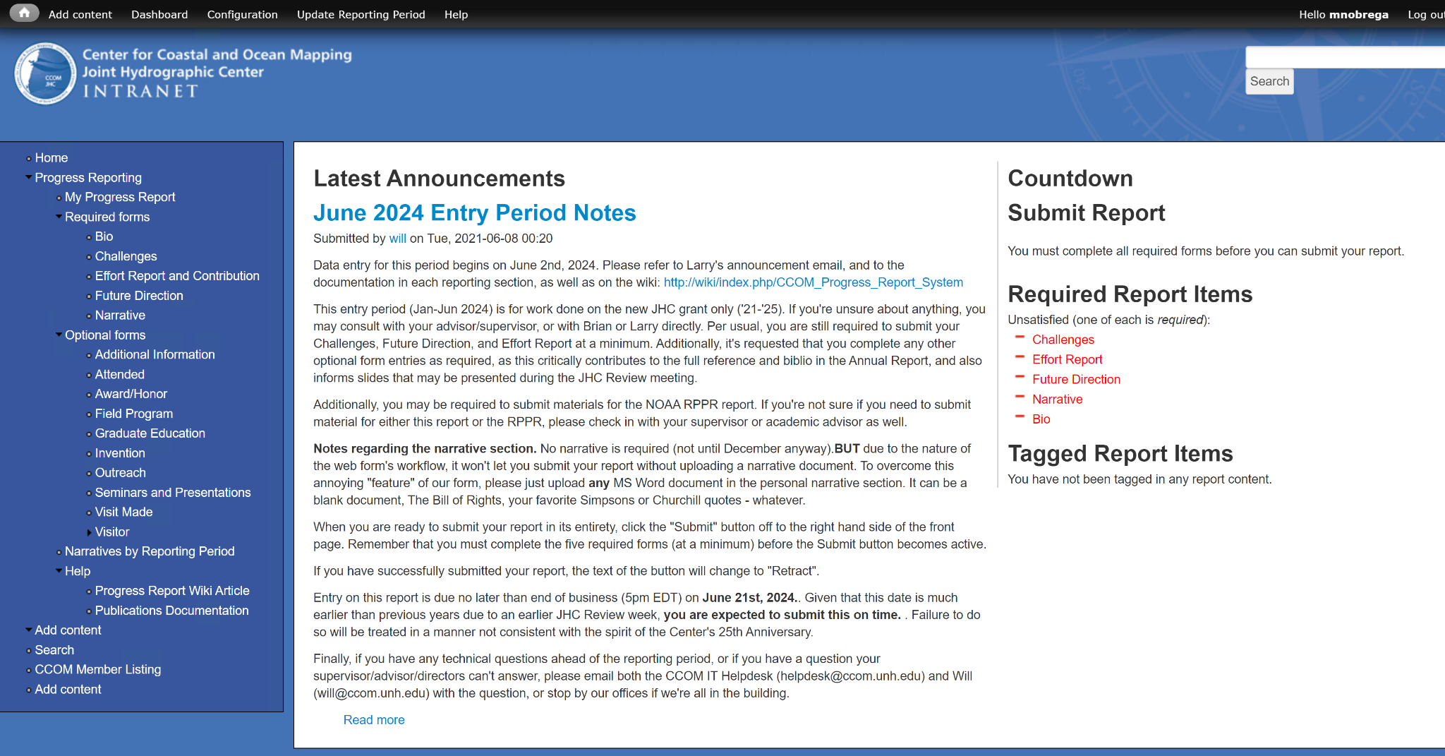
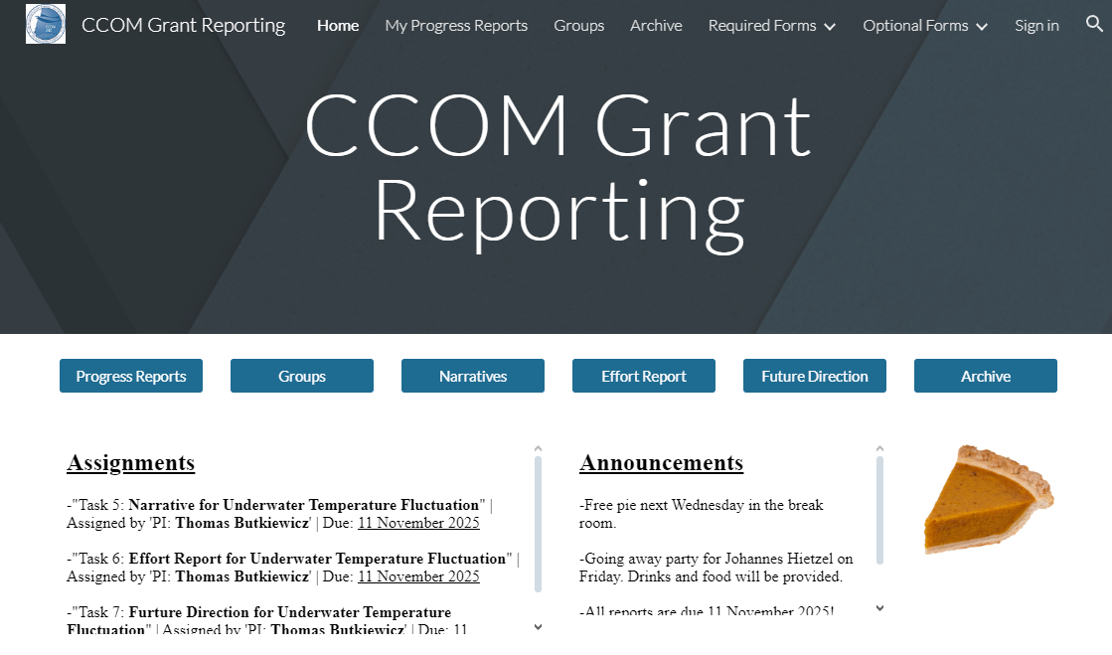
CCOM Grant Reporting Platform
Chase Cushman, Maxwell Nobrega, Rose Shore, and Sam Heinze
Computer Science and Information Technology, University of New Hampshire, Durham, NH 03824
Introduction
sTAMD Simulations
Implementation
Context
Managing federal grant reports at UNH’s Center for Coastal and Ocean Mapping (CCOM) is a cumbersome and inefficient process, plagued by fragmented documents, lack of standardization, and difficulty in tracking progress. Currently the report system is long and messy, consisting of a word document shared between dozens of contributors that is hard to keep uniform, as well as archive.
Our project focuses on creating a new grant reporting system for CCOM to use. This system would replace the old way of creating reports and make the task easier to complete. Along with streamlining the process, our project looks to create an easy way to archive reports so past sections can be used again in the future.
To accomplish the task at hand, the development team split into two groups, focusing on the web dashboard and the database. Chase Cushman and Maxwell Nobrega were assigned to the website, while Sam Heinze and Rose Shore focused on the database. We first designed a database schema and implemented it in MySQL, before integrating it with the user-facing web dashboard. A key challenge was accessing the UNH CCOM development server to test and deploy the system, but this was successfully resolved with assistance from CCOM IT. Throughout the process, the team also worked on producing thorough documentation, guaranteeing long term maintainability by UNH CCOM.
Figure 1: Legacy Reporting Workflow - Fragmented and Inefficient.
Figure 2: Proposed Grant Reporting System - Streamlined and Unified.
Requirements
Conclusions
Functional Requirements:
The UNH CCOM Grant Reporting System is intended to allow the different UNH CCOM research contributors to work together to build the final report from many different forms and subreports. This shall be achieved with the following:
Integrate CCOM AD server into new system, use to facilitate sign in.
Allow reports to be saved for future work.
Create RPPRs process.
Create and organize GROUPS with hierarchies.
  Assign subordinates tasks with due dates.
Create an archival system that stores reports that can be retrieved.
Create a process of escalating submissions.
Needs to follow federal regulations set by NOAA and CCOM.
Non-functional Requirements:
The UNH CCOM Grant Reporting System is intended to consolidate and simplify the current reporting system into one easy to follow process. This shall be achieved with the following:
Needs to be familiar to the old system.
Security: Needs to be internal to the CCOM system. No outside reach.
The UX needs to have logical and concise flow. Fewer page navigations are better.
UI, while not a priority, should not be overlooked.
System Layout
The goal of this project was to create a reporting platform that would increase organization, eliminate ambiguity, and track progress of reports. While not fully achieved, the groundwork has been set via technical and planning documents, the basic creation of the webpages, and the partial creation of the database. The MOV statement defined success as having designed and created a platform that increased simplicity, efficiency, and usability in the UNH CCOM reporting process. This was partially achieved with the design and partial creation of a platform that consolidated the whole reporting process into one website. As well, it was achieved by reducing the number of applications used in the reporting process from 2 to 1.
CCOM Grant Reporting System
Website
Database
Announcements
Forms and Reports
Groups
CCOM AD
Forms and Reports
Figure 3: System Layout showing the relationship between the front-end website and the back-end database.
Design
Testing and Results
The CCOM Grant Reporting System was designed to address the inefficiencies of the previous reporting workflow, which relied on disjointed tools like Google Docs, making version control and collaboration difficult. Our solution consolidates all reporting functions into a centralized web dashboard, allowing CCOM researchers to easily submit, edit, and track their reports. Figure 1 illustrates how the old system functioned, leading to bottlenecks in submission and approvals. Figure 2 presents our redesigned system, where users can seamlessly navigate reports, assign tasks, and track compliance. At the core of our system are two key components: the database (which securely stores and organizes all report data) and the web dashboard (which provides an intuitive interface for users). The landing page of the website is the announcements page, where key announcements can be viewed. After CCOM users sign into the dashboard, they can access the Forms and Reports sections which allow them to create and edit reports including RPPRs that pertain to them. They can also access the Groups page which serves as a hub for collaboration and oversight during the reporting process. Forms and Reports are stored in the database as individual chunks assigned to a particular person for writing, editing, reviewing, etc. The integration with CCOM’s AD server further ensures that only authorized users can access and edit data based on their assigned tasks and groups.
Testing efforts have been limited so far, presenting an area of possible improvement, but the team has begun exploring key validation steps. For example, compilation checks are possible using Jenkins to schedule builds, while data integrity tests could be used to stress-test the database schema. Unit testing will also be implemented. User testing and feedback remain areas for further development, but the favored approach is to run an instance of the project on a CCOM internal server and allow personnel to use it in a beta testing scenario. A key next step is determining how to provide CCOM personnel with a beta version of the system to observe their interactions and gather insights for improvement.
References
Sponsors: Thomas Butkiewicz
William Fessenden
Erin Selner
Colleen Mitchell
Advisor: Lisa Henry

Slide 2
Abstract
The Center for Coastal Ocean Mapping (CCOM) at UNH is responsible for federally funded research projects that must adhere to strict reporting guidelines set by the National Oceanic and Atmospheric Administration (NOAA). However, the existing reporting system is fragmented, relying on shared Google Docs and an outdated internal platform, leading to inefficiencies, version control issues, and compliance risks.
To address these challenges, we developed a centralized grant reporting platform that consolidates all reporting functions into a single, structured system. This platform enables seamless collaboration, task delegation, and real-time tracking, ensuring that reports remain organized and accessible. Additionally, our solution transitions the database from a deprecated Drupal-based system to a modern SQL architecture, improving security, maintainability, and scalability. This project lays the groundwork for a more efficient and streamlined reporting workflow, reducing administrative overhead and enhancing NOAA compliance.

