Slide 1


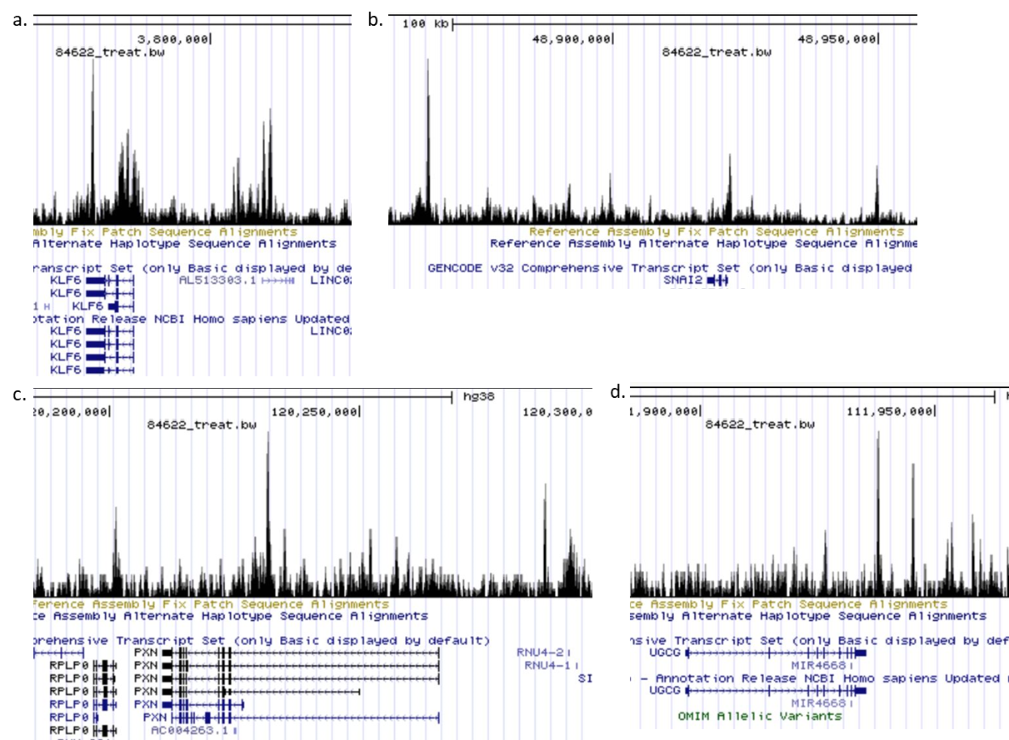
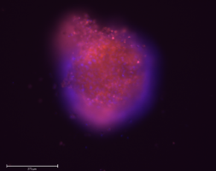
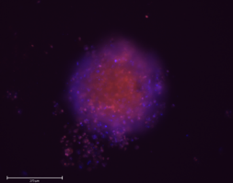
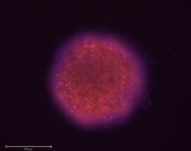
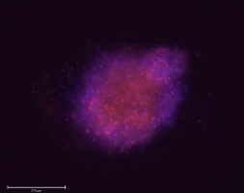
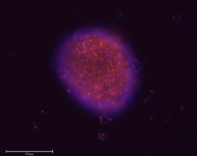
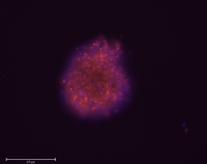
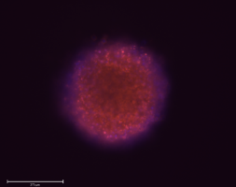
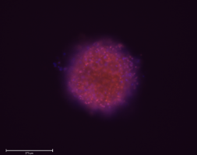
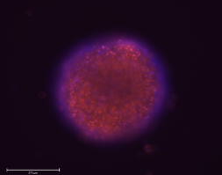
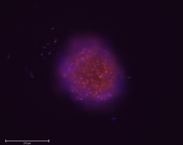
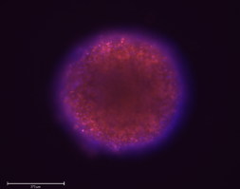
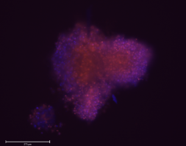
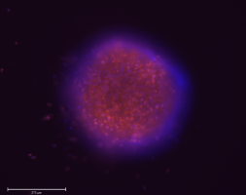
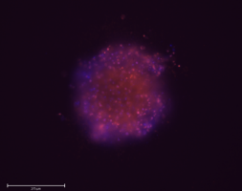
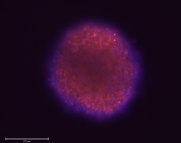
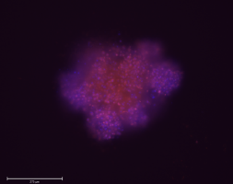
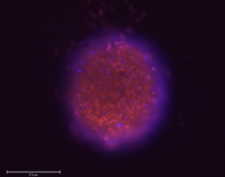
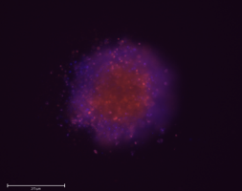
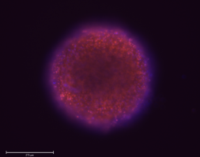
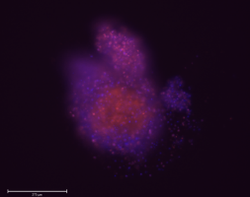
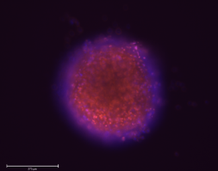
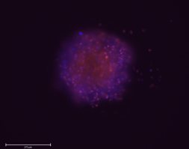
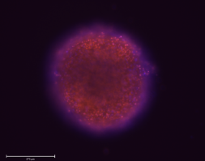
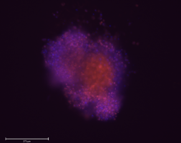
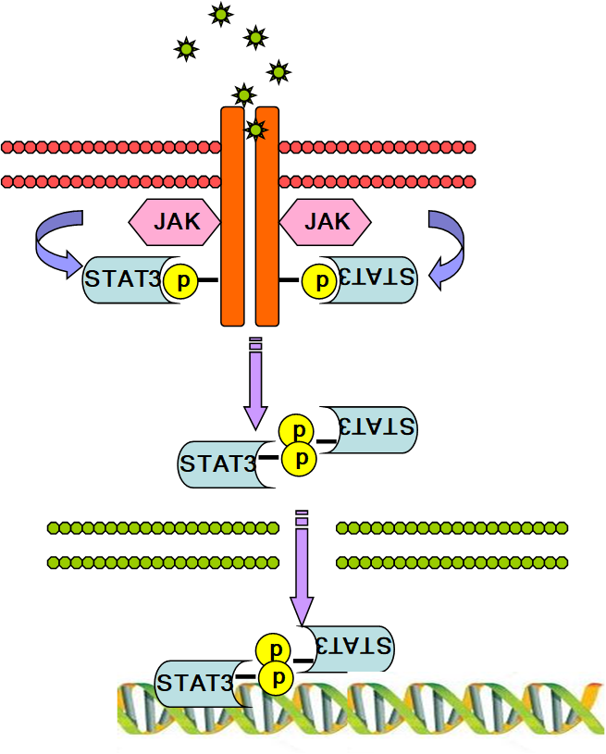

Analyzing the role of STAT3 in cisplatin resistant ovarian cancer
Sarah J. Miseirvitch and Sarah R. Walker¹
¹Department of Molecular, Cellular, and Biomedical Sciences, Biochemistry Department, University of New Hampshire
Introduction
Results
Results continued
In 2018, approximately 22,000 women were diagnosed, and 14,000 women died from ovarian cancer. One reason why this disease is the fifth leading cause of death in women is because it is typically not diagnosed until the disease has progressed to later stages of cancer. Progression of the disease leads to cancerous tumors spreading to other parts of the body (metastasis), and chemotherapy having less of an impact on fighting the cancer (drug resistance) and my research is focused on identifying genes involved in these steps. STAT3 is part of the Signal Transducer and Activator of Transcription (STAT) family and plays a leading role in several cellular functions involved in cellular metastasis, including; cellular proliferation, invasion, migration and angiogenesis. For my thesis work, I focus on genes that are targets of STAT3, such as KLF6, PXN, UGCG and CD44 and how they may be differentially expressed in an ovarian cancer cell line (OVCAR8) that has been adapted to grow either with (Cisplatin Resistant, CR) or without (Cisplatin Sensitive, CS) the presence of chemotherapy. To first confirm these genes to be STAT3 target genes, I used siRNA’s to knockdown the expression of STAT3 target genes in a 3D model to more accurately mimic tumor behavior. Preliminary results of OVCAR8 cells have shown that knocking down STAT3 also results in the reduced expression of KLF6, PXN, UGCG and CD44. Future experiments will include plating CS and CR siRNA treated cells in 3D cultures, treated with either 3uM Cisplatin or media only, and incubated for 7 days. Dyes that label cells for viability (NucBlue) or death (Propidium Iodide) will be added and differences between all treatments visually observed using the EVOS cell imaging system. Cell TiterGlo 3D will subsequently be added and ATP activity (viability of cells) measured and quantified. The overarching goal is to modulate the gene expression of CR cells to make them more sensitive to chemotherapy drugs.
STAT3 binds near genes upregulated in Cisplatin resistant cells
Knocking down STAT3 target genes enhances cisplatin induced morphology changes in resistant cells
Media Only
3uM Cisplatin
Media Only
3uM Cisplatin
siCTRL
Sensitive
siCTRL
Resistant
siSTAT3
Sensitive
siSTAT3
Resistant
siCD44
Sensitive
siCD44
Resistant
siUGCG
Sensitive
siUGCG
Resistant
siPXN
Sensitive
siPXN
Resistant
siKLF6
Sensitive
siKLF6
Resistant
Ovarian cancer cells (CS and CR) were plated with siRNA to knockdown genes of interest, in a 96 well round bottom plate to encourage spheroid (3D) formation. After 48 hours in culture, cells were then dosed with either media (control) or 3uM cisplatin. Cells continued to grow in culture for 5 additional days before NucBlue (blue nuclear stain) and Propidium Iodide (red: dead cells) dye was added and spheroids imaged on the EVOS imager. Knockdowns pictured: Control (CTRL), STAT3, CD44, UGCG and PXN
We analyzed STAT3 binding using ChIP data from the GEO dataset GSM2278006 where we looked for STAT3 binding sites near select genes which are identified by the large peaks. a. KLF6 b. Snai2 c. PXN d. UGCG Data represented above is from STAT3 ChIP-seq in a breast tumor.
Background
Future Directions
Jak-STAT3 signaling pathway
ChIP studies for confirmation of STAT3 binding of targets in ovarian tumor cells
Viability assay to check for re-sensitization of resistant cells to chemotherapy treatment
Overexpression studies of STAT3 and/or target genes to make sensitive cells resistant to chemotherapy
Studies on the effects of gene modification on cancer cell metastasis using a mesothelial clearance assay
The STAT3 signaling pathway is activated by growth factor and cytokine stimulation. This causes Janus kinases associated with the receptors to phosphorylate the receptor and recruit STAT3. Janus kinase then phosphorylates STAT3, causing STAT3 to disassociate from the receptor. Once disassociated STAT3 then forms a homodimer allowing it to enter the nucleus and affect transcription.
Acknowledgements
Cisplatin resistant cells were obtained from Alexander Brodsky’s lab at Brown University. Scan QR code.
Supported by an Institutional Development Award (IDeA) from the National Institute of General Medical Sciences of NIH under Grant number P20GM113131
Ovcar8 cells grown in 3D were transfected with siRNA to STAT3 and known STAT3 genes of interest: Dec1, CD44, TNFRS1A, UGCG, PXN and KLF6. Data was acquired through qPCR and values are normalized to actin and expressed relative to a knockdown control (siCTLA).

