Slide 1
A Passive Detection System for Localizing Vulnerable Road Users
Shuva Paul
Email: Shuva.paul@unh.edu
Advisor: Dr. Nicholas Kirsch

Slide 2
Introduction
Recent Trends of Road Fatalities
Vulnerable Road User (VRU) Fatalities
Source: National Highway Traffic Safety Administration (NHTSA)

Slide 3
Background
VRU Collision Avoidance Systems
Research on collision Avoidance
Passive Collision Avoidance
LED-equipped Helmets & Gloves
Pedestrian-Friendly Bumpers in Vehicles
Active Collision Avoidance
Advanced Driver Assistance Systems (ADAS)
Sensor-enabled Airbag Systems
Dedicated Lanes for Cyclists
Cooperative Collision Avoidance Systems (CCAS)

Slide 4
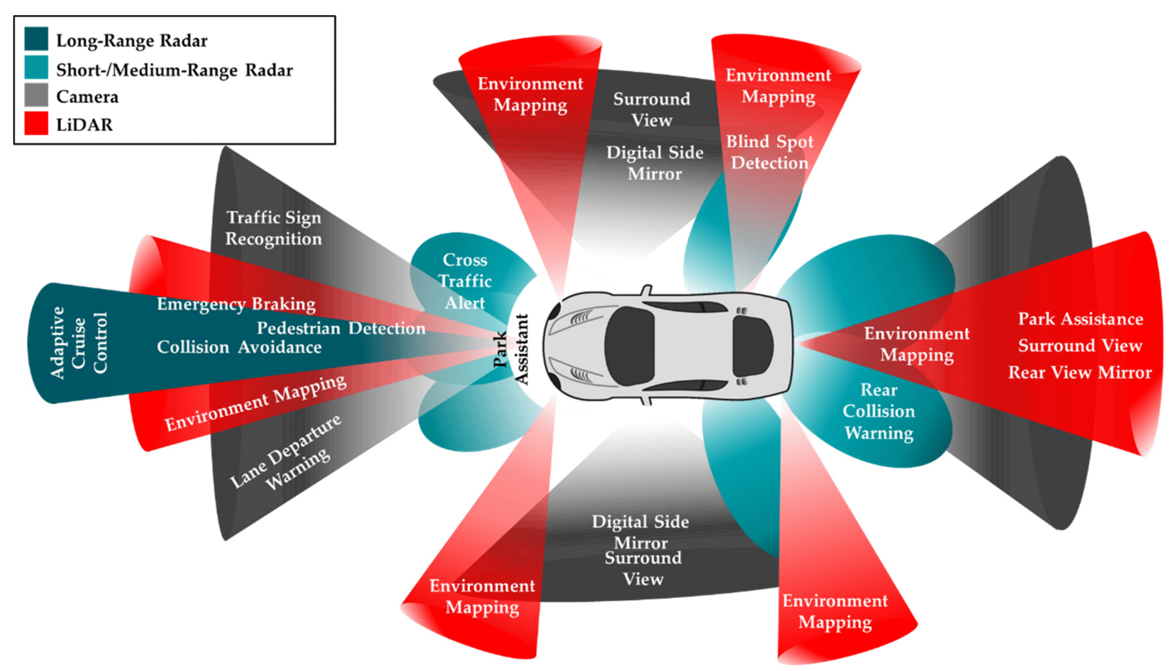
Advanced Driver Assistance Systems (ADAS)
A typical example of a Vehicle’s Sensors positioning
Limitations:
  Range
  Obstructed views
  Adverse weather
(D. J. Yeong et al., 2021)

Slide 5
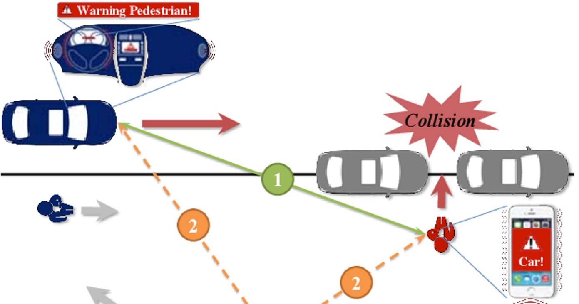
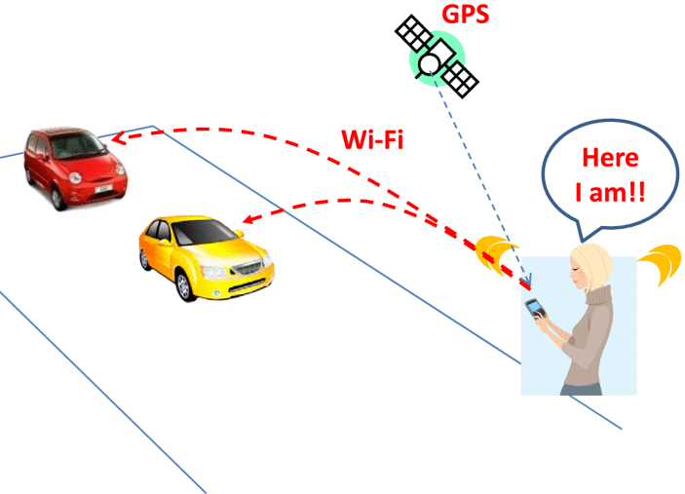
Cooperative Collision Avoidance Systems
How it works
Non-Line-of-Sight Scenario
(P. -F. Ho et al., 2017)
(M. Morold et al., 2022)

Slide 6


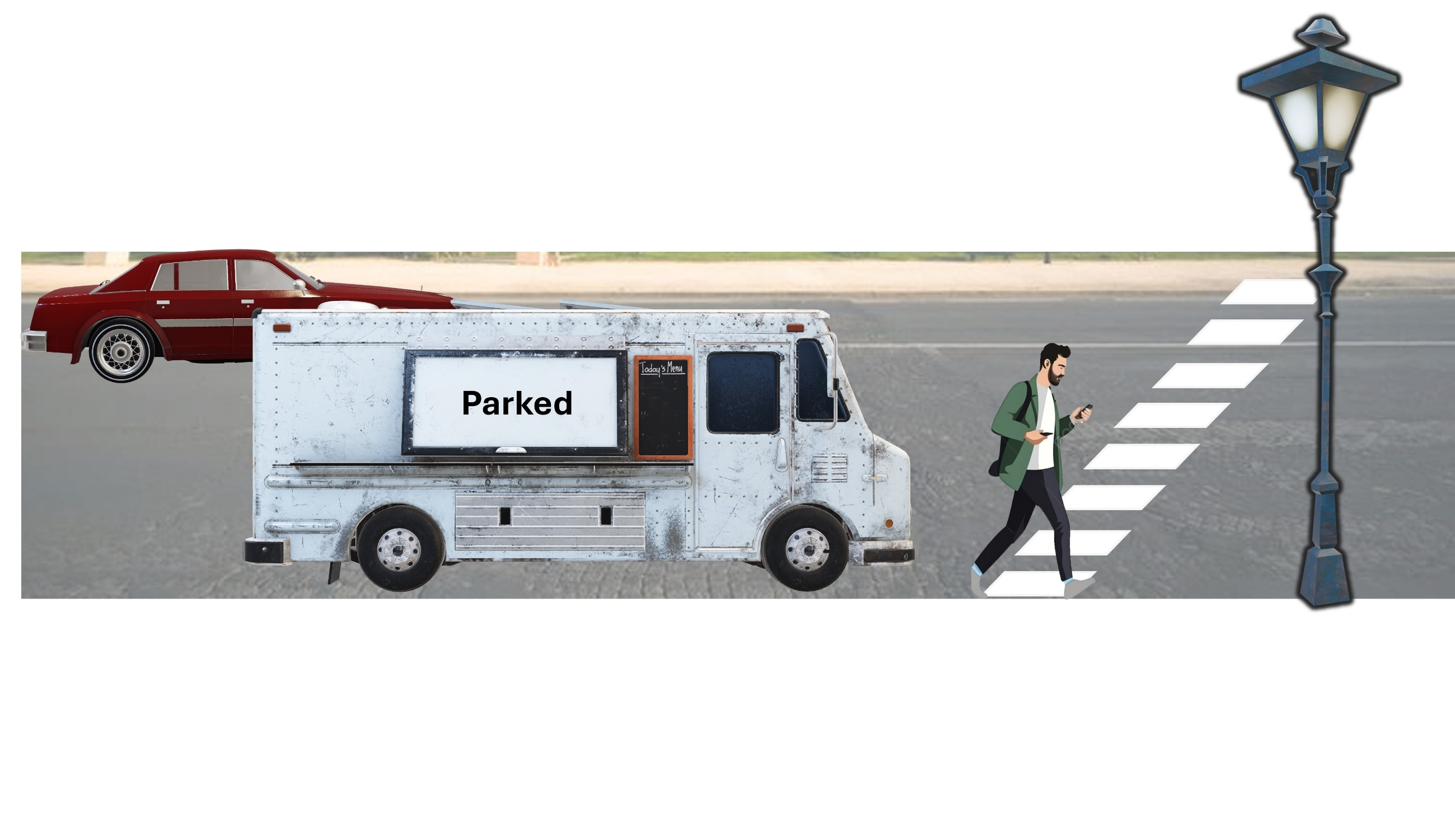





Fundamental Steps of CCAS
Cloud/Roadside Server
CAM: Cooperative Awareness Message
CAM
VAM: VRU Awareness Message
Alert
VAM
Alert

Slide 7
State-of-the-art VRU safety Limitations
    Autonomous vehicles rely on their own detection
    Multi-sensor system is not available in older/cheaper vehicles
    CCAS Requires Active Participation of VRU
    Problems relating to VRU direct communication with Vehicles

Slide 8

Research Goal
Cloud/Roadside Server
VAM: VRU Awareness Message
CAM: Cooperative Awareness Message
CAM
Alert
VAM
Alert

Slide 9





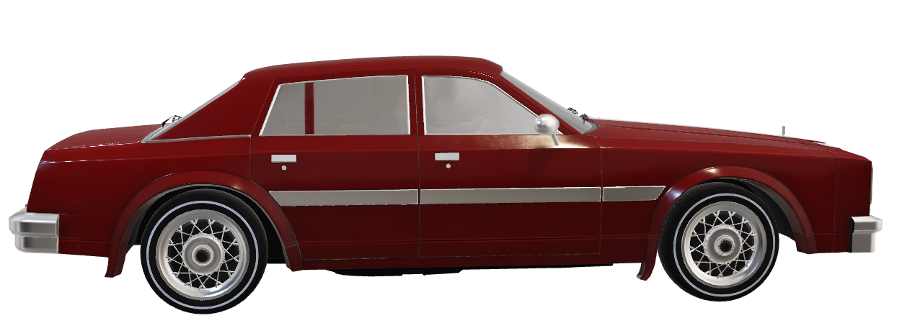

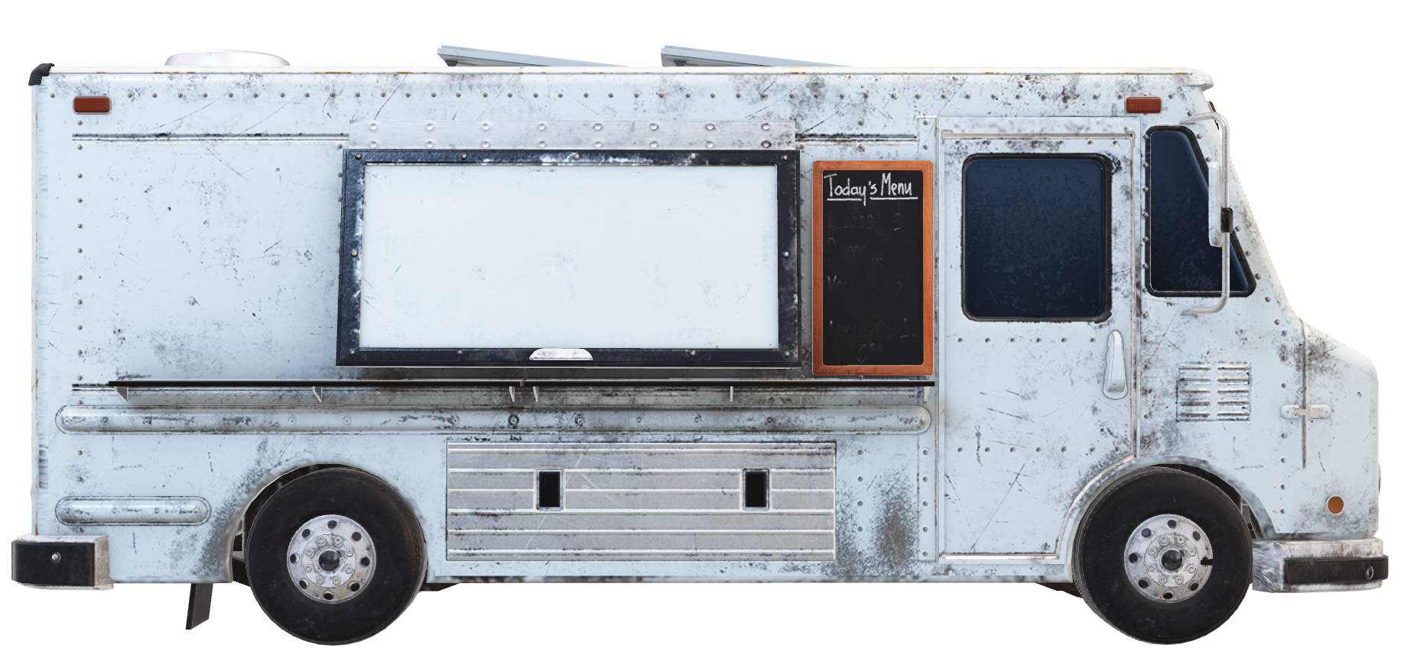

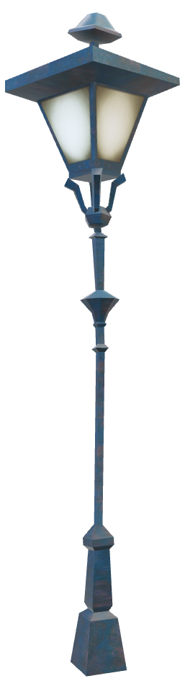

VRU Detection Via Signals of Opportunity
Cloud / Roadside Server
Sensor Data
Sensor Data
Warning
~ Dairy Ice Cream Bar ~

Slide 10
Preliminary Simulation Framework
Simulating VRUs Trace
Simulating Opportunistic Signals
Capturing RSSI at Sensors Locations
Data Preprocessing
Position Estimation Using Least Square Estimation (LSE)
Localized Pedestrian
Kalman Filter
Data Fusion
Camera Data
Computer Vision Algorithm
VRU Identification with Position
RSSI= Received Signal Strength Indicator

Slide 11










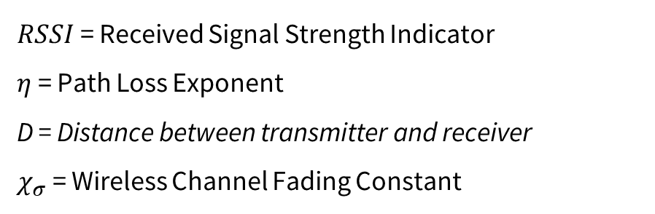


RSSI To Location Estimation Algorithm
Log Distance Path Loss Model
D
$$RSSI=−10η{Log}_{10}D+ χ_{σ}$$
$RSSI$ = Received Signal Strength Indicator
$η$ = Path Loss Exponent
D = Distance between transmitter and receiver
$χ_{σ}$ = Wireless Channel Fading Constant
D1
D2
$$(x_{1}, y_{1})$$
$$(x_{1}, y_{1})$$
$$(x, y)$$
Using the General Formula of Circle
$$(x_{1}, y_{1})$$
$$D_{1}=\sqrt{{(x_{1}−x)}^{2}+{(y_{1}−y)}^{2}}$$
D3
$$D_{2}=\sqrt{{(x_{2}−x)}^{2}+{(y_{2}−y)}^{2}}$$
$$D_{3}=\sqrt{{(x_{3}−x)}^{2}+{(y_{3}−y)}^{2}}$$
Trilateration

Slide 12







Least Square Estimation
$$RSSI=−10η{Log}_{10}D+ χ_{σ}$$
D
Numerical Analysis To Estimate Position
D1
Estimated Distance Matrix
Least Square Estimation (LSE)
Estimated Position
$$d_{1}$$
$$d_{2}$$
$$(x_{1}, y_{1})$$
$$(x_{2}, y_{2})$$
D2
Iterative Analysis Method
Mathematical Model to Estimate and Minimize Error
Starts With Initial Guess
Provide Output: Error < Threshold
$$(x_{3}, y_{3})$$
$$d_{3}$$
D3

Slide 13
Kalman Filter Algorithm
Step-1
Step-0
INPUTS:
Measurements, Measurement Uncertainty
INPUTS:
Initial State,
Initial State Uncertainty
Predict → Newton’s Motion Models
Update → Using Kalman Gain and Measurements
Step-2
Step-3
UPDATE
PREDICT
OUTPUTS:
Output State,
State Uncertainty
Kalman Gain
Unit Delay
(n → n-1
KALMAN FILTER

Slide 14
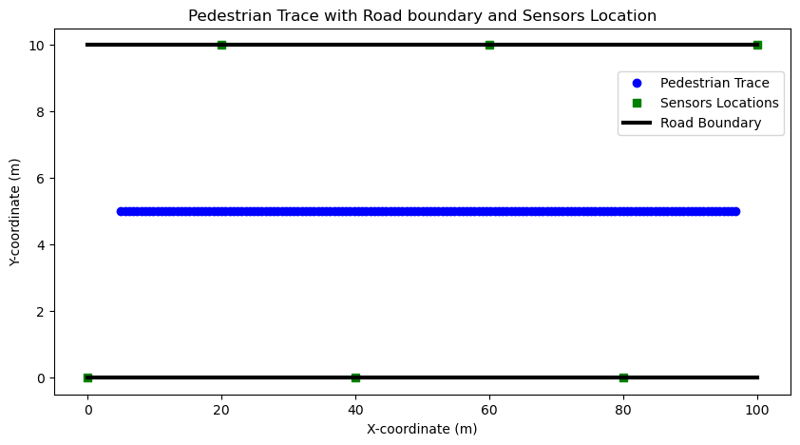
Preliminary Simulation

Slide 15
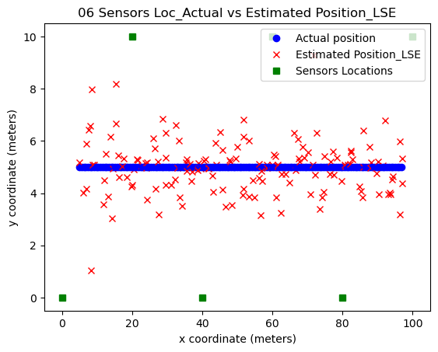
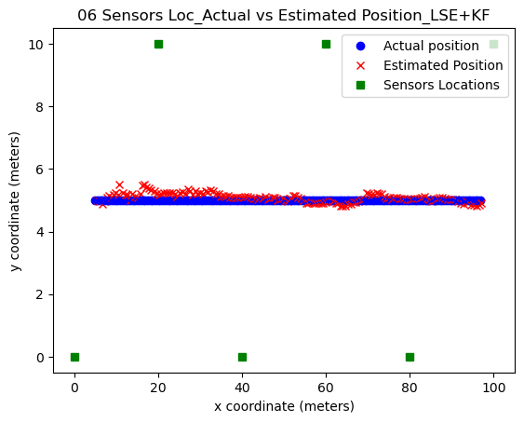
Preliminary Results of VRU Localization
$$RSSI=−10η{Log}_{10}D+ χ_{σ}$$
Position Estimation: LSE Output
Position Estimation: Kalman Filter Output

Slide 16
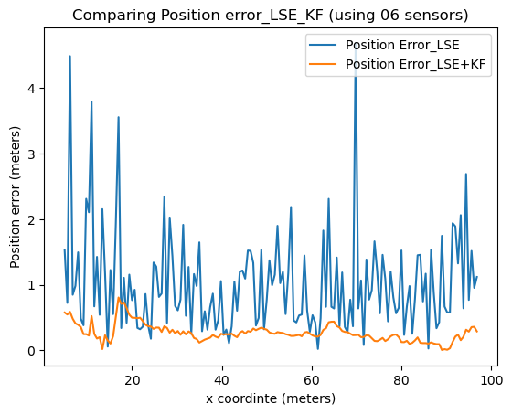
Error in VRU Localization

Slide 17
References
A. M. Wyglinski et al., "Phantom Car Attack Detection via Passive Opportunistic RF Localization," in IEEE Access, vol. 11, pp. 27676-27692, 2023.
Z. Yan et al., “Online learning for 3D LiDAR-based human detection: experimental analysis of point cloud clustering and classification methods”, Auton Robot 44, 147–164 (2020).
M. Morold, M. Bachmann and K. David, "Toward Context Awareness for Cooperative Vulnerable Road User Collision Avoidance: Incorporating Related Contextual Information," in IEEE Vehicular Technology Magazine, vol. 17, no. 3, pp. 75-83, Sept. 2022.
D. J. Yeong, G. Velasco-Hernandez, J. Barry, and J. Walsh, “Sensor and Sensor Fusion Technology in Autonomous Vehicles: A Review,” Sensors, vol. 21, no. 6, p. 2140, Mar. 2021.
P. -F. Ho and J. -C. Chen, "WiSafe: Wi-Fi Pedestrian Collision Avoidance System," in IEEE Transactions on Vehicular Technology, vol. 66, no. 6, pp. 4564-4578, June 2017.

Slide 18

Source: https://www.searchenginejournal.com/how-to-make-qa-videos/353832/
Email: Shuva.paul@unh.edu

