Slide 1
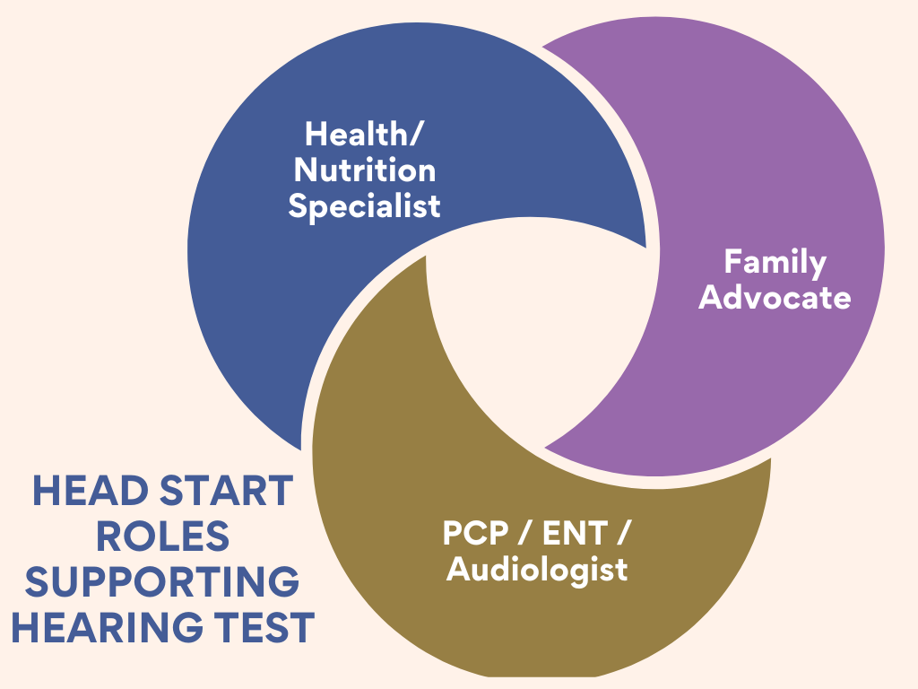
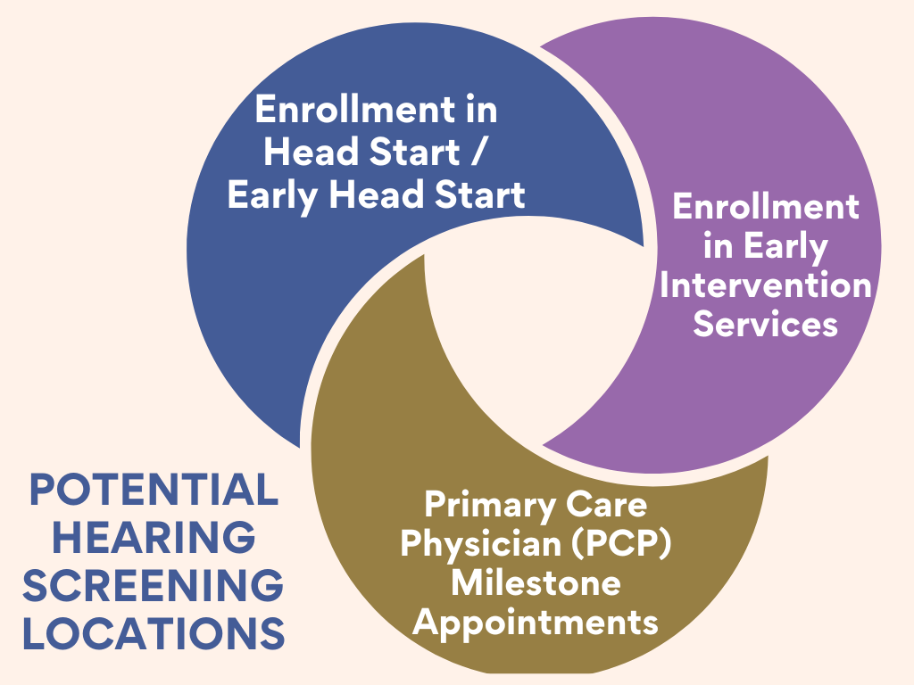
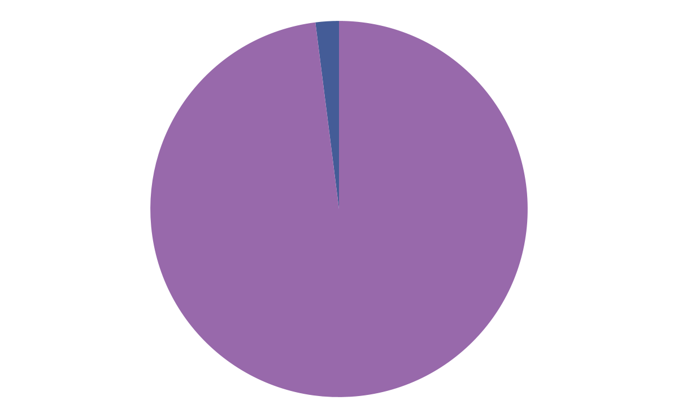
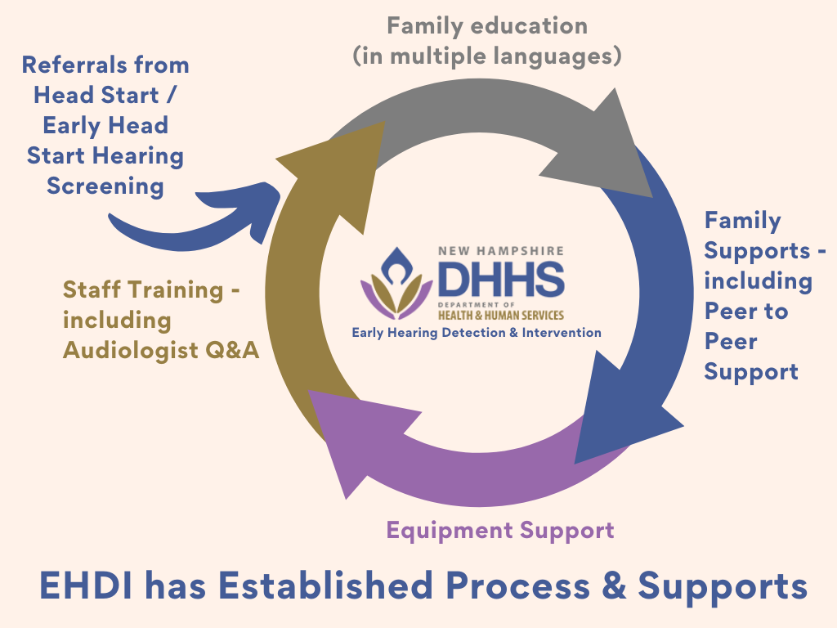
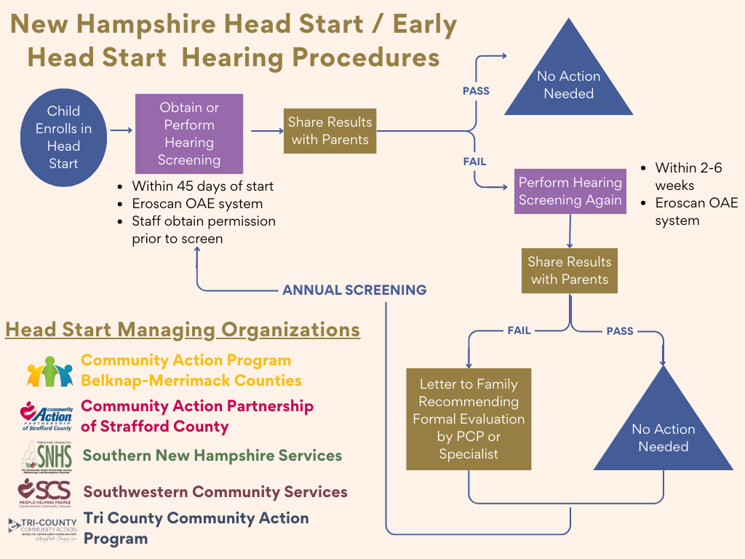
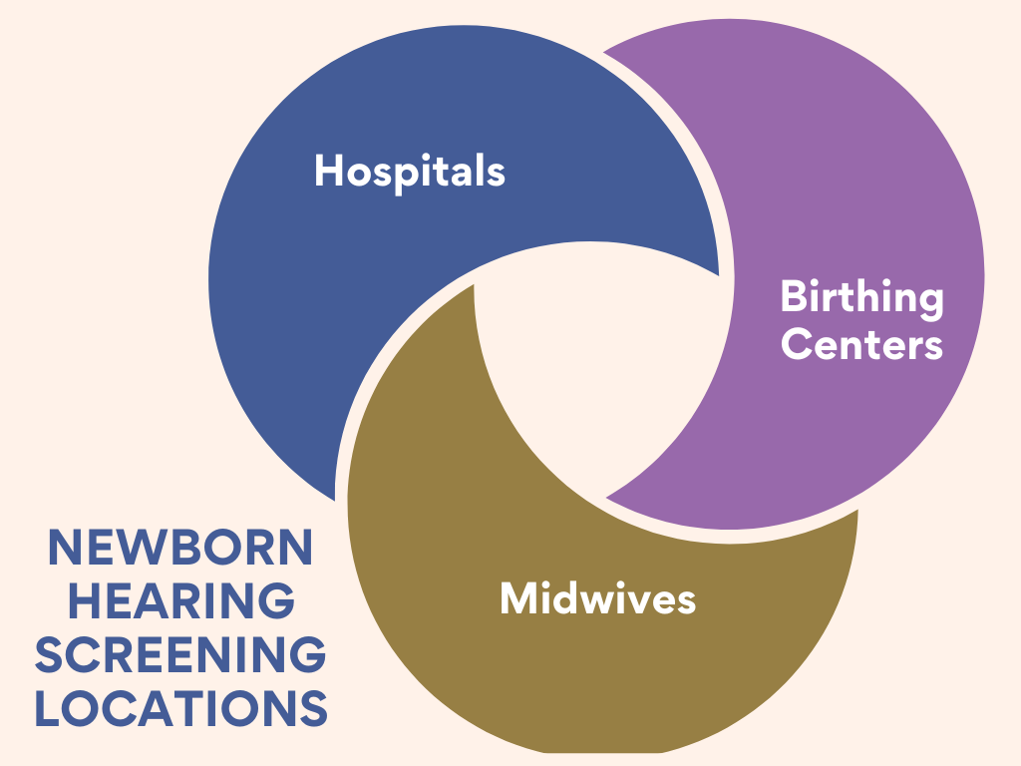
Enhance New Hampshire Early Hearing Detection & Intervention (EHDI) system infrastructure for the young child
Danielle Heaton, Family Trainee
NH-ME LEND, Institute of Disability, University of New Hampshire
Introduction
Methods
The state of New Hampshire (NH) was awarded funding for Early Hearing Detection and Intervention State/Territory Program (Funding Opportunity Number: HRSA-24-036) through the Health Resources & Services Administration (HRSA).
This funding is to expand beyond the newborn screening and strengthen current NH infrastructure to identify deaf or hard of hearing (DHH) infants and children up to age 3. Ensuring services are available to optimize language, literacy, cognitive, social and emotional development.
Those involved in the process is similar across all 45 locations.
Health/Nutrition Specialist
Family Advocates
PCP/ENT/Audiologist
1
IDENTIFY
Current Hearing Screening Infrastructure
2
VALIDATE & DOCUMENT
Locations, Management & Hearing Process
3
ESTABLISH RELATIONSHIP
Findings
Conclusion
There are multiple locations identified where hearing screenings may be occurring in NH:
Primary Care Milestone Checkups
Head Start Enrollment
Early Intervention Enrollment
Currently no NH Head Start locations share details of any referred children with NH EHDI. Multiple Head Start locations are interested in partnering with EHDI and utilizing their existing process and supports already in place.
EHDI is working to create a process for sharing details when a child is referred from NH Head Start facilities for additional hearing evaluation.
Background
Age 0-3 = critical development
98% of NH newborns have a hearing screening performed at birth. A child can have up to two hearing screenings, before being referred to an audiologist for further testing.
This project focused on exploring the Head Start processes within NH. NH has 34 Head Starts and 11 Early Head Starts, managed by 5 organizations. All 45 locations follow the same intake process.
The EHDI Guidelines are screening by 1 month, diagnosis by 3 months and intervention by 6 months.
In NH, a newborn hearing screening is part of the standard of care. Hearing screenings are performed at hospitals, birthing centers and with midwives, with established reporting to EHDI.
Additional efforts are underway, outside of the scope of this project, to understand the early intervention hearing screening process.

