Slide 1
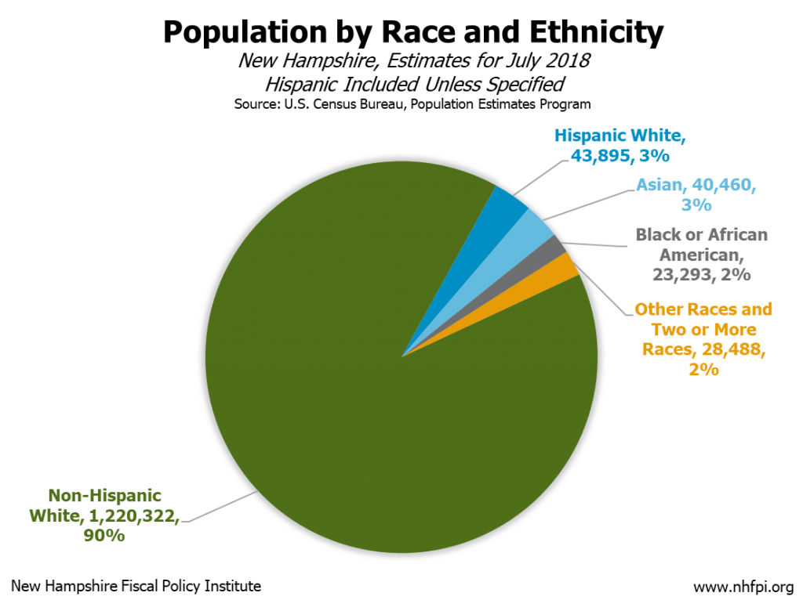
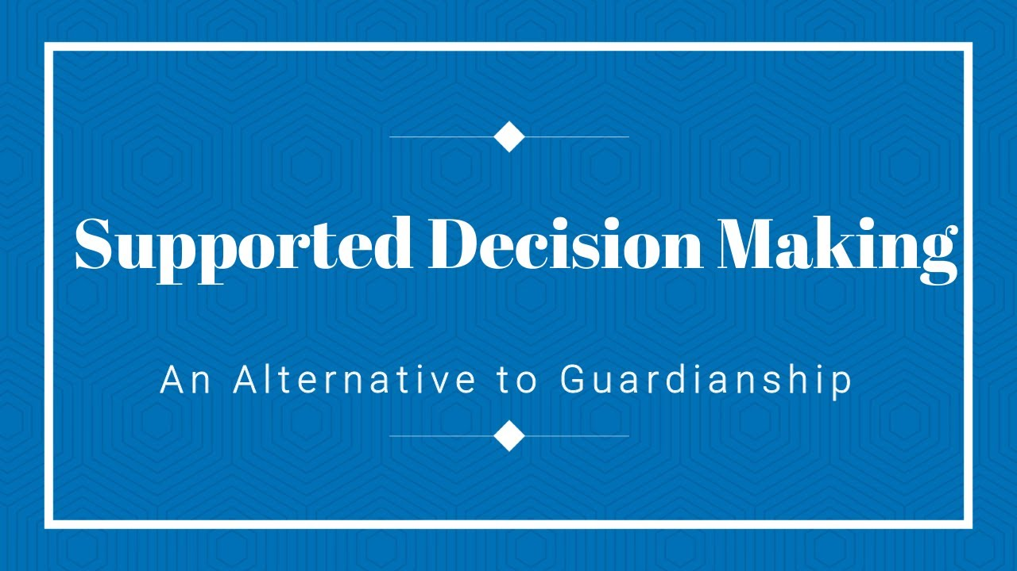
Supported Decision-Making (SDM) for New Americans with Disabilities
Sabitri Rayamajhi, MPH, MSW
NH-ME LEND, Institute on Disability, University of New Hampshire
Introduction
Data Analysis
Conclusion
      Disability Rights Center (DRC) states that SDM supports the freedom to make choices to the best of their abilities for individuals with disabilities.
The SDM process is individually driven.
The SDM is a legal alternative to guardianship.
Individuals with disabilities can choose someone they trust to help them make decisions.
NH has become more diverse in recent years.
This research strongly relies on a case study which is through extensive interaction with the family being studied.
The qualitative data collection is based on observation and interviews of the client and his family.
The case study will be used in testing the model below:
The core of this research is to educate the supporters of new Americans about the SDM.
SDM enhances the freedom to make choices to the best of their abilities for individuals with disabilities
Cultural competence is seen as a critical component in avoiding biases & and stereotypes.
Individuals supporting the new Americans with disabilities could use the model as guidelines.
Supporter ensures the choices are well understood
Supporter allows to make decisions that are risky
Supporter communicates decision
Supporter recognizes decision
Supporter respects the decision made
Supporter supports picking his/her trusted person
Research Questions:
1. Why is the SDM important to individuals with disabilities?
2. How is the SDM enhanced in improving the lives of New American populations with disabilities?
3. Why is cultural competence important for supporters/providers of new American populations with disabilities?
Methods
In this study, I have used the qualitative research method.
The supported decision-making model is built.
The model works as the guidelines for clients’ supporters in serving the clients’ core rights.
A case study of a new American family is presented:
    The eldest son who is 18 years old is an individual with mental health and developmental disabilities.
    The client is staying at his parent’s home.
    The client’s parents provide support.
    Existing cultural and linguistics challenges.
Supported Decision-Making Model
References
External Layer of the Model: Supported Elements:
    Supported external elements: Supporter respects the decision made, supporter recognizes decision, supporter communicates decisions, and supporter allows to pick a trusted supporter.
    Limited supported external elements: The Supporter ensures the client’s choices are well-understood and the supporter allows the client to make risky decisions.
The SDM model presents the importance of clients’ rights and supporter involvement in better-supporting clients’ SDM process.
The higher the elements, the better the clients’ SDM is fulfilled.
Bhattarai, D. (2023, December 18). Supported decision-making. DRCNH. https://drcnh.org/webinar/supported-decision-making/
Centers for Disease Control and Prevention. (n.d.). Disability and Health Data System (DHDS). Centers for Disease Control and Prevention. https://dhds.cdc.gov/
Inequities between New Hampshire racial and ethnic groups impact opportunities to thrive. New Hampshire Fiscal Policy Institute. (2022, February 9). https://nhfpi.org/resource/inequities-between-new-hampshire-racial-and-ethnic-groups-impact-opportunities-to-thrive/
Malik, S., & Velazquez, J. Jr. (n.d.). Cultural competence and the “New Americans.” Cultural Competence and the. https://alameda.networkofcare.org/veterans/library/article.aspx?id=543

