Slide 1
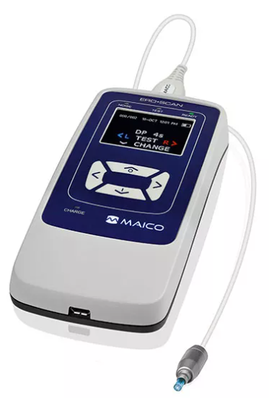
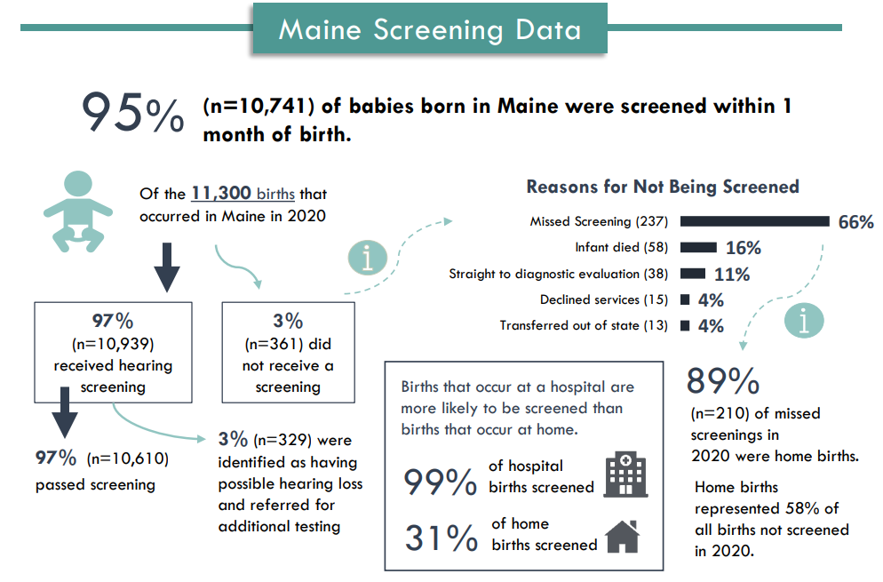
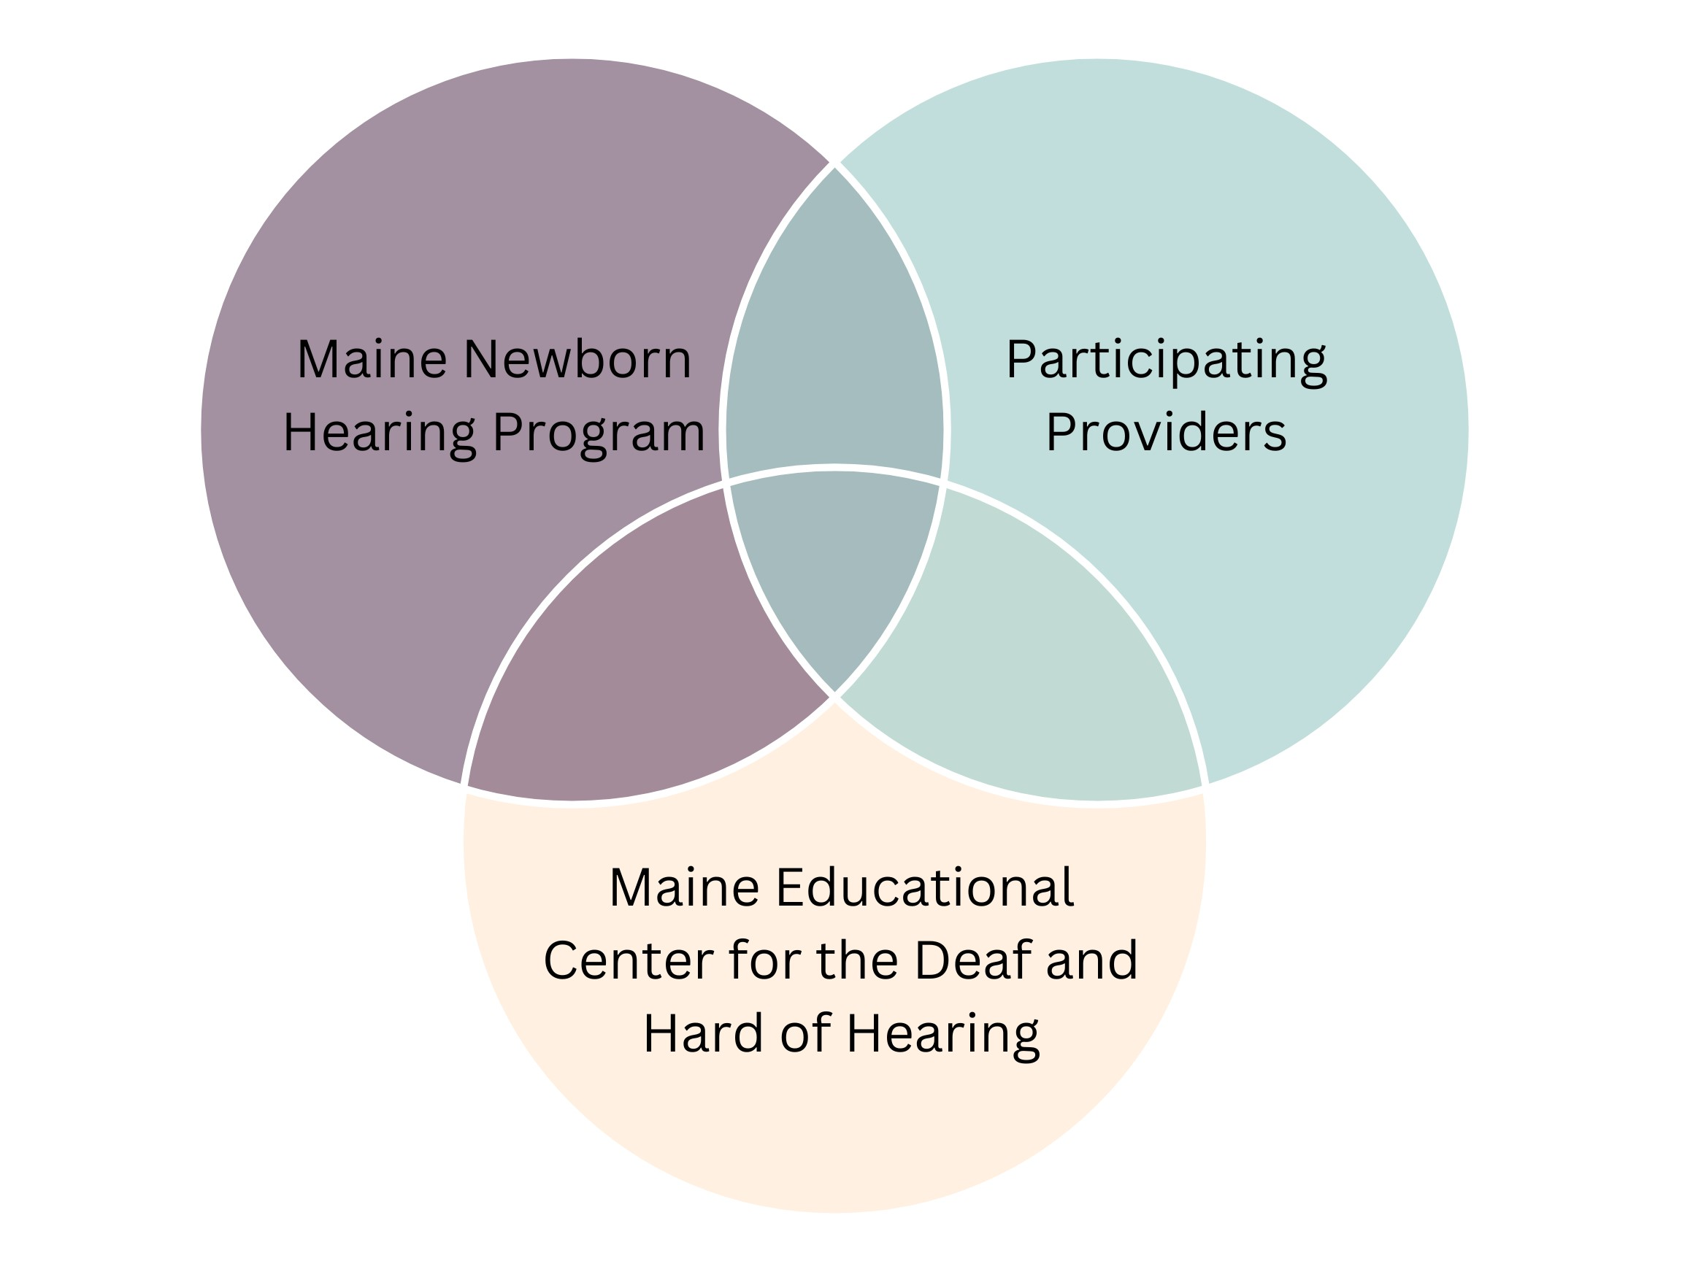
Increasing Accessibility to Newborn Hearing Screening for Out-of-Hospital Births
Katherine Russum, B.A., Psychology
NH-ME LEND, Institute on Disability, University of New Hampshire
Introduction
All infants should be screened for hearing differences by 1 month of age. It is best if it is part of their very first newborn care. If the baby does not pass the hearing screening, it is important to make an appointment for a full hearing test no later than 3 months of age.
Babies who do not pass their hearing test should be seen by a specialist no later than 3 months of age. This will help ensure that every infant with hearing differences is diagnosed early.
Providing recommended medical, hearing, educational, and support services to infants with hearing differences no later than 6 months of age will help the child develop communication and language skills that will last a lifetime.
Next Steps
Hearing Screening Guidelines
The Maine Educational Center for the Deaf and Hard of Hearing (MECDHH) “provides transformative learning, language-focused education, and opportunities for social-emotional growth, empowering Deaf and Hard of Hearing individuals, birth to 22, to reach their full potential.” (https://www.mecdhh.org/)
MECDHH, in collaboration with the Maine Newborn Hearing program, and participating midwives embarked on a pilot program to increase accessibility to newborn hearing screening for out-of-hospital births. Early Hearing Detection and Intervention (EHDI) guidelines recommend screening infants for hearing differences by 1 month of age, evaluation by 3 months of age, and being enrolled in early intervention by 6 months of age. Most infants who have a missed hearing screen after 1 month of age have consistently been infants born outside the hospital setting.
In this pilot program, participating providers (often practicing midwives) will be provided hearing screeners to offer newborn screening to families who had out-of-hospital births. MECDHH possesses 11 Otoacoustic emissions (OAE) hearing screeners which are to be lent to participating providers. To participate in the pilot program, providers will be required to sign agreements that outline the requirements and expectations of participating. The goal of the pilot program is to decrease the incidences of missed hearing screening for infants birthed outside the hospital setting.
Hearing screeners will be located strategically where births occur outside of hospital settings, and in rural areas of the state.
Midwives and other providers have expressed interest in participating in the pilot program.
A Hearing Screening Equipment Agreement has been drafted outlining the requirements of participation in the program.
Requirements of the participating providers include timely reporting of screening data, appropriate maintenance of hearing screeners, as well as training for the use of equipment, and appropriate licensure.
Requirements of the MECDHH include providing a Maico Ero-Scan Pro hearing screener at no cost to the provider, provide initial training for the newborn hearing screening process in Maine and how to use the borrowed machine to complete newborn hearing screens, and provide initial supplies for the hearing screeners.
Requirements of the Maine Newborn Hearing Program include providing ongoing consultation and technical support for participating providers.
Proposed Distribution Plan
Maine Newborn Hearing Program, 2020
Susi Delaney, Red Tent Midwifery

