Slide 1

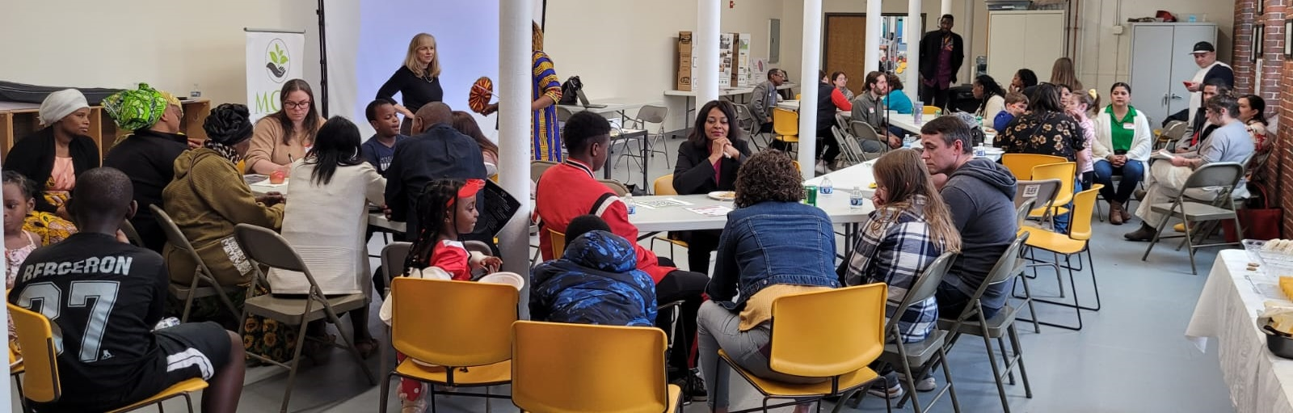
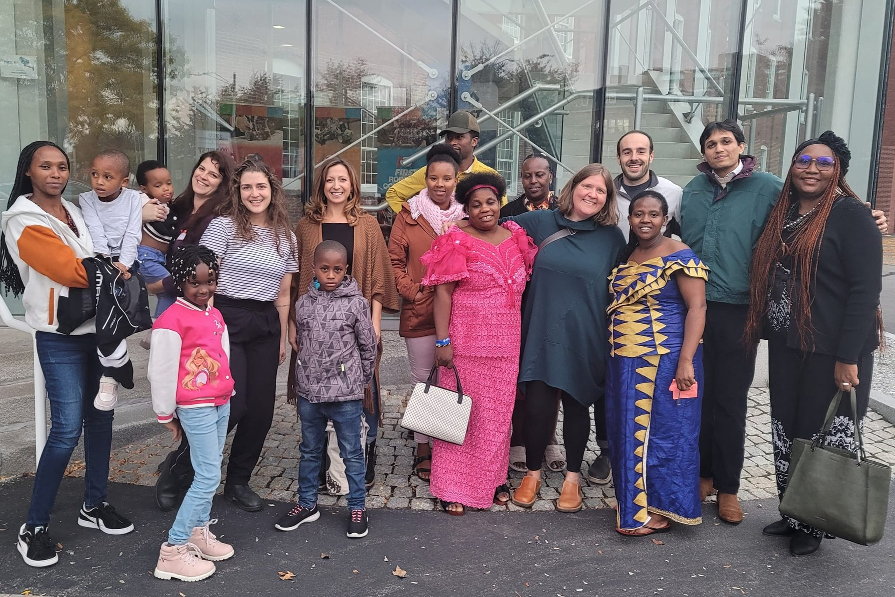
Building a Village Through Community Action
Jaime Gallagher Driscoll, MS OTR/L, Occupational Therapy, Trainee
NH-ME LEND, Institute on Disability, University of New Hampshire
Healthcare Initiative
Intersecting Projects
Childcare Initiative
How to Build a Village
Encouraging group discussions
Accessible materials
Utilize members to support initiatives
  Volunteers
  Translators
  Cultural Brokers
Community meals
  Brings people and cultures together
  Creates a sense of community
Meeting families where they are at
  Transportation
  Childcare
  Making space for work schedules and varying days of worship
Introduction
The Manchester Community Action Coalition is a community-based nonprofit that aims to support, organize, and elevate the voices of BIPOC members of the community. Kile Adumene is the head of the organization, and it is her dream to create a space where community members can learn to use their voice to self advocate and advance their community towards goals identified and accomplished by each of the members. MCAC aims to create a village, promoting stronger family ties within communities of color, encouraging children to succeed and for families of color to experience equal social and economic opportunities.
Barriers
MCAC faces many barriers. Some common to all nonprofit grassroot projects and some unique to MCAC and the people it serves.
Funding
Volunteers
Support Staff
Translators
Scheduling Events
Need for childcare among healthcare workers
Home-based, community member run, childcare
Prior Vaccine Clinic
Current Vaccine Clinic
Healthcare Workforce Shortage
Community Need for Competitive Wages
Healthcare Fair
Dartmouth med students administer vaccines
Presentation/ education on various healthcare occupations
Partner with local college wo provide trainings/ certifications
_________________________________________________
_________________________________________________
Conclusion
A combination of patience and perseverance is needed to work within a community action coalition. It is rare to start and finish a project in a linear fashion. Roadblocks and intersecting initiatives/projects require an organization to have a macro view. It is necessary to know when to pause an initiative while continuing to prepare so when the environment changes you are ready to push forward and take advantage of opportunities that arise. This calls for a leader who is a strategic, creative, resilient, and dedicated. The work is arduous but worth it. The change you bring about is lasting.
Continuing work for the future
Education Initiative – Tutoring, knowledge of the system, parent involvement
Healthcare Fair
Hire Support Staff
Increase Monthly Sustainer Donors
Continue to Partner with Other Non-Profits
Continue to Build a Village
Unable to use volunteer med students to administer vaccines
College disengages
Transport community members to pharmacies
Loss of support
Paused Healthcare fair
Bill - SB 403 FN
Healthcare Workforce Initiative

