Slide 1
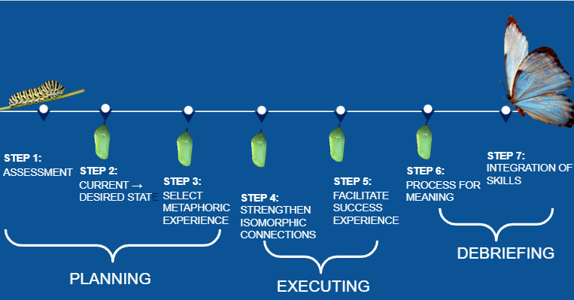
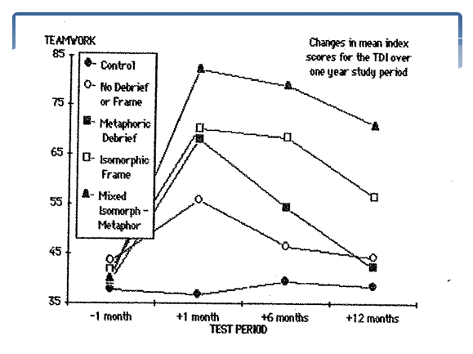
METAPHOR-PHOSIS If an experience is worth 1000 words, a metaphor is worth 1000 experiences. Kendra Bostick & Mackenzie Keefe Kinesiology: Outdoor Education University of New Hampshire
Introduction
7 Step Metaphor Planning Process
Facilitation Matters
As educators work toward integrating experiential activity into practice, kinesthetic metaphors provide experiences that meet each client where they are at. Research has shown that kinesthetic metaphors are powerful change agents for clients. Kinesthetic metaphors create greater change that lasts for longer periods of time. Kinesthetic metaphors work because they bypass conscious resistance, they activate trans derivational searches, and simulate associational memory and learning. The use of kinesthetic metaphors works best when they are intentional, isomorphic, and provide a successful resolution that provides insight to the client. This poster displays the integral planning and implementation involved in facilitating Kinesthetic metaphors.
Assessment: Identify patterns of participant’s current state
What behaviors, feelings, thoughts, or relational interactions is the participant exhibiting?
Identify the participant's desired outcome/state
What will the participant be doing, feelings, thinking, or showing when the desired state is achieved?
Select an experience
What strengths/resources does the participant already have to achieve the desired state?
What activity may help to highlight those strengths or elicit different outcomes?
Strengthen isomorphic connections
Help the participant have an experience that parallels the emotions, behaviors, and thoughts in their daily life. Use frontloading or setting the scene to draw isomorphic connections.
Facilitate a success experience
After eliciting similar emotions, behaviors, and thoughts, allow the participants to write a new end to the story. Create opportunity for success.
Reflect and debrief for meaning
Use reflection and dialogue to assess the experience for newfound behaviors, thoughts, and emotions.
Integration of new skills
Intentionally plan how these learnings can apply to other situations. Hold accountability by revisiting the transfer of learning.
Kinesthetic Metaphor
Isomorphic framing/metaphoric debriefing proved to be the most effective training methodology for initially developing, as well as maintaining, teamwork in the Corporate Adventure Therapy training programs (Gass &Priest, 2006).
Intentional therapeutic actions with isomorphic links to participants’ affect, behavior, and/or cognitions that aid in transfer of functional change through the clients’ perception of their similarity.
Mirror participant’s previous actions up to a point where the client’s choice in the current action will lead to new learning and/or a break in dysfunctional behavior patterns.
Provide an experience where successful resolution of the kinesthetic experience provides insight/pathways/clues to successful resolution of the participant’s issue.
References
Bacon, S. (1983). The conscious use of metaphor in outward bound . Denver, CO: Colorado Outward Bound School.
Boyle, I. & Gass, M. A. (2000). The effectiveness of metaphors on the locus of control in adolescents. Kangaroo Valley, New South Wales: Glengarry.
Doherty, K. (1995). A quantitative analysis of three teaching styles. Journal of Experiential Education, 18 (1), 12-19.
Gass, M. A.; Gillis, H. L.; & Russell. K. C. (2012). Adventure therapy: Theory, Practice, & Research. Routeledge Press.
Gass, M. A. & Priest, S. (2006). Effectiveness of metaphoric facilitation styles in corporate adventure training (CAT) programs. Journal of Experiential Education, 29 (1), 18-24.
Gillis, H. L. & Gass, M. A, (2009). Kinesthetic metaphors. Retrieved from: http://kinestheticmetaphors.com/Kinesthetic_Metaphors.html
Gillis, H. L. & Gass, M. A. (2010). Treating juveniles in a sex offender program using adventure-based programming: A matched group design. Journal of Child Sexual Abuse. 19, 20-34.
Gillis, H. L.; Gass, M. A.; & Russell, K. (2008). The effectiveness of Project Adventure’s Behavior Management Programs for male offenders in residential treatment. Residential treatment for Children and Youth. 25 (3), 227-247.
Hartford, G. (2011). Practical implications for the development of applied metaphor in adventure therapy. Journal of Adventure Education and Outdoor Learning: Outdoor and Adventure Therapy, 11(2), 145–160. https://doi.org/10.1080/14729679.2011.633383
Hirsch, J. & Gillis, H. L. (1997). Food for Thought: A workbook & video for developing metaphorical introductions to group activities. Dubuque, IA: Kendall/Hunt Publishing Company. ISBN 0-7872-2369-X.
Hirsch, J. & Gillis, H. L. (2004). Developing metaphors for group activities. {DVD/CD}.
Contacts
.
For more information contact:
Kendra Bostick, LCSW, MEPD
Co-Founder, Kikori
Doctoral student, UNH
kendra.bostick@gmail.com
Mackenzie Keefe
University of New Hampshire
Graduate Student MSW, MS
mln228@wildcats.unh.edu

Slide 2
This poster template provided courtesy of
UNH ESRC Poster Printing Services
Trust us to make your poster look GREAT!
Website: http://posters.unh.edu
Poster Guide: http://goo.gl/1E7TJY
DELETE THIS SLIDE BEFORE PRINTING

