Slide 1
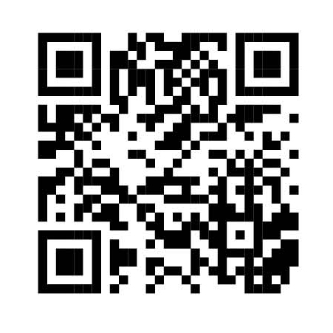
Collaborating with Others Through Training to Enhance Inclusion
Rachel Williams, BA-Early Childhood Education
NH-ME LEND, Institute on Disability, University of New Hampshire
Background
Project Description
Outcomes
The Maine Inclusion Credential is part of the work of Maine Roads to Quality Professional Development Network (MRTQ PDN), funded by the Maine Department of Health and Human Services, Office of Child and Family Services. The University of Maine Center for Community Inclusion and Disability Studies (CCIDS) is a collaborative partner with MRTQ PDN and was the lead in developing the Maine Inclusion Credential.
This project incorporated a variety of activities to update one specific training within the inclusion series that leads to a Maine Inclusion Credential-Collaborating With Others to Support Inclusion
Activities included:
Created and disseminated surveys to gather a variety of viewpoints of the current Collaborating with Others to Support Inclusion training.
Former training participants
Related organizations (Parent and Training Information Center, NAMI, Protection and Advocacy agency, Autism Society of Maine)
Current Maine Inclusion Credential awardees
Analysis of data
Discovered themes from the survey to consider for revising the Collaborating with Others to Support Inclusion training
Communication (with a focus on difficult communications)
Working as a team
Managing interacting with families with a lack of time
Identifying connections to Maine resources to support families and professionals in the training (Maine Parent Federation, NAMI, etc.)
Need for connection to other training topics, Autism, Mental Health, Universal Design for Learning
Consider breaking the current training into 4 on-demand trainings to create more accessibility for a broader audience
The Maine Inclusion Credential is comprised of 6 trainings:
Inclusive Child Care OR Creating Inclusive Youth Development Settings.
Your Professional Development Portfolio.
Foundations of Inclusion: Relevant Laws, Featuring the Americans with Disabilities Act (ADA).
Foundations of Universal Design and Individualizing.
Collaborating with Others to Support Inclusion.
Positive Supports and Challenging Behaviors.
What are the primary challenges that EC professionals experience when working with related professionals in early care and education settings?
Next Steps
Complete revision of Collaborating with Others to Support Inclusion
Offer the training more frequently (currently offered 1-2 times per year)
Review and revise other Inclusion series trainings
3. Data-informed training review and revision
Reviewed current online offering of Collaborating with Others to Support Inclusion
Utilized outline for keeping/removing content based on data
Created recommendations for additional activities and resources
Reviewed with CCIDS
Finalized activities and resources

