Slide 1
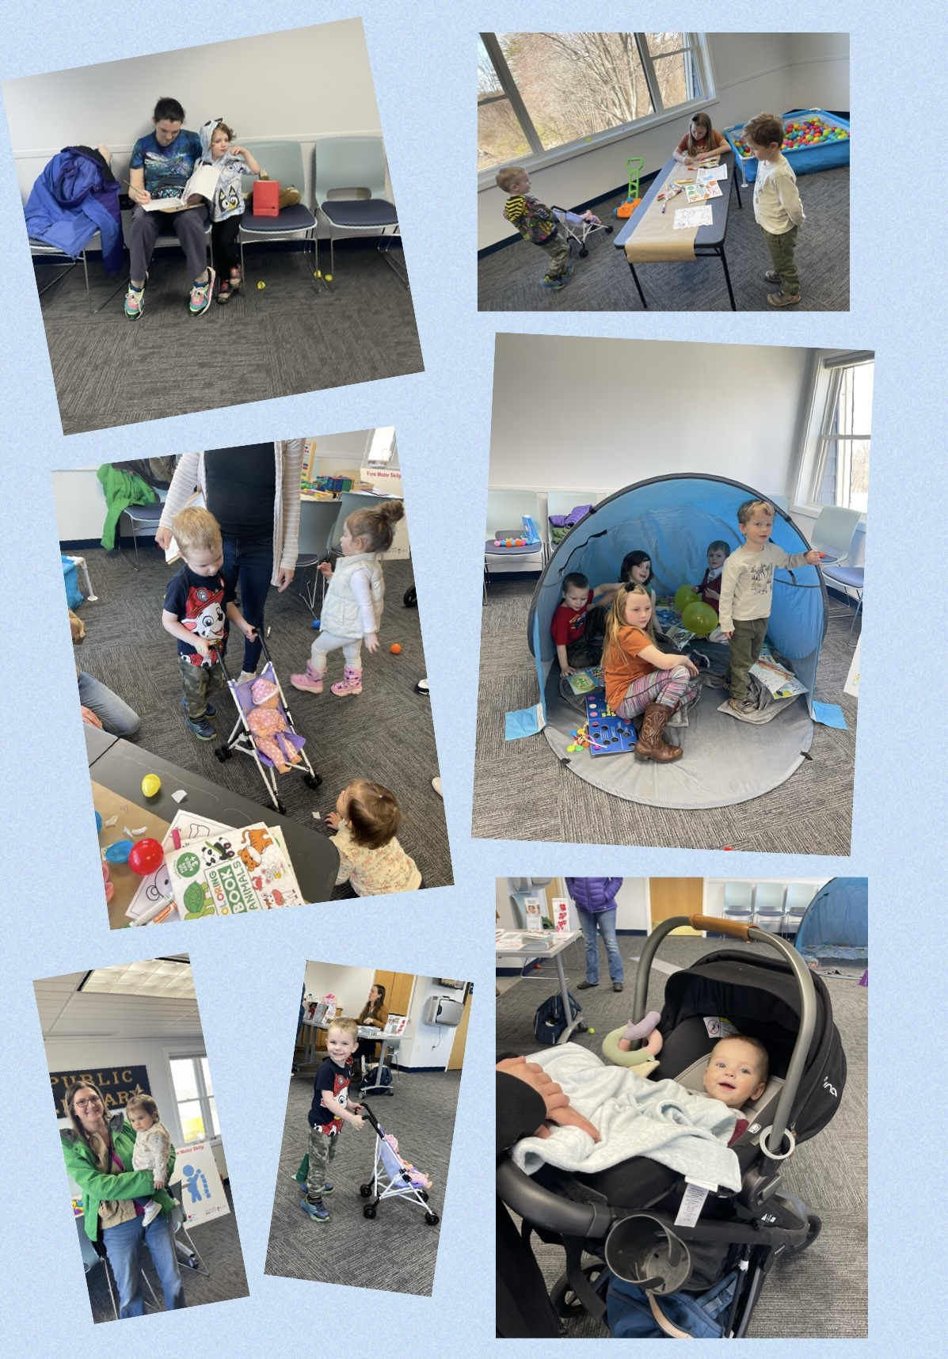



Watch Me Grow Developmental Screening
Rachelle Enes Family Member /Advocate
NH-ME LEND, Institute on Disability, University of New Hampshire
Background
Decorative Image
Conclusions
New Hampshire Family Voices is NH’s Family to Family Health Information Center. NHFV provides free, confidential services to families and professionals caring for children with chronic conditions and/or disabilities. They empower and inform families and professionals to feel confident when making choices for children and youth in their care. Watch Me Grow is New Hampshire's developmental screening, monitoring, information and referral system. Watch Me Grow, through the Centralized Access Point (CAP) at NHFV supports screening, monitoring, and the early identification of children who may need developmental supports and services.
It was a successful event and learning experience highlighting hands on how the developmental screening works. Having all the manipulatives and equipment at their fingers tips, made the event seamless for caregivers. This type of screening is beneficial to the families and any type of classroom or program they attend.
“I enjoyed interacting with the families and the kids the most. I was familiar with most of the kids and families, as they were families from the daycare where I work. It helped a couple of ways with the screening. Knowing the kids helped them feel comfortable with me. Already having a good rapport with the families helped them feel comfortable discussing the results with me. I strongly believe these screenings are important and can benefit every family. I hope to see more events like this become more frequent. I hope in the future I can be involved with more Books, Blocks & Balls events.”
-Rachelle Enes NH ME LEND 2024 trainee
Description of Project Activities
Working with the Developmental Screening Coordinator and the Learn the Signs. Act Early. Ambassador at NHFV to hold a Books, Blocks, and Balls developmental screening event.
Steps to holding the event included
Book a space
Create a flyer
Advertise event with flyers around the community and a Facebook event and posts
Set up stations at events
Provided age appropriate ASQ-3 questionnaires
Report back to families on results of screening
Summary
Books, Blocks & Balls developmental screening event was held at the Hampstead public library in Hampstead, New Hampshire on March 23rd, 2024.
During the event there were different stations,
•BOOKS. Reading station: popup tent with books placed in the tent, for a comfy reading spot.
•BLOCKS. Fine motor station : Blocks to build and string, Magna –Tiles to create with and a coloring spot.
• BALLS. Gross motor station. Bubble wrap taped to the floor for the kids to walk on and pop. Cones and rings to play ring toss, ball pit and doll carriage with doll to push around.
Caregivers were given the option to complete a questionnaire. All eight families that attended completed a questionnaire for twelve children. After the caregiver filled out a questionnaire, it is was scored. The summary sheet was completed with scores to provide a snapshot of where the child is developmentally. If additional resources and referrals were needed, they were given, along with follow up activities.
“Rachelle was an absolute pleasure to have organize and co-facilitate WMG’s BBB event. She tirelessly worked out all the details of the event so that when the day came, everything went smoothly. She also brought such a crucial element to the event: the professional/family relationship. Having Rachelle there to really sit with families to share and explain their child’s screening results, was such an important aspect (and luxury) to the event. It really showcased the power of positive family engagement and bridging that family/provider connection with the children at the heart of the conversations. WMG is excited to take what Rachelle modeled for us and implement at future BBB events."
-Carly Ireland
Watch Me Grow Central Access Point &
Developmental Screening Coordinator
Additional training provided prior to event
-ASQ-3 (Ages & Stages Questionnaire 3) and ASQ:SE-2 (Ages & Stages Questionnaire Social Emotional 2) to understand how these questionnaires support families to understand their child’s development.
-CDC training on early childhood development
-Additional support provided to CAP and WMG
enter questionnaire data from previous screenings.

