Slide 1




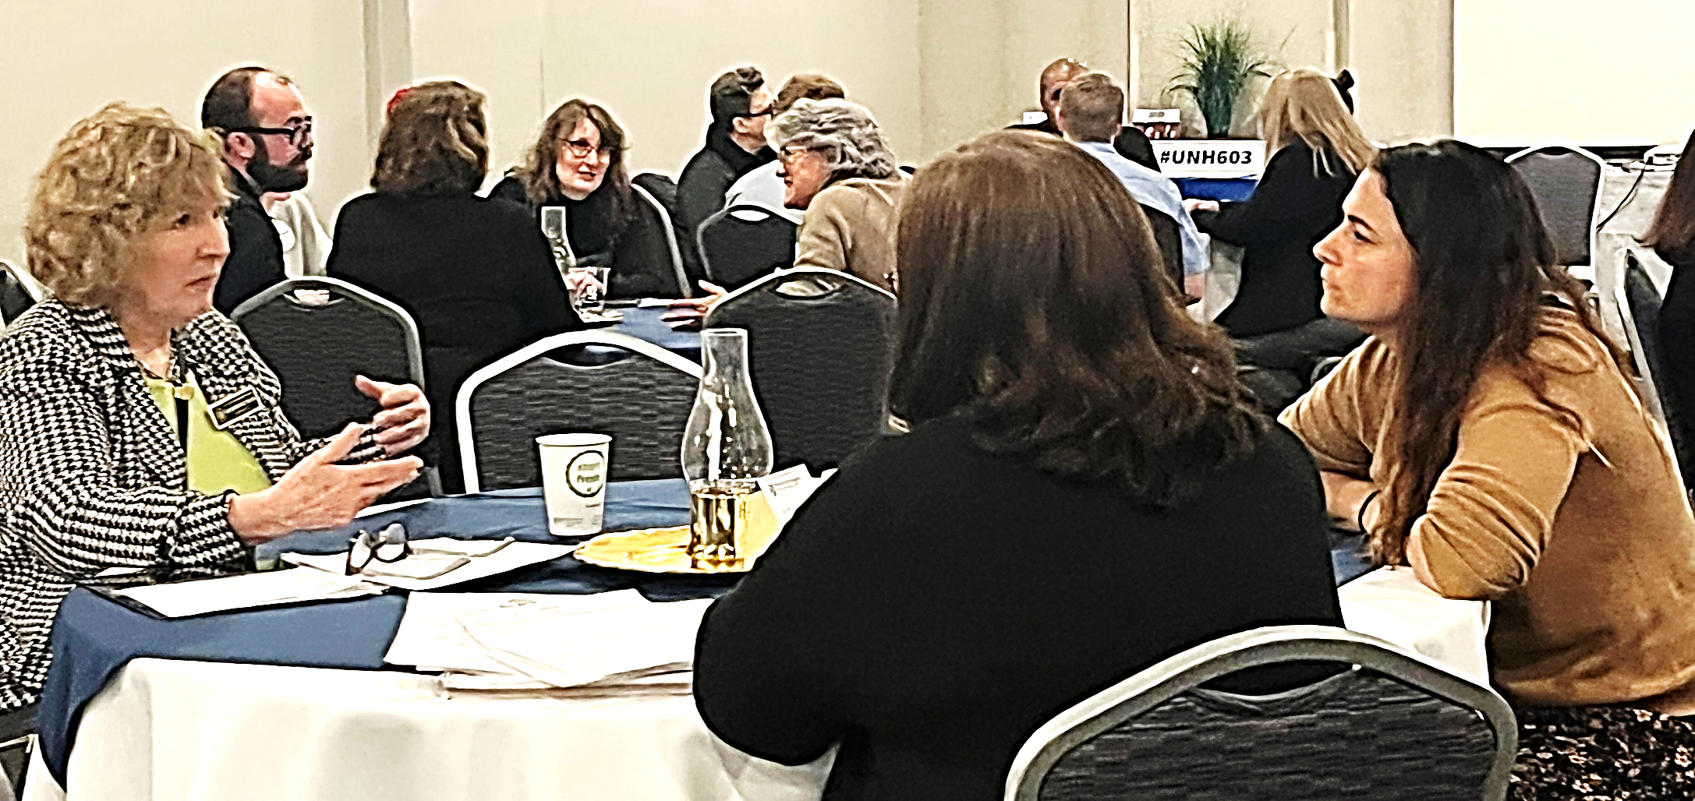
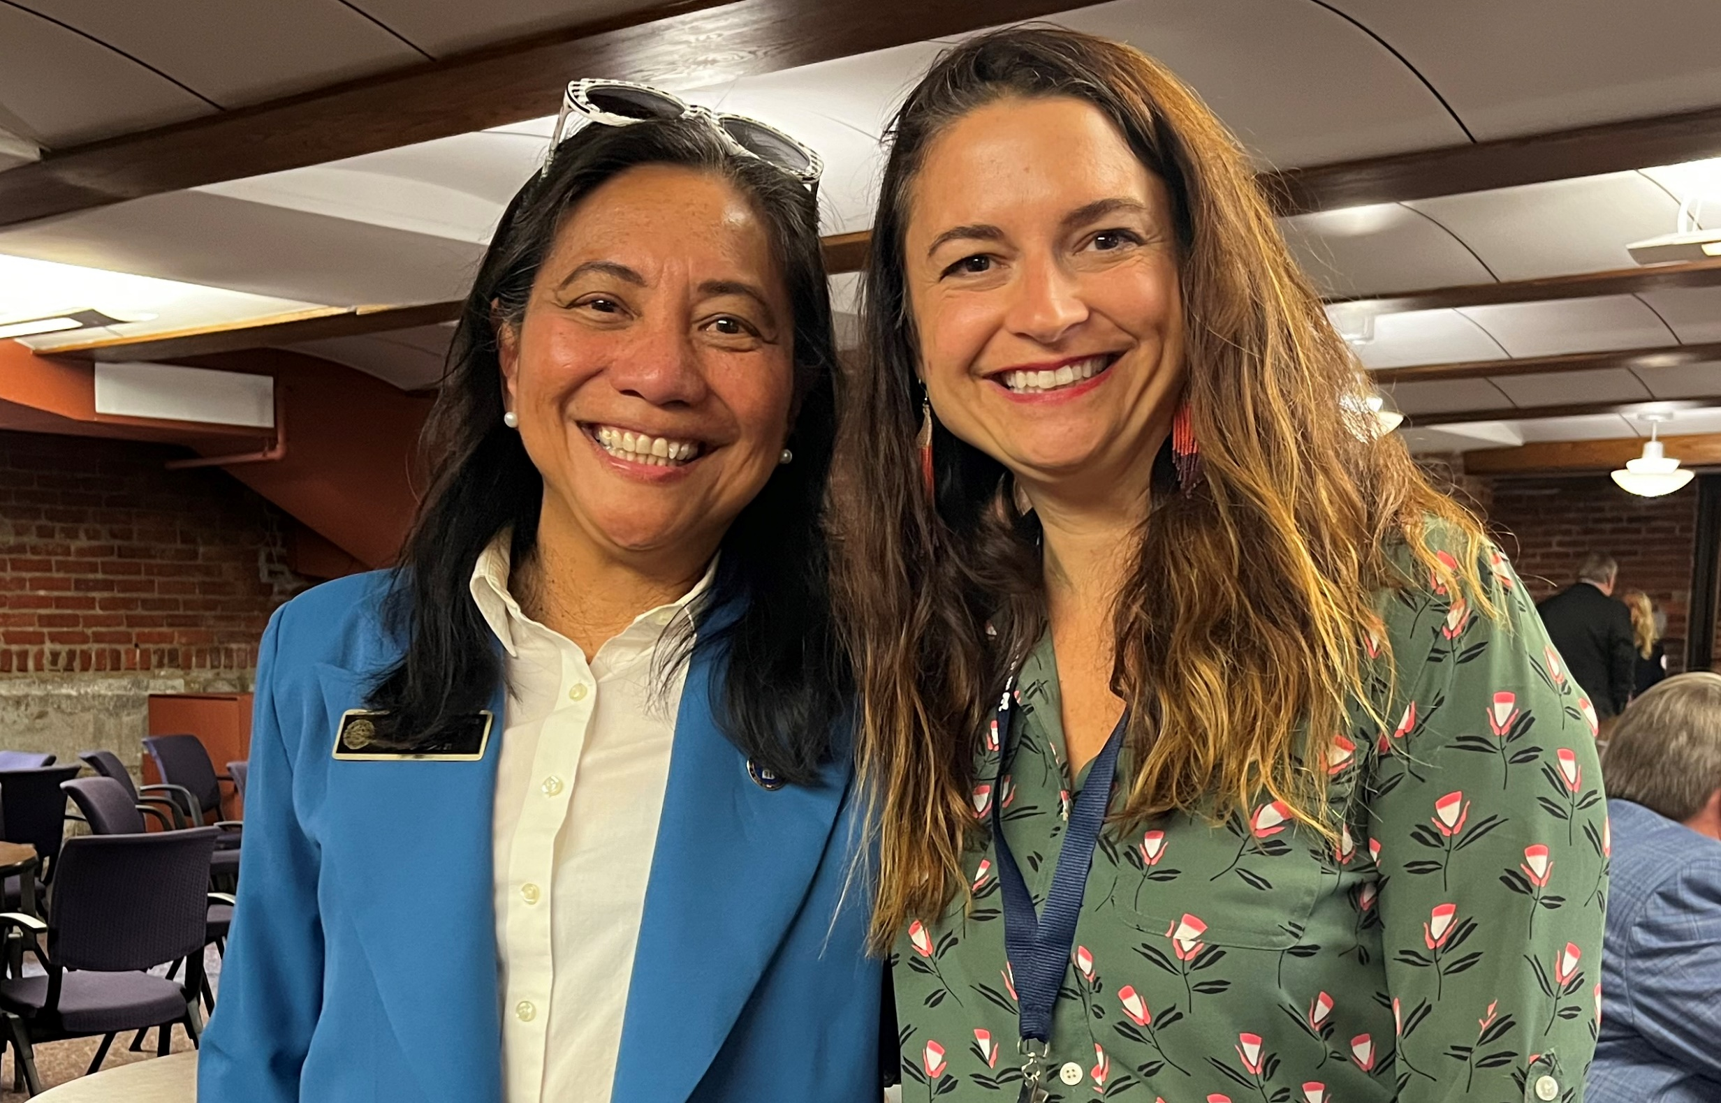

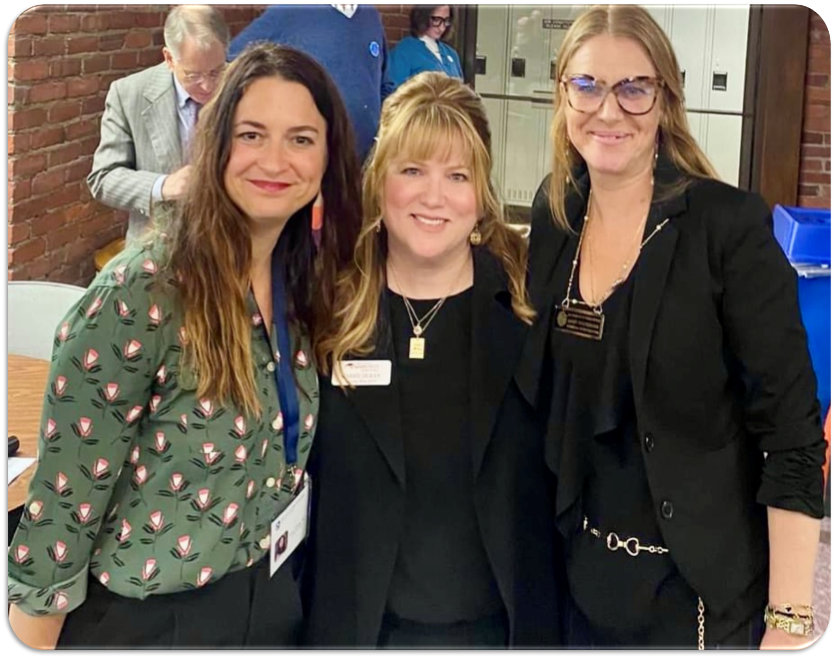
Untangling the Policy: A Perspective
Seana B. Hallberg, MS Family Trainee
NH-ME LEND, Institute on Disability, University of New Hampshire
Understanding the legislative process and key stakeholders within the state, and discovering ways to promote and support public policy impacting those with developmental disabilities.
Leadership Placement
Community Crossroads (area agency region 10) is a comprehensive community agency serving families and individuals with disabilities or chronic health conditions from birth to elder years through conflict free case management.
Community Crossroads educates and empowers individuals and families and advocates for their civil rights. This poster presents the work done in collaboration with my Leadership mentor, Karen Blake, Director of Community Partnerships at Community Crossroads. She provided multiple opportunities to meet stakeholders within the state of NH working on disability policy.
Activities
Family Listening Sessions
Bureau of Developmental Services Redesign
Attended
NH Disability Policy Roundtable
Area Agency Legislative Liaison
Legislative Ad Hoc
CSNI Legislative Liaison
Quality Council
Public Policy Outreach Meeting
Webinars
Reviewed Legislation 101 (Karen Blake/ Carrie Duran)
Attended Special Education 101 (Bonnie Dunham)
NH HB1593
Listened to hearings on HB 1593
Wrote Testimony for HB1593
Attended Executive Session HHS & Elderly Affairs HB1593
Advocacy & Networking
Art of the Share (Karen Blake/ Carrie Duran)
NH Disability Roundtable Legislative Luncheon
Leadership Legislative Session Class 2024
As a LEND trainee for Karen Blake, Community Crossroads (the facilitator for the NH Disability Roundtable) I was invited to attend this group and participate
I assisted in the Art of The Share webinar, moderating the webinar chat. This webinar advances participants advocacy through storytelling.
The Art of the Share webinar is co-hosted by Carrie Duran, LRCS and Karen Blake, CSNI.
NH Disability Roundtable consists of key advocacy groups, as referenced (1A) below. Working closely with these groups and discussing all the perspectives of proposed legislation gives a better understanding of issues and solutions. In the legislative session, the 8 major disability advocacy groups meet monthly to discuss legislative issues and priorities of their organizations.
Community Crossroads is an area agency under CSNI. CSNI is part of the Disability Roundtable (1B), working together to advocate for, or against legislation; sometimes as a collective group. Keeping these lines of communication open in the state of NH positively impacts the advocacy done for individuals with disabilities.
1A
1B
Community Crossroads
Community Partners
Northern Human Services
NH Disability Roundtable
One Sky
PathWays of the River Valley
The Moore Center
Lakes Region Community Services
I participated in supporting the current
NH Leadership Series ‘24 class in the Citizenship Session, where trainees practice educating lawmakers on current legislation impacting the disability community.
Gateways Community Service
Monadnock Dev Services
Community Bridges
Advocate for Change
Understand the NH Legislative Process
Meet and build relationship with your legislator
Focus on issues you are passionate about
Get informed about disability related bills through http://www.nh.gov/index.htm
Register Your Support or Opposition of a Bill online at http://ww.gencourt.state.nhus/
Provide testimony at a public hearing
Email testimony in favor or opposition of a bill to the committee
Meet with local reps to discuss important upcoming bills
Join an advocacy group
NH Disability Organizations
Meet & Greet @ State House
All legislators join NH’s disability organizations to learn about and discuss how policy can impact the lives of those with disabilities. We believe amplifying the voices of those who experience disabilities can empower decision-makers to develop policies that benefit all NH citizens.
Pictured with NH State Representative Luz Bay
Conclusion
NH has 400 legislators, who are extremely accessible to constituents. Build relationships with local representatives, network with individuals in your community doing advocacy work.
Policy often begins with an idea in community where spaces are inaccessible for the disabled. Meet your representative for coffee, share your story and advocate for change. Discuss what is needed to become an accessible and equitable space or experience. Become comfortable with being an expert of your own lived experience. Join boards or organizations you have stake in and align with your values.
Take up space where change happens. The more involved you become, the easier it is to make an impact.

