Slide 1
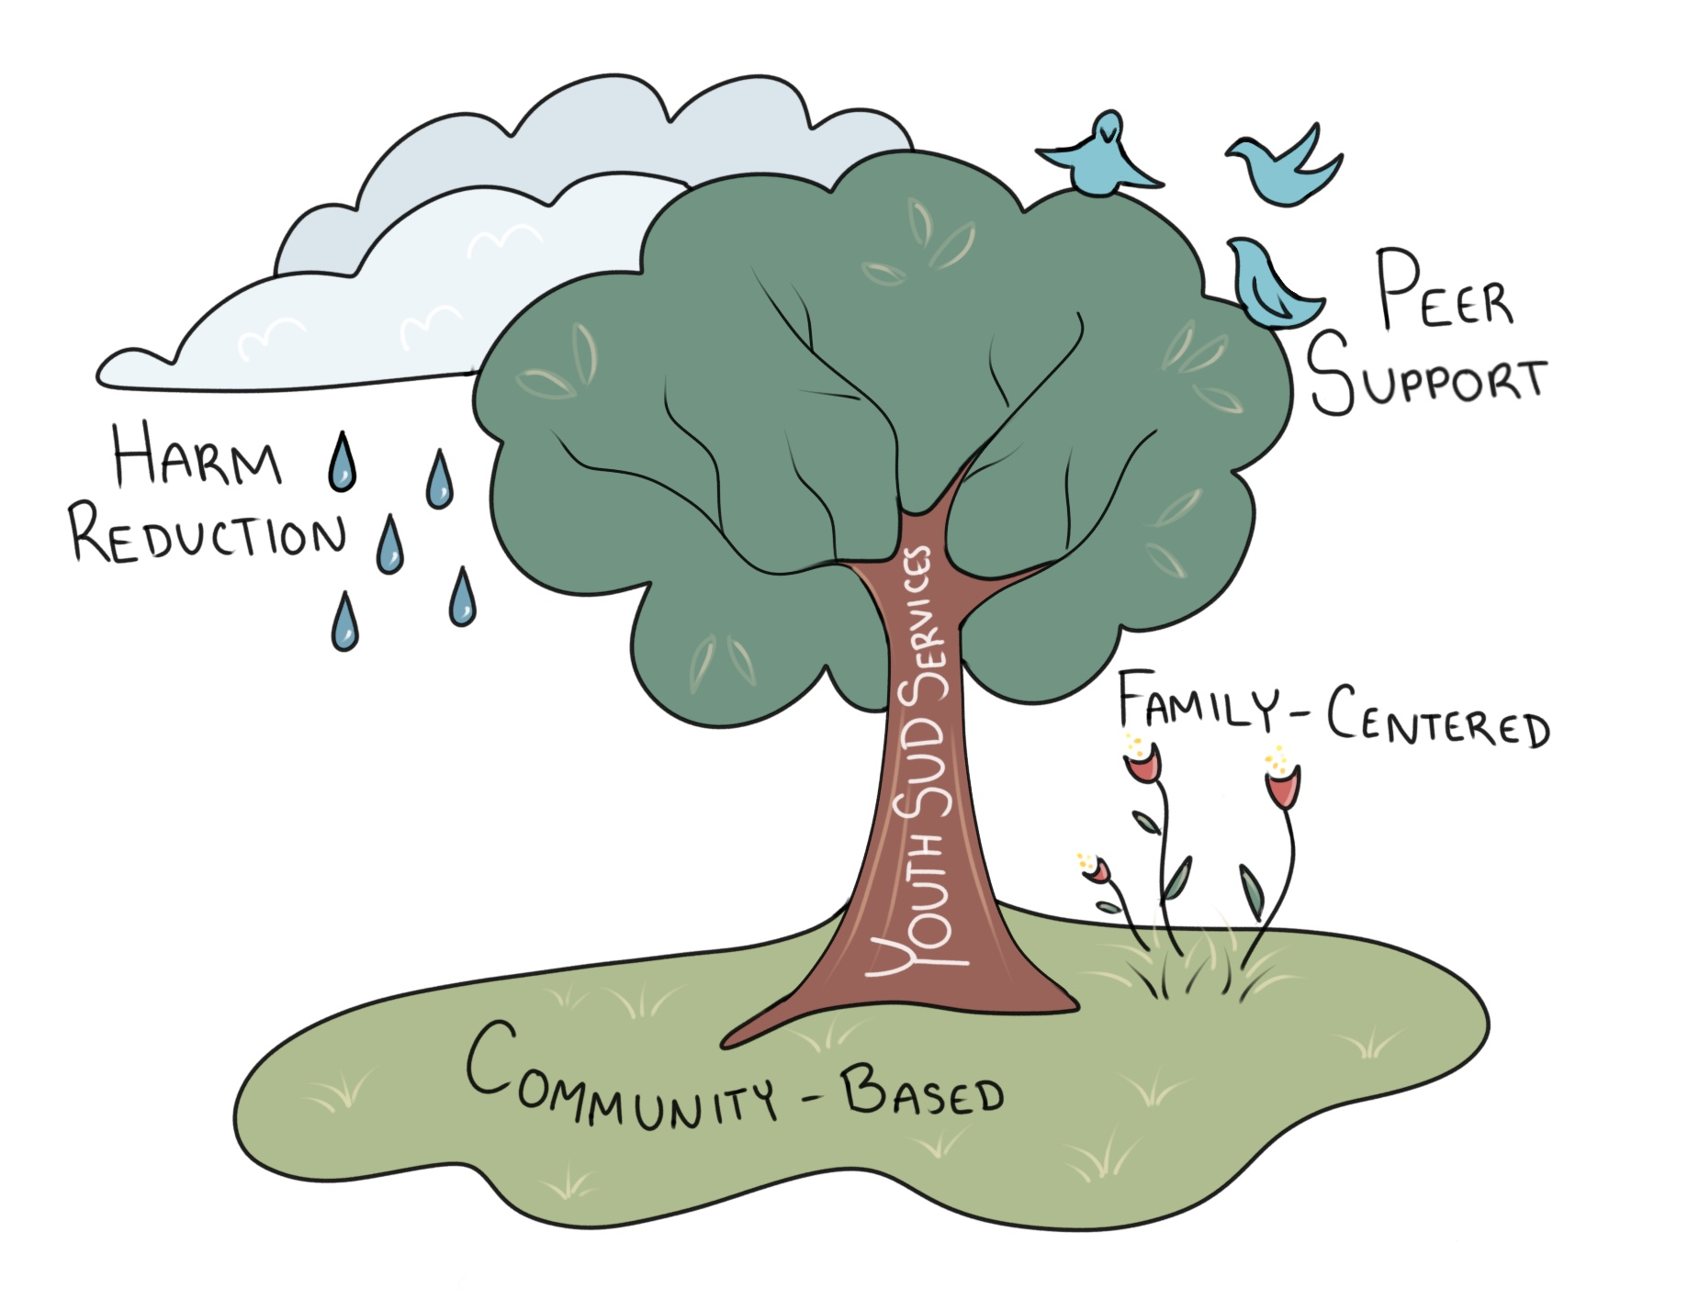
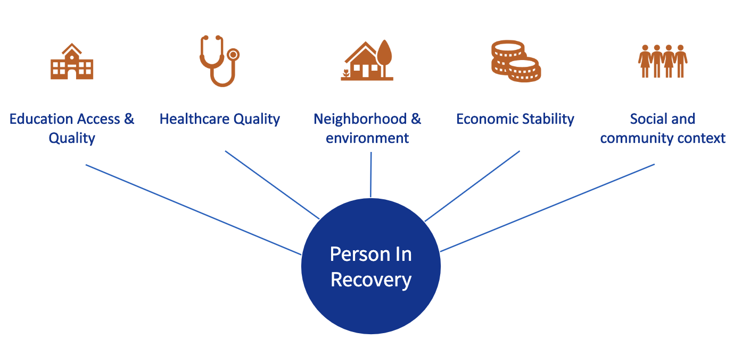
Youth and Young Adult Substance Misuse
Emily Seymour, Master of Social Work Trainee
NH-ME LEND, Institute on Disability, University of New Hampshire
The Institute on Disability (IOD)
Youth Substance Misuse in NH
Youth-Specific SUD Services
As New Hampshire’s University Center for Excellence in Developmental Disabilities Education, Research and Service (UCEDD), the IOD’s mission is to “promote full access, equal opportunity, and participation for all persons by strengthening communities and advancing policy and systems change, promising practices, education and research.”
Creating Connections NH is a system of care for youth and young adults (age 12-25) with substance use disorder (SUD) managed by the IOD.
NH Youth Risk Behavior Survey (YRBS) 2021
Youth need developmentally appropriate services with a social foundation. The IOD supports programs developed with this in mind.
17.8% use marijuana
Sexual Safety
4.8% experienced unwanted sexual advances due to another person’s drinking
Mental Health
36.2% of students report their mental health is most of the time or always not good
24.7% seriously considered suicide this year
Driving Safety
4.6 % drove while drinking in the last month
15.1% rode with a driver who was drinking in the last month
21.3% drink alcohol, 11.2% binge drink
16.2% vape nicotine
19% used substances before last sexual intercourse
Current Use
Placement Activities
Wildcats for Recovery Ally Trainings
Developed Recovery Ally training with team at IOD in collaboration with UNH Health and Wellness
Trainings provided to students, faculty & staff Spring of 2024
Alternative Peer Group (APG) Community Engagement
Met with community partners across NH
Analyzed barriers to APG development, engagement strategies
APG Program Evaluation
Utilized IOD data on APGs to assess strengths and needs
Found that APG facilitators are meeting facilitator fidelity goals
NASW NH JEDI Conference
IOD’s We are Here video presentation on equity & access to mental health and SUD services in NH
UNH IOD Elephant in the Room poster presentation
Youth and young adults are at a critical period of brain development. Substance use can negatively impact memory, learning, decision making, and increase risk for SUD later in life (Winters & Arria, 2011).
(CDC, 2023)
SUD is a Protected Disability Under the Americans With Disabilities Act
Conclusion
From Stigmatizing…. To Empowering
(Wells, 2019)
Youth and young adults have a high need for SUD services but are unlikely to seek or access developmentally appropriate services. The solution is multifaceted, including cultural change and advancements in equity. The IOD supports several initiatives to fill this gap.
Substance Misuse, Substance Use Dependence
Addict
Person who uses drugs
Substance Abuse
The solution is individual treatment
The solution is multi-faceted and systemic
SUD is a moral failing
SUD is a disability, brain disorder, socially influenced
Disability is a bad thing
Disability is a natural part of life
College students are the largest group of individuals meeting criteria for SUD, but the least likely to seek help (Wu et al., 2007).
Adverse Childhood Experiences (ACEs) and
Social Influencers of Health are associated with increased rates of SUD (Amaro et al., 2021; Broekhof et al., 2023).
References
Amaro, H., Sanchez, M., Bautista, T., & Cox, R. (2021). Social vulnerabilities for substance use: Stressors, socially toxic environments, and discrimination and racism. Neuropharmacology, 188, 108518. https://doi.org/10.1016/j.neuropharm.2021.108518
Broekhof, R., Nordahl, H. M., Tanum, L., & Selvik, S. G. (2023). Adverse childhood experiences and their association with substance use disorders in adulthood: A general population study (Young-HUNT). Addictive behaviors reports, 17, 100488. https://doi.org/10.1016/j.abrep.2023.100488
Centers for Disease Control and Prevention. Disability and Health Data System (DHDS) [Internet]. [updated 2023 May; cited 2023 May 15]. http://dhds.cdc.gov
NH DHHS (2024) Youth risk behavior survey. New Hampshire Department of Health and Human Services. https://www.dhhs.nh.gov/programs-services/population-health/health-statistics-informatics/youth-risk-behavior-survey
Rizk, M. M., Herzog, S., Dugad, S., & Stanley, B. (2021). Suicide Risk and Addiction: The Impact of Alcohol and Opioid Use Disorders. Current addiction reports, 8(2), 194–207. https://doi.org/10.1007/s40429-021-00361-z
Trujillo, C. A., Obando, D., & Trujillo, A. (2019). An examination of the association between early initiation of substance use and interrelated multilevel risk and protective factors among adolescents. PloS one, 14(12), e0225384. https://doi.org/10.1371/journal.pone.0225384
Wells, L. (2019). Teenage Brain [Electronic Image]. Edutopia. https://www.edutopia.org/article/decoding-teenage-brain-3-charts/
Winters, K. C., & Arria, A. (2011). Adolescent Brain Development and Drugs. The prevention researcher, 18(2), 21–24.
Wu, L.-T., Pilowsky, D. J., Schlenger, W. E., & Hasin, D. (2007). Alcohol use disorders and the use of treatment services among college-age young adults. Psychiatric Services, 58(2), 192–200. https://doi.org/10.1176/appi.ps.58.2.192

Slide 2
\

