Slide 1
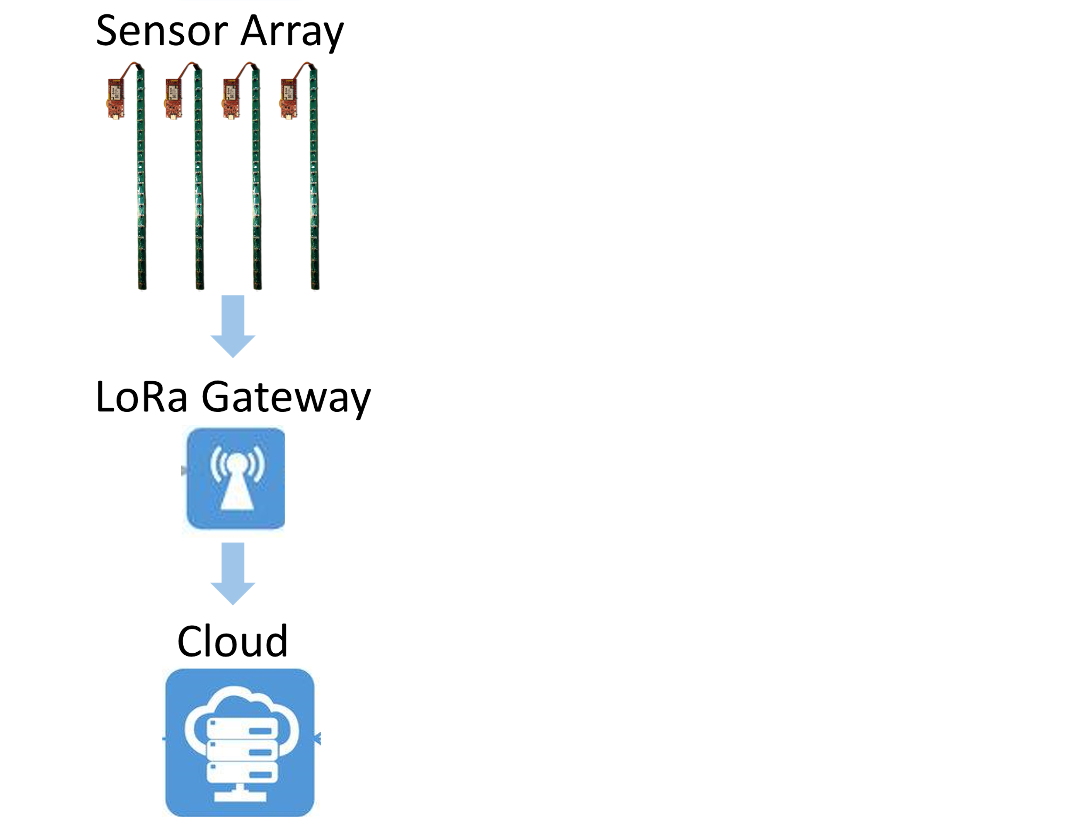
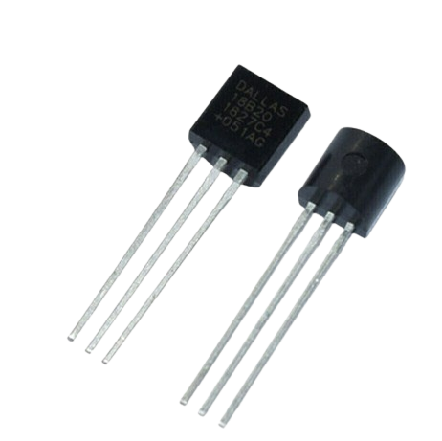
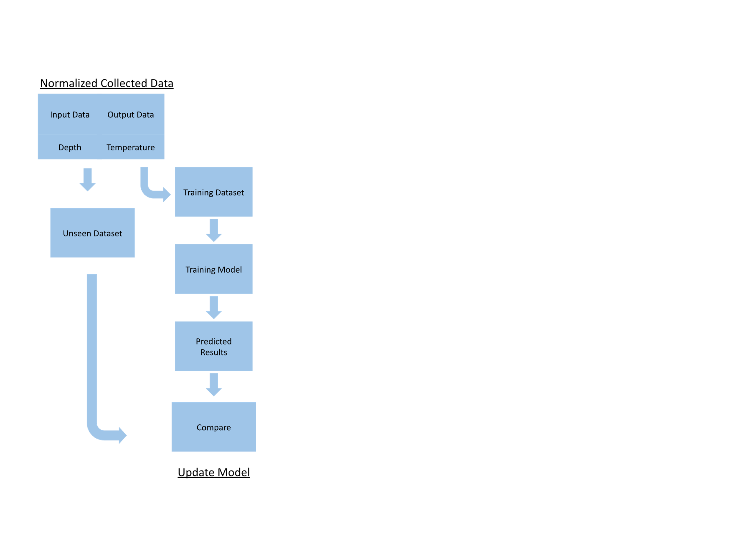
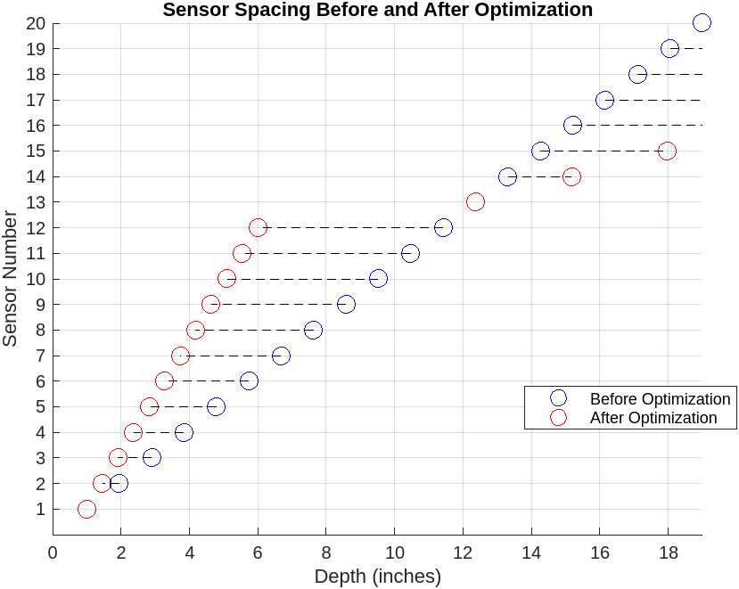
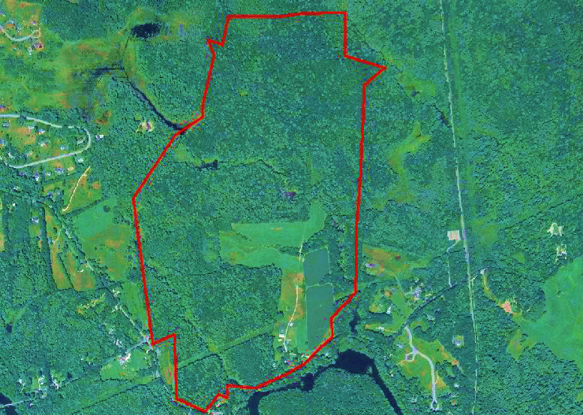
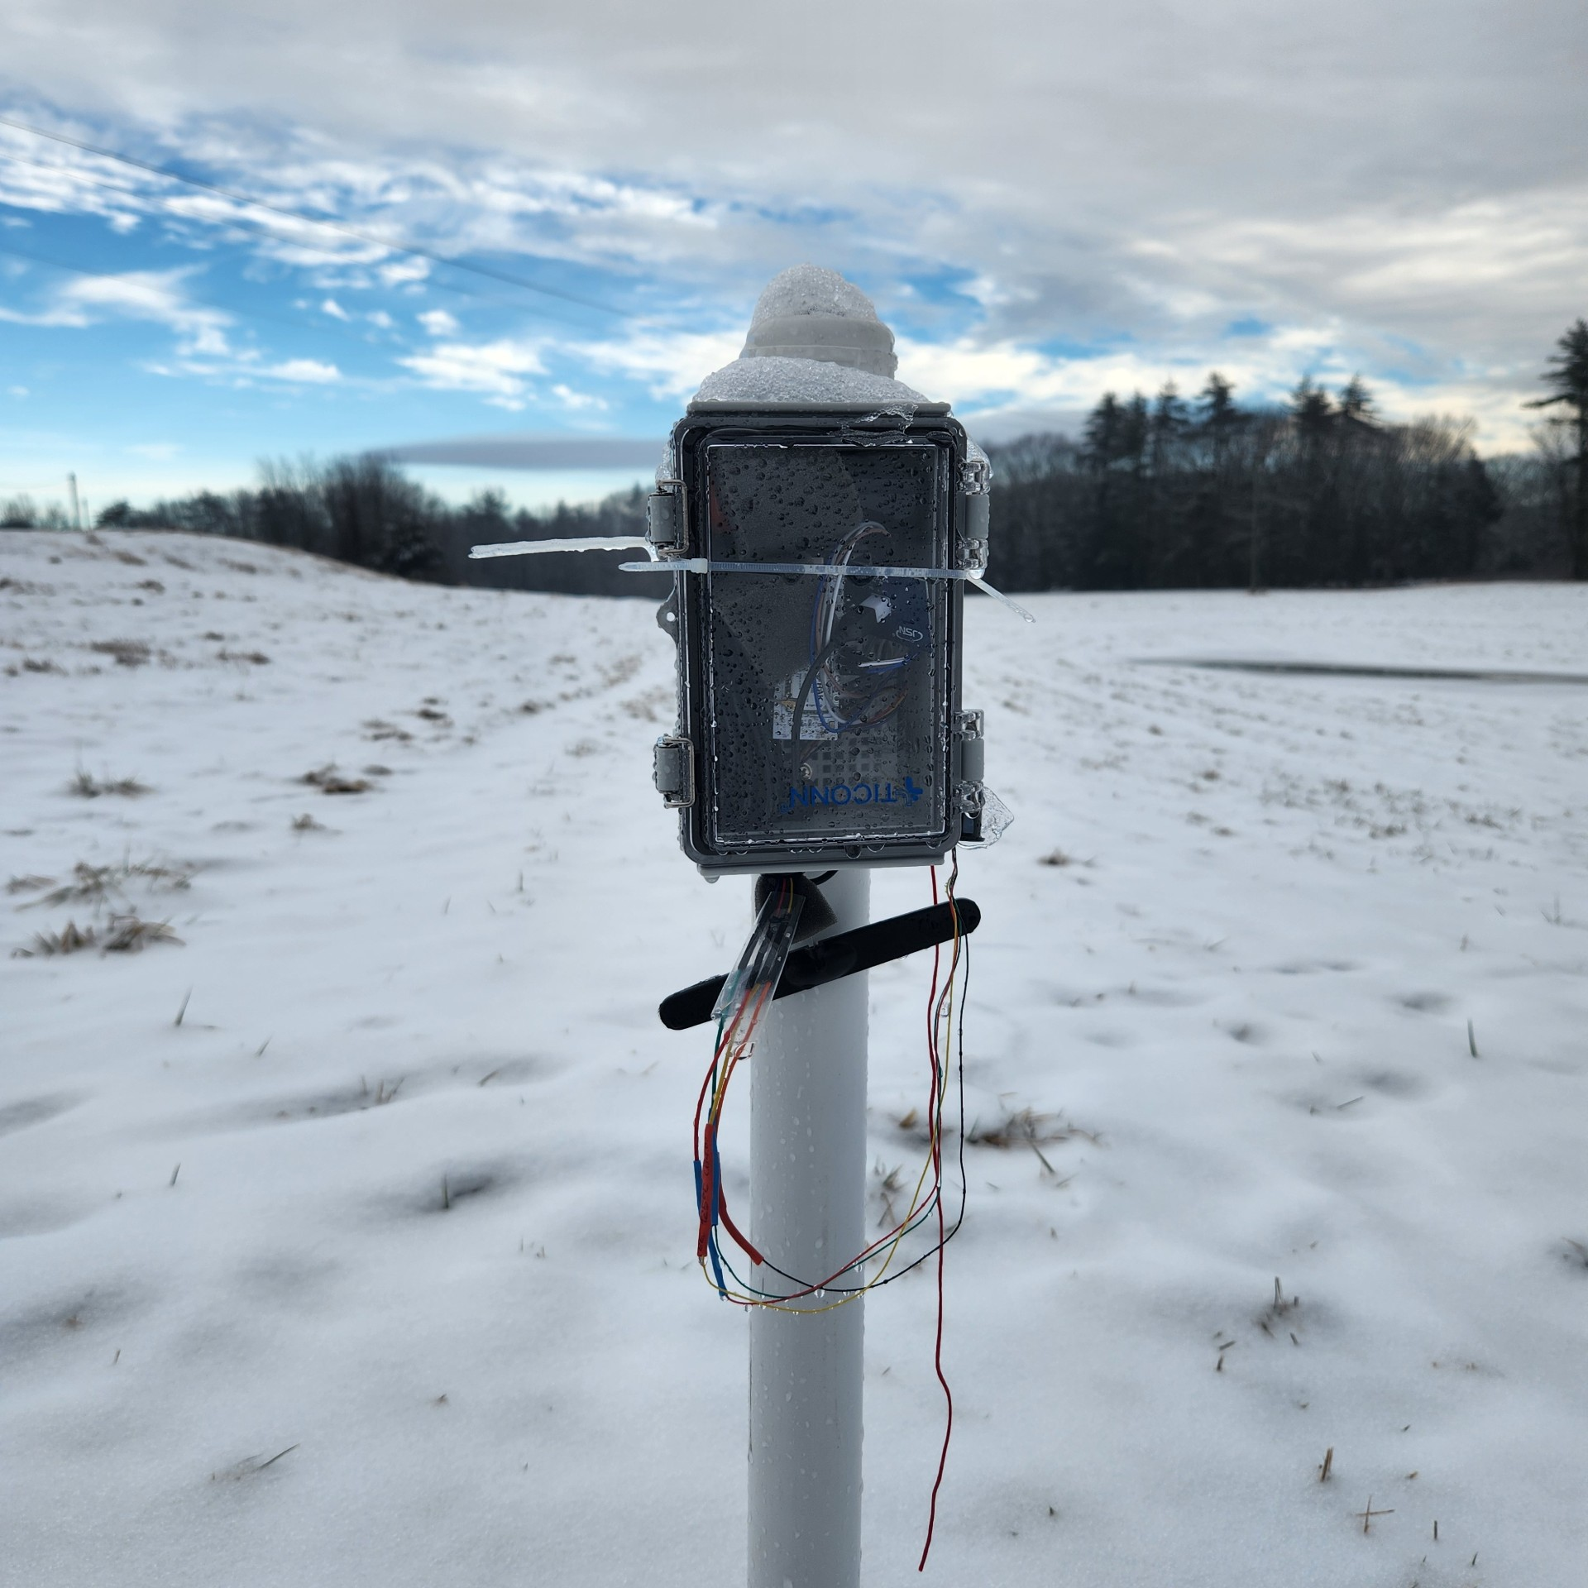
DEVELOPMENT AND INTEGRATION OF AN AI-ENABLED TEMPERATURE SENSOR ARRAY FOR MONITORING FREEZE-THAW CYCLES IN NEW HAMPSHIRE
Sabby Clemmons and Sarah Remeis Advisors: Professor MD Shaad Mahmud, Dr. Alexandra Contosta
Acknowledgements:
Faishal Yousuf
BACKGROUND
RESEARCH OBJECTIVES
APPLICATIONS
Soil Erosion Studies
Understanding FTCs aids in predicting soil erosion patterns.
Climate Change Research
Monitoring FTCs provides data on climate change effects.
Land Use Planning
Data supports informed decisions on land development and conservation.
Energy Efficiency
Insights can optimize energy use in temperature-sensitive systems.
Freeze-thaw cycles (FTC), "the total number of times temperature readings crossed the freezing threshold during a given time period, divided by two" [1], are indicative of the frequency and intensity of temperature fluctuations.
Climate Research
Fig. 1: Illustration of a Singular Freeze-Thaw Cycle
Current methods for tracking FTC, including remote sensing and ground instrumentation, have limitations. While microwave sensing offers broad coverage, it lacks precision [2]. Ground instrumentation provides more accurate data but is expensive and site-restricted [3]. Integrating low-cost sensor arrays with machine learning enables cost-effective, real-time monitoring. This approach builds upon the capabilities of the iBUG, an edge node with diverse sensors and embedded machine learning, facilitating wireless data transfer [4].
Fig. 2: Individual Temperature Sensor Instrument
Deploy instruments for real-time monitoring.
Collect temperature data and verify accuracy with NOAA records.
Develop a reliable data analysis method.
Identify temperature-frost depth correlations using tiny ML.
MATERIALS & METHODS
CURRENT FINDINGS
Instrument Design
Data Retrieval and Processing
Each deployed instrument is working properly and streamlining data efficiently.
Instruments must be checked every 5-7 days to exchange the power supply.
Current data processed reads closely to NOAA data.
Actively working on streamlining data retrieval to data analysis method.
Components
Custom PCB with 20, 1-inch Markings
20 DS18B20 Digital Temperature Sensors
3.3 V Battery Supply
iBUG Board (Fig.4 ):
K11300 Long Range Wide Area Network (LoRaWAN) module
Dual-core Raspberry Pi RP2040 MCU
MicroSD
Steps
Register DeviceEUI on ThingsNetwork
DeviceEUI of each sensor registered on LoRa gateway
Assign Addresses to DS18B20 Sensors
Use C program assign an addresses to each sensor, depth of sensor is noted.
RTC Call-back Looping Program
Program retrieves data using timed delays.
Retrieve and Store Data
Read temperatures from sensors, store on integrated microSD card.
Send Temperatures via LoRa to Cloud
Transmit data wirelessly through LoRa to Cloud
Fig. 3: CAD iBUG Board Design
FUTURE DEVELOPMENTS
Solar Power Supply
Integrating solar panels into device outer housing to transition to a fully autonomous operation.
​
Fig. 4: Actual iBUG Board
Optimizing Sensor Placement
Study trends to adjust sensor spacing.
Increase sensor density where largest temperature changes occur.
Ensure even spread of temperature differences across sensors.
Fig. 5: Sensor Stick Made with Custom PCB and DS18B20 Sensors
Fig. 8: Data Collection Flow Chart
Instrument Deployment
Data Analysis
Location
Thompson Farm was selected due to its diverse soil conditions, representative characteristics of the region, and its use for various university research projects.
Several temperature sensor instruments are currently deployed and collecting data there.
Deploying Process
Each instrument is placed into an existing PVC tube buried in the soil 30 inches
PVC tubes shield sensors from external factors like moisture physical disturbances eliminating major disturbances in data.
Data Normalization
Outlier data points, outside of the expected temperature range, are replaced with the average of nearest two sensors.
Data Validation Using Real Time Comparison
Comparison plots are made with the NOAA local FTC data
Correlating Temperature-depth by Employing ML
Utilize TensorFlow Lite for developing a linear regression model.
Train the model on temperature-depth relationships from retrieved, formatted data.
Predict depth for new inputs of temperature, sensor number, address, and location.
Test predictions against collected data for accuracy.
Fig. 10: Example of Sensor Placement Optimization
Fig. 6: Aerial View of Thompson Farm
REFERENCES
[1] "Freeze-thaw cycles." GLISA. Available:https://glisa.umich.edu/resources-tools/climate-impacts/freeze-thaw-cycles/ [2] Kim, Y., Kimball, J. S., Glassy, J., and Du, J.: An extended global Earth system data record on daily landscape freeze–thaw status determined from satellite passive microwave remote sensing, *Earth System Science Data*, 9, 133–147, https://doi.org/10.5194/essd-9-133-2017, 2017. [3] Chen, Y., Li, S., Wang, L., Mittermeier, M., Bernier, M., & Ludwig, R. (2024). Retrieving freeze-thaw states using deep learning with remote sensing data in permafrost landscapes. *International Journal of Applied Earth Observation and Geoinformation*, 126, 103616. https://doi.org/10.1016/j.jag.2023.103616. [4] M. F. Yousuf, T. Siddique, and M. S. Mahmud, "iBUG: AI Enabled IoT Sensing Platform for Real-time Environmental Monitoring," in *Proceedings of the 2022 IEEE 31st Microelectronics Design & Test Symposium (MDTS)*, Albany, NY, USA, 2022, pp. 1-7, doi: 10.1109/MDTS54894.2022.9826935.
Fig. 7: Deployed Instrument in PVC Housing at Thompson Farm
Fig. 8: Data Collection Flow Chart

