Slide 1
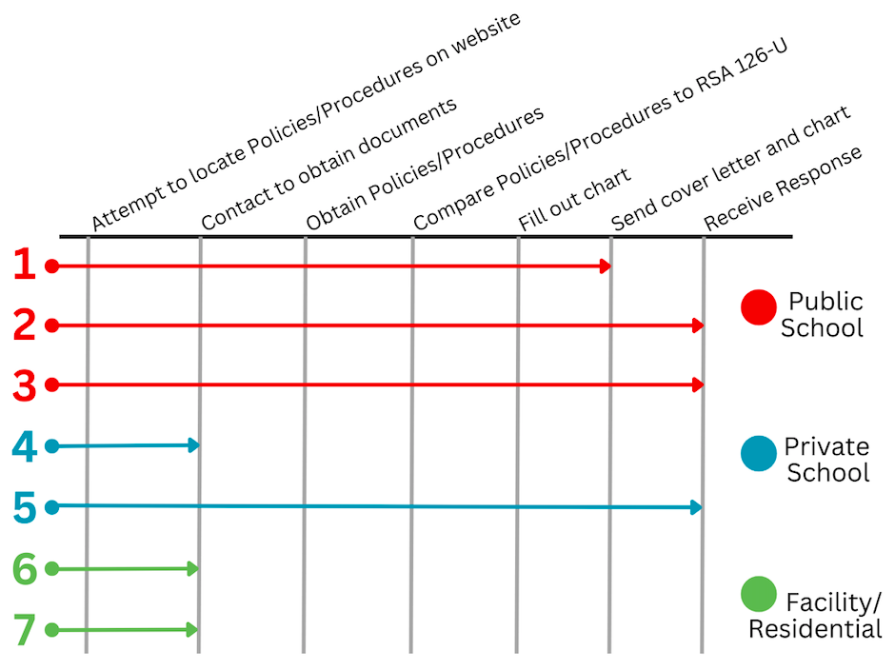


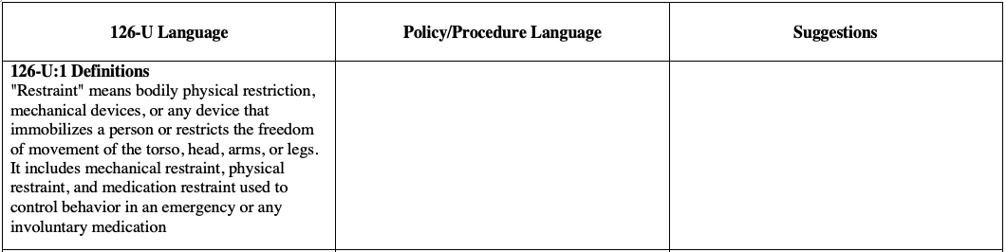
Examining Policies and Procedures For Restraint & Seclusion In New Hampshire Schools and Facilities
Christina Giannopoulos, MS, OTR/L, NH LEND Occupational Therapy Trainee
Institute on Disability at the University of New Hampshire
Introduction
School/Facility Progression
Summary of Results
In recent years, there have been significant changes to restraint and seclusion laws aimed at enhancing the safety and well-being of students within educational settings. These changes reflect a growing recognition of the need to establish clear guidelines and safeguards if children are subject to restraint or seclusion. RSA 126-U was amended during the 2023 legislative session and went into effect on September 26th, 2023. Clear and transparent communication of school policies related to this topic is vital.
3 public schools, 2 private schools, 2 residential facilities
1 co-regulation conversations with 1 public school
Different progression with each school/facility and some more challenging than others.
In general, got much further with public schools as compared to private schools/residential facilities
Each chart outlining alignment with RSA 126-U had missing components: no school or facility was 100% “compliant” with the law
Inner conflict: Where to go with the project? How to navigate being a new graduate/professional job searching vs pushing to advocate for what I believe to be positive/coming from a good place?
After dilemma, decided to take a step back and leave progress “as is”
Funding, resources, more training, and increase of education for co-regulation and restraint and seclusion practices
Objectives
Education regarding the updates to RSA 126-U
Identify gaps in school/facility current policies and procedure
Provide information on these gaps to increase alignment with the current law
Gain knowledge of current practices for co-regulation
Co-Regulation Conversation
Conclusions and Next Steps
Methods
Gained experience on having hard conversations
Restraint and seclusion is a very controversial topic and even if coming from a good place the topic can automatically cause walls to be put up
Policy is a challenging area of work but once you begin you can feel empowered to use your voice
Transitioning from a student to a professional has been challenging to navigate but it is exciting
Continue to advocate for the proper use of restraint and seclusion
Continue to learn about co-regulation in schools and facilities
Continue to advocate for clear and transparent communication between schools and facilities
Continue to embody the practice of clear and transparent communication to the patients and families in the OT world
Review reported occurrences of restraint/seclusion in schools and facilities provided by DHHS/DOE
Compared and chose highest percentage of reports keeping in mind student population size
Chart and Cover Letter after meeting with DRC Attorney
Co-regulation conversations
Co-regulation information sheet
”The main people trained in restraint and seclusion are the principal and secretary”
“The nurse and many other staff chose not to take the training because they do not want to use restraint on children (out of fear of being sued/risk involved)”
“The School Resource Officer is also trained in restraint and seclusion, but he is not here every day”
“The things that could
be helpful include:
Funding to improve space
Full time SRO
Better education
Increased staff comfortability”
References
New Hampshire statutes. New Hampshire Statutes - Table of Contents. (n.d.). https://www.gencourt.state.nh.us/rsa/html/NHTOC/NHTOC-X-126-U.htm
Restraint and seclusion. Department of Education. (2024). https://www.education.nh.gov/who-we-are/division-of-educator-and-analytic-resources/bureau-of-education-statistics/restraint-and-seclusion
Notes:
I completed my capstone project with the Disability Rights Center of New Hampshire. I worked with the Executive Director, Stephanie Patrick. My focus of this project was reviewing school and facility policies and procedures and comparing them to last year’s changes to the law. My placement activities included choosing 3 public schools, 2 private schools, and 2 residential placements/facilities to review. I chose these based off of their high incidences of restraint and seclusion in comparison to their total student size. After meeting with DRC’s attorney to review the changes to the law, I then created a chart to outline the specific wording in the law, a column for the school or facility’s current wording, and lastly some suggestions of how to increase compliance. I created a cover letter and sent both documents to the 7 places I chose. Lastly, I created a document with information on co-regulation as well as had a conversation with a school nurse regarding how co-regulation is going in their school. I learned a lot from the process of this project and gained a lot of insight on having hard conversations, having conversations that involve controversial topics can be a challenge, and how to navigate being a new grad searching for a job vs advocating for what I believe to be right. Overall, I gained a lot of insight on leadership in general as I continue to advocate for clear and transparent communication between organizations and the families they serve, being a leader doesn’t always mean being right, and realizing that I can make a difference with policy work.

