Slide 1



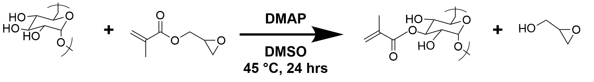
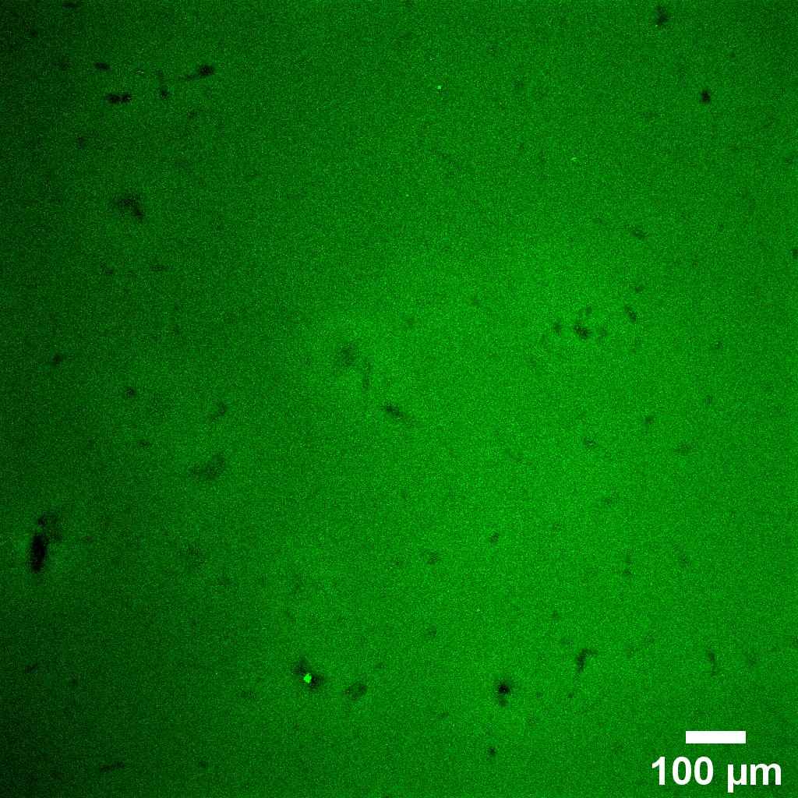
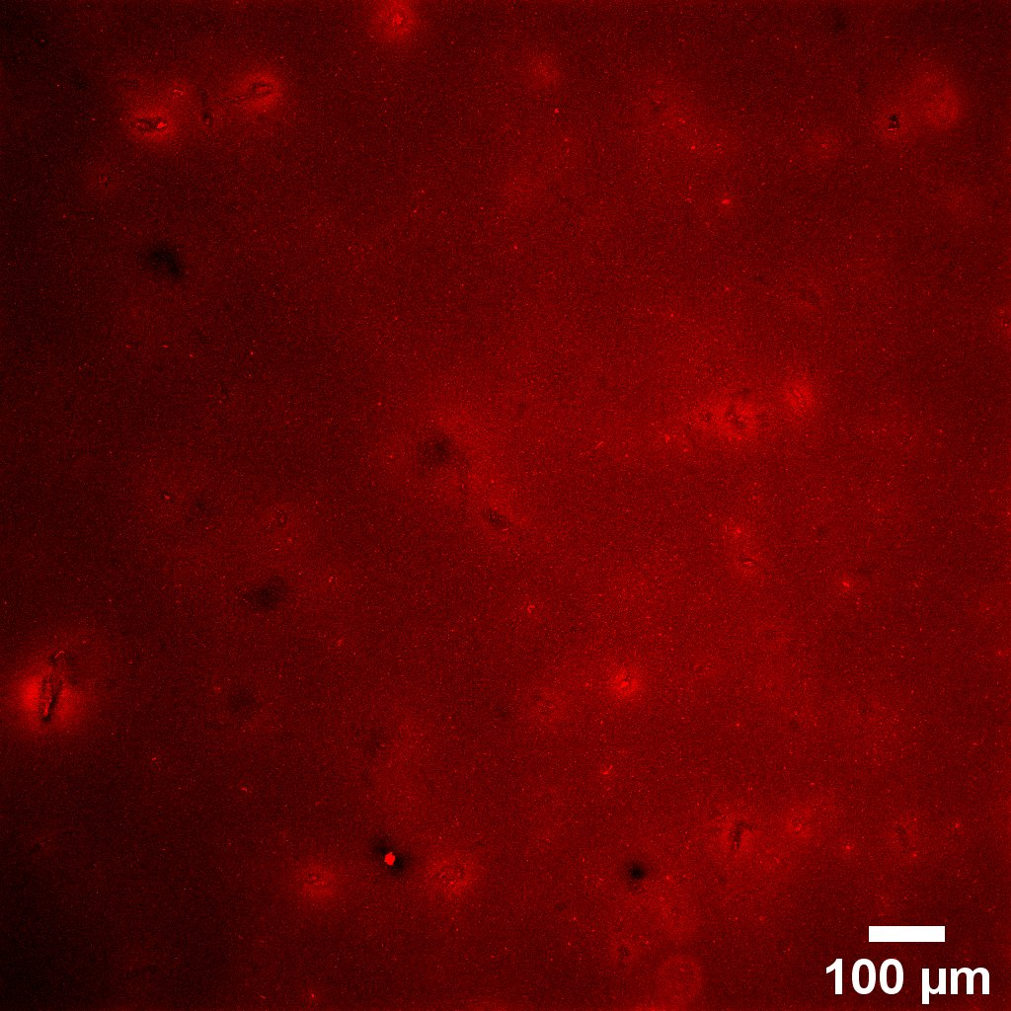
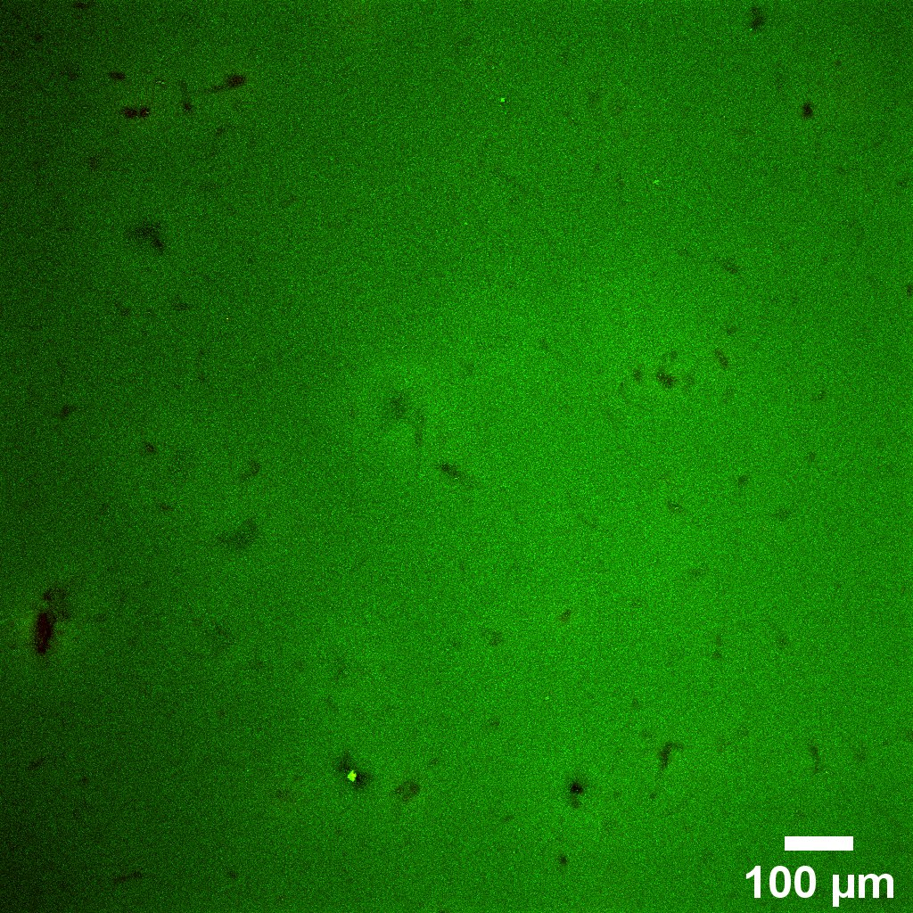
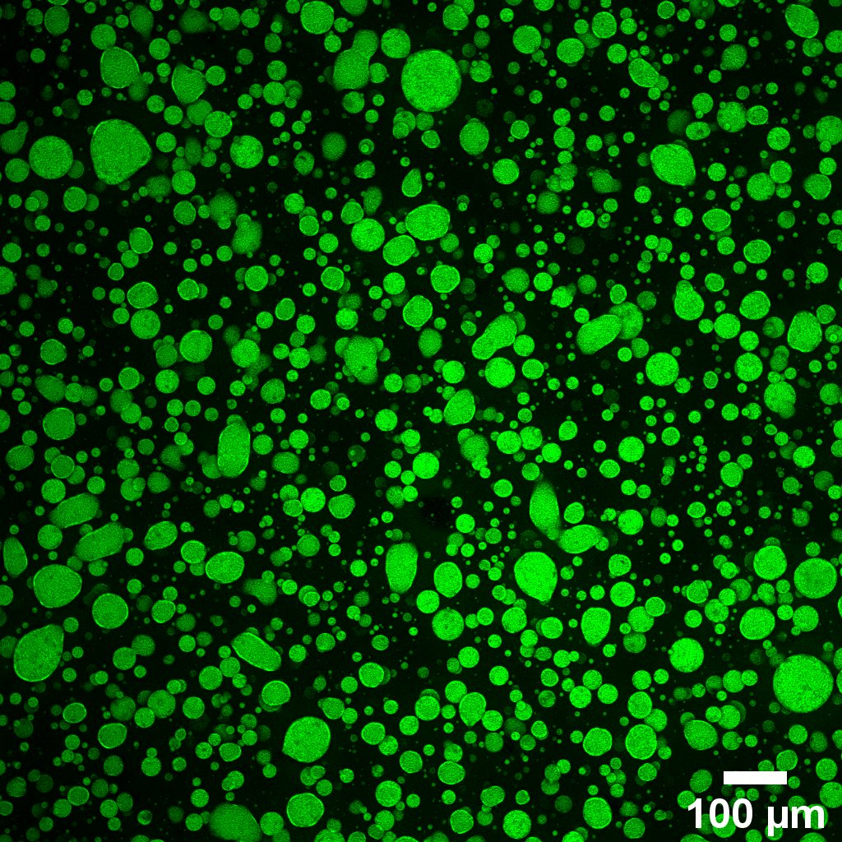
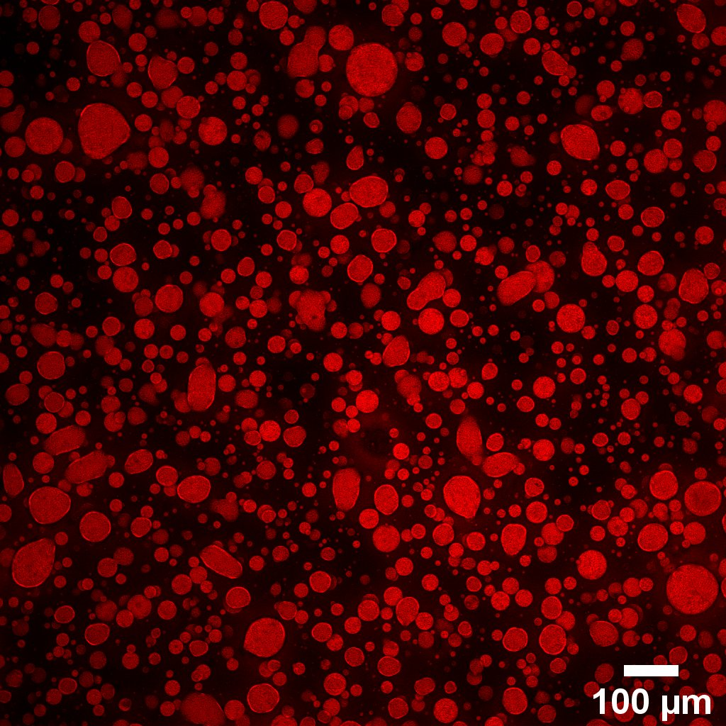
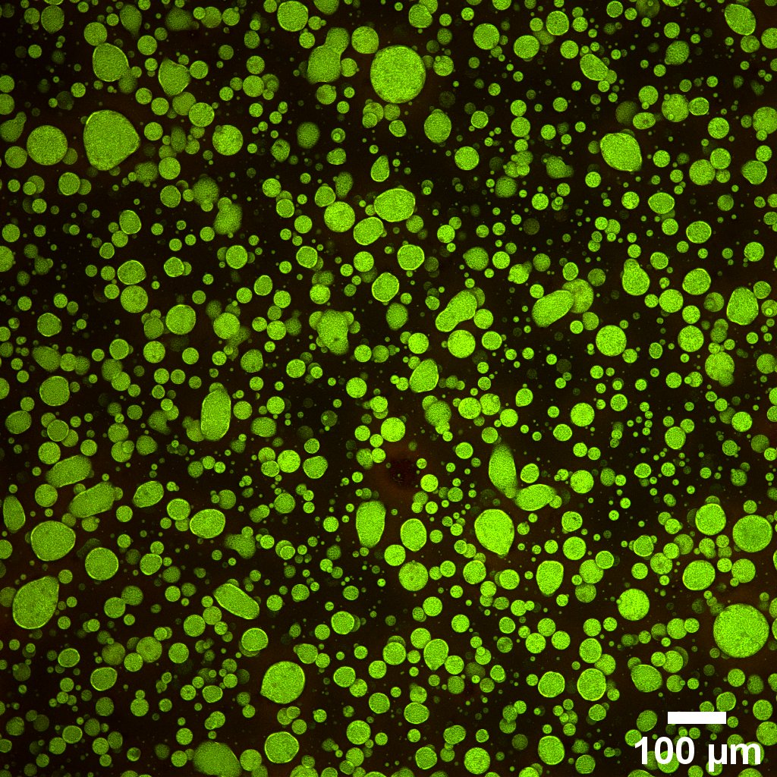
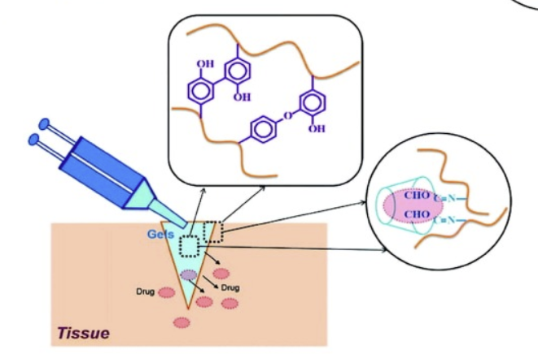
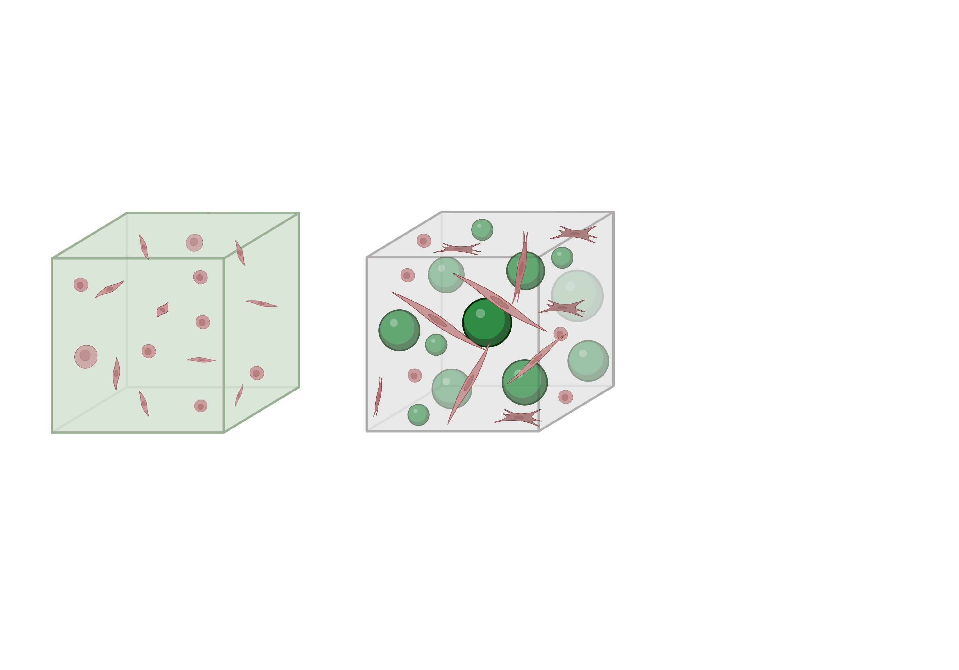
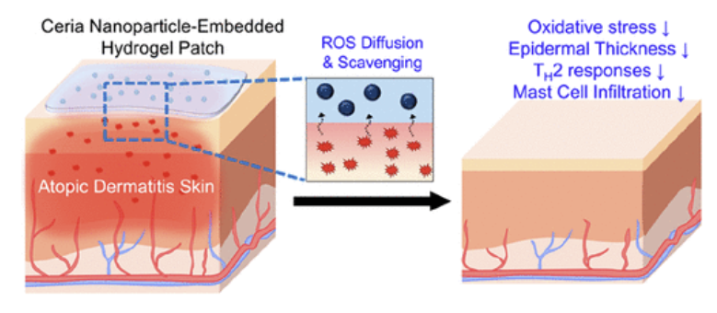
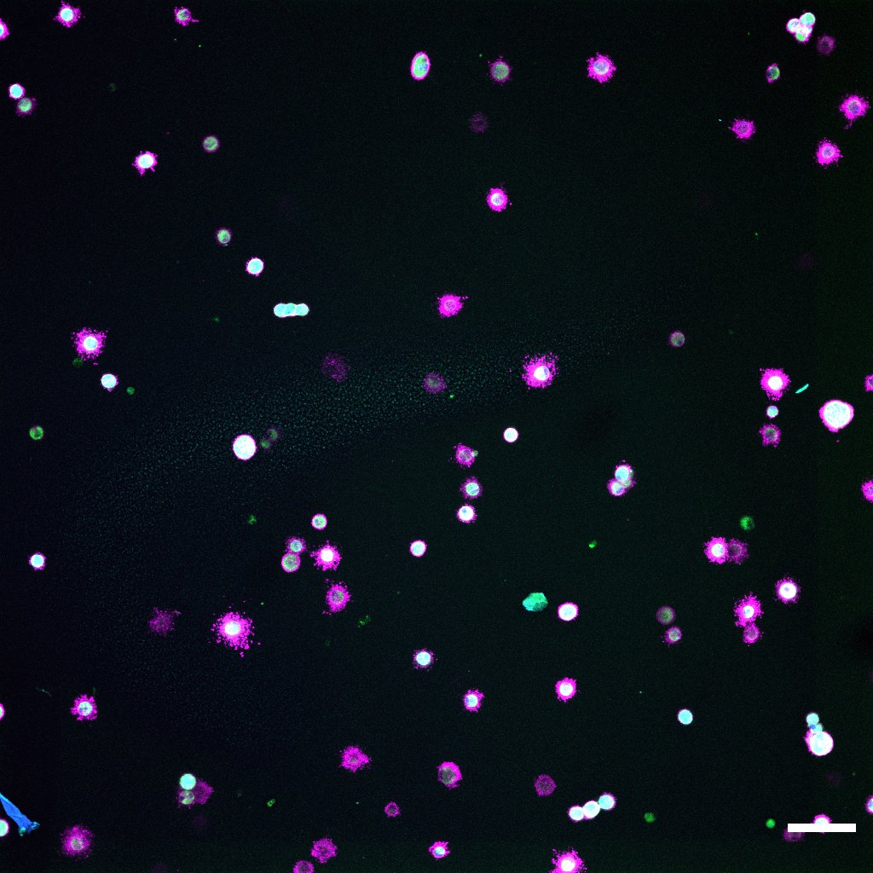
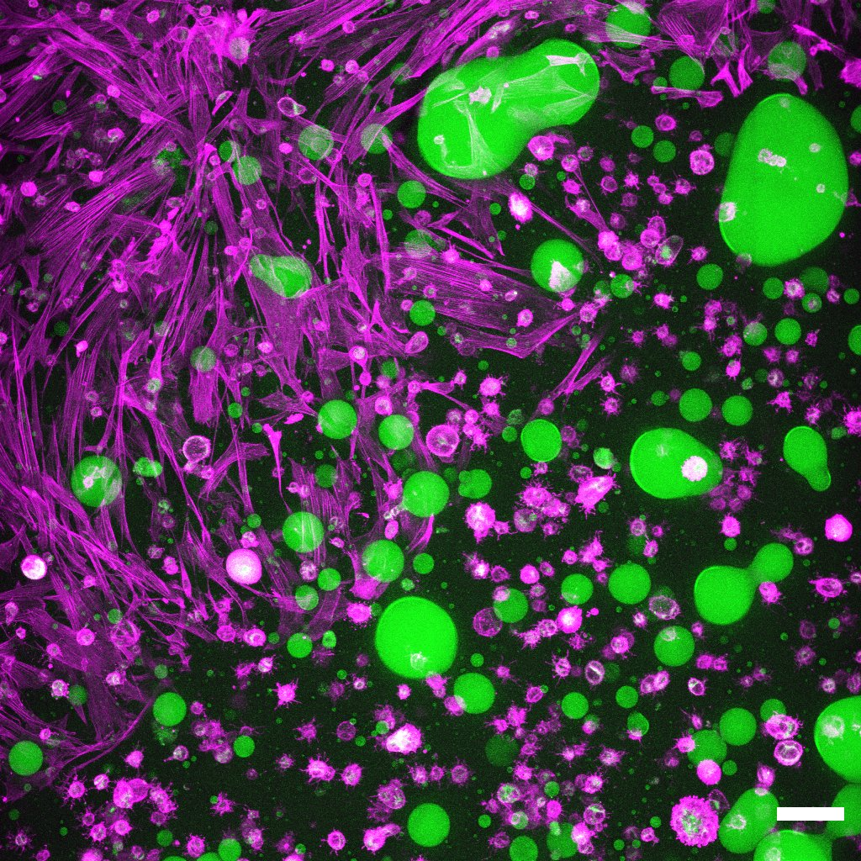
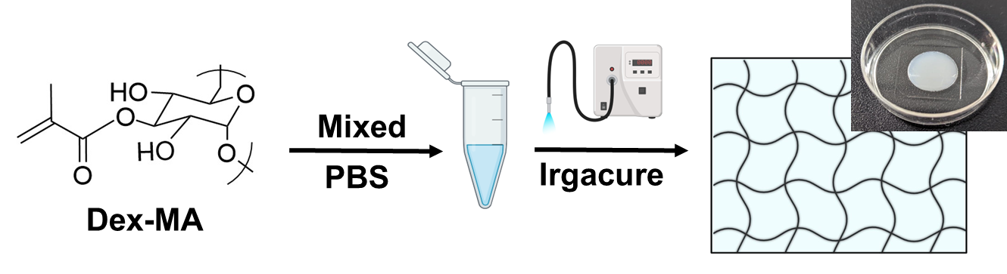
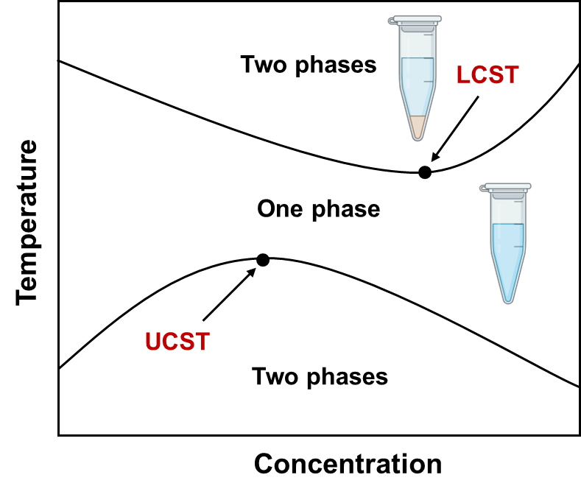
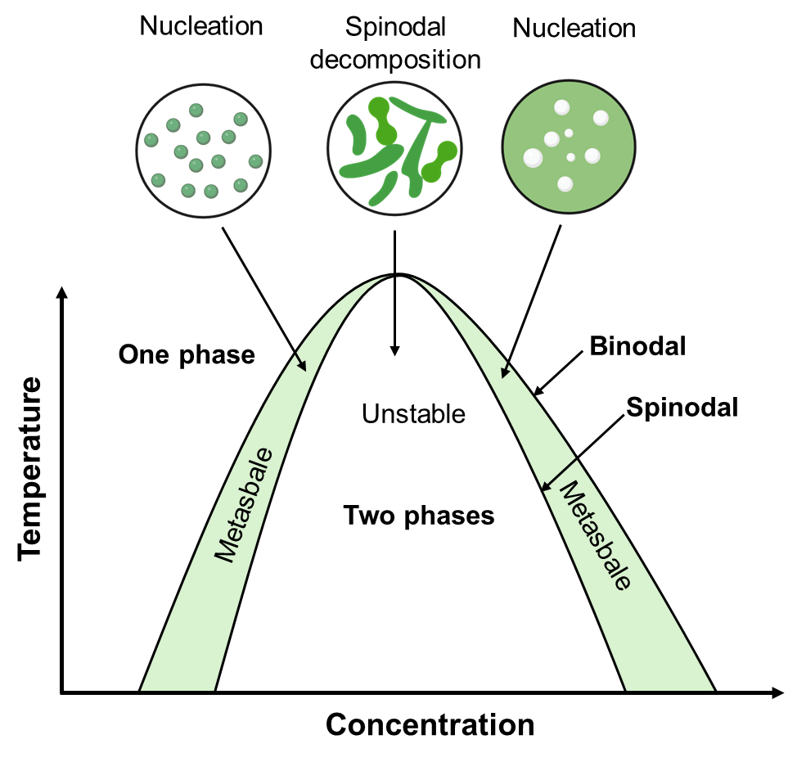
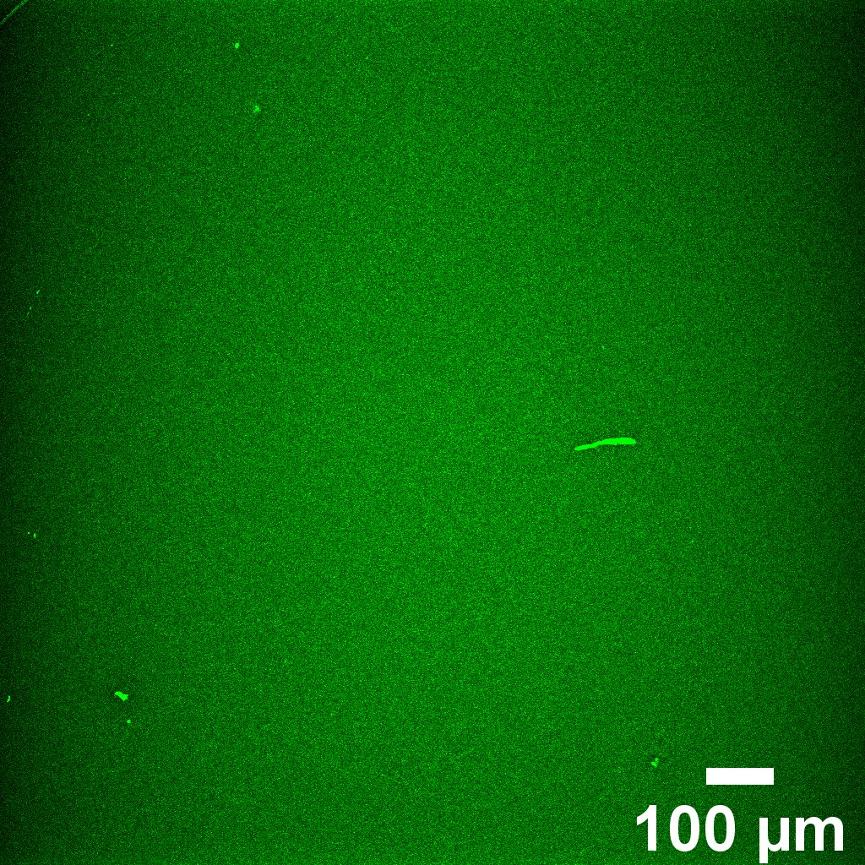
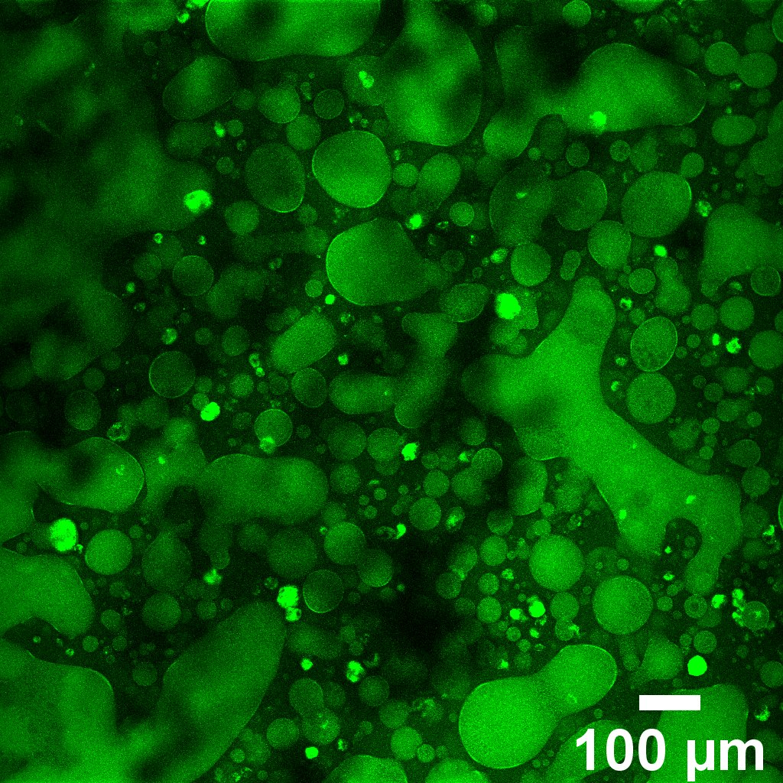
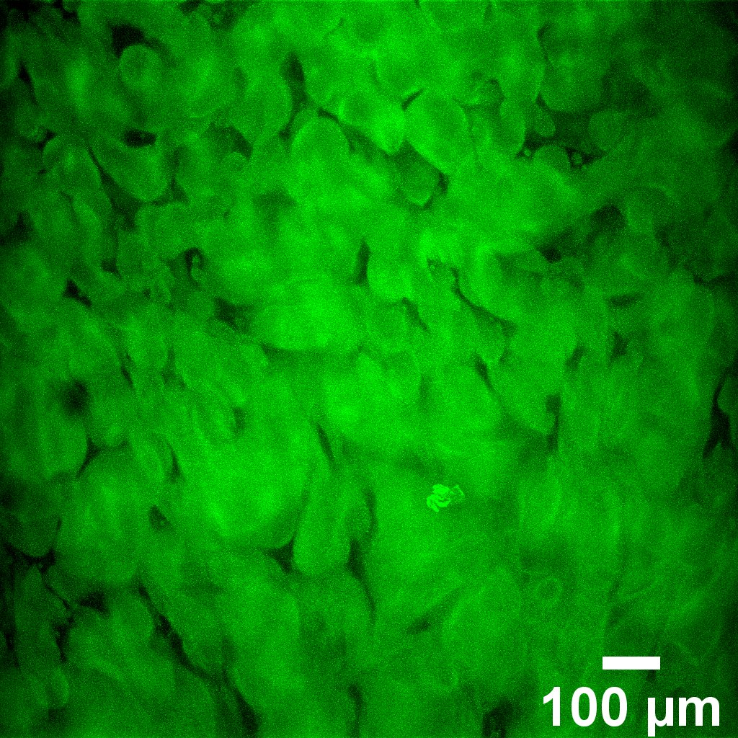
Leveraging Phase Separation to Engineer Microstructures and Cell Encapsulation in Biomaterials
Evan Kennedy, Saniya Yesmin Bubli, and Linqing Li*
Department of Chemical Engineering and Bioengineering, University of New Hampshire, Durham, NH, USA
* Linqing.Li@unh.edu
1. Introduction
3. Addition of Hydrophobic Modifications Allows for Phase Transition
5. Hydrogel Microstructures Regulate the Rate of Drug Release
A fluid containing hydrophilic and hydrophobic parts may phase separate, resulting in the aggregation of hydrophobic-rich regions.
Polymer solutions are photo-crosslinked into non-phase-separated and phase-separated hydrogels containing well-defined microdomains.
Cargo can be encapsulated into hydrogels if introduced to the precursor solution at the time of phase separation.
Hydrogel crosslinks disassociate over time, degrading the hydrogel structure. Controlling the degradation rate allows for a controlled, continuous release of encapsulated cargo.
By dictating synthesis parameters, dextran-based polysaccharide hydrogels can be generated with controlled morphologies.
Morphological control is useful in materials and biomimicry, and cargo delivery and uptake is useful for drug administration or toxin removal.
Synthesis of dextran methacrylate (DexMA)
Non-phase-separated
Dextran is an uncharged hydrophilic homopolysaccharide and FDA-approved material.
The hydrophilic backbone can be modified with hydrophobic residues (methacrylate) to induce phase separation.
Phase-separated
Absorbance graphs illustrating the reversibility and concentration dependance of the phase transition of DexMA-PBS solutions³
Methacrylate Drug Merged
Autofluorescence Autofluorescence
Drugs are encapsulated as the gel phase separates and crosslinks, and are released as the gel degrades
Release rate dependent on gel’s crosslinking density and microstructures
6. Hydrogel Microstructures Regulate Cellular Behavior in 3D
Hydrogel injection for Drug Delivery¹
Hydrogel Patch for Selective Absorption²
Human dermal fibroblast cells in hydrogel matrix
Microstructures provide a scaffold for cells to migrate across
Lack of microstructure results in lack of cell migration
Excessively dense microstructures trap cells in place, also inhibiting migration
“Goldilocks” microstructures provide cell attachment points
4. Photocrosslinked Microstructured Hydrogels with Distinct Morphology
Non-phase-separated
Phase-separated
Hydrogel Synthesis Procedure³
Phalloidin;
Phase-separated domains
2. Phase Separation in Macromolecules
7. Conclusions
Phase Diagrams of Polymer Solutions³
 | Gel 1 | Gel 2 | Gel 3
Precursor Solution: | Non Phase Separated | Phase Separated | Phase Separated at high concentration
Morphology | No Structure | Droplets | Continuous Phase
Auto-fluorescence Gel Image
Hydrogel microstructures can be tuned by controlling polymer concentration and solution temperature
Hydrogel microstructure morphology affects the ability of cells to migrate and proliferate and the release rate of drugs
Future plans involve varying crosslinking density to control drug release; using rheological testing to quantify gel stiffness as a function of multiple parameters; and designing multi-functional hydrogels.
Acknowledgement
NH BioMade IIA 1757371 and EPS-1101245
CIBBR (P20GM113131) at NIH
UNH CHBE Department
Dr. Linqing Li’s Lab, UNH
UNH Core facility and Instrumentation Center
Solutions exhibit phase separation according to a “transition temperature”
At the transition temperature, nucleation occurs, leading to the formation of a new phase
Factors that affect the transition temperature include solute concentration, the presence of surfactants, and more.
This phase transition is reversible
References
Hydrogels were crosslinked via UV-initiated radical polymerization.
As the degree of the solution’s polymer aggregation increases, the resultant microstructure proceeds from no structure to condensed spherical domains to continuous phase
No defined structures in non-phase-separated gels.
1. Narayanaswamy R, Torchilin VP. Hydrogels and Their Applications in Targeted Drug Delivery. Molecules. 2019 Feb 8;24(3):603. doi: 10.3390/molecules24030603. PMID: 30744011; PMCID: PMC6384686.
2. Ye Eun Kim, Seung Woo Choi, Min Kyung Kim, Thanh Loc Nguyen, and Jaeyun Kim
Nano Letters 2022 22 (5), 2038-2047
DOI: 10.1021/acs.nanolett.1c04899
3. Bubli, S. Y. et al. Inducing an LCST in hydrophilic polysaccharides via engineered macromolecular hydrophobicity. Sci. Rep. 13, 14896 (2023).
Notes:
SEM – 20 um
Toxicity- 100 um
Gel- 100 um
Gel with cells- 50 um, 2D

