Slide 1
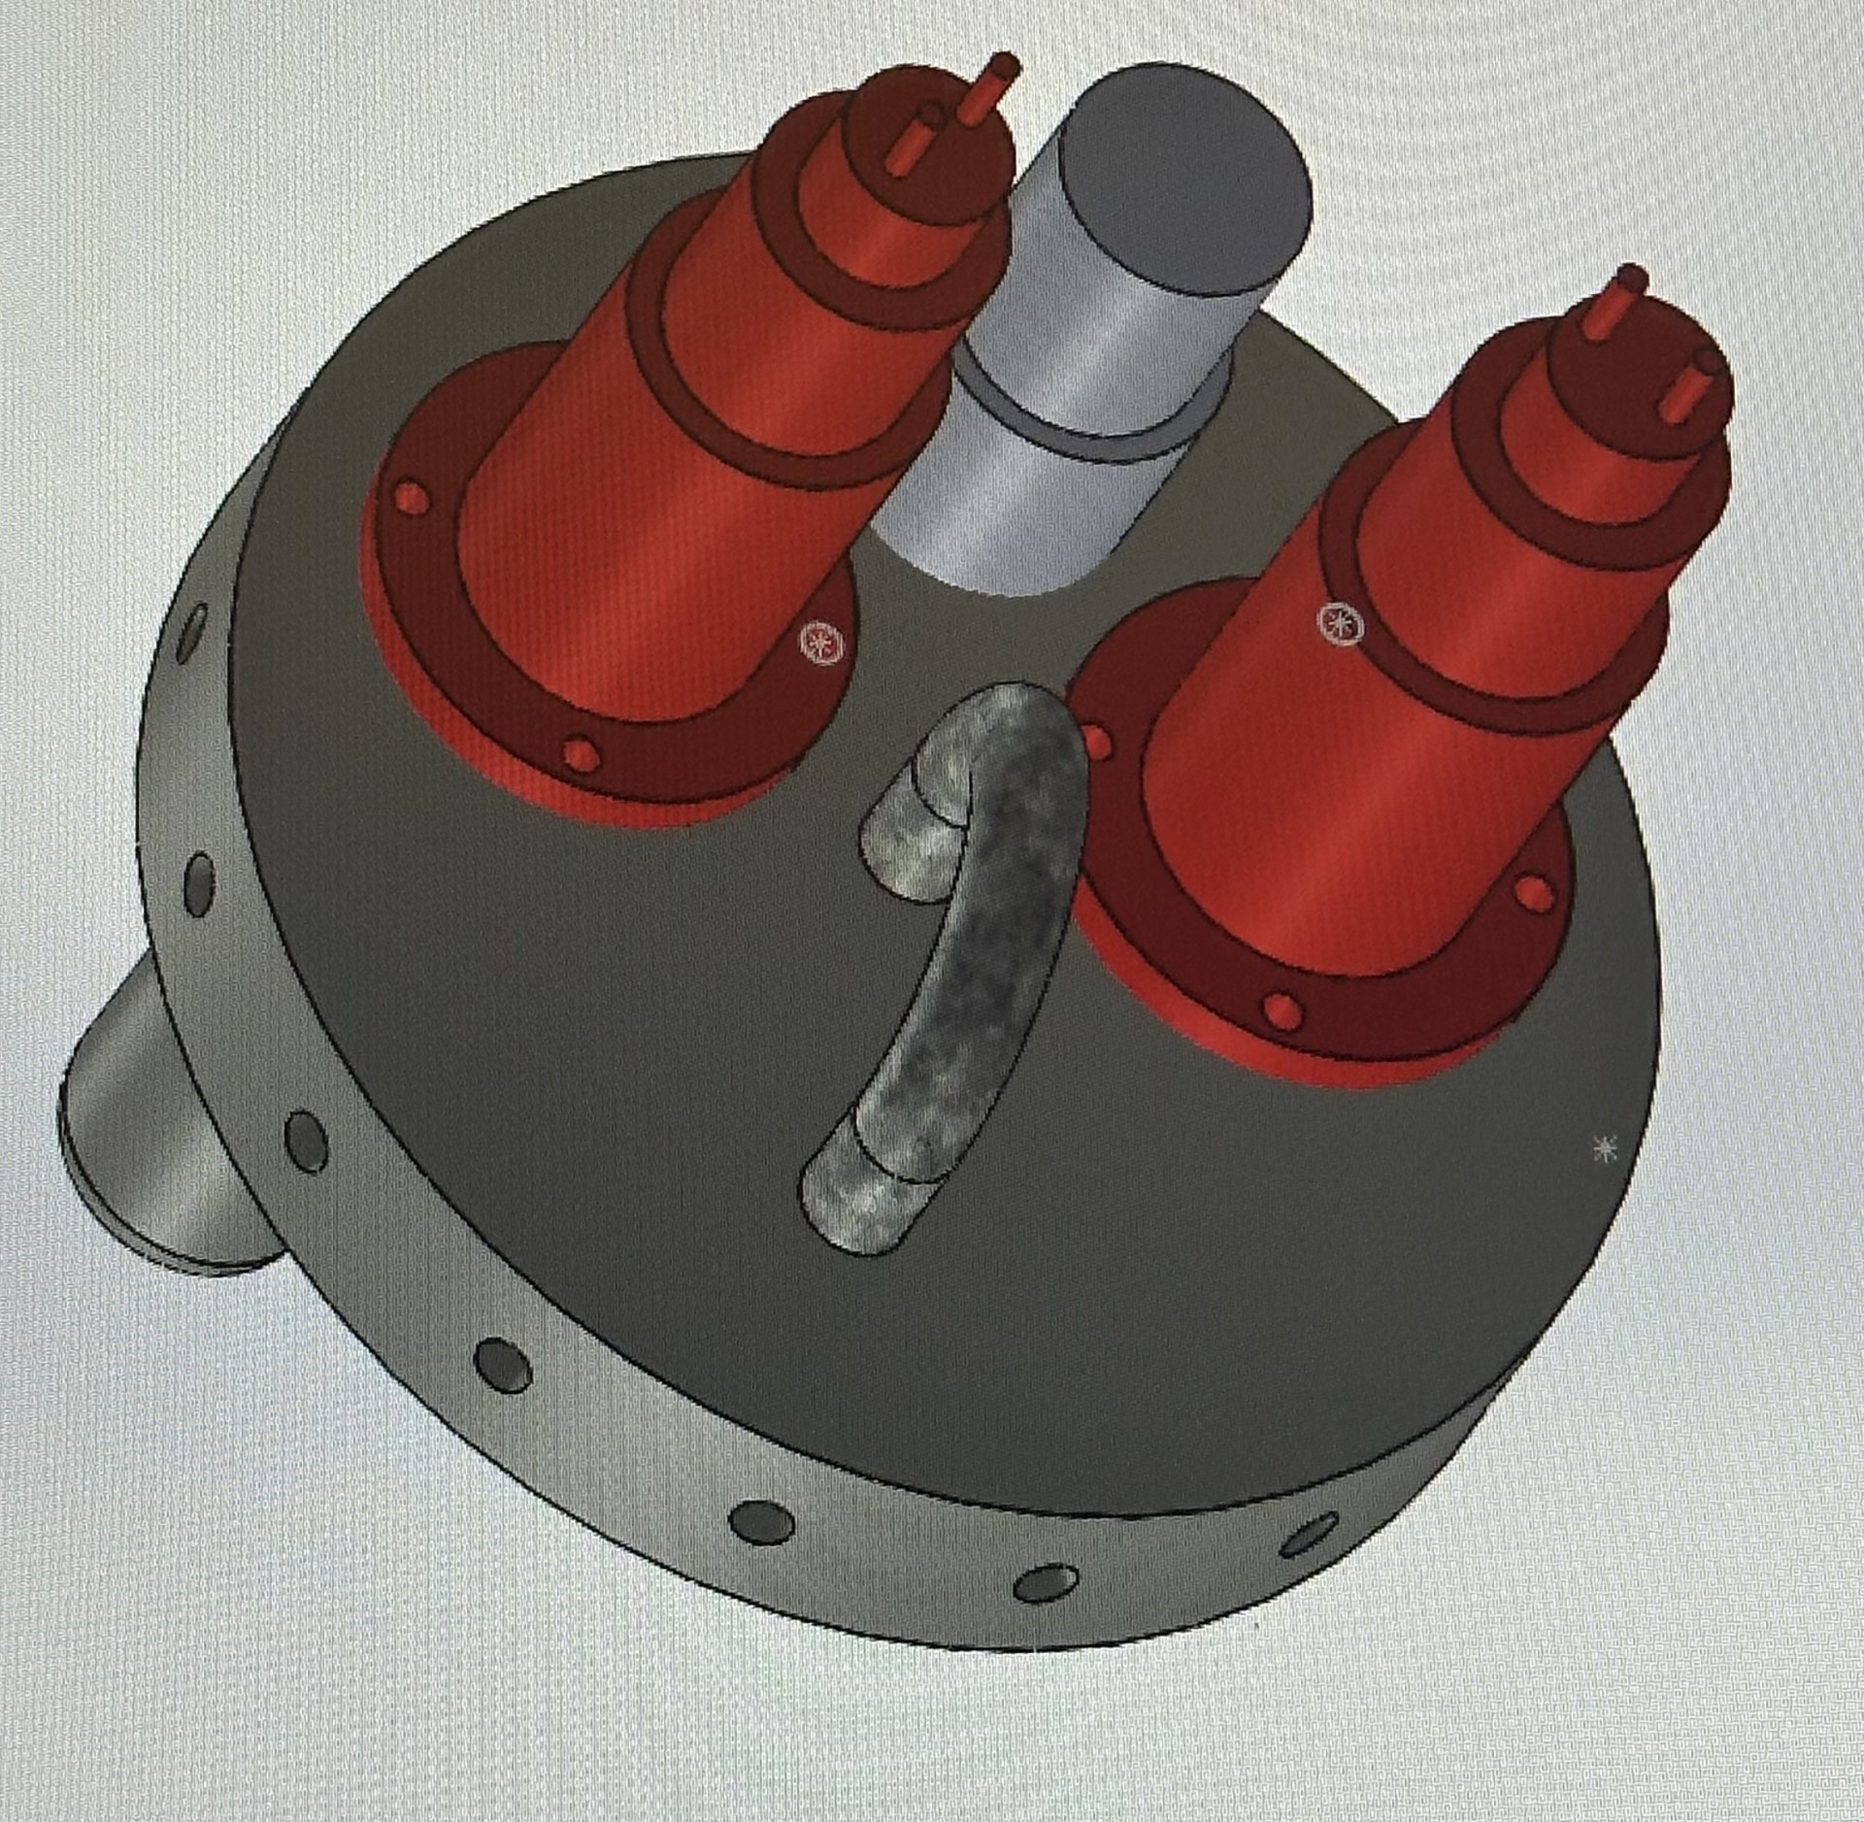
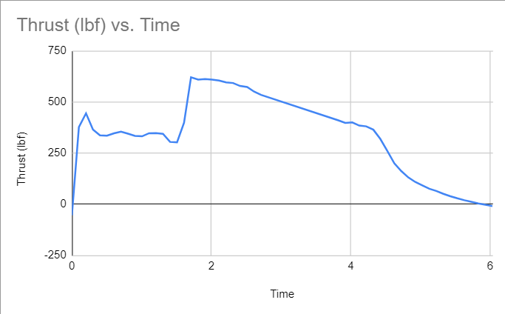
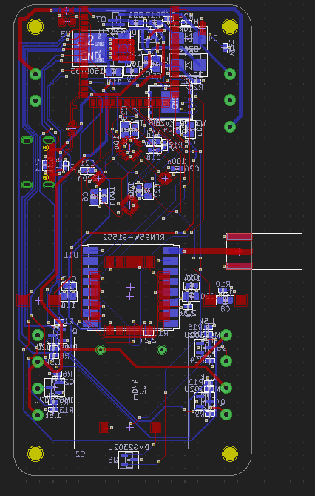
UNH SEDS High Powered Rocket FAR-OUT Hybrid Rocket Competition Mason McDonald, Matthew Wharton, Anthony Bilodeau, Douglas Coulter, Matt Williams, Sam Flynn, and Ryan Tripp Department of Mechanical Engineering, University of New Hampshire
Project Overview
Frame
Payload and Recovery
Goals: Design and develop Hybrid engine rocket to launch at FAR-OUT competition
Reach 9500 feet apogee
Meet safety requirements set by FAR-OUT officials
Implemented non-deployable water ballast payload
Reduced descent velocity
Simplified two stage deployment recovery system
Maximized axial strength in recovery plate
Von Karman fiberglass nose cone with an aluminum tip
Minimum diameter frame based upon engine diameter to minimize weight and drag
G12 fiberglass tubing used for upper frame and lower fin attachment section
Fiberglass fins utilized to ensure stability of the rocket
Recovery Plate Assembly
Propulsion
Testing
Conducted hydrostatic testing to verify nitrous tank can withstand pressure
Measured thrust by static fire test with vertical test stand
Ensured functionality of recovery system with ground deployment testing
The rocket consists of a hybrid engine:
Solid Paraffin Wax fuel with 10% EVA
Nitrous Oxide oxidizer injected via a multi-stage vortex generator
Phenolic insulation to ensure chamber can withstand immense heat
Graphite C-D nozzle with aluminum carrier and RTV thermal break
Hybrid Engine's Thrust Readings
Avionics
Design Considerations
Iterated previous avionics design
Quadrupled processing power from v1.0
Added wireless connectivity
Upgraded peripherals and onboard storage
Machining complexity for propulsion components (casing and internals)
High shock loading on parachute deployment
Effects of high launch-site temperatures on fuel, oxidizer, and valves
Balancing takeoff velocity, recovery (dry) mass, and maximum velocity
.
Static Engine Test (4/19/24)
Acknowledgments
We would like to thank our advisors, Professor Nedyalkov and Professor Clemmons as well as Noah MacAdam, Kevan Carpenter, and Scott Campbell from the Technical Service Center

