Slide 1



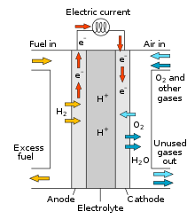
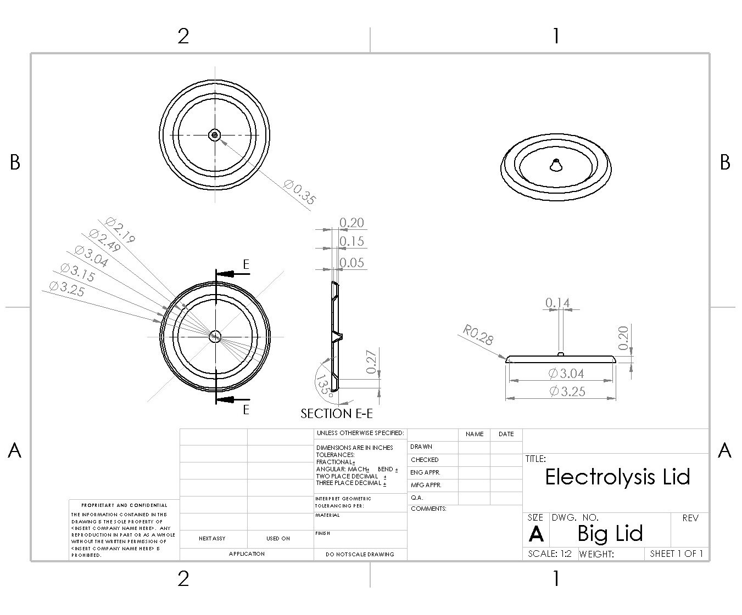
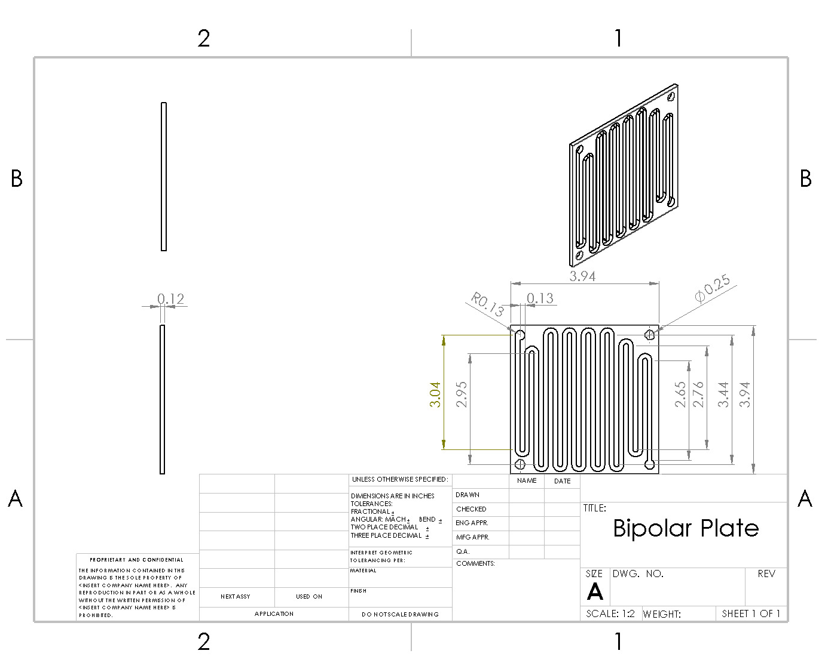
Alkaline Fuel Cell
Nicholas Martel, William Danais, CEPS TECH 412, University of New Hampshire
background
DESIGN & MANUFACTURING
FINAL PRODUCT
The search for solutions to slow Climate Change has led to an increased manufacturing of electric vehicles, as well as the development of new technology for green alternatives. The Hydrogen Fuel Cell, specifically, has shown promise as a climate safe and efficient electricity generation method. The Hydrogen fuel cell takes hydrogen and oxygen gas to create energy via redox reaction; water is the only byproduct. However, this fuel cell requires platinum which is a rare and expensive metal, making the Fuel Cell cost prohibitive.
Our mission was to replicate a fuel cell that had the same reactants and products as the Hydrogen Fuel Cell, without the use of expensive metals. This is the Alkaline Fuel Cell.
The typical Hydrogen Fuel Cell consists of bipolar plates, gas diffusion layers, a proton exchange membrane, and an anode/cathode.
From left to right, it would be something like this:
Bipolar Plate→ Gas diffusion layer→ Anode→ Proton exchange membrane→ Cathode→ Gas diffusion layer → bipolar plate
The Alkaline Fuel cell follows the same format, but differs in the materials.
The bipolar plate is a carbon graphite material, indented along the surface to allow for gas distribution along the gas distribution layer. Graphite cannot be cut using a water cutter; An extra layer of aluminum makes the indent for the bipolar plate.
Carbon Cloth was used for the anode and the cathode. A nickel paste is used as a catalyst on the anode and cathode.
Carbon Cloth is also used for gas distribution layer.
Aqueous potassium hydroxide solution is used as the electrolyte (POH).
Hydrogen Production:
A sodium hydroxide/ aluminum reaction was used to produce and capture hydrogen gas.
2Al +2NaOH+2H20→ 2NaAlO2 +3H2
Final Product Picture Glued Here
CONCLUSIONS
The standard hydrogen fuel cell produces 0.5 to 1.2 volts of electricity. Stacked together, these produce large amounts of electricity. However, the cost of a single hydrogen fuel cell can range from hundreds to thousands of dollars. The alkaline fuel cell cost roughly $100 of UNH funding to produce volts.
INTERNAL REDOX REACTION
Hydrogen Gas loses electrons at the anode and diffuses across the potassium hydroxide solution to reduce oxygen gas and form water.
The transfer of electrons produces electrical energy.
    Anode:
    H2→ 2e- + 2H+
    Cathode:
    ½ O2 + 2e- + 2H+ → H20
Acknowledgments
Dr. Benjamin Mitchell, Jinjae Kim
TECH 412 Class instructors
Inspiration
Vaghari, Hamideh & Jafarizadeh, Hoda & Berenjian, Aydin & Anarjan, Navideh. (2013). Recent Advances in Application of Chitosan in Fuel Cells. Sustainable Chemical Processes. 1. 16. 10.1186/2043-7129-1-16.

