Slide 1
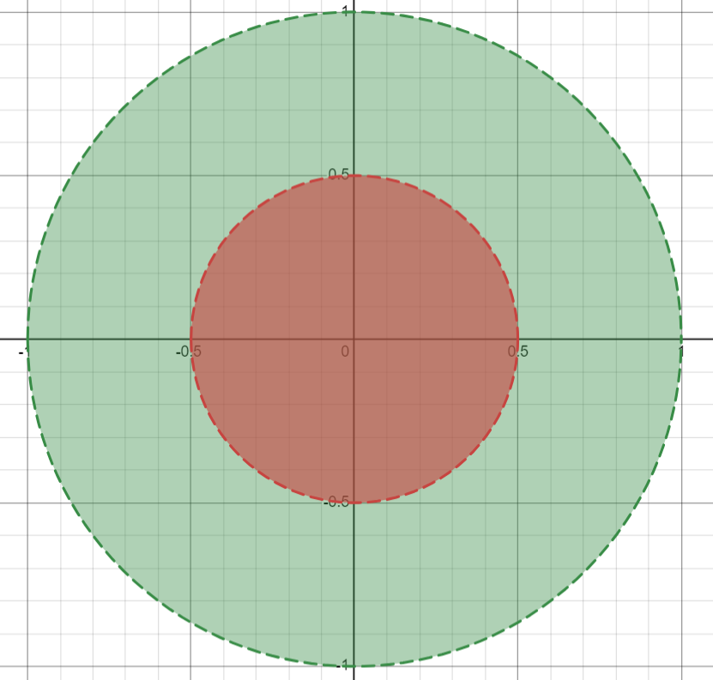
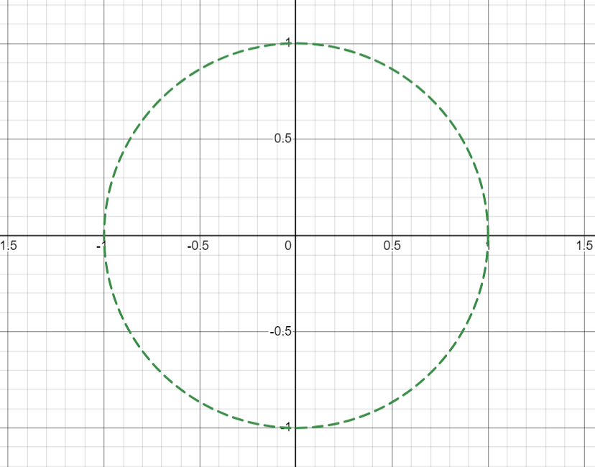
The Generalized Composition Operator on Bloch Spaces Phil Breton Department of Mathematics & Statistics, University of New Hampshire, Durham, NH 03824 Advisor: Dr. Rita Hibschweiler
Background
Theorem Statement
Two Cases
Therefore,
Then, in the case of , we have
And by our original assumption, since , . , and since ,
And therefore,
Together, we get our result:
In complex analysis, a function is called analytic on D if is differentiable on D and is continuous on D.
Fix and fix analytic functions and . .
We now proceed with two cases:
and
In the case of , we have
The open unit disk (denoted ) is the set of complex numbers with modulus less than 1.
We define to be the set of functions analytic on .
Sufficient Condition
Here, the sufficient condition is the direction.
Important to note that is analytic for analytic, and .
Assume . Then for all and for all ,
is a sufficient condition for .
An operator on is a linear function that maps analytic functions to analytic functions.
For a fixed , we define the Bloch Space as
This is a set of analytic functions with membership defined by a condition on a function’s growth.
is a normed vector space with the norm
Objective
Fix two analytic functions and
( is called a self-map because it maps into .)
For , we can define the Generalized Composition Operator :
Objective: characterize and such that
I.e., find a necessary and sufficient condition on … and so that takes functions from to
is called the generalized composition operator because of its similarity to the composition operator
Test Function
Necessary Condition
Since we will be assuming that . , we can choose a function to help us get to our result.
We can fix and define the function
It follows that
Further, and there exists independent of such that for all .
This function helps us construct our result if we evaluate it at :
The necessary condition is the direction.
We assume . According to a theorem, this is equivalent to
for all , so the following inequality holds.
By evaluating and because of the supremum, we can see that for all ,
In particular, it is true for , so
Acknowledgements & Notes
Cy Williston
Providing his Bloch Spaces writeup, which I used to prepare for my work
Ian Bresnahan
Giving me opportunities to present to someone during the semester
The proof presented in this poster only works for . . and is an excerpt of my thesis, which covers the case as well as a generalization of .
Please reach out at phil.breton@unh.edu if you are interested.

