Slide 1
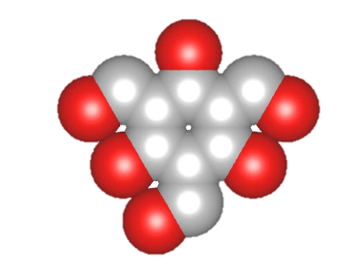
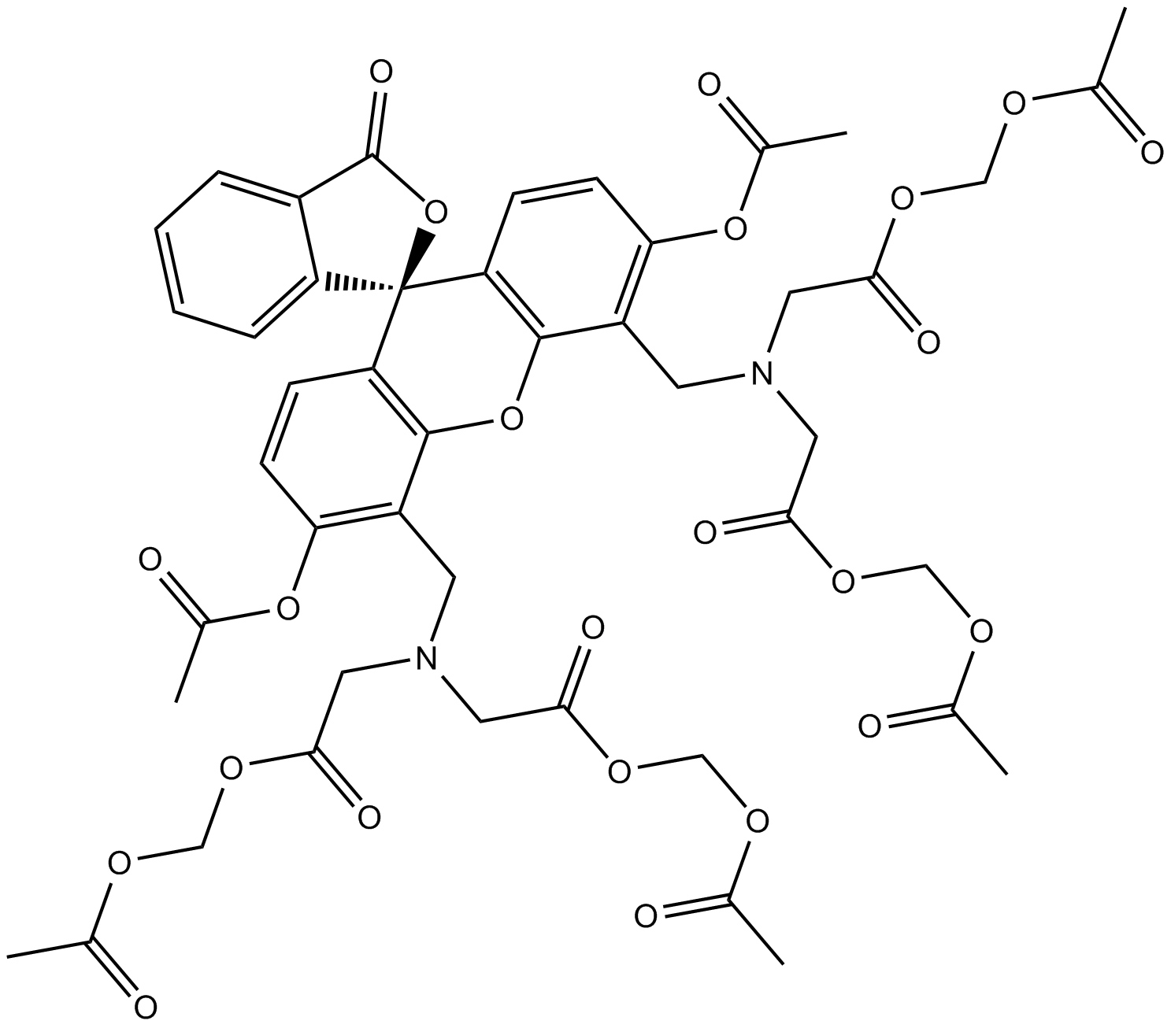
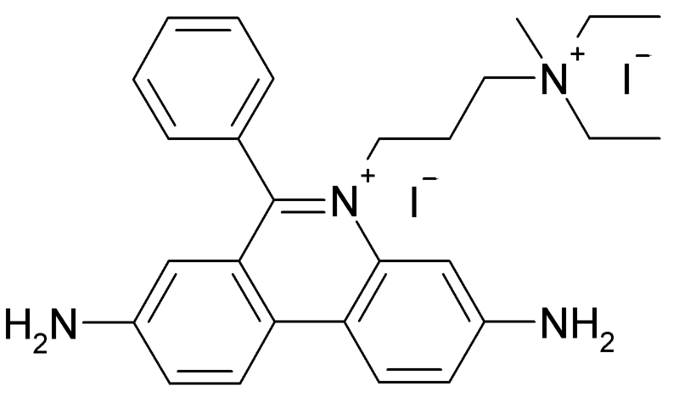
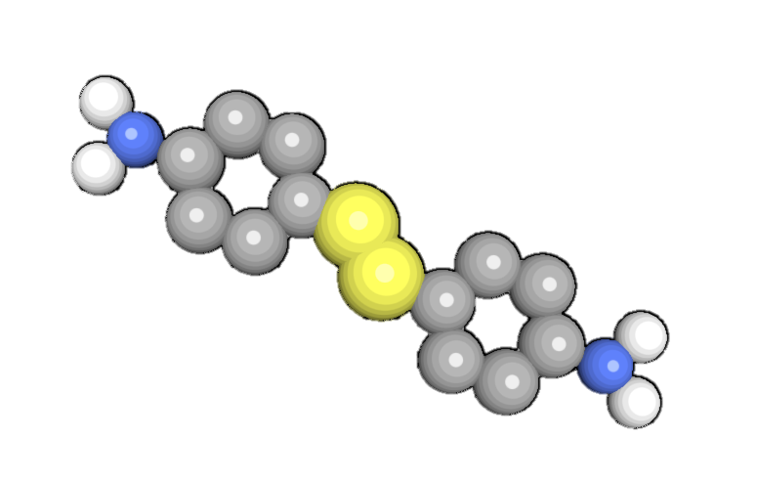
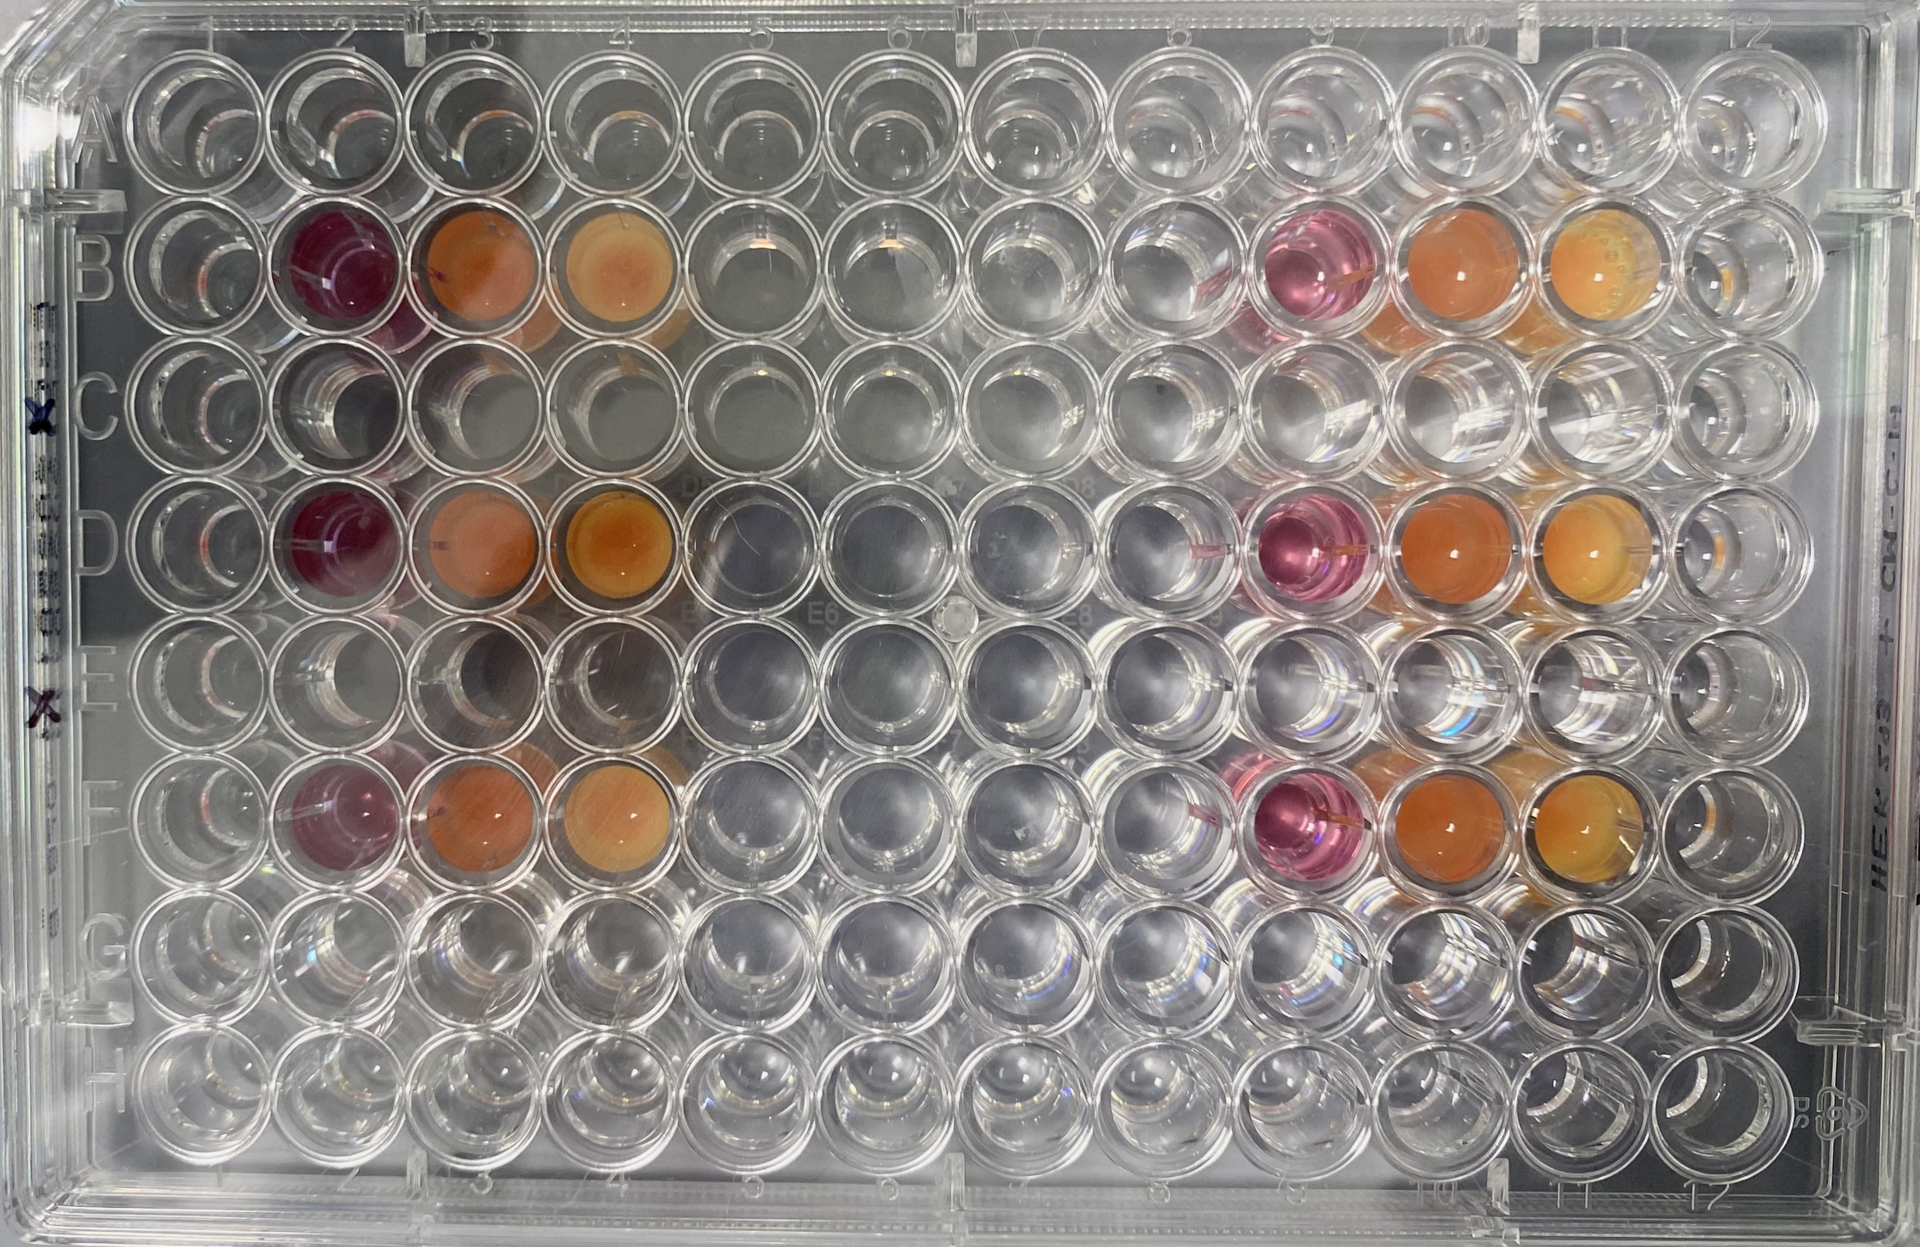
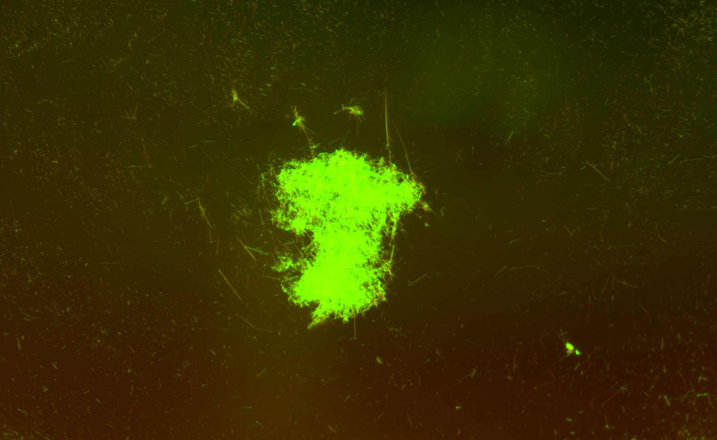
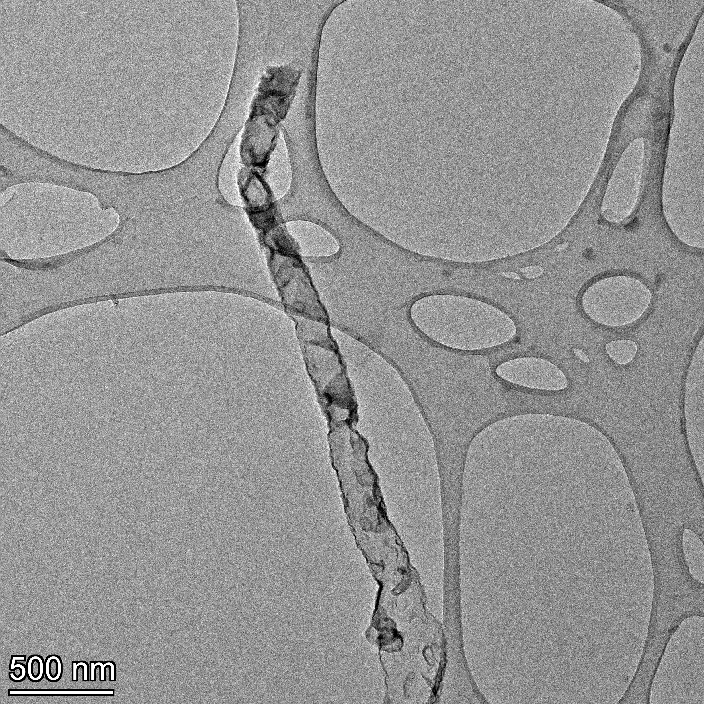
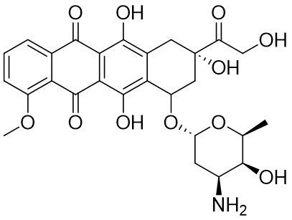
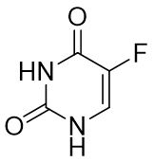
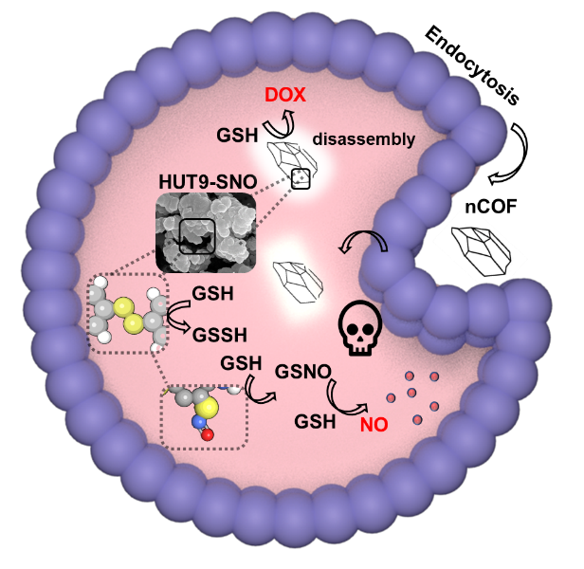
Glutathione-Sensitive Nanocarrier Frameworks for the Synergistic Release of Chemotherapeutics Carmelina Minico, Patrick Strobel, Dr. Nathan Oldenhuis, Dr. Aylin Aykanat Department of Chemistry, University of New Hampshire, Durham, NH 03824
Introduction
Molecular Design
Preliminary Cell Studies
Alive
Dead
Cancer remains the second leading cause of death in the United States, resulting in nearly 2 million cases with over half a million deaths annually. Cancer cells are dysregulated, genetically altered cells arising from normal cellular origins, characterized by uncontrolled proliferation leading to tumor formation. While chemotherapy is commonly used as the primary treatment method, it has limitations such as tumor cell chemoresistance, suboptimal cellular uptake, and adverse effects on patients’ physiology. To address these issues, extensive research has been dedicated to nanoscale carriers including porous organic polymers. These advancements aim to enhance drug efficacy and reduce side effects.
Research has shown the promising potential of optimizing nanoscale covalent organic frameworks (nCOFs) for drug delivery applications. Through a strategic choice of building blocks, these frameworks undergo self-assembly, resulting in functional molecular configurations with detailed pore chemistry that can respond to stimuli.
Our objective is to synergistically deliver chemotherapeutics with developed frameworks to induce apoptosis in cancer cells.
4-Aminophenyl
HUT 9
-S-S- 268 kJ/mol
A
B
Conditions:
Aniline
Benzonitrile
Methanol
+
Chemotherapeutic “docking”
Doxorubicin
Figure 5. A) Calcein AM (Calcein acetoxymethyl ester) is a non-fluorescent, permeable compound that is hydrolyzed in living cells, indicating metabolic activity (green fluorescent). B) Propidium iodide (PI) is a membrane exclusion dye used to stain non-viable cells with compromised membranes. PI represents non-viable (red fluorescent) cells in a sample.
MOFs
COFs
2,4,6-Triformylphloroglucinol
A
B
Scanning Electron Microscopy and Transmission Electron Microscopy
metal
organic linker
A
B
building blocks that self-assemble
Figure 6. A) 96-well plate was loaded with HEK293 cells and two different concentrations (5mgs and 15mgs). of the COF. A Resazurin assay and Calcein-AM and PI stains were used to produce a cytotoxicity growth kinetics model. B) Despite exhibiting fluorescence characteristics, the COF treatment crystalized cells and indicated the absence of viable cells using an ECHO fluorescence microscope.
50µm
10µm
Drug Loading Studies
C
D
Experimental Methods
The investigation of redox-responsive disulfide bonds as drug delivery systems has gained traction due to tumor-specific physiological triggers. Under oxidative conditions, these bonds can be broken by cellular free thiols such as glutathione (GSH), which is 100 to 1000 times more concentrated in cancer cells. The COF should degrade in these conditions without harming any healthy cells.
500µm
Doxorubicin
5-Fluorouracil
500nm
50nm
Figure 7. Doxorubicin and 5-Fluorouracil are two chemotherapy drugs that will be loaded into the COF to target and treat cancer.
Figure 2. Crystal morphology revealed through Scanning Electron Microscopy (SEM) at two magnifications 50µm (A) and 10µm (B). Scanning electron microscopy (SEM). Transmission electron microscopy (TEM) images taken at 500nm (C) and 50nm (D) with visible lattice structures.
Acknowledgements
Powder X-Ray Diffraction and Fourier-Transform Infrared Spectroscopy
A special thanks to the Department of Chemistry, Dr. Aylin Aykanat, Dr. Nathan Oldenhuis, and Patrick Strobel.
NH BioMade is funded by NSF Award #IIA 1757371 administered by NH EPSCoR at UNH
PXRD
FT-IR
C=C
C-N
References
COF Product
Normalized Absorbance (a.u.)
Anusree Natraj, Ji, W., Xin, J., Castano, I., Burke, D. W., Evans, A. M., Strauss, M. J., Ateia, M., Hamachi, L. S., Gianneschi, N. C., ALOthman, Z. A., Sun, J., Yusuf, K., & Dichtel, W. R. (2022). Single-Crystalline Imine-Linked Two-Dimensional Covalent Organic Frameworks Separate Benzene and Cyclohexane Efficiently. Journal of the American Chemical Society, 144(43), 19813–19824. https://doi.org/10.1021/jacs.2c07166
Huang, C., Zhou, S., Chen, C., Wang, X., Ding, R., Xu, Y., Cheng, Z., Ye, Z., Sun, L., Wang, Z. J., Hu, D., Jia, X., Zhang, G., & Gao, S. (2022). Biodegradable Redox-Responsive AIEgen-Based-Covalent Organic Framework Nanocarriers for Long-Term Treatment of Myocardial Ischemia/Reperfusion Injury. Small (Weinheim an der Bergstrasse, Germany), 18(47), e2205062. https://doi.org/10.1002/smll.202205062
Li. (2022). Dynamic Disulfide Bonds Contained Covalent Organic Framework Modified Separator as Efficient Inhibit Polysulfide Shuttling in Li–S Batteries. ACS Sustainable Chemistry & Engineering., 10(41), 13638–13649. https://doi.org/info:doi/
Veselska. (2018). Structural Diversity of Coordination Polymers Based on a Heterotopic Ligand: Cu(II)-Carboxylate vs Cu(I)-Thiolate. Inorganic Chemistry., 57(5), 2736–2743. https://doi.org/info:doi/
Zhang. (2023). Harnessing Self-Repairing and Crystallization Processes for Effective Enzyme Encapsulation in Covalent Organic Frameworks. Journal of the American Chemical Society., 145(24), 13469–13475. https://doi.org/info:doi/
2,4,6-Triformylphloroglucinol
COF Product
2,4,6-Triformylphloroglucinol
4-Aminophenyl
4-Aminophenyl
Figure 1. Endocytosis of nCOF to facilitate the release of chemotherapeutics doxorubicin (DOX) and reactive oxygen species (ROS)
Figure 3. Powder X-Ray Diffraction (PXRD) patterns of the COF product as well as the individual components: the ligand 4-Aminophenyl and the linker 2,4,6-Triformylphloroglucinol
Figure 4. Infrared (IR) spectroscopy analysis depicting the vibrational spectra of the synthesized COF

