Slide 1
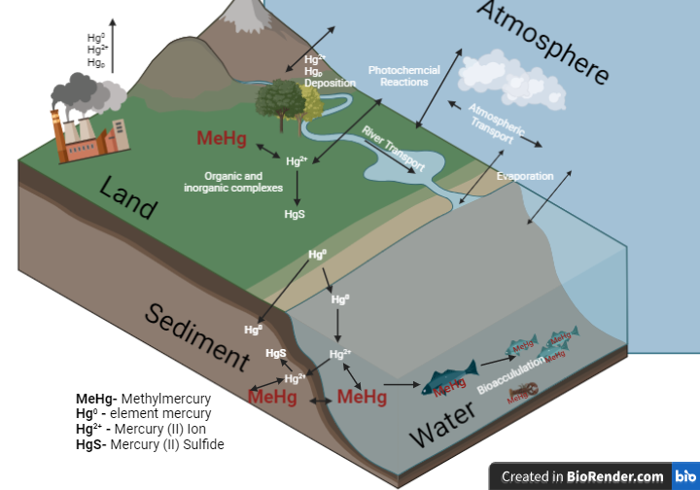
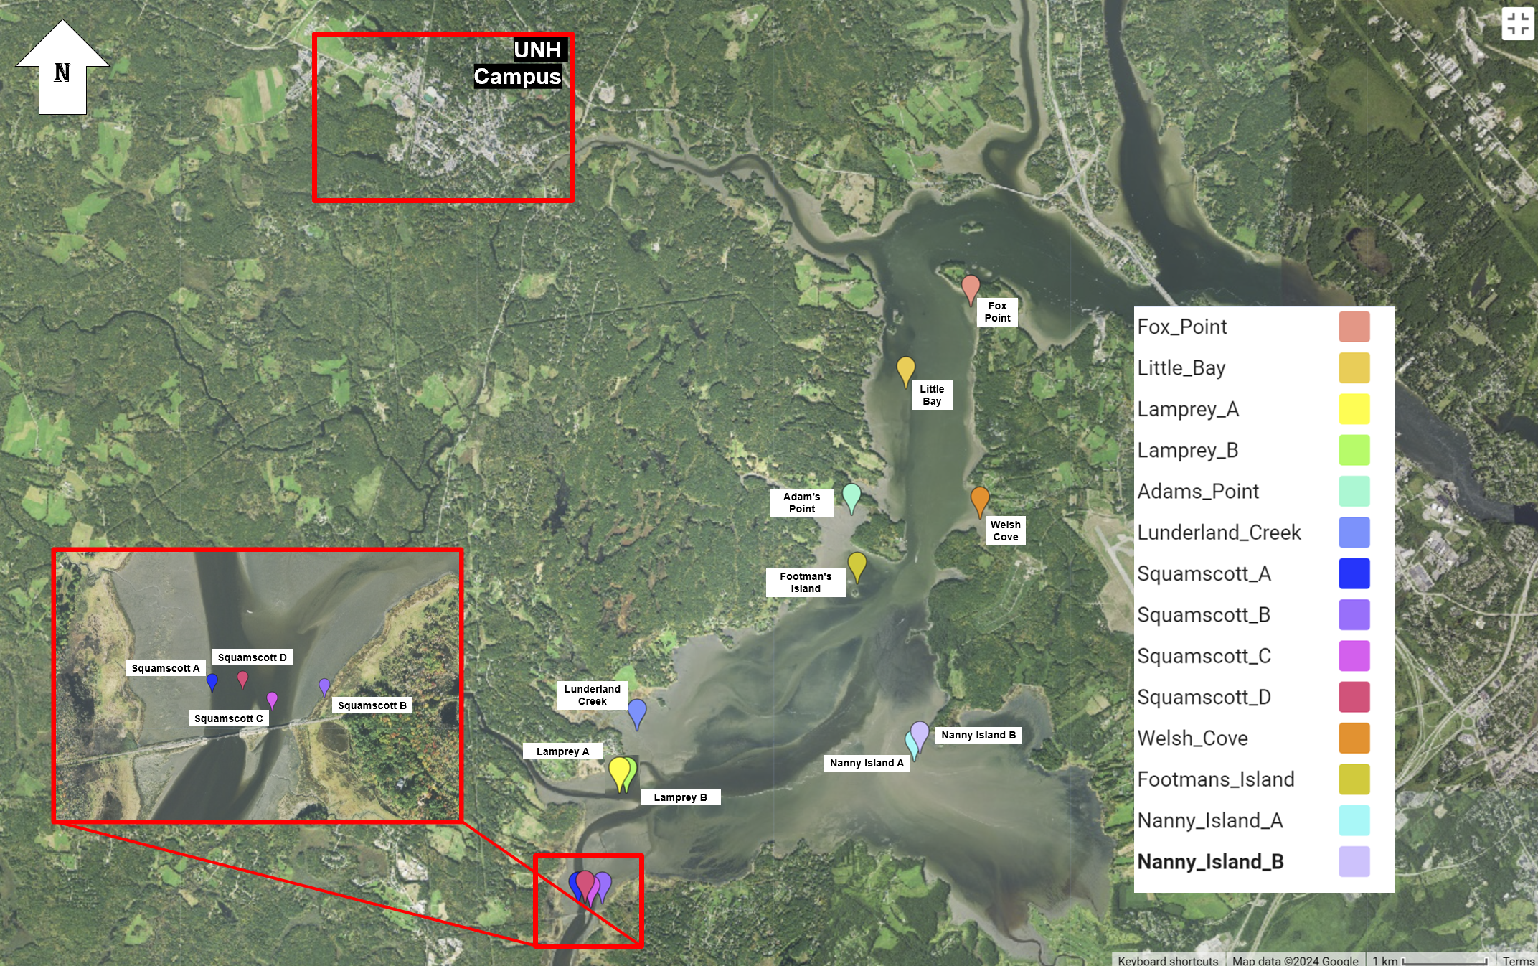
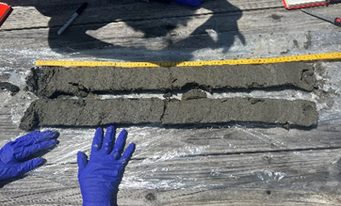
Mercury Concentrations in the Great Bay Estuary, New Hampshire Annika Culbertson | Advisor: Maria Florencia Fahnestock Department of Earth Science, University of New Hampshire
Fahnestock
Fahnestock
Introduction
Results & Discussion
Estuary Toxicity Standards. The US has no official limits on sediment Hg concentrations however, Canada, sets the Interim Sediment Quality guidelines (ISQGs) for marine and estuarine sediments at 130 ppb and the probable effect levels (PELs) at 700 ppb³. In the top 5 cm, we measured an average of 184 ppb across the 14 cores represented (Figure 4).
Concern with storm surges. Depending on sediment grain size, water depth, wind direction, and the duration of the storm, consistent winds of 30-50 mph have the potential to disrupt sediment 15 cm below sediment surface⁵. Hg levels above the ISQGs are found in the top 15 cm of 70% of the cores analyzed (Figure 5). This means storms with these strong winds have the potential to mobilize sediment Hg.
Relationship with Organic Matter. Organic matter can bind to Hg and promote the formation of more toxic and bioaccumulative methylmercury species⁶ (Figure1). These data show the positive relationship between percent organic matter and Hg in these sediments (Figure 6).
ISQG
Figure 4: Depth profile of [Hg] for all points. The orange dashed line represents the Interim sediment quality guidelines of 130 ppb, representing the threshold for toxicity³.
Figure 1: Conceptual diagram of Mercury (Hg) cycling showing the prominent local sources, pathways, and reservoirs.
Mercury (Hg) cycling in the environment
Governed by biogeochemical processes (Figure 1)
Influenced by different primary and secondary sources.
Natural reservoirs include minerals (e.g., cinnabar) and organic rich sedimentary rocks.
Anthropogenetic activities e.g. mining, coal burning release Hg to atmosphere.
Transport
Hg is transported via the atmosphere and water bodies with organic complexes
Hg is deposited onto the Earth’s soil, vegetation or water bodies.
Hg is redistributed but never fully removed from the environment.
Figure 5: Summarized depth profiles of [Hg] from multiple cores sampled at Nanny Island, the Lamprey River and the Squamscott River. Error bars denote the standard deviation.
Figure 6: Comparison of [Hg] and percent LOI for all points. LOI represents the percent of organic mater present in the samples.
Study Site & Methods
Conclusions
Great Bay Estuary, New Hampshire
The Oyster, Lamprey, and Squamscott rivers have history of industrial activity.
The Squamscott River was a waste dumping ground in the early 1900s.
Historical actives such as early human developments and the expansion of mills
Modern activities such as the coal burning e.g., Granite shore Power in Southern NH
Sediment Sampling
Sediment cores were taken in 2019 aboard the Gulf Challenger by USDA Natural Resources Conservation (NRCS) soil scientists (Figure 2).
Vibracoring allowed for longer sections of cores to be recovered ranging 1-3 m.
On land, cores were split, half analyzed by USDA NRCS for sediment characterization. The other half handled using trace element clean protocols and sub-sampled at 5cm intervals (Figure 3).
Sediment samples in plastic bags were frozen, freeze dried and homogenized.
Analysis
The top 40 cm samples of 14 cores were prioritized.
Total Hg analyzed via Milestone Direct Mercury Analyzer (DMA-80) via thermal decomposition, amalgamation/atomic abosorption spectrophotometer (TDA/AAS) at UNH following EPA Method 747.
Precision and Accuracy were assessed with QA/QC standards DORM-5 and NIST 1547.
Loss on Ignition (LOI) was used as proxy for % organic matter.
Lower levels of Hg measured at the surface via grab sampling techniques could mask much higher concentrations found just beneath the surface. Coring techniques give us a much more complete understanding of legacy contaminants.
As shown in previous studies, Hg was found to be positively correlated with organic matter, benthic organisms in these habitats or fauna can bioaccumulate Hg.
High levels of Hg present within the top 15 cm of sediment surface in Great Bay merit further study as climate change driven increases in storm frequency/intensity can mobilize high levels of Hg > 500 ppb to be released into the water column where it can be made more bioavailable.
Figure 2: Map of 14 sediment cores taken by USDA NRCS soil scientists in August 2019.
.
Acknowledgments & References
Figure 3: Photo depicting Great Bay Estuary sediment core being subsampled for trace element work.
This research was funded in part by INCO 790 funds as part of the Earth Sciences senior capstone project. We also thank the USDA NRCS scientists Donald Parizek and Milton Vega who carried out all the vibra coring field core sampling and shared with us the cores to carry out high resolution trace element work. Personal acknowledgments go to Dr. Maria Florencia Fahnestock for helping and educating every step of the way.
1. Apeti et al., 2021. An Assessment of Contaminants of Emerging Concern in the Gulf of Maine. NOAA Tech. Memorandum NOS NCCOS 291. Silver Spring, MD. 118.
2. Brown et al., 2015. The effect of sediment mixing on mercury dynamics in two intertidal mudflats at Great Bay Estuary, NH, USA. Elsevier Science Direct. Vol. 177, Part 5, 20 Dec. 2015.
3. Canadian Council of Ministers of the Environment. 1999. Canadian sediment quality guidelines for the protection of aquatic life: Mercury. In: Canadian environmental quality guidelines, 1999, Winnipeg.
4. Fitzgerald et al., 2018. Local Sources of Mercury Deposition in Coastal New England Reconstructed from a Multiproxy, High-Resolution, Estuarine Sediment Record. Environmental Science & Technology, 52 (14), 7614-7620.
5. Flores et al., 2017. The Impact of storms and Stratification on Sediment Transport in the Rhine Region of Freshwater Influence. Adv. Earth and Space Sci.
6. Ravichandran, 2004. Interactions between mercury and dissolved organic matter––a review, Chem., Vol. 55, Issue 3, 2004, p. 319-331, ISSN 0045-6535.
7. WHO. 1990. Methylmercury. Environmental Health Criteria 101. International Programme on Chemical Safety (IPCS). World Health Organization, Geneva.
Photo Credit: A.Culbertson (2022)

