Slide 1
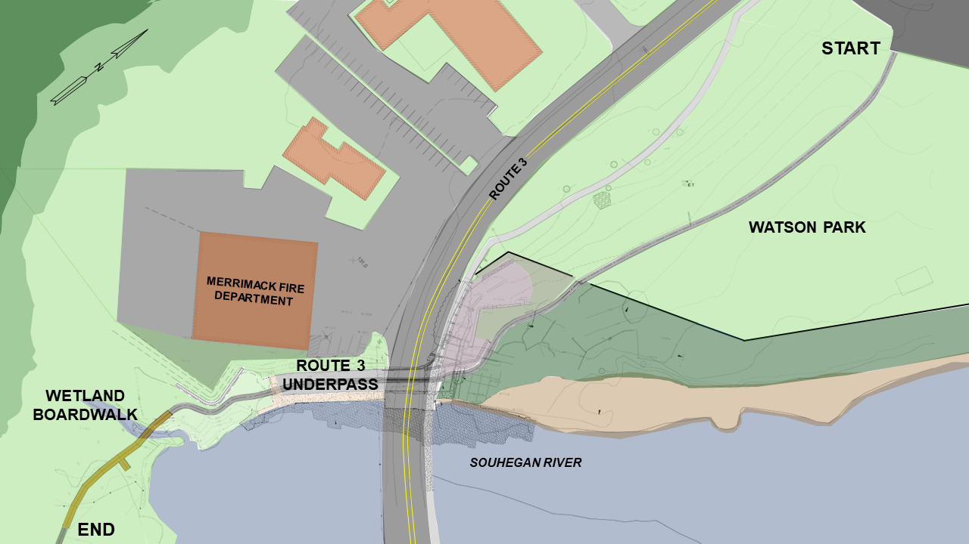
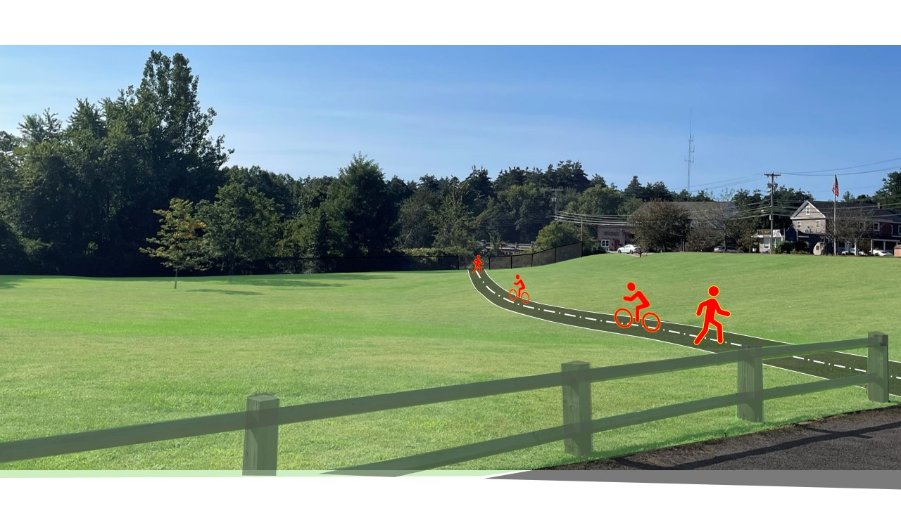
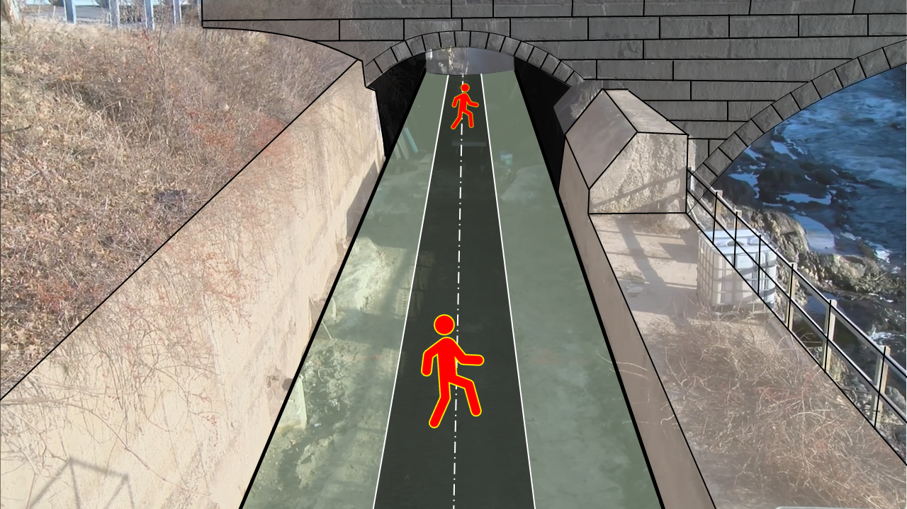
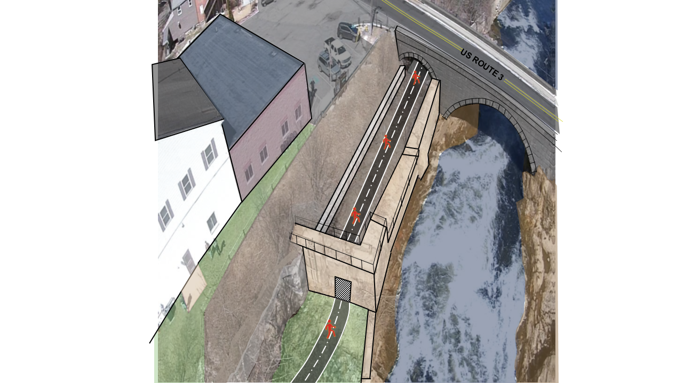
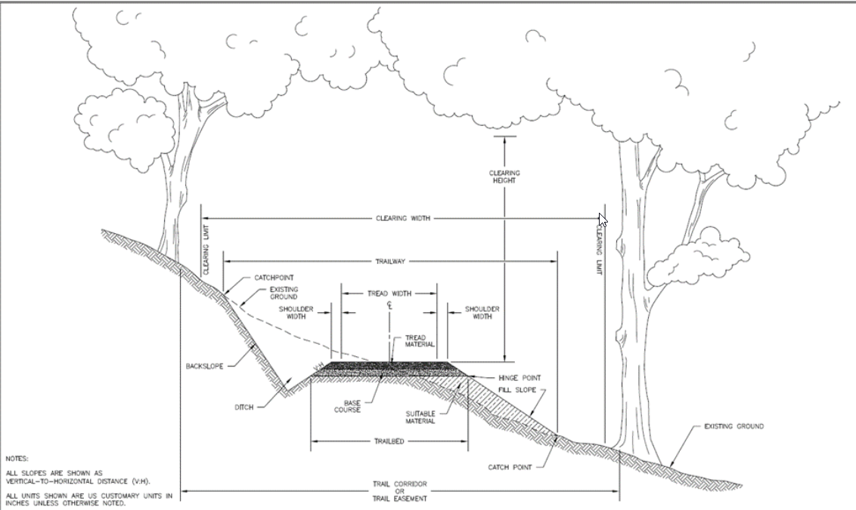
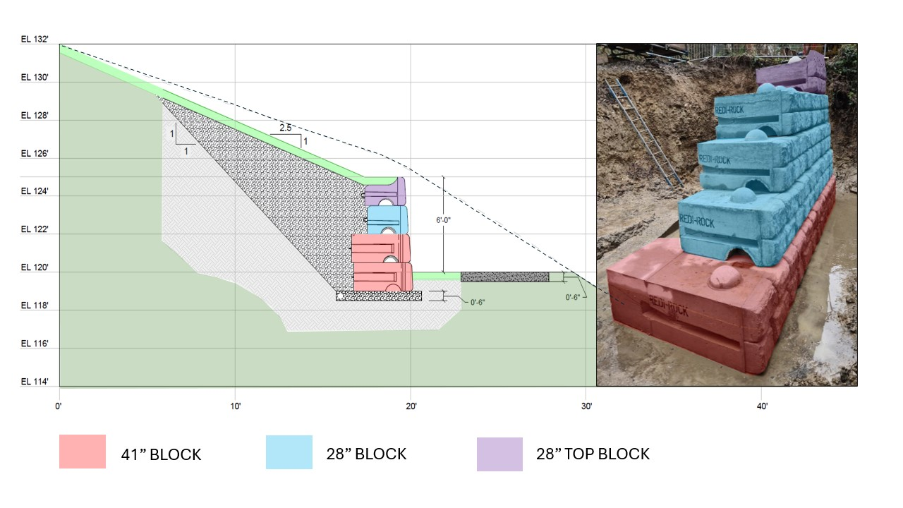
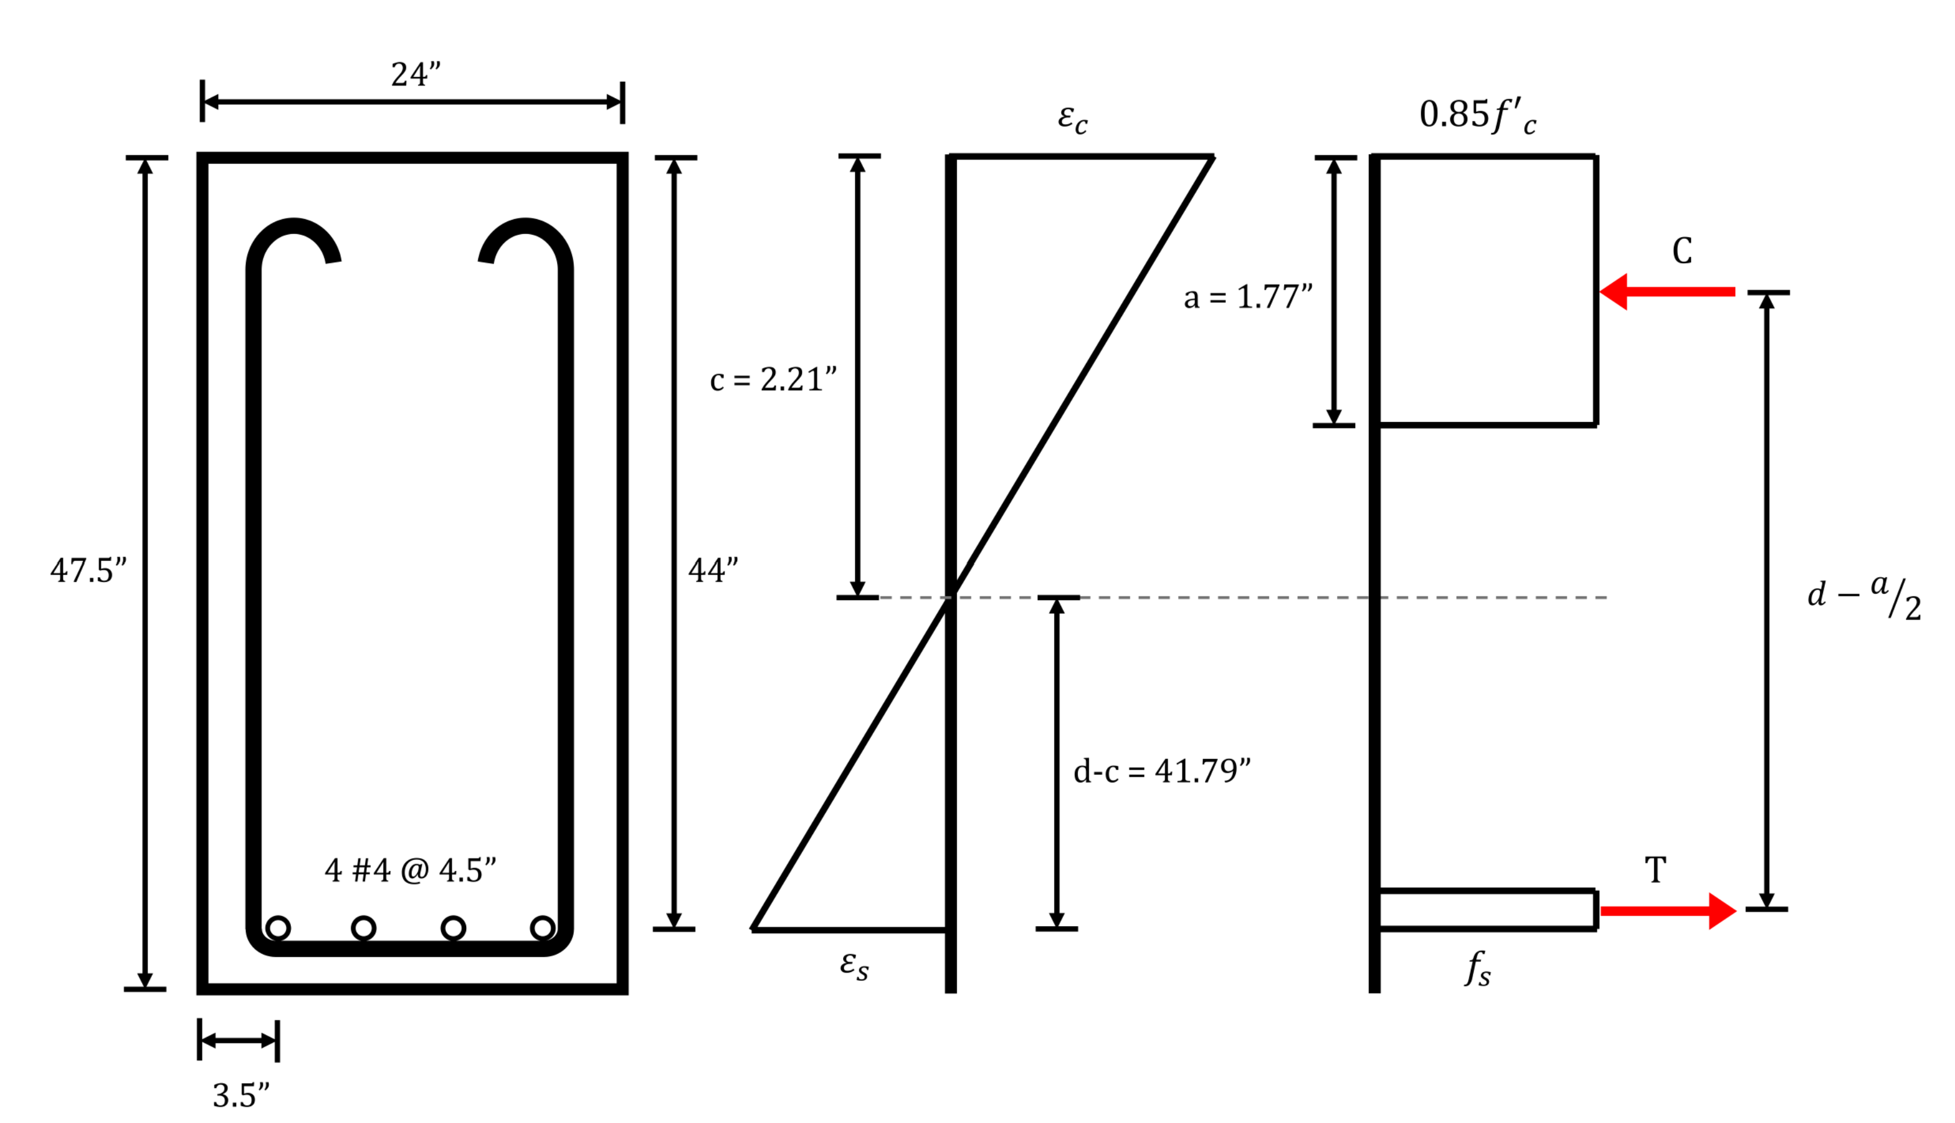
Souhegan River Pedestrian Trail: Merrimack, NH Andrew Merenda, Will Paglia, Max Perreault, Catrin Herbert
Department of Civil Engineering
Introduction
Methods
Site Plan
Concerns surrounding pedestrian accessibility in the town of Merrimack inspired the town center committee to introduce a new walking trail. By creating a pathway to connect the school district of Merrimack and the town center, pedestrians would have the ability to safely cross town. The difficulty of this crossing mainly results from environmental concerns surrounding the former dam impoundment area, and safety risks related to Route 3.
During the Preliminary phases of this project, our team used CAD and GIS to analyze existing conditions and get an overview of the site's layout. After a site visit was conduced the first stages of design were carried out, where a series of alternatives were evaluated for each section of the proposed trail. After evaluating a multitude of options, we selected a final design that offered the most safety and lowest impact to the environment and traffic of the site. Next, grading profiles were created to highlight potential areas of concern. When viewing the profile, it was evident that a reattaining wall would need to be implemented. Another unique challenge that we faced was repairing the deteriorated beams found on the Eastbound side of Route 3.
Section 1
Section 2
Trail Cros Section
`
Section 1: Watson Park Crossing:
Watson Park acted as a home base for us when designing this project. The park features a smoothly graded landscape which a trail could easily be adapted to with minimal interference to the flow of the park.
Section 2: Route 3 Underpass:
The former headgate below route 3 offered a unique solution to crossing The busy road. It was important for us to avoid an at grade crossing, because of the high traffic levels (1800 Vehicles/day) and safety risks.
Trail Profiles
Section 3
Results
Section 3: Wetland Boardwalk:
This section of the project offered some difficult challenges relating to environmental impacts and wetland regulations. Another concern was the slope stability behind the Merrimack Fire Department, where a retaining wall design had to be implemented
Trail dimensions
5 ft. wide Gravel Path Length: 758 ft.
6 ft. wide Boardwalk Length: 142 ft.
Total Length of Project: 900 ft.
Retaining wall:
Height- 6ft; Length- 50ft
Beam Design:
Height- 3' 11½"; Width- 2'; Length- 26'
Cover- 3 ½"
Tension- 4 #4 Bars @ 4 ½"
Shear- No additional reinforcement needed
Regulations & Standards
References
Regulations: -ADA
-Wetland
Standards:
-ASTM- (for retaining Wall)
-ACI (for Beam Repair Calcs)
Faculty Support
Anthony Puntin, PE
Matt Lowe, PE
The H.L. Turner Group inc.
Sam Cheney, EIT
Jim Bouchard, PE

