Slide 1

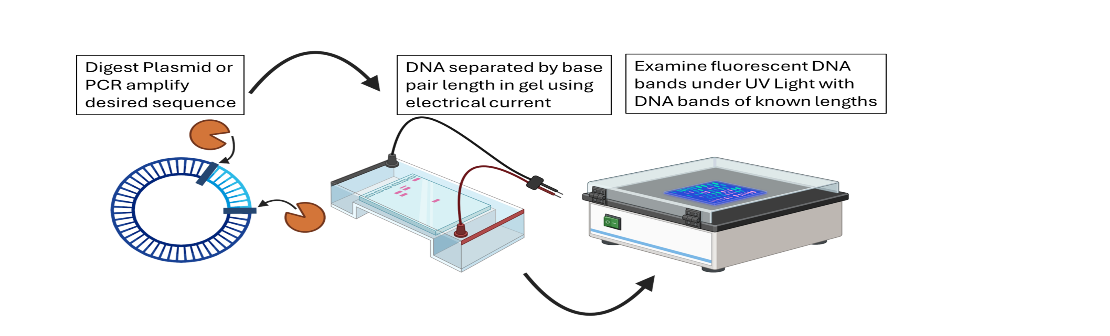
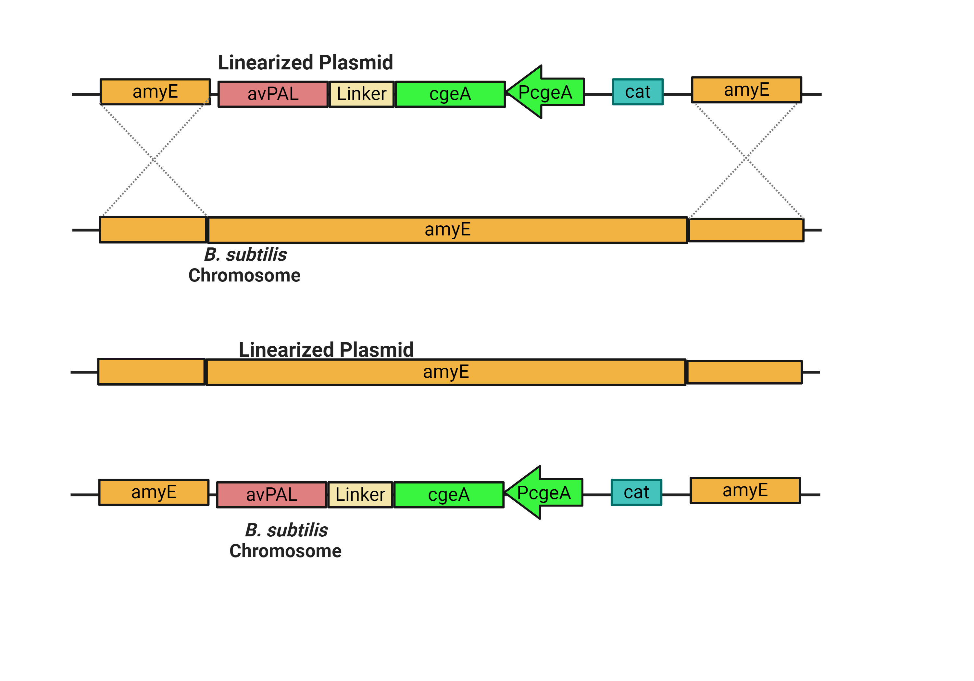
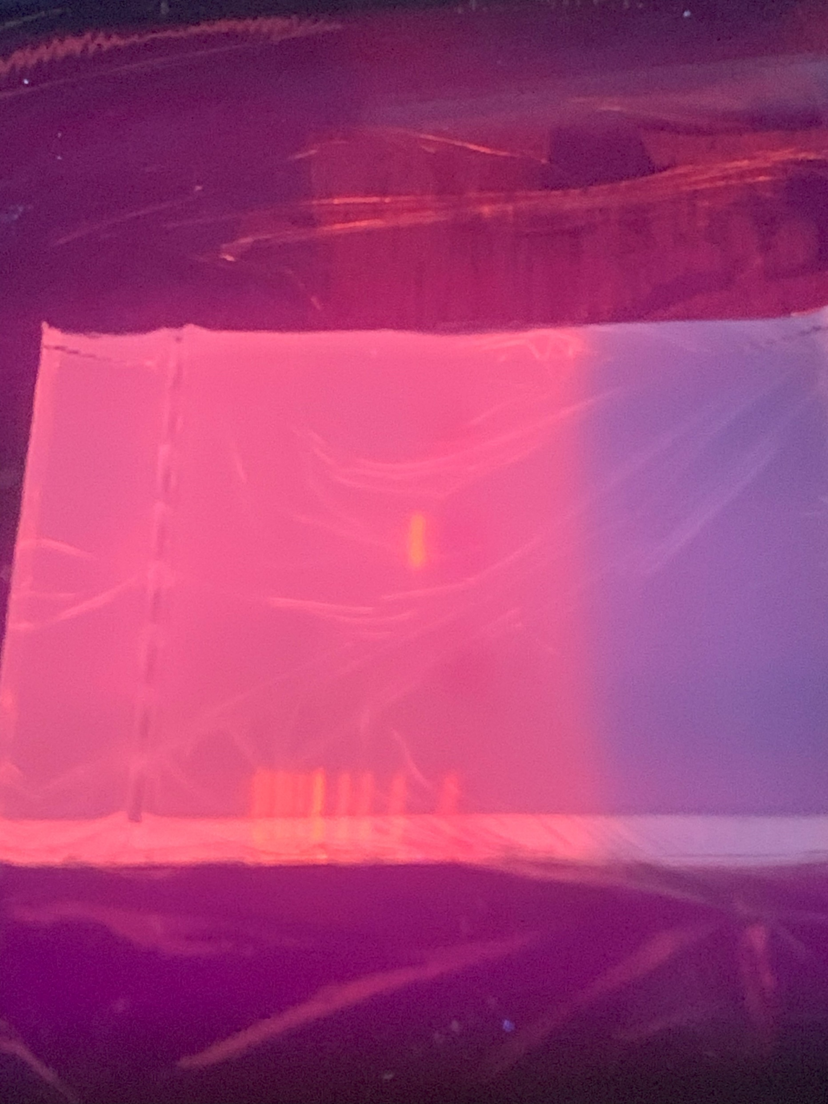
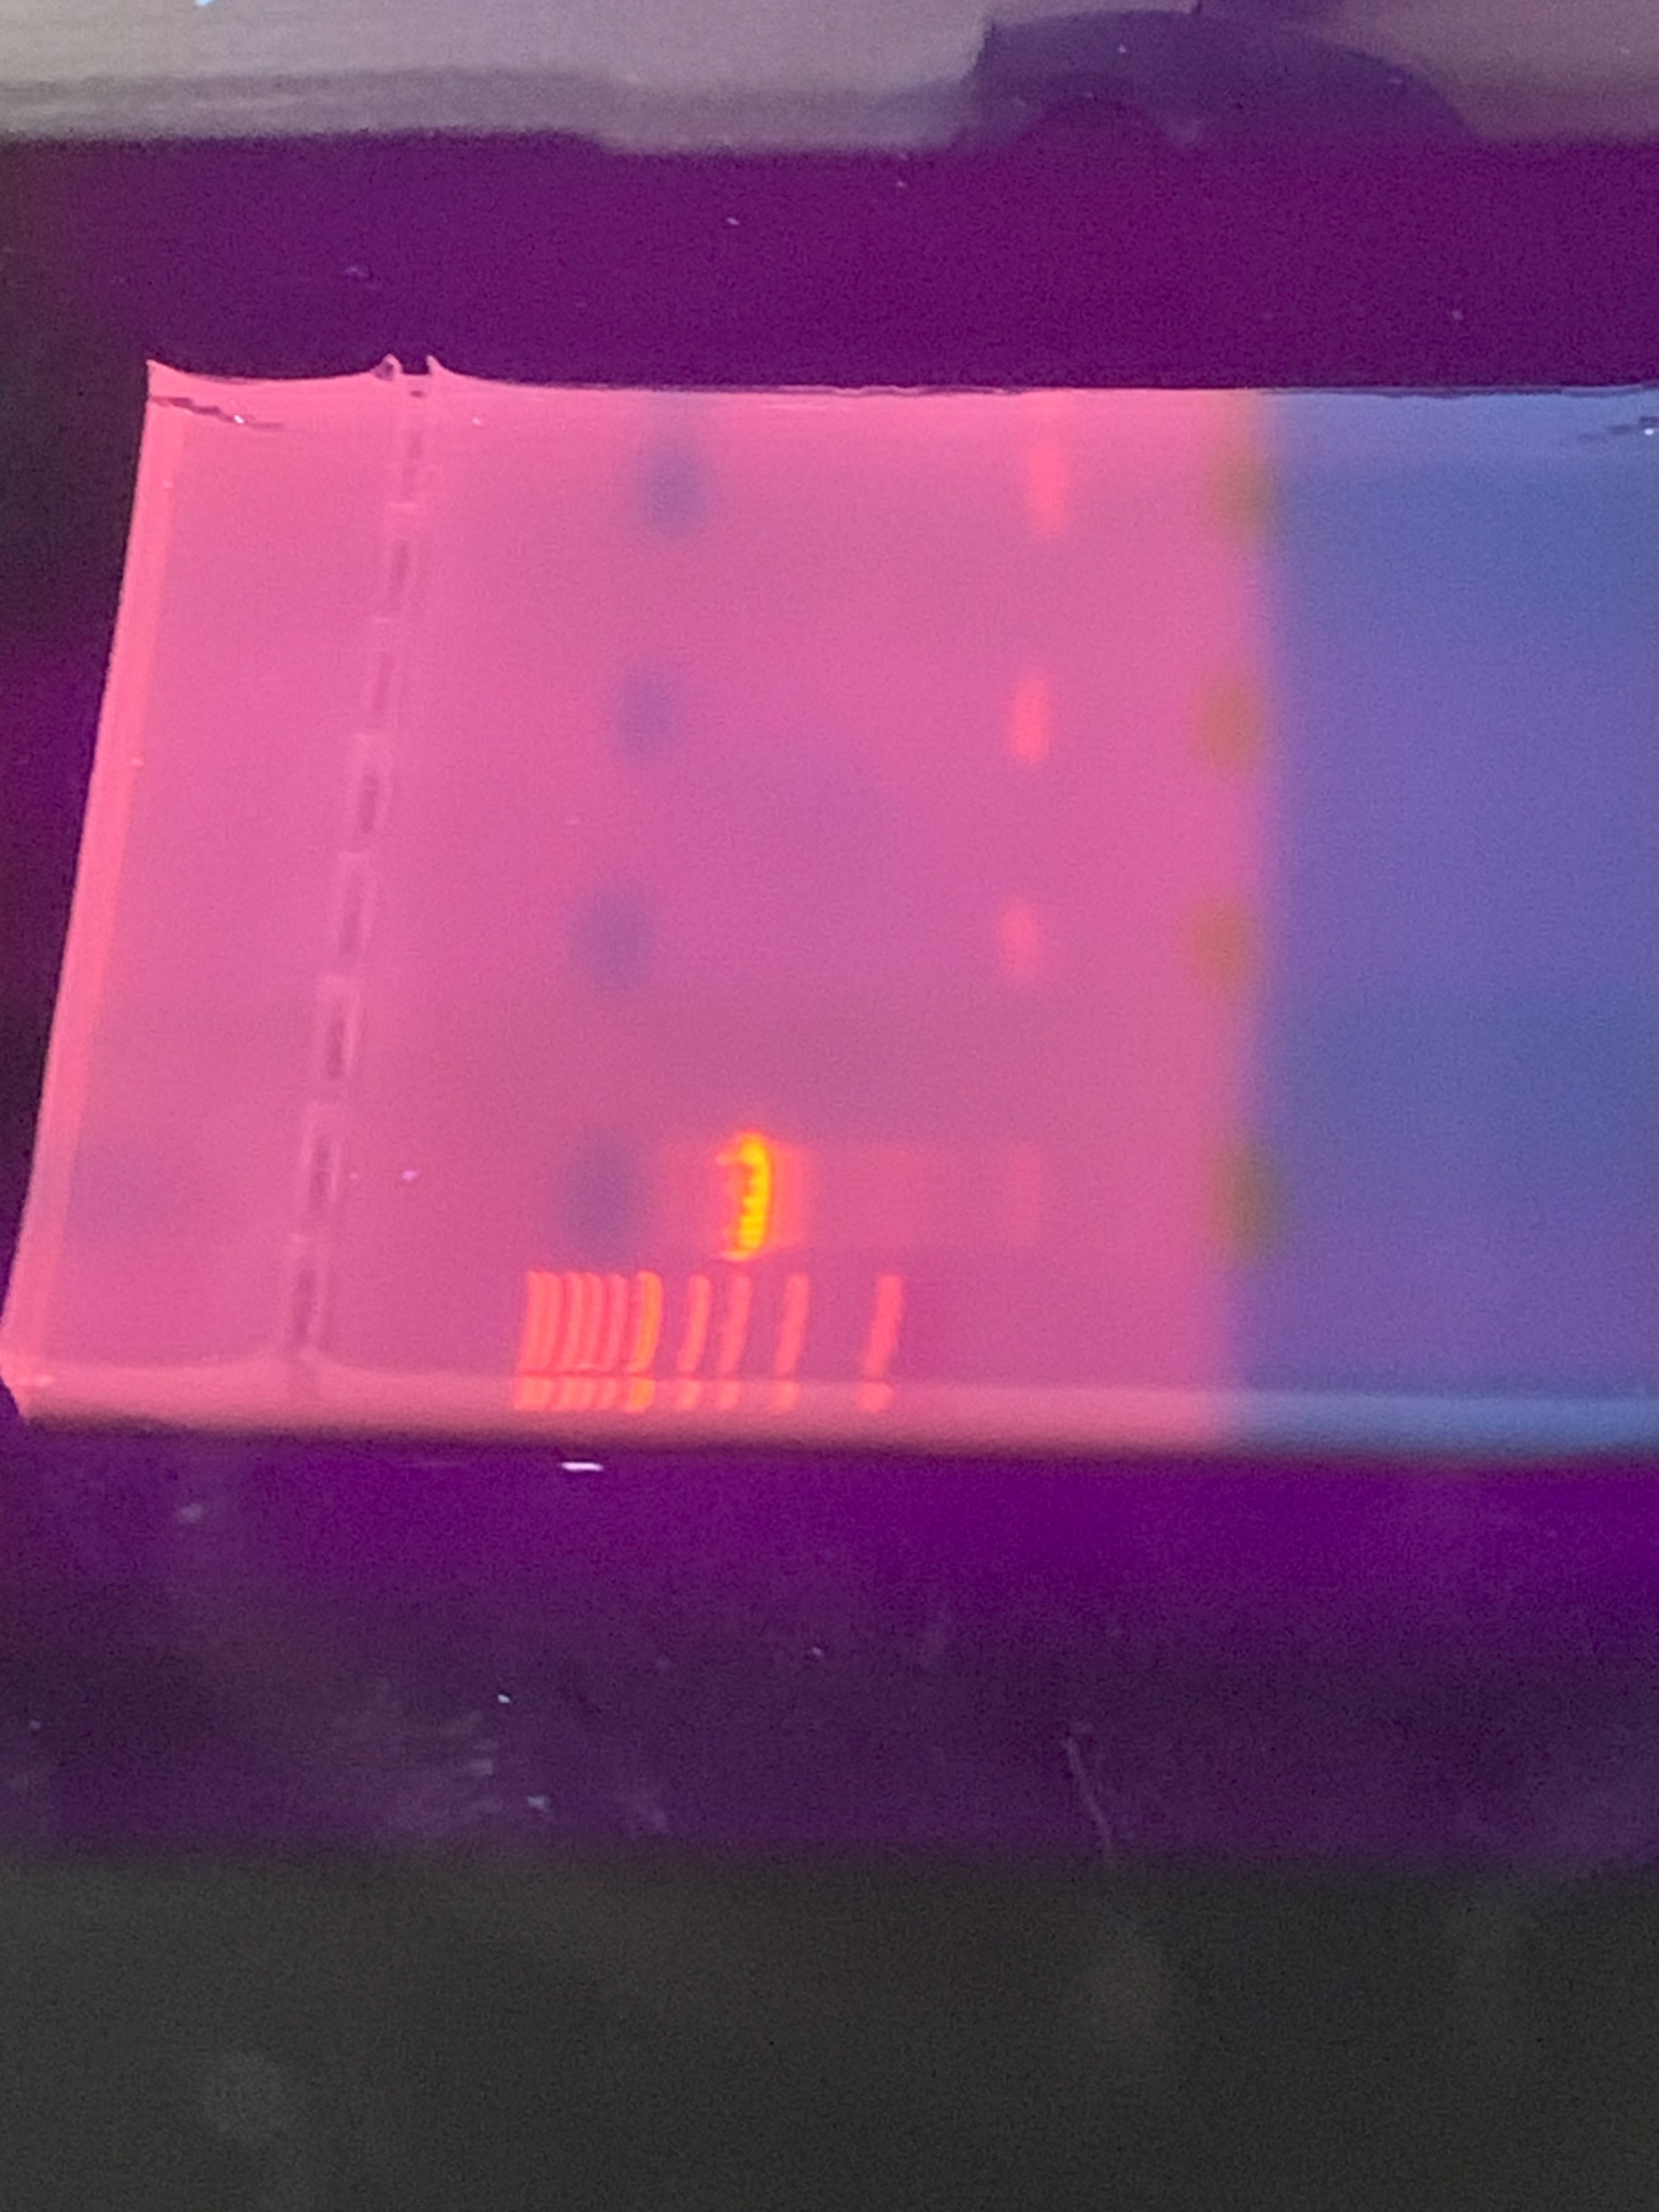
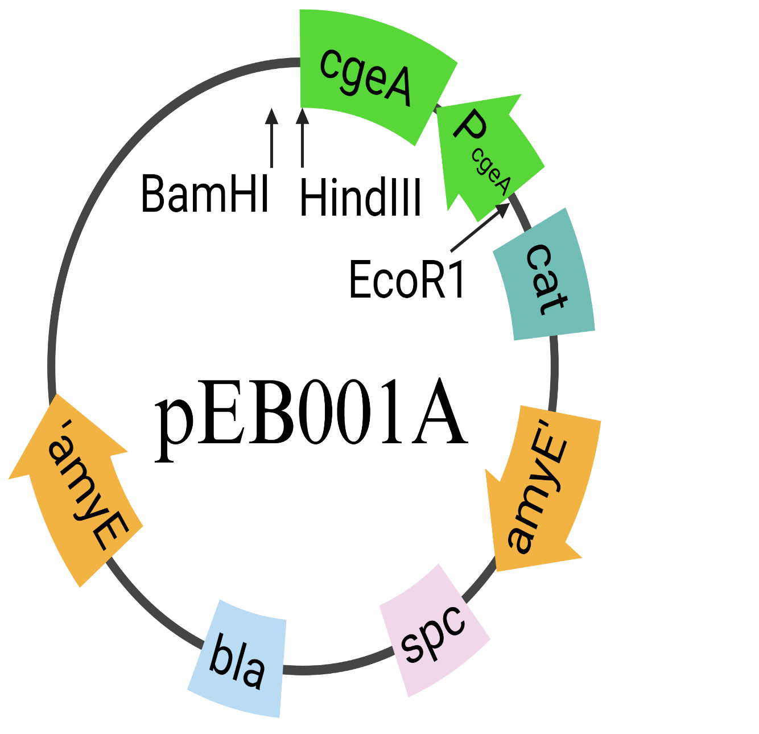

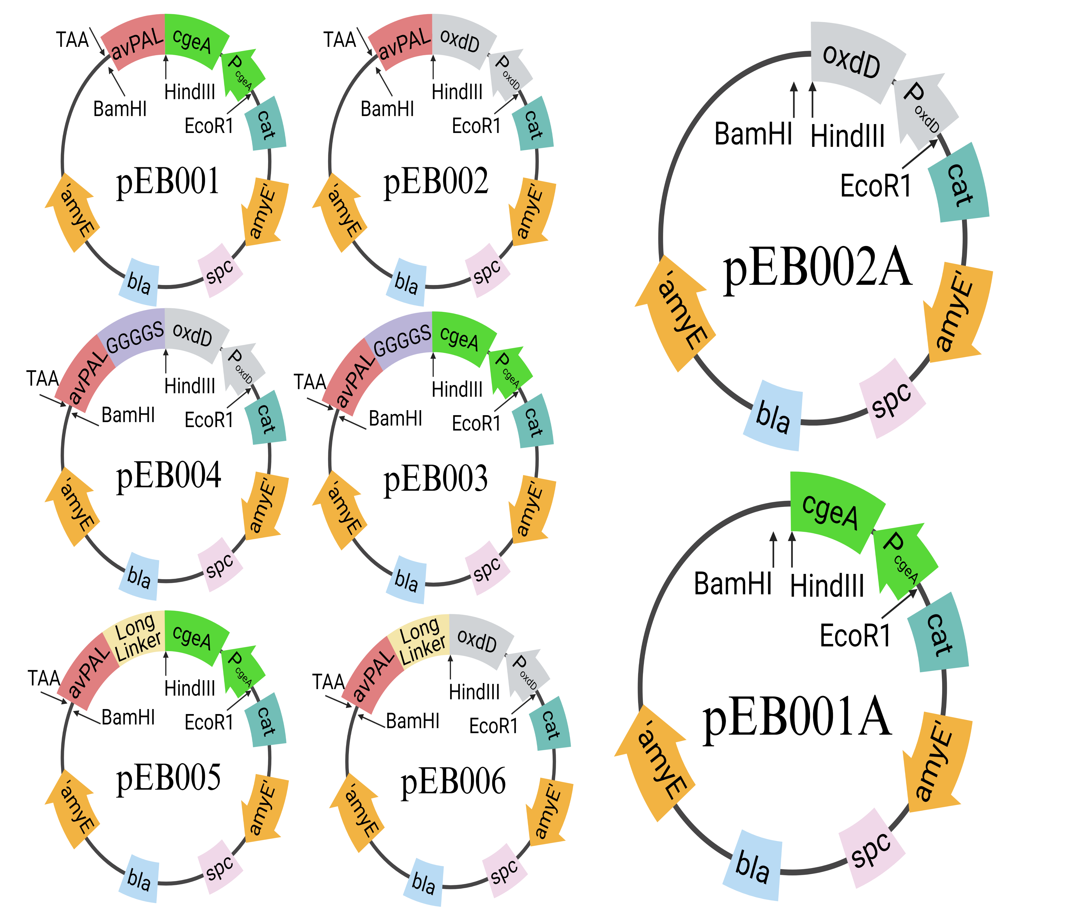

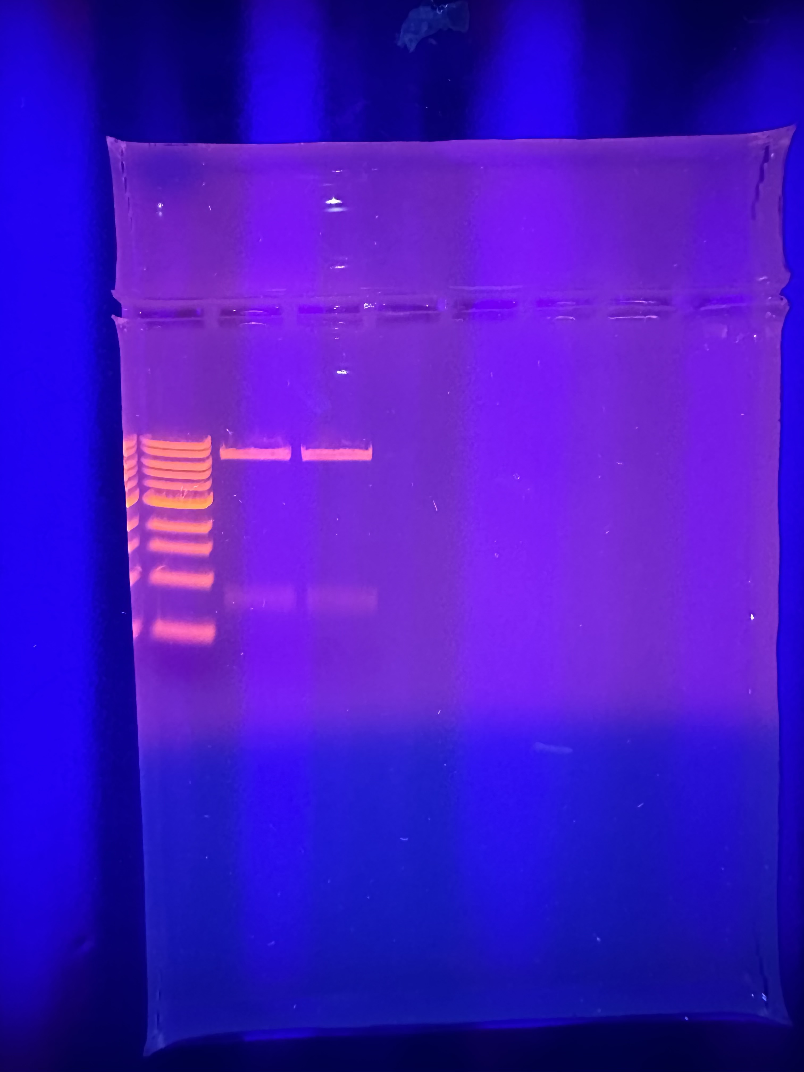
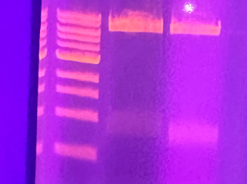
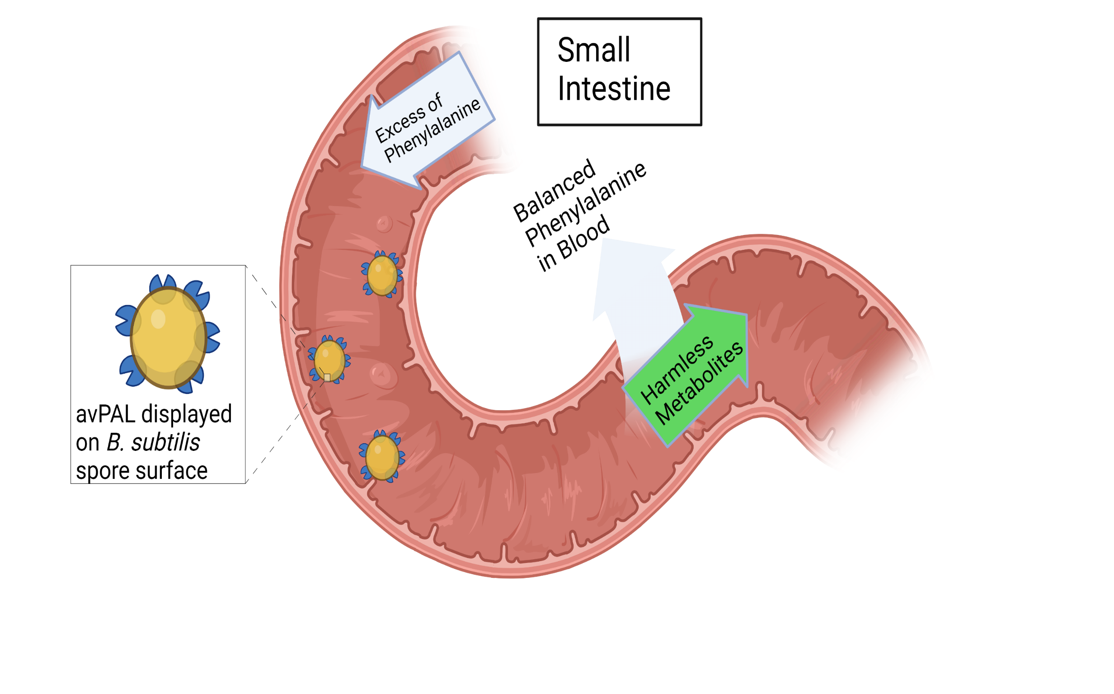

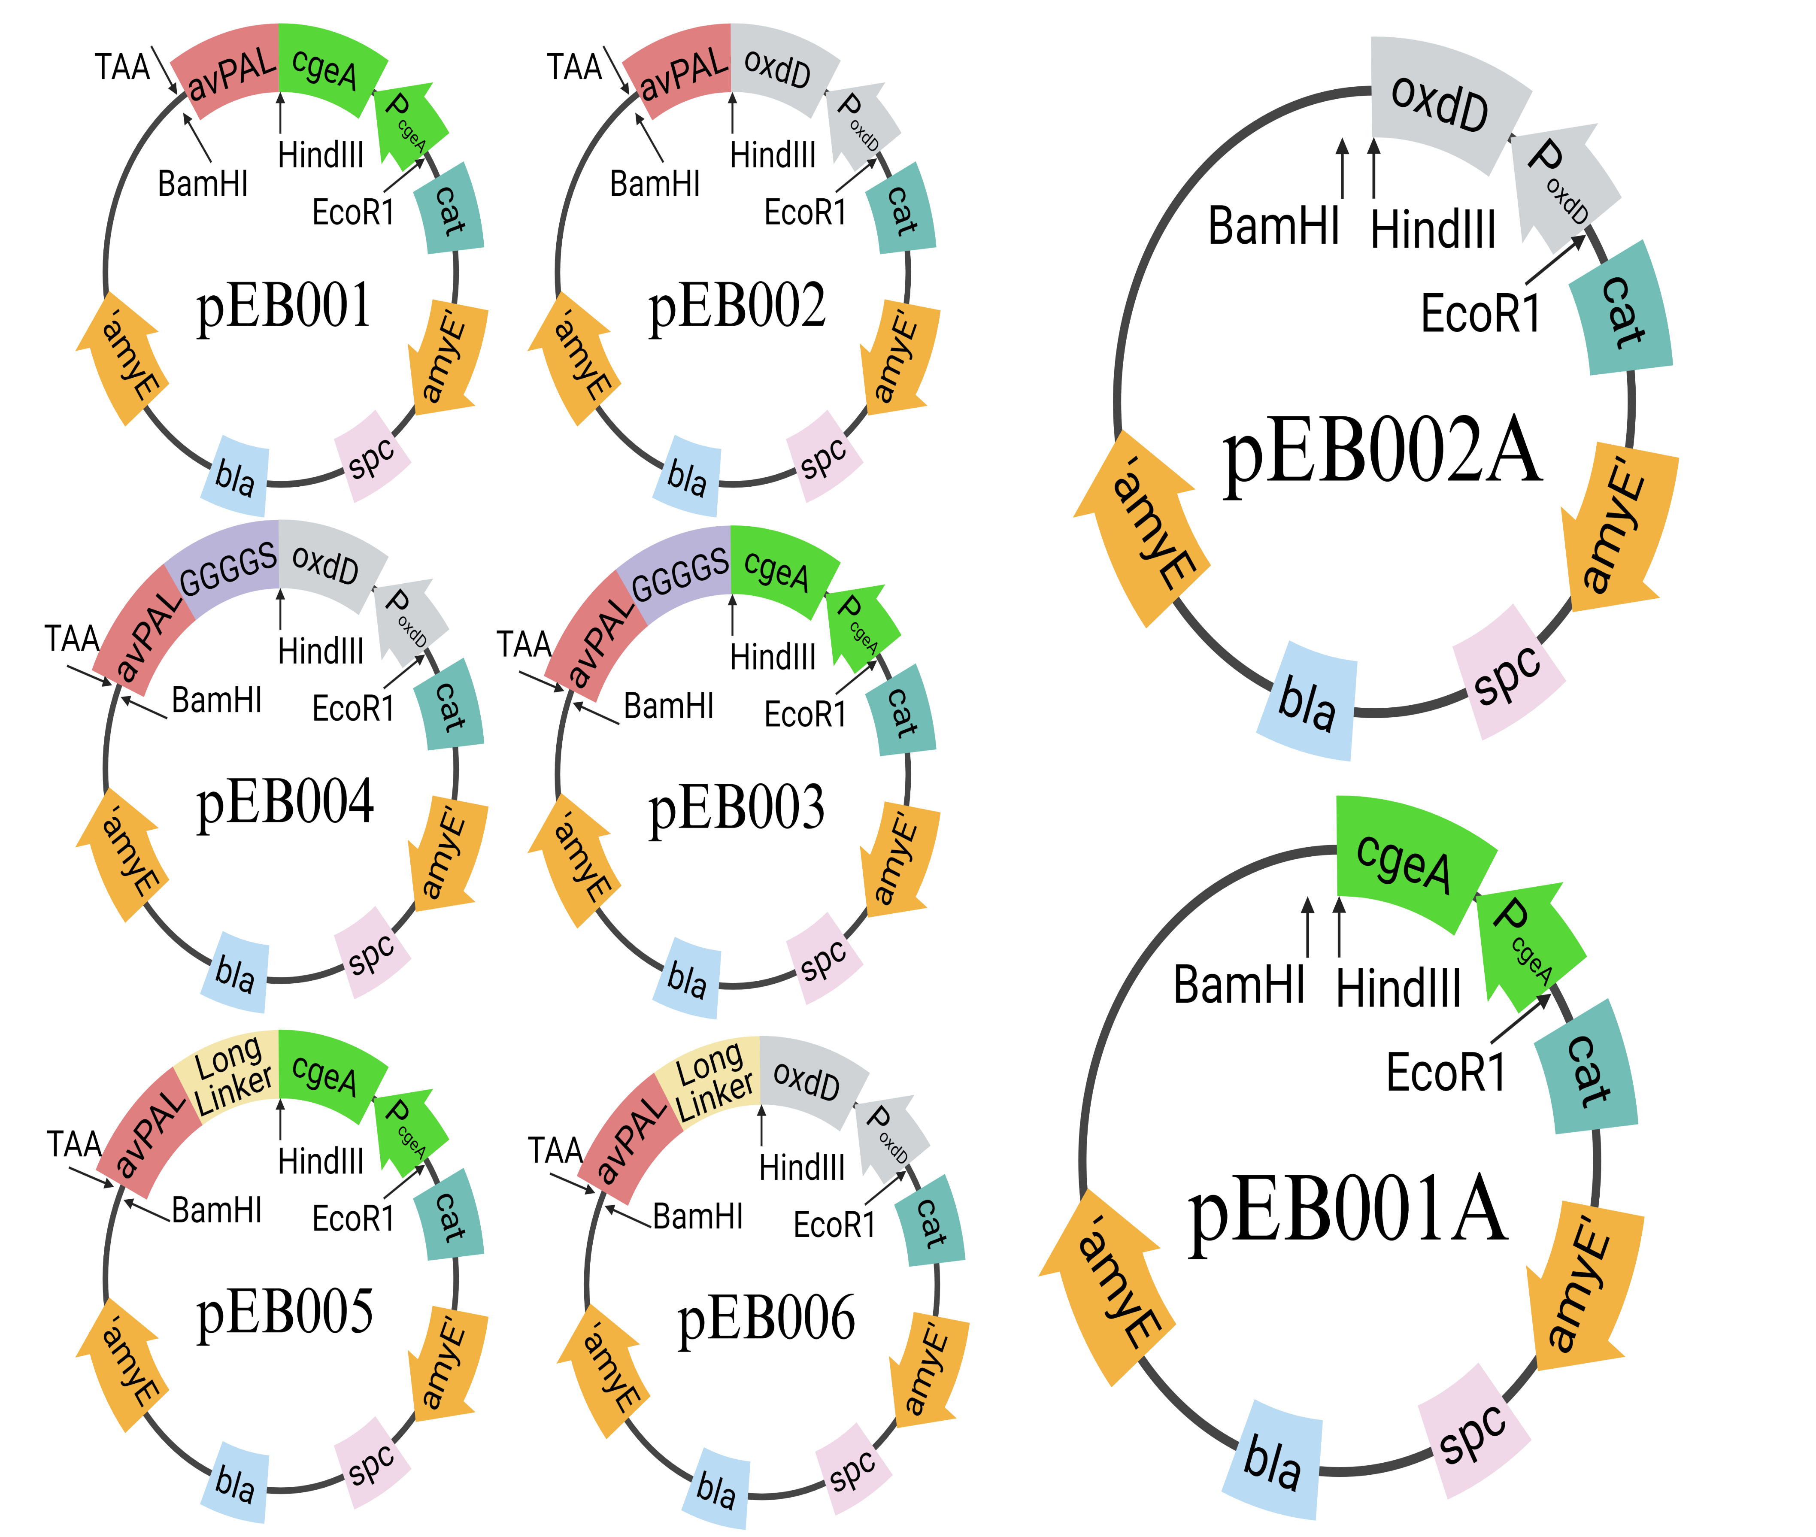

Display of Therapeutic Enzymes on Bacterial Spore Surface for Oral Delivery
Eric Boheen, Jayden Hartigan, Guo Wu, and Kang Wu
Chemical Engineering and Bioengineering, University of New Hampshire
Abstract
Objectives
Verification of successful Cloning Through Gel Electrophoresis
Current effective and efficient methods of treating the severe metabolic disorder Phenylketonuria (PKU) are few and often highly uncomfortable for the afflicted person. PKU causes the buildup of phenylalanine in the blood for which the only available enzyme therapy is through weekly injections of phenylalanine ammonia-lyase (PAL) which reduces the levels of phenylalanine in the bloodstream. However, these regular injections can be painful and can come with potential side affects and therefore an oral delivery method is preferable. For this reason, bacterial spores were seen as a potential candidate to safely deliver PAL through the digestive tract and preserve it to provide long lasting treatment.
When exposed to harsh environmental conditions several species of gram-positive bacteria will produce highly resilient spores. These spores are comprised of multiple dense protein layers which enable it to survive in unfavorable conditions such as intense heat or low pH. Due to these desirable properties, bacterial spores have been seen as a potential display system for enzymes and antigens. Experiments have already been performed which have demonstrated that foreign proteins can be fused to natural structural proteins in the spore allowing the foreign protein to be functionally displayed on the spore. In this work, PAL was fused to two potential structural protein candidates to be displayed on the spores of the bacteria Bacillus subtilis. Once displayed on the spore coat the efficiency of the fused PAL will be assayed via an enzyme activity assay.
Long Term Goal: Develop a novel oral delivery method for therapeutic enzymes using bacterial spores capable of prolonged treatment of metabolic disorders.
Project Goal: Display avPAL on the surface of recombinant bacterial spores using two spore structural proteins and analyze its activity.
Methodology
Benefits of Recombinant Spore Display:
No purification of the protein is necessary
Protein is more robust and able to withstand harsh conditions
Selection of Spore Structural Proteins and Linkers:
CgeA is located in the crust layer of the spore while OxdD is located within the inner coat
Two different amino acid residue linkers are being tested: a short flexible GGGGS linker and a long rigid alpha helical linker to prevent interactions between the avPAL and the spore protein
Cloning of Recombinant Plasmids:
Transformation and Sporulation of Bacillus Subtilis:
Competent Bacillus subtilis are cultured and each plasmid is linearized before being transformed into the bacteria.
Sporulation is then induced in the recombinant strains of B. subtilis
Core
oxdD-avPAL
cgeA-avPAL
Gel Electrophoresis of Colony PCR product:
Gel Electrophoresis of Double Digestion:
Introduction
Cortex
PKU is an inherited metabolic disorder caused by a mutation in an essential enzyme in the phenylalanine pathway. If left untreated it can cause permanent neurological damage which may lead to death.
Current Methods of Treatment:
Restrictive Dieting:
The individual must adhere to a strict diet of foods with little or no phenylalanine, however phenylalanine buildup may still occur regardless. Often expensive supplements are required.
Enzyme Injection Therapy :
Injections of a modified version of PAL are directly administered into the bloodstream to reduce phenylalanine levels once weekly. These injections are both costly and risk an allergic reaction or immune response from the individual.
Hypothesized Recombinant Spore Delivery Method:
The enzyme avPAL is directly linked to a structural protein in a bacterial spore and taken by mouth. The spores would enter the small intestine intact through the GI tract and reside there converting phenylalanine into harmless metabolites.
Basement Layer
Results
Inner Coat
8 kb
8 kb
Outer Coat
6 kb
6 kb
Crust
5 kb
5 kb
4 kb
4 kb
3 kb
3 kb
oxdD 1.6 kb
2 kb
2 kb
1.5 kb
cgeA 0.9 kb
1.5 kb
1 kb
1 kb
0.5 kb
0.5 kb
8 kb
8 kb
6 kb
5 kb
Linear Plasmid
Linear Plasmid
6 kb
4 kb
5 kb
Linear Plasmid
Linear Plasmid
3 kb
4 kb
2 kb
3 kb
1.5 kb
cgeA 0.9 kb
2 kb
1 kb
1.5 kb
0.5 kb
cgeA 0.9 kb
1 kb
0.5 kb
oxdD 0.8kb /0.9kb
oxdD 0.8kb /0.9kb
Future Plans
Complete second round of cloning to complete fusion protein integration plasmid.
Transform integration plasmids into competent B. subtilis cells.
Perform an enzymatic activity assay on the successful recombinant spores.
If a spores show sufficient efficacy for the breakdown of PAL , animal testing will be next.
Acknowledgements
Thank you to Dr. Li and the UNH Innovation Scholars Biomaterials Cohort for providing funding.

