Slide 1
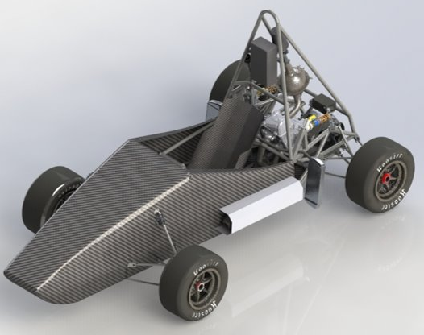
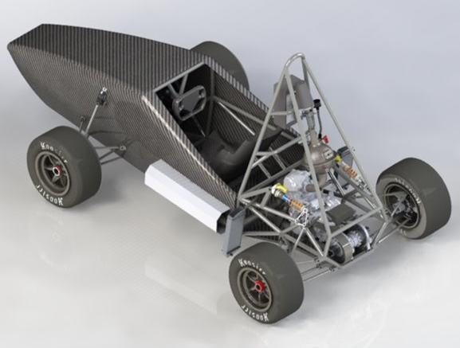
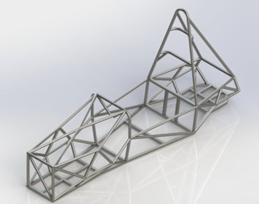
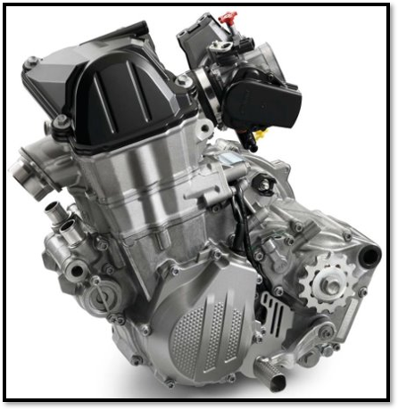
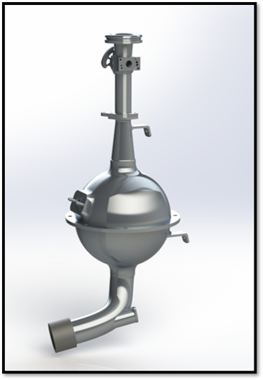
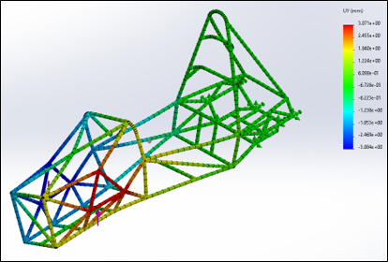
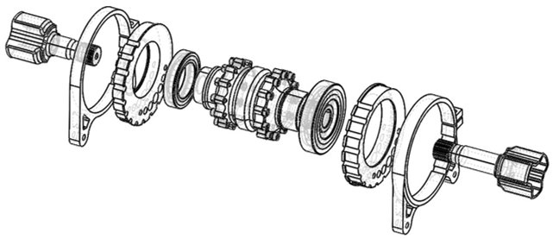
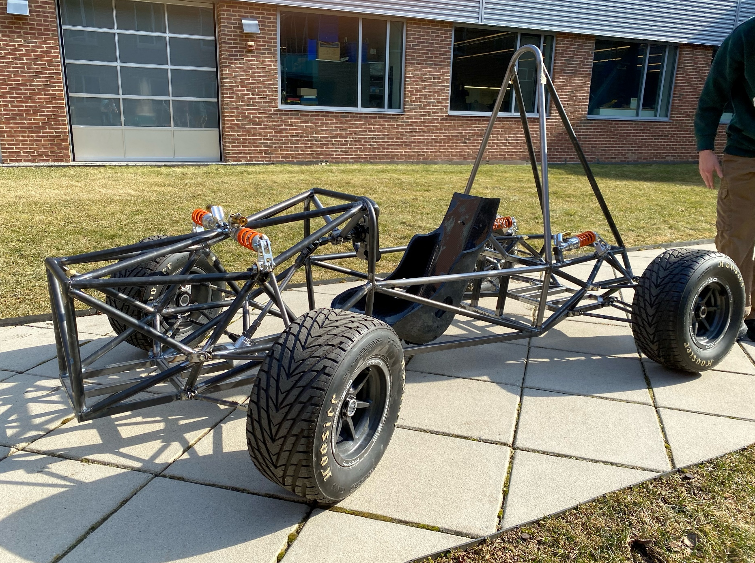
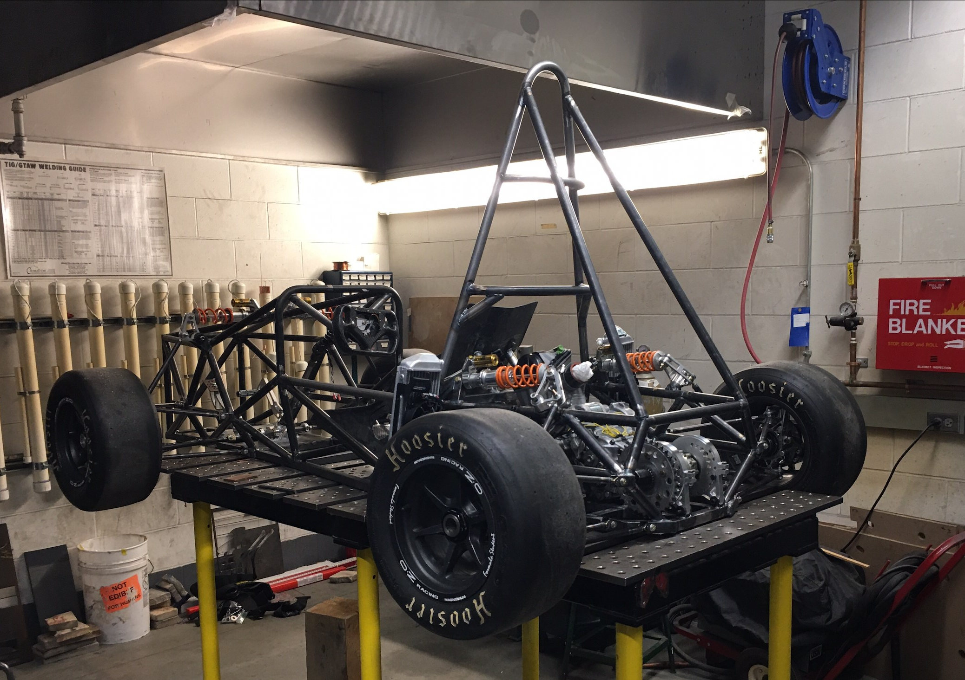
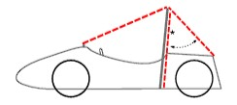
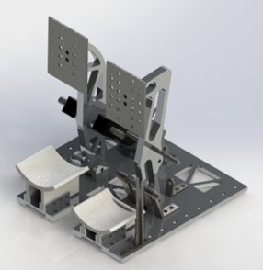
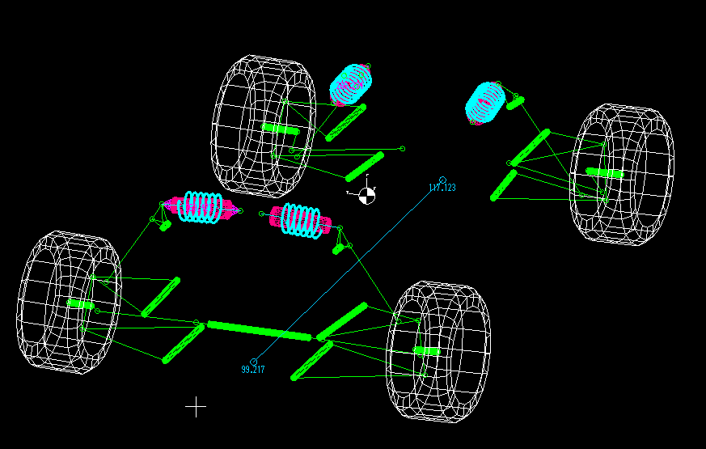
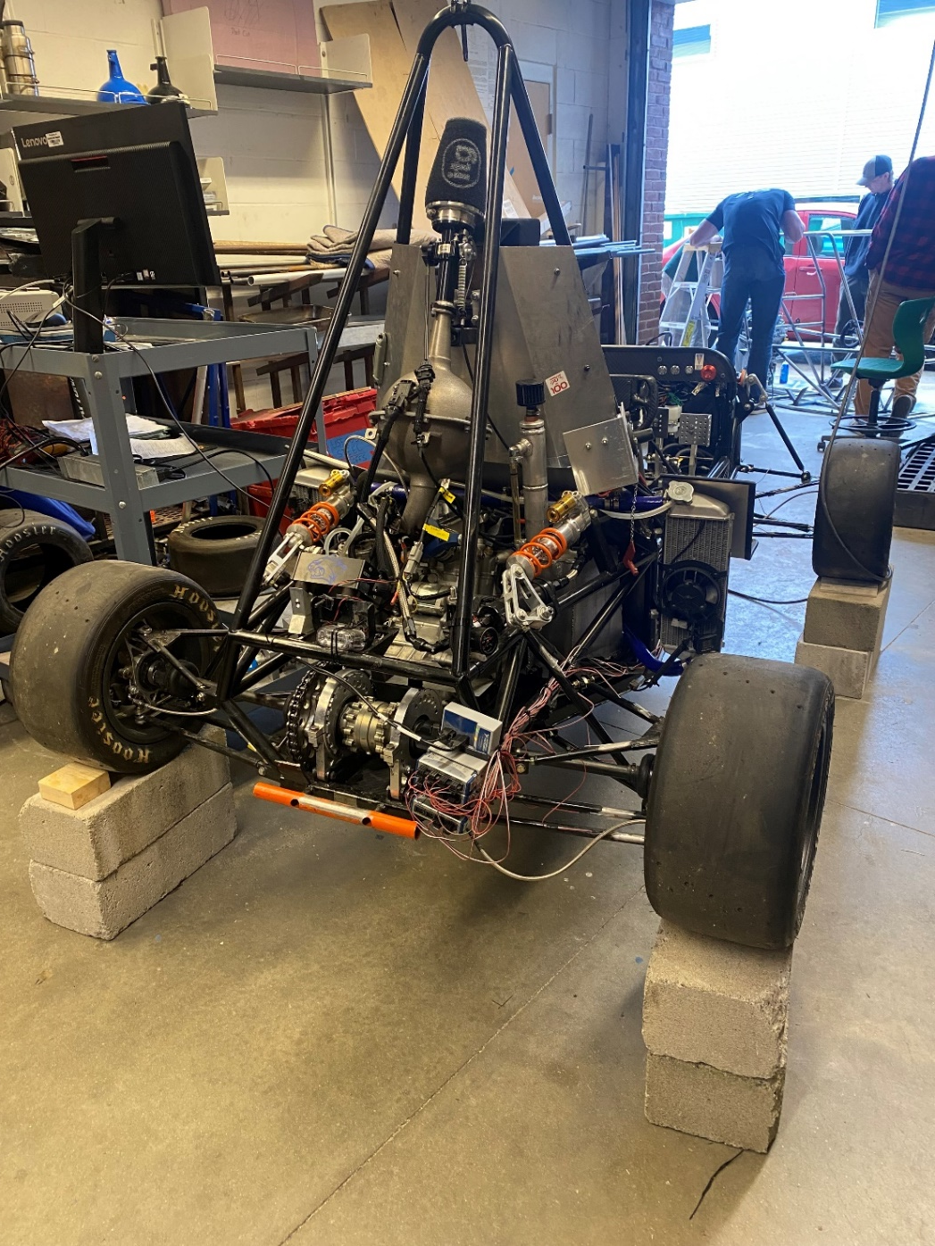
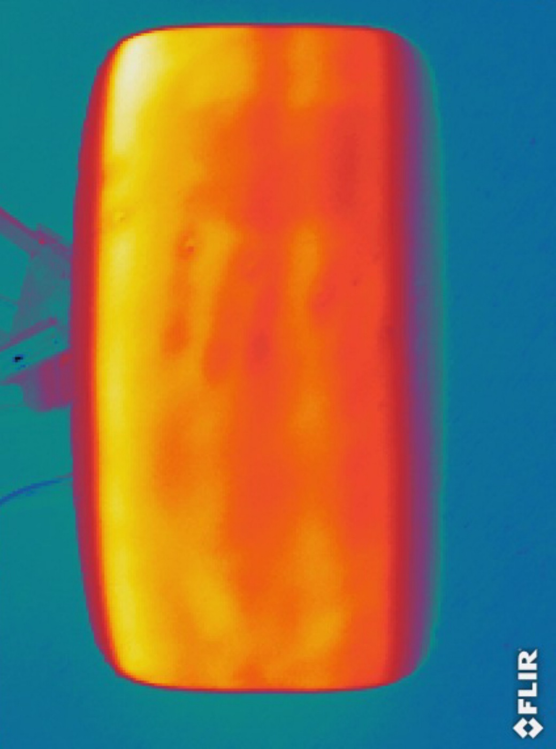
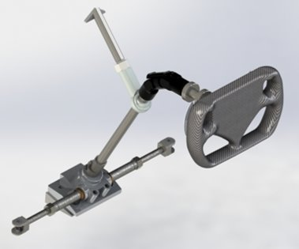
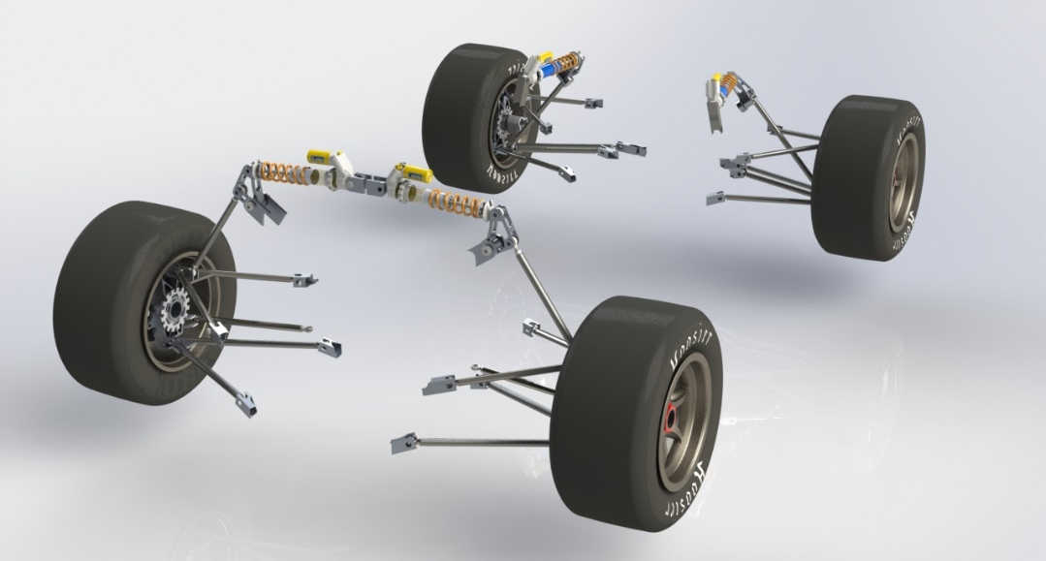
UNH Precision Racing Team 2024
College of Engineering and Physical Sciences
Mechanical Engineering Department
Powertrain
Abstract
UNH PRECISION RACING IS A STUDENT-PROJECT ORGANIZATION DEDICATED TO FOSTERING THE DEVELOPMENT OF YOUNG ENGINEERS THROUGH THE FORMULA SAE (FSAE) COMPETITION SERIES. THE FSAE PROGRAM EXPOSES STUDENTS TO ENGINEERING OUTSIDE THE CLASSROOM, INCLUDING DESIGNING, MANUFACTURING, PROJECT MANAGING, AND COMMUNICATING WITH THE WIDER COMMUNITY
Team Members
Project Managers: Mathieu Champagne, Trevor Legros
Controls: Ryan Gervais, Owen Pratt
Frame: Mathieu Champagne, Todd Brown
Powertrain: Trevor Legros, Sam Osgood
Suspension: Ryan Gervais, Owen Pratt
Faculty Advisor: Juan Carlos Cuevas Bautista
Engine
2016 KTM 450 SX-F
Max Torque : 34lb-ft @ 7000 RPM
Max Power: 53 HP @ 9500 RPM
Naturally aspirated, 100 Octane
High torque at low RPM's and linear power curve makes driving easier for inexperienced drivers
Drivetrain
Chain Drive
Drexler Limited Slip Differential
RCV Half-Shafts
Aluminum differential designed to allow tightening of the chain using an eccentric disk concept, various locking points.
Intake Manifold
3000 cc plenum
Utilize AT Power's FSAE throttle body with built in restriction diameter
Made from printed titanium, experimenting with ABS plastic printing.
Runner length of 264 mm with a single 42 lb./hr. injector firing directly at the intake valves.
Frame
Design Goals
Torsional stiffness greater than 1500 [Nm/deg]
Maintain weight less than 100 lbs
Effectively maximize space for the driver, powertrain, suspension, and controls
Meet all structural qualifications outlined by the SAE structural equivalency survey
Current design
TIG welded AISI 1020 steel tube members
Torsional stiffness equal to 1,831 [Nm/deg]
Weight of manufactured frame equal to 89lbs
Allows for optimal suspension attachment
Fits a driver of the 95th percentile
Adheres to SAE rules to ensure driver safety
Torsional stiffness test for simulation validation
New design
Main goal of weight reduction
Efficient use of space
Increase engine bay volume
Shifted driver position
Increased manufacturability
Weight reduction of 10 lbs
Suspension
Purpose
Resist chassis roll – maximize tire contact patch with road
Roll center placement prioritizing responsiveness
Minimize roll center migration, increase stability/predictability
Select coilover to achieve desired ride frequency and roll rate
Adjustability: static camber, ride height, toe angle
Geometry Selection
Double wishbone, Short-Long Arm (SLA), pushrod actuated
Rear bell-crank repositioned out-of-plane to improve packaging
Component Modeling & FEA
SolidWorks 3D modeling - FEA and kinematics in MSC Marc Mentat, MATLAB, & LOTUS Shark
Calspan tire data used to predict dynamic forces
Manufacturing
Waterjet in Olson Center, finish machining in CEPS machine shop, TIG welding
Controls
Brake Assembly
6061-T6 Aluminum components withstand 2000N (450 lb-f) force from the driver.
Vertically mounted master cylinders optimize packaging, braking force, and pedal travel.
Wilwood Brake Calipers
Track Brake pads
Safety Considerations
6-point RaceQuip harness holds driver securely in place.
Driver must be within the rollover protection envelope.
Impact attenuator on the front of the car absorbs impact forces.
Steering Column
Utilizes double universal joint designed for automotive steering shafts
Rack mounted behind the front axle to improve Ackermann Steering..
Sponsors
Todd Gross
Special Thanks to the UNH Alumni Association and UNH Dean's Allocation

