Slide 1


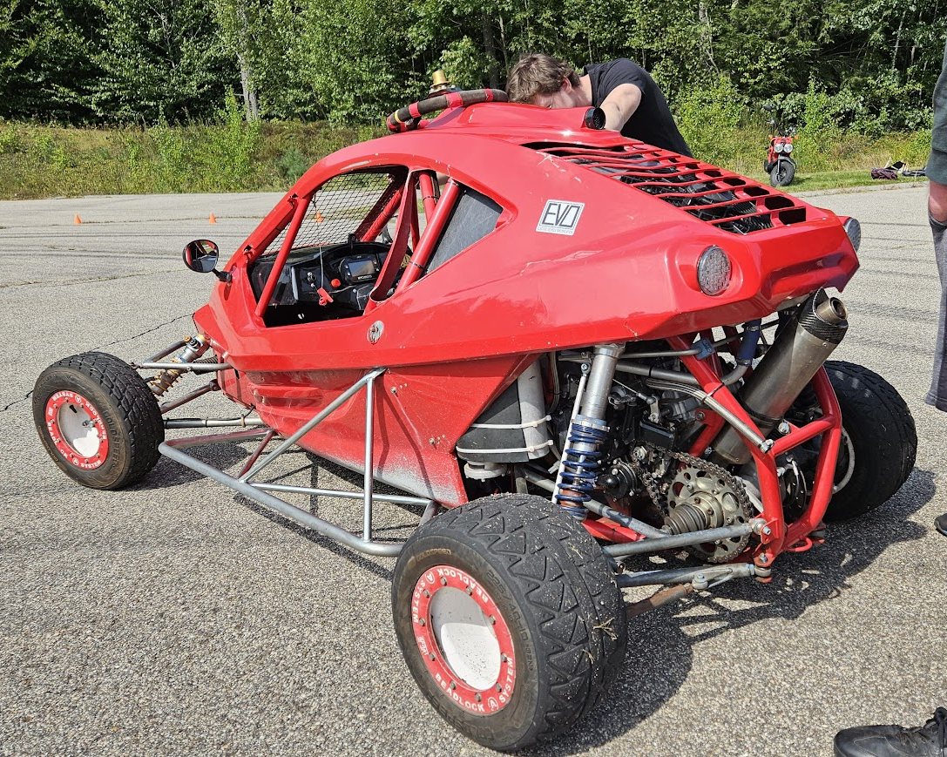
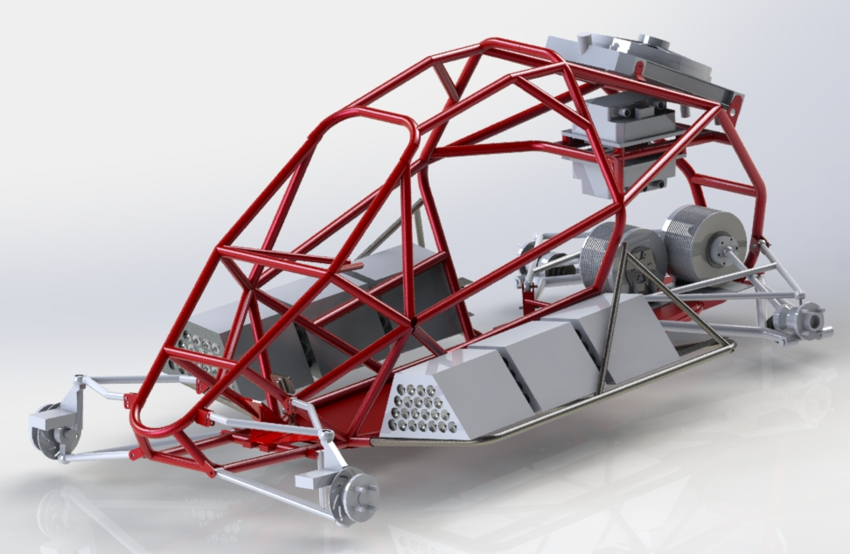
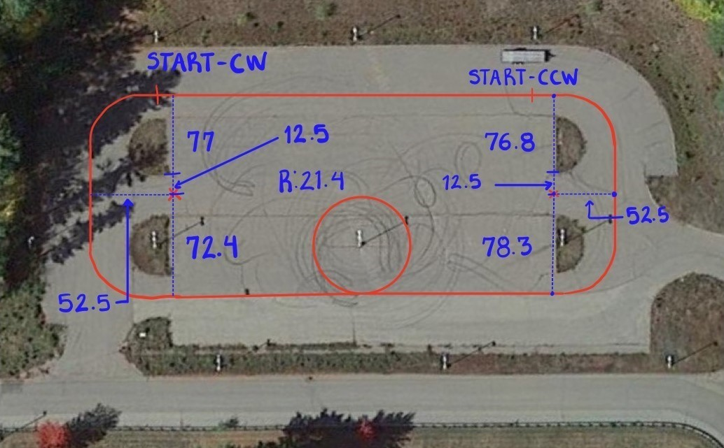
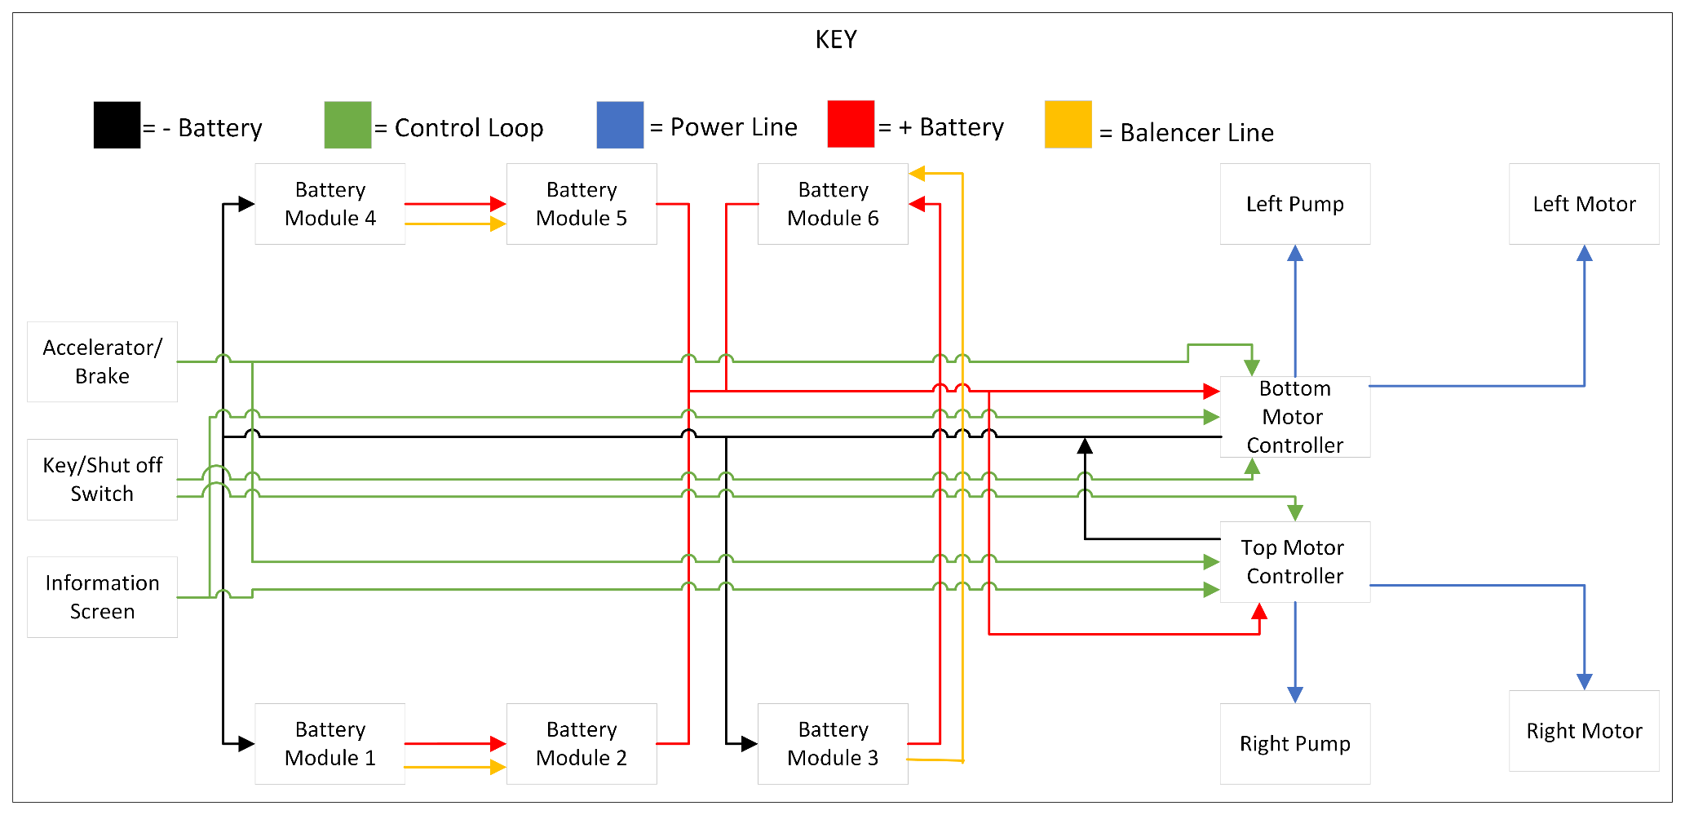
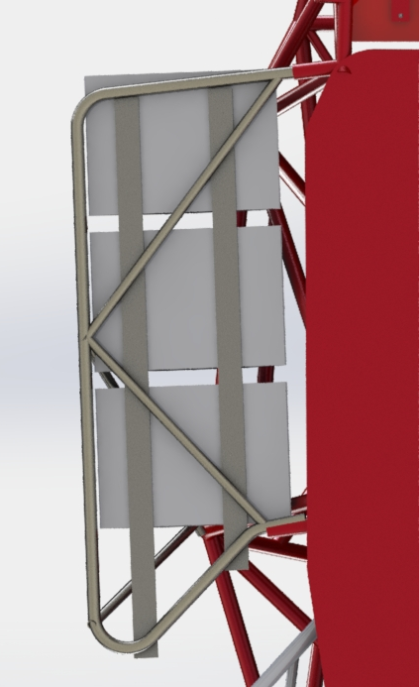
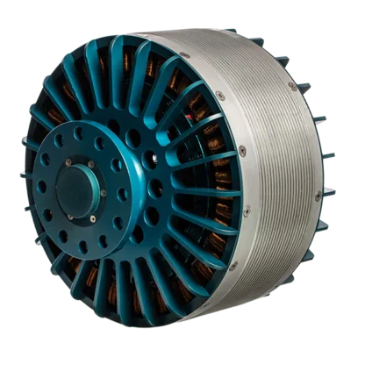
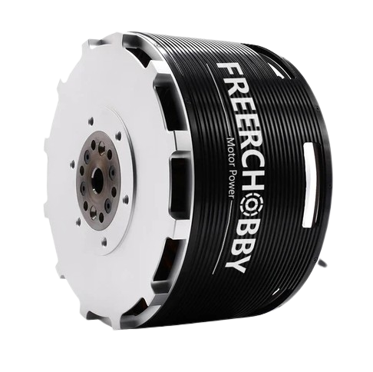
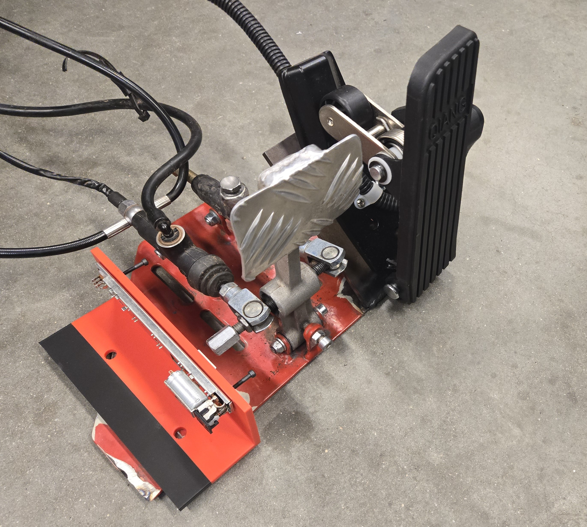
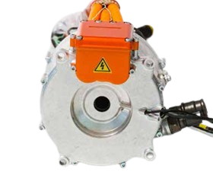
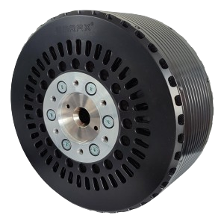
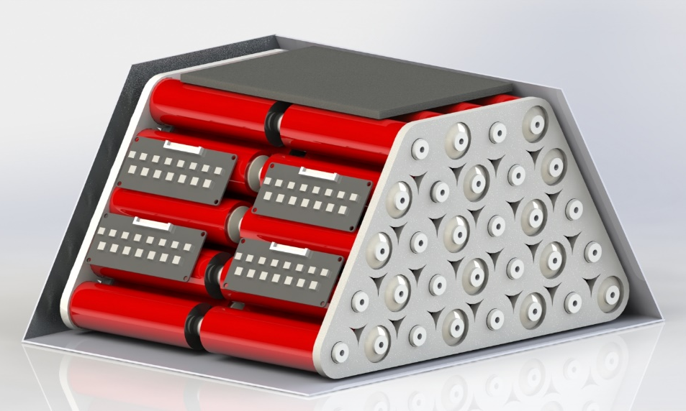
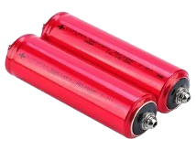
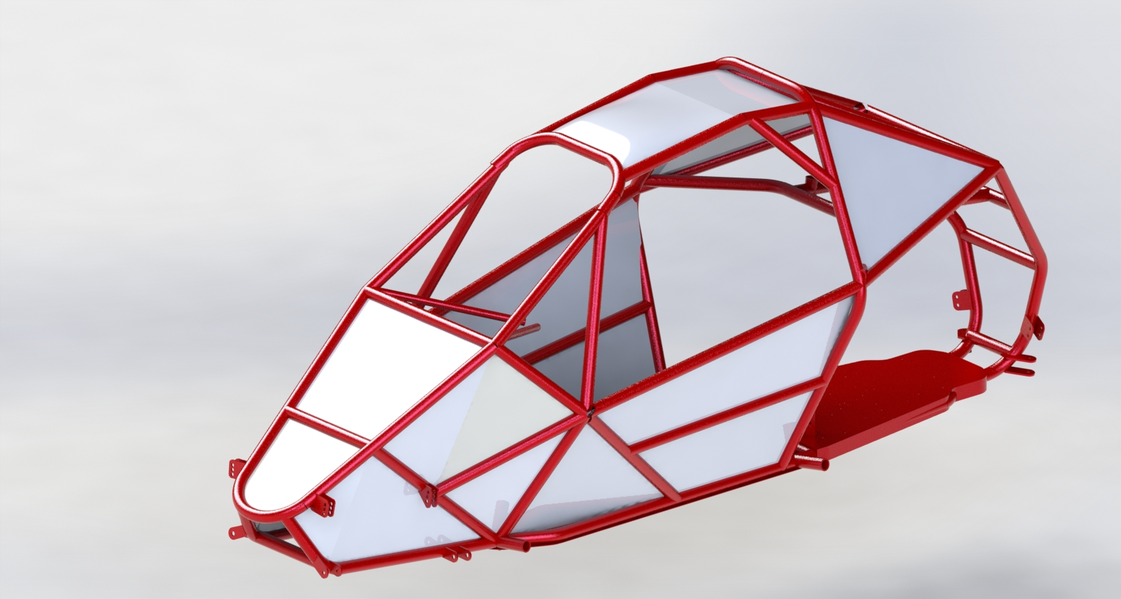
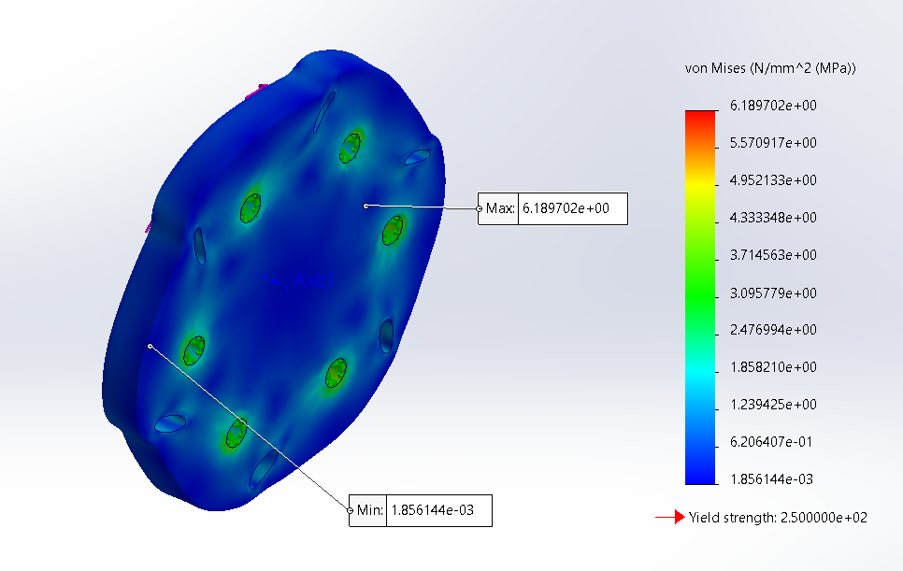
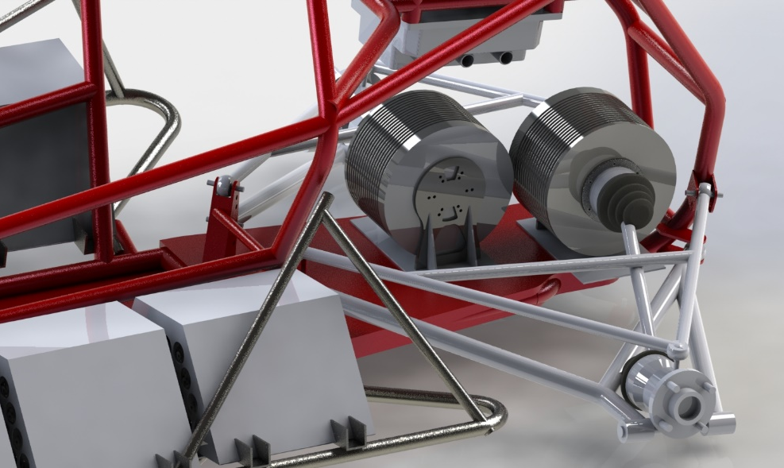
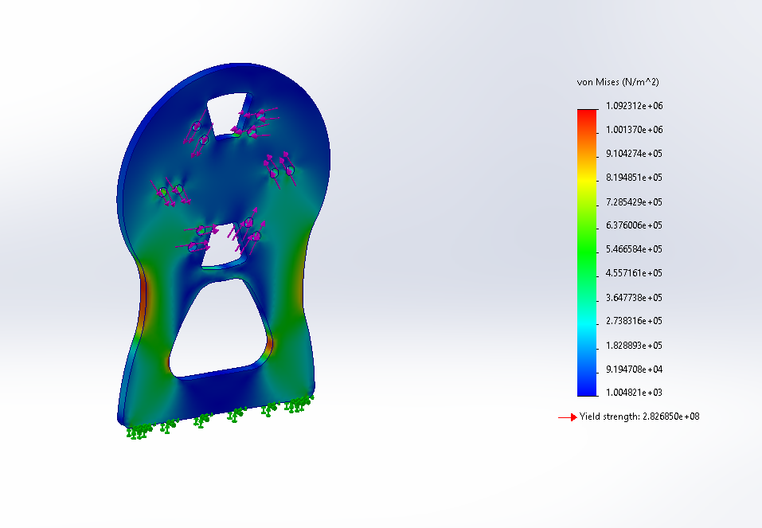
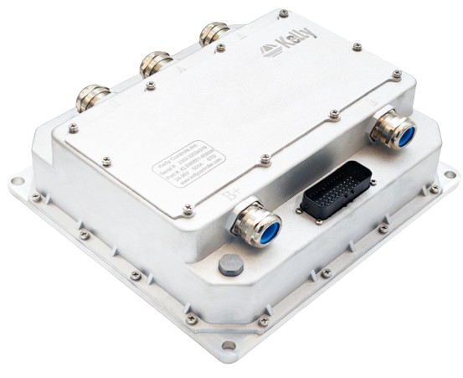
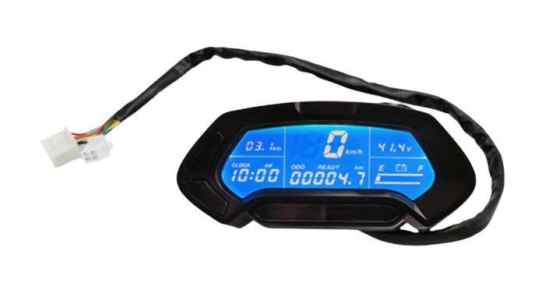
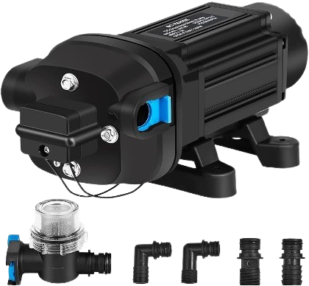
Electric Conversion of a Crosskart
Department of Mechanical Engineering, University of New Hampshire
Faculty Advisor: Professor Ivaylo Nedyalkov
Daniel Ciarla, Emma Mikucki, Timothy Polychronopoulos, Adam Raffay, Isaac Tilbor
Project Overview
SolidWorks Model
Vehicle Comparison
The original gas-powered Crosskart was equipped with a gsxr750 motor that produced 127 horsepower. The scope of this capstone project is to show a proof of concept that a student team can create a low-cost high performance fair-weather electric vehicle that matches or exceeds the abilities of the gas-powered alternative.
Gas Power and Battery Electric Performance Comparison:
Battery Electric Crosskart | Gas Powered Crosskart
Range: Approximately 37 miles | Range: Approximately 90 miles
Top Speed: 120 mph | Top Speed: 110 mph
HP: 268 | HP: 127
Baseline Testing
0-60 Acceleration Time | 4.53 seconds
60-0 Deceleration Distance | 86'6"
Clockwise Lateral Acceleration | 37.5 ft/s^2
Counter-Clockwise Lateral Acceleration | 46.4 ft/s^2
Why Electric?
Maximum torque is delivered immediately allowing for instantaneous response from the vehicle.
Regenerative braking capabilities enhance efficiency.
Dual motor EVs improve dynamic handling
Vehicle Overview:
Dual Motor
Rear-Wheel Drive
Direct Drive
384V 9.3kWh
Battery system
6 battery modules at
full power
Motor & Drivetrain
Design Choice | Justification
Dual Motors | Better power distribution Independent traction control and torque vectoring
Rear-Wheel Drive | Required minor adjustments to existing frame Allows for most direct comparison to gas-powered cart
Direct Drive | Minimizes mechanical linkages in transmission More immediate traction control and braking
Battery
Key Design Features:
System Specifications
384V nominal
9.3 kWh
120S3P Configurations
6 modules in total
Rubber Lining
Shock absorption
Prevent possible shorts
Side Mounted Battery Modules
Central location prevents the cart from being backloaded
Modules lay within existing suspension to prevent racing impact damage
Aluminum Casing
Provides puncture resistance
Cell Consideration:
Module Design:
Module Specifications:
Hexagonal shape to ensure fit within existing bash bars
Air cooled from the flow of air going through the cells as it is being driven
60 cells in series
4 balancers
Weight of around 50 lbs.
Crosskart Wiring Diagram
Controls and Frame
Motor Selection:
Braking System:
Electrical pedal system integrated with mechanical braking using potentiometers
  Mechanical braking on front wheels with simultaneous electrical braking from rear wheel motors.
Throttle and brake control ECU unit
Zytek 75 kW
75 kW Peak Output
200-400V
50 Nm Peak Torque
16,500 max RPM
Compro REB 90
80 kW Peak Output
400-800V
300 Nm Peak Torque
1500-4000 max RPM
Emrax 228
124 kW Peak Output
50-710V
230 Nm Peak Torque
6500 max RPM
FreeRCHobby
100 kW Peak Output
50 kW nominal
400V max
180 Nm Peak Torque
Mounting Design for Modules
Electrical-Mechanical Braking System
Motor Controller Specifications:
Nominal Voltage: 360 V
Continuous Current: 350A
Hall Sensors
Water cooling
Body panels:
Fabricated from 1/16" aluminum
Flat angular plate design
Selected Motors: FreeRChobby MP240150 Total Cost: $3,900
Drivetrain Components:
Design Method – SolidWorks FEA under both static and fatigue loading.
Battery Module
Headway 38120 Lifepo4 Battery Cells
Materials:
Headway LFP cells
PLA 3D printed end plates
Copper bridges
Screws
Steel support beams
Aluminum casings
150A fuse
Quick connectors
Total Cost: $3,800
 | Samsung 25R | Molicel P42A | Headway LFP
Nominal Voltage | 3.6V | 3.6V | 3.2V
Capacity | 2.5Ah | 4.2 Ah | 8Ah
Weight / Dimensions | 47g/ H=65mm d=18mm | 70g/ H=70mm d=21mm | 330g/ H=136mm d=39mm
Needed Cell Configuration | 110S10P | 110S8P | 120S3P
Motor Coupling
Drivetrain Assembly
Motor Mount
Motor Controllers
ECU Display
Body Panel Design
Fabrication Method: Waterjet cut at the Olson Center.
What's Next?
Water Cooling System:
2 pumps for separate loops to ensure equal cooling
Required cooling flow rate: 3.75 gal/min
Sourced pumps: 12V, 60 psi, 5.5 GPM
Hot swappable battery pack redesign
Replace rear suspension for improved stability and traction
Fabricate shortened axles for more efficient use of space in rear of frame
Selected Cells: 360 Headway LiFePo4

