Slide 1
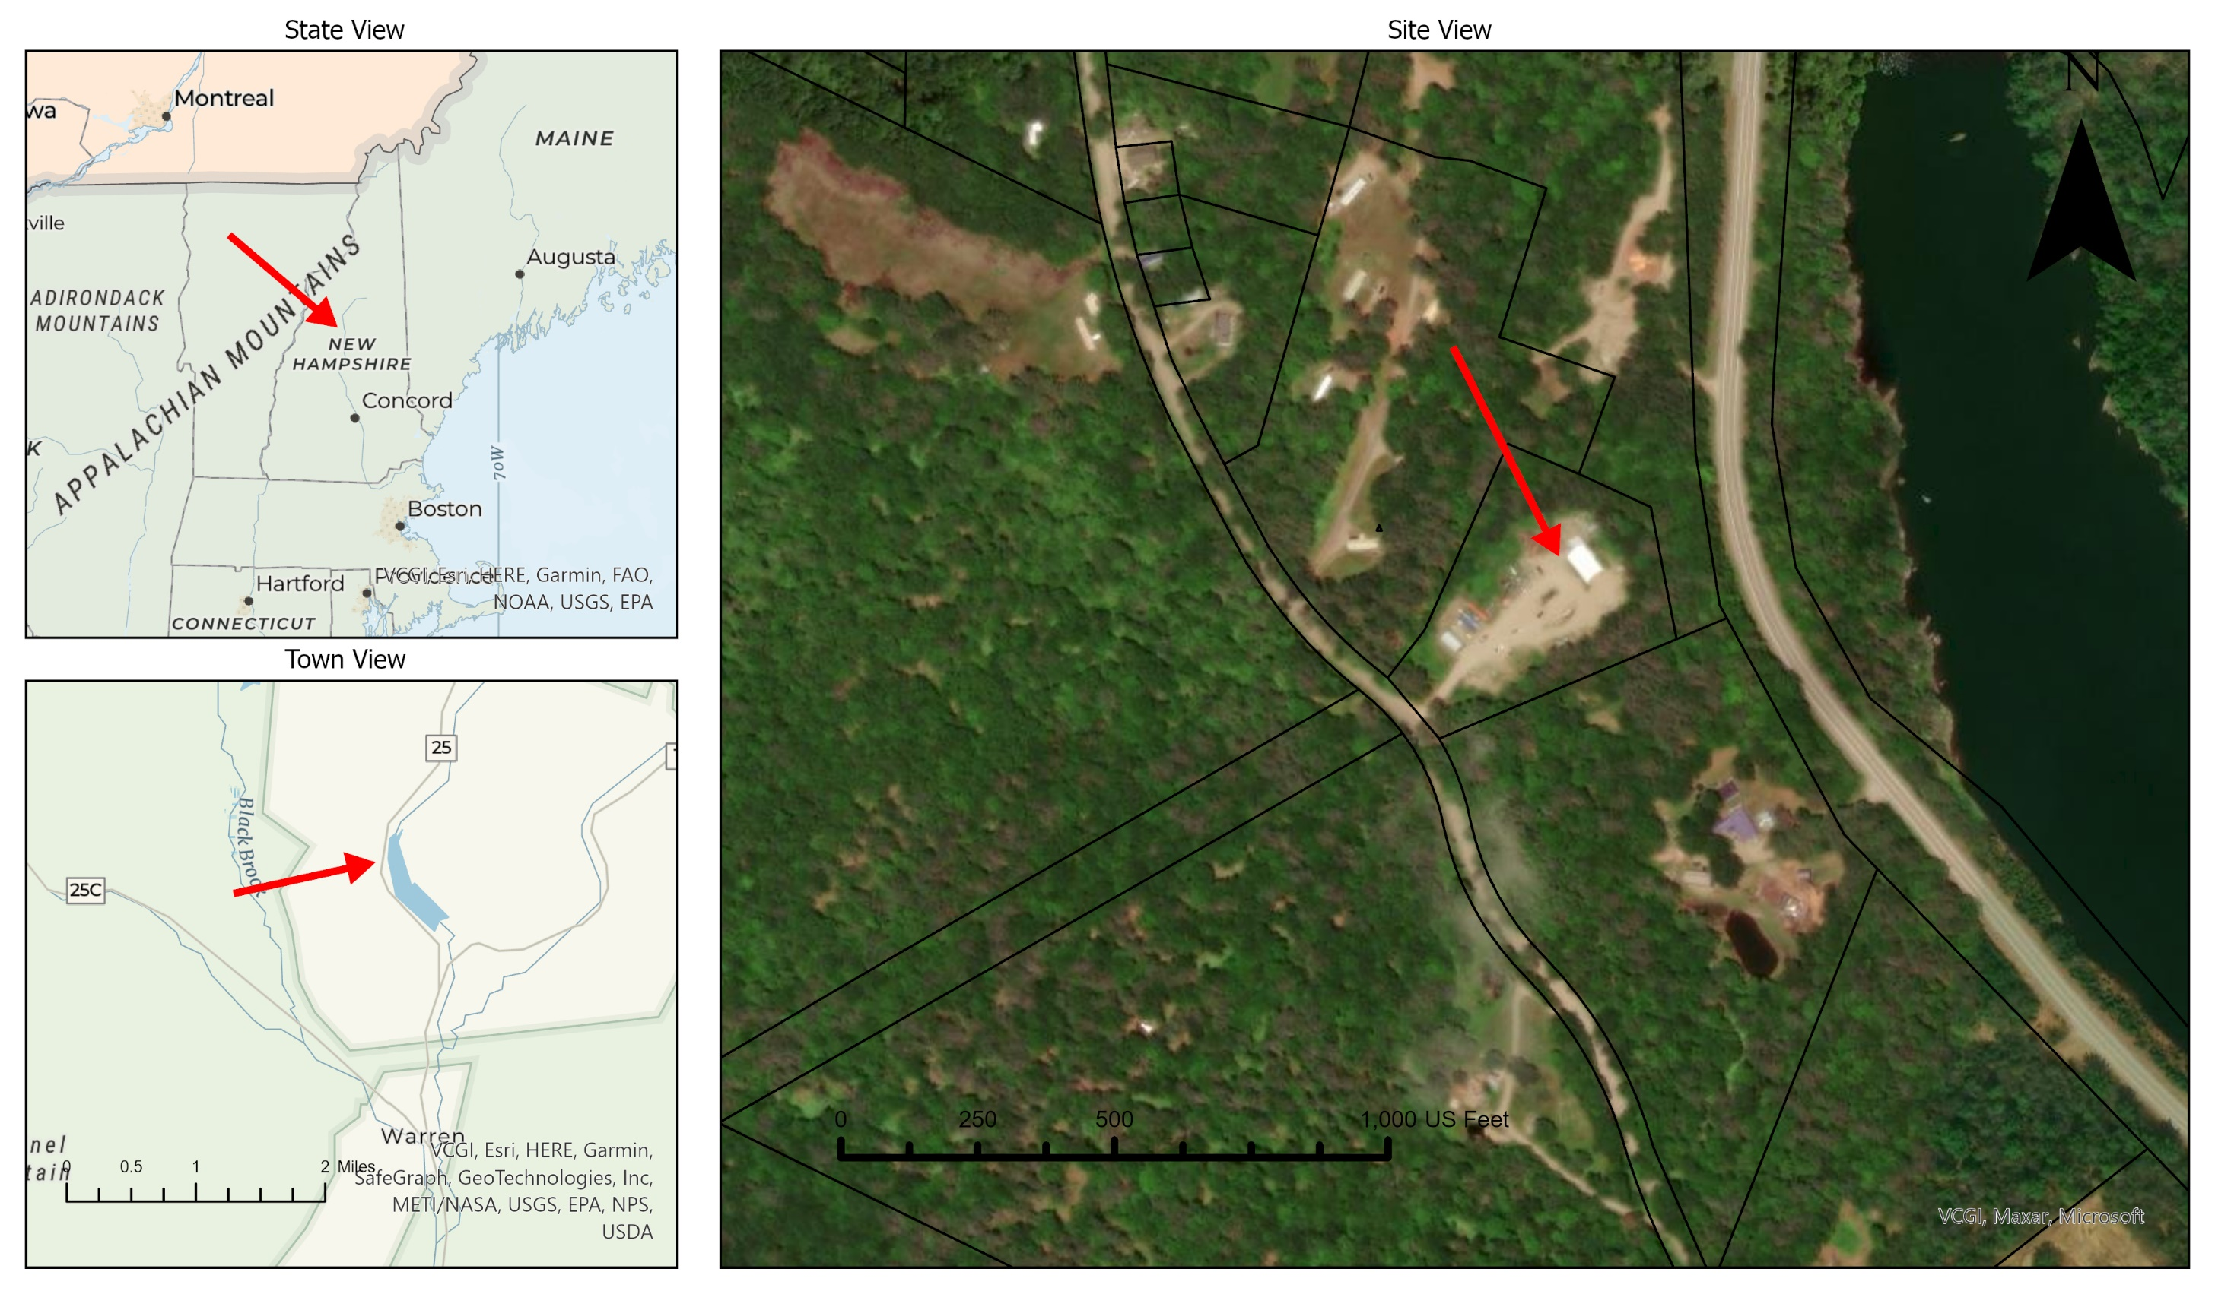
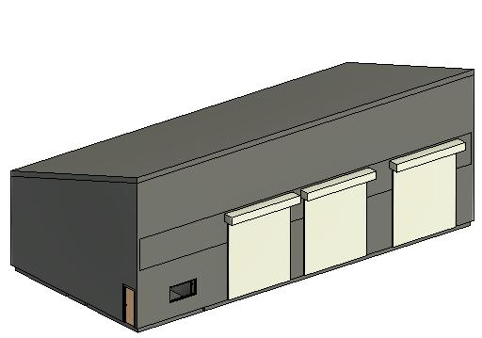
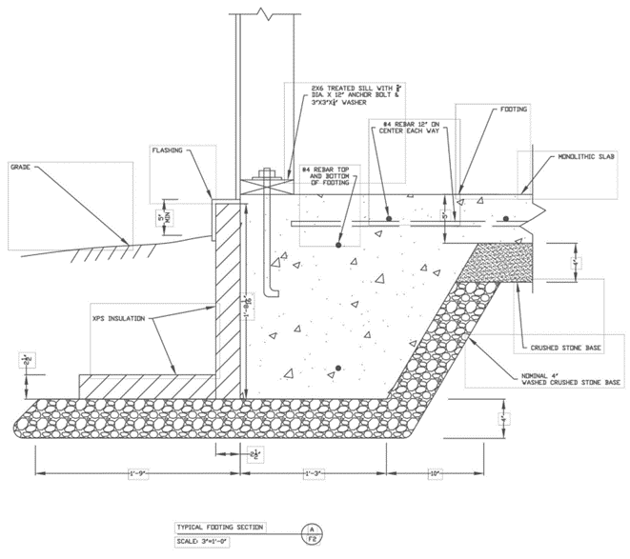
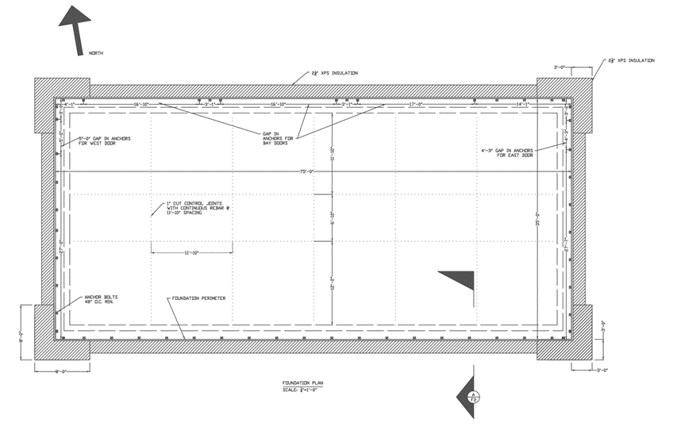
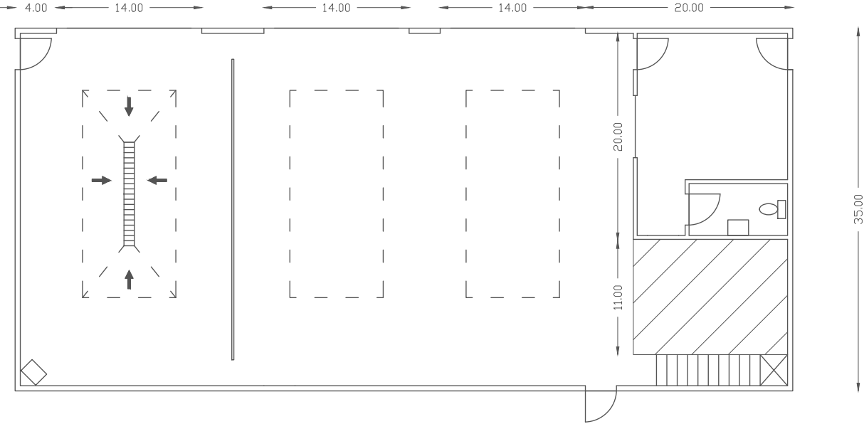
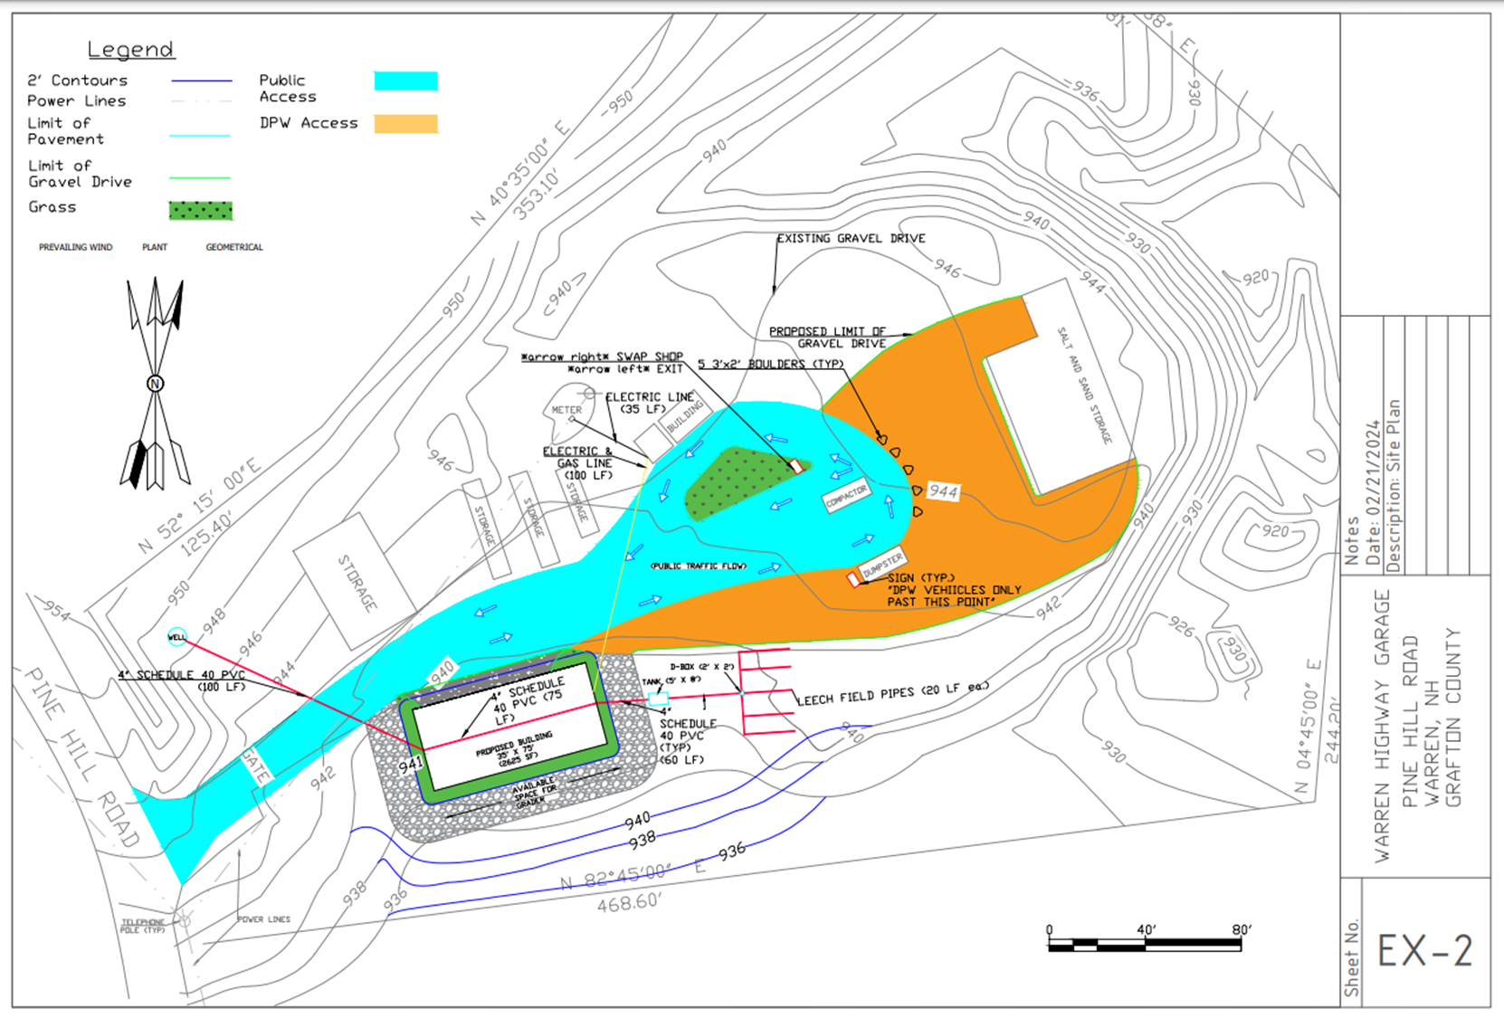
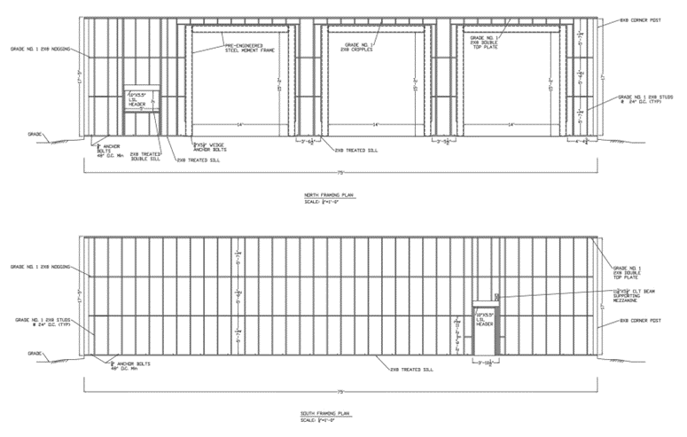
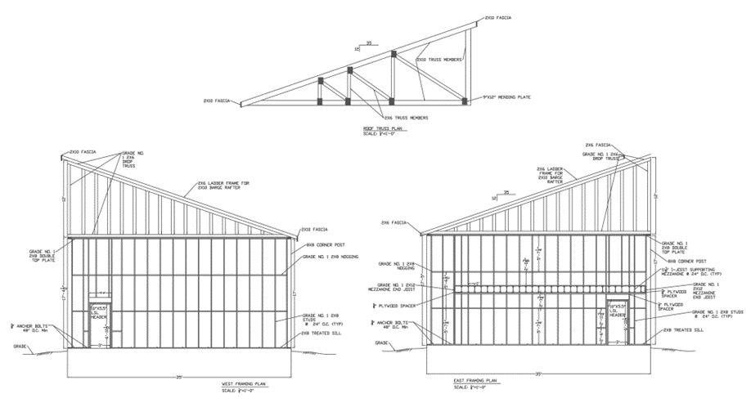
Warren Highway Garage Josh Brown, Jake Dutile, Aidan Michalak, and Peter Schultz Civil Engineering, University of New Hampshire, Durham, NH 03824
Introduction
Cost Estimation
Locus Map
For the Town of Warren, UNH capstone group 8 has created site and building design plans that fulfill our client's needs. In our scope of work, we decided to include a cost estimate, a foundation plan, a framing plan, and a proposed conditions plan. The final design cost is under the Town's budget of $1.1 million and includes the majority of extra design considerations they requested. Ask us about the features we included in their design!
Thank you to our sponsor, Austin Albro, our faculty advisors, Anthony Puntin and Matt Low, and our outside resource, Liam Kalloch. We appreciate your dedication to our learning as we complete our degrees in civil engineering.
*The average costs of material and labor were used to find the price of each component installed.
Framing - $33,000 | Mezzanine - $10,750
Plumbing - $3,000 | Foundation - $33,600
Electrical - $3,000 | Roof - $56,000
Drywall - $12,000 | Earth Work - $12,000
Well - $11,000 | Fixtures - $58,000
Septic - $18,000 | Total - $288,000
Building Design
Floor Plan
Revit Model
Foundation Plan
Site Plan
Framing Plan
The site plan sheet includes grading for drainage, flow paths for vehicles, and the new building location. The well and septic system are also shown in red. This image is not to scale.

