Slide 1


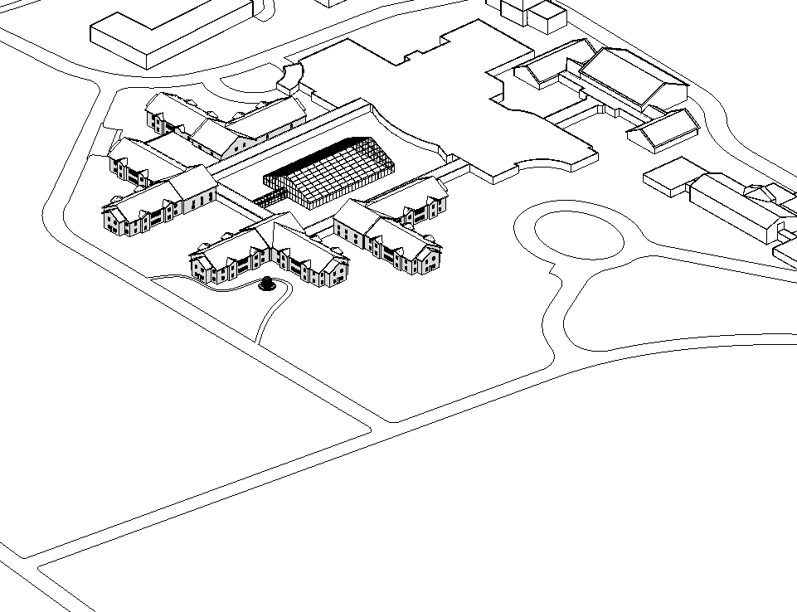
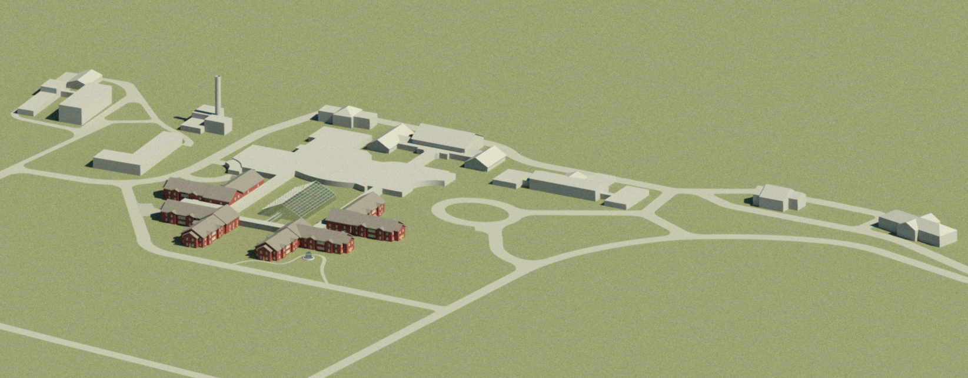
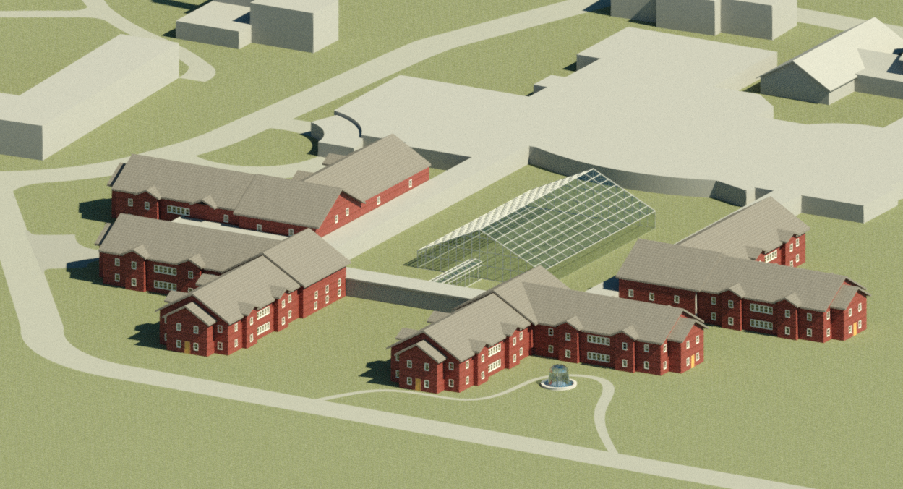
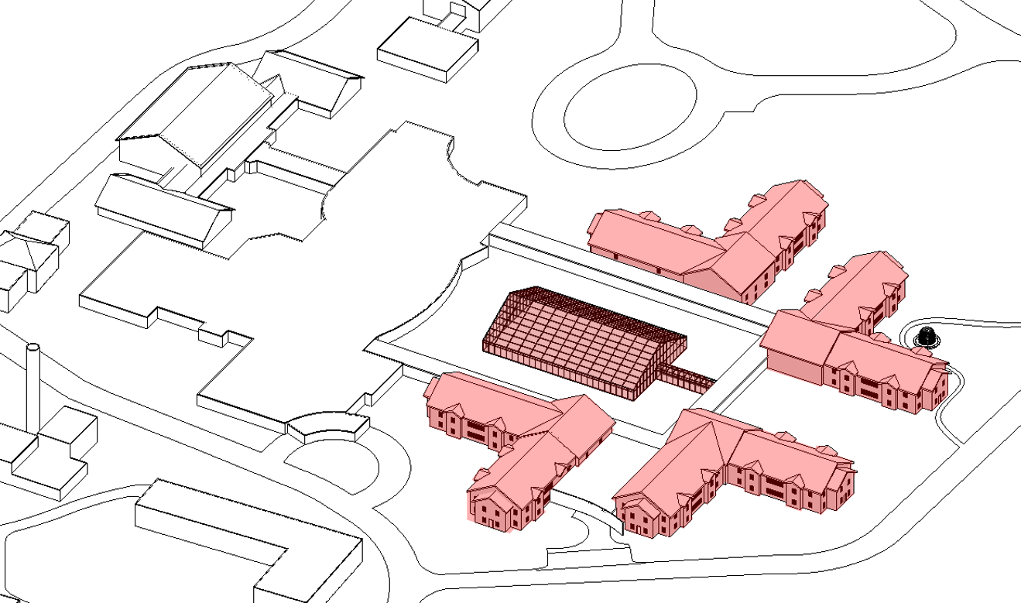
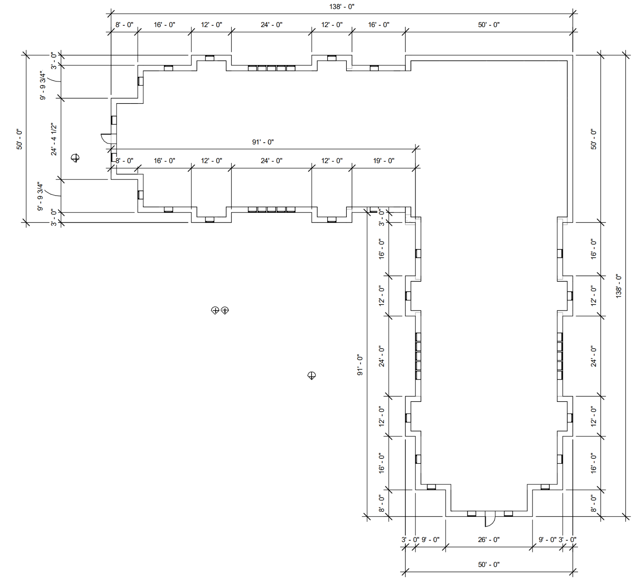
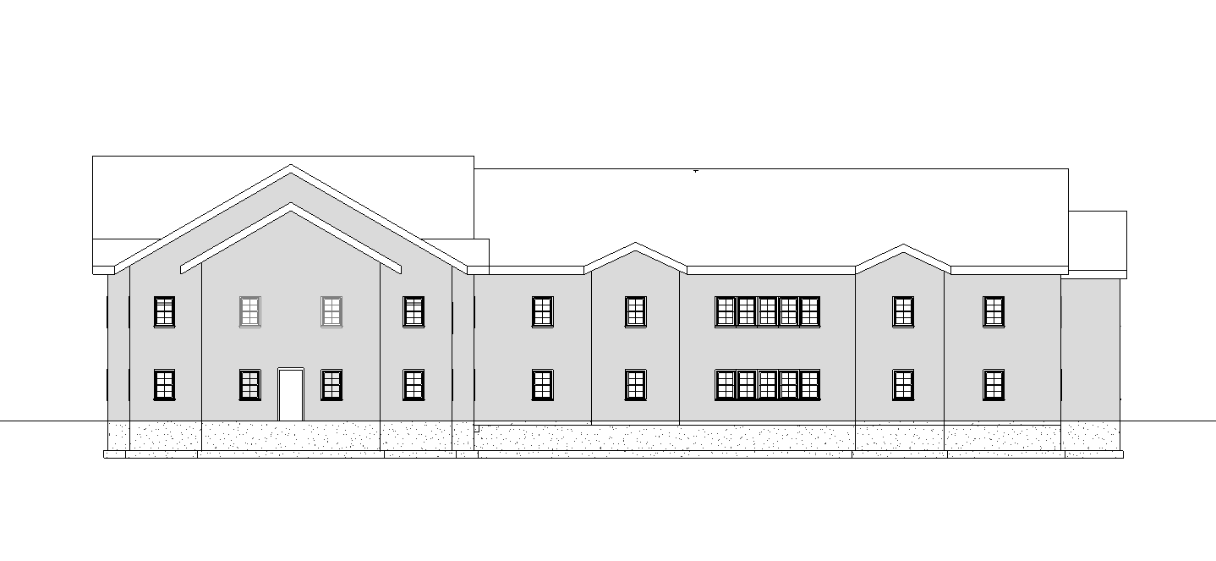
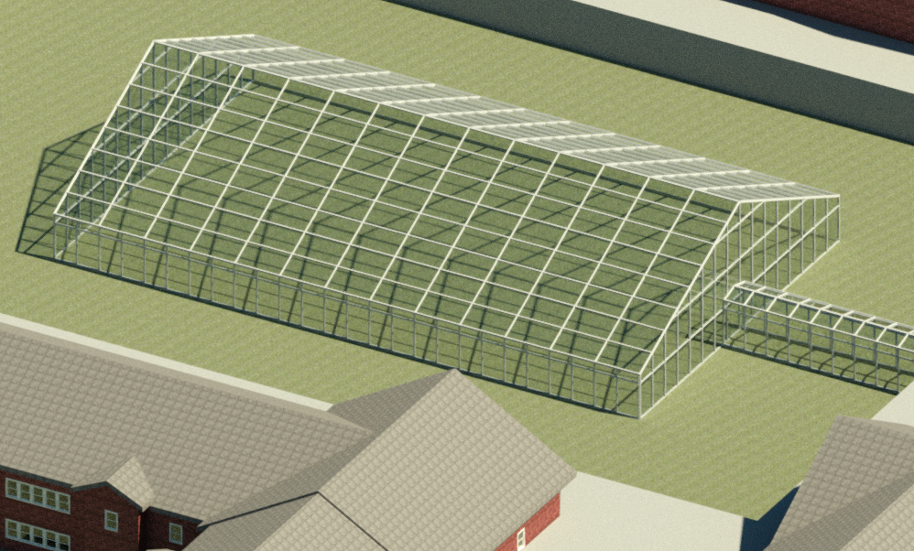
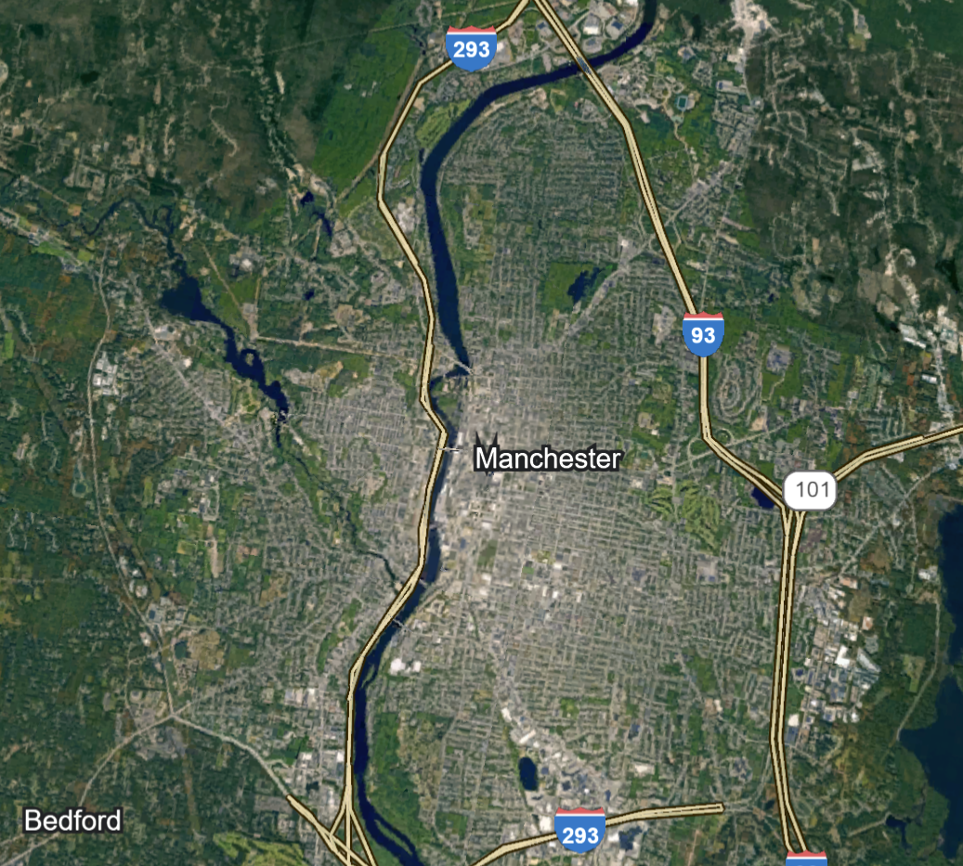
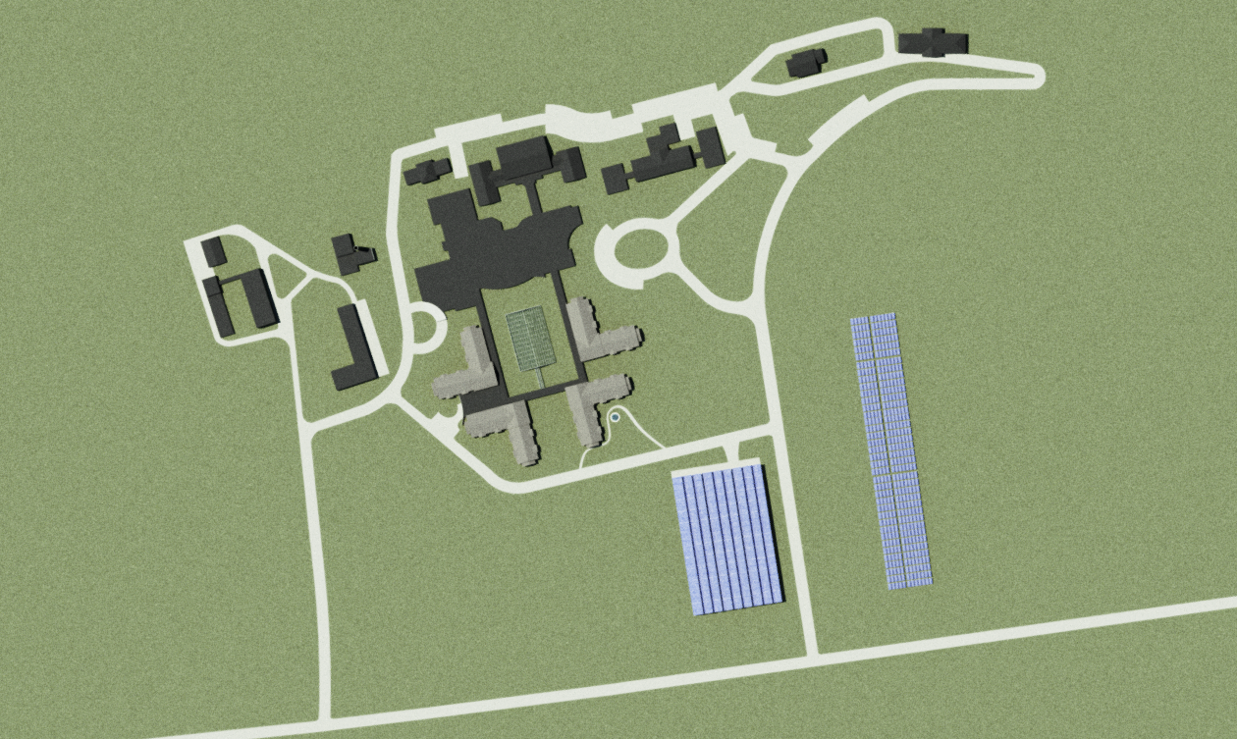
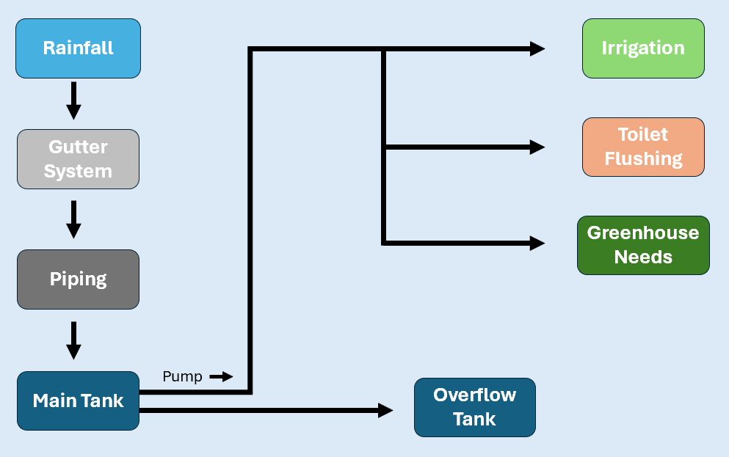

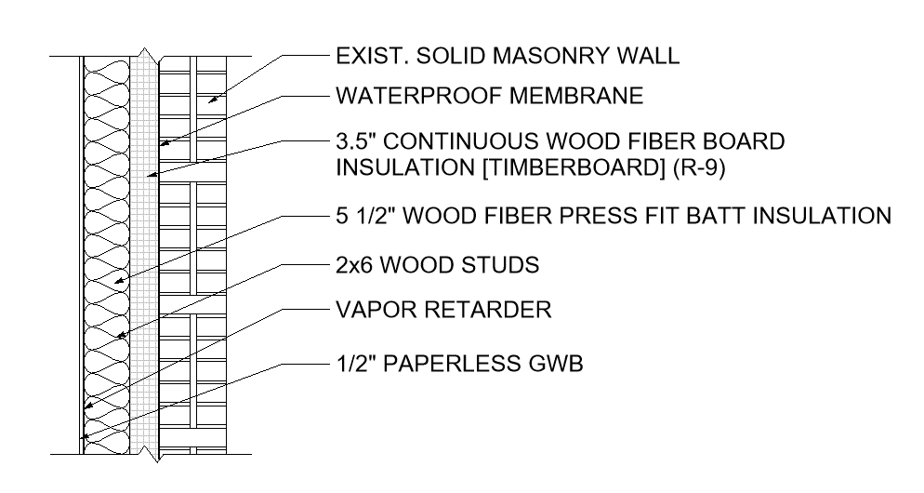
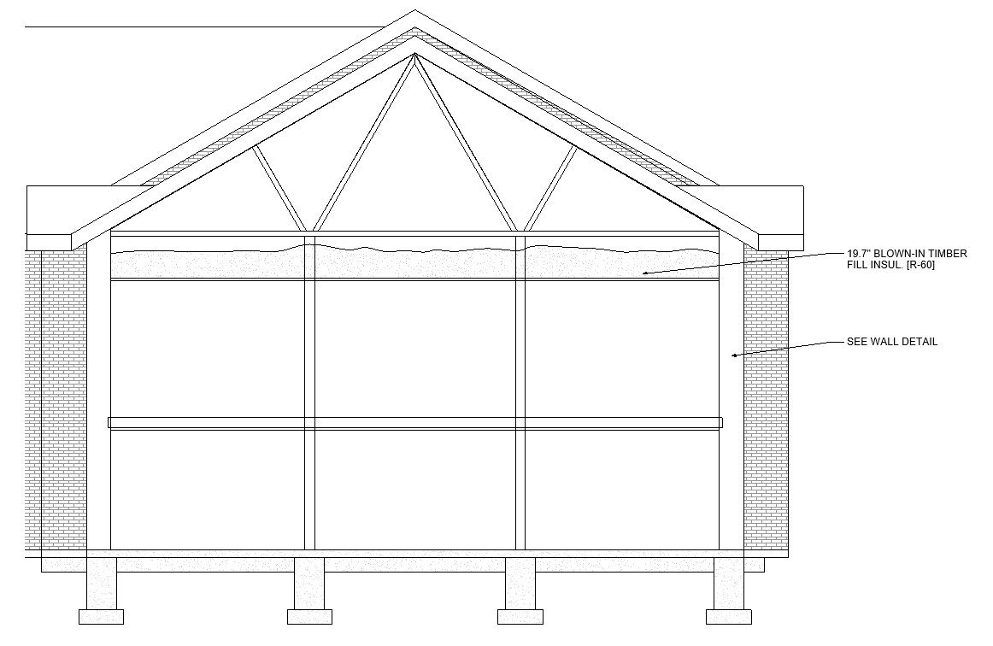
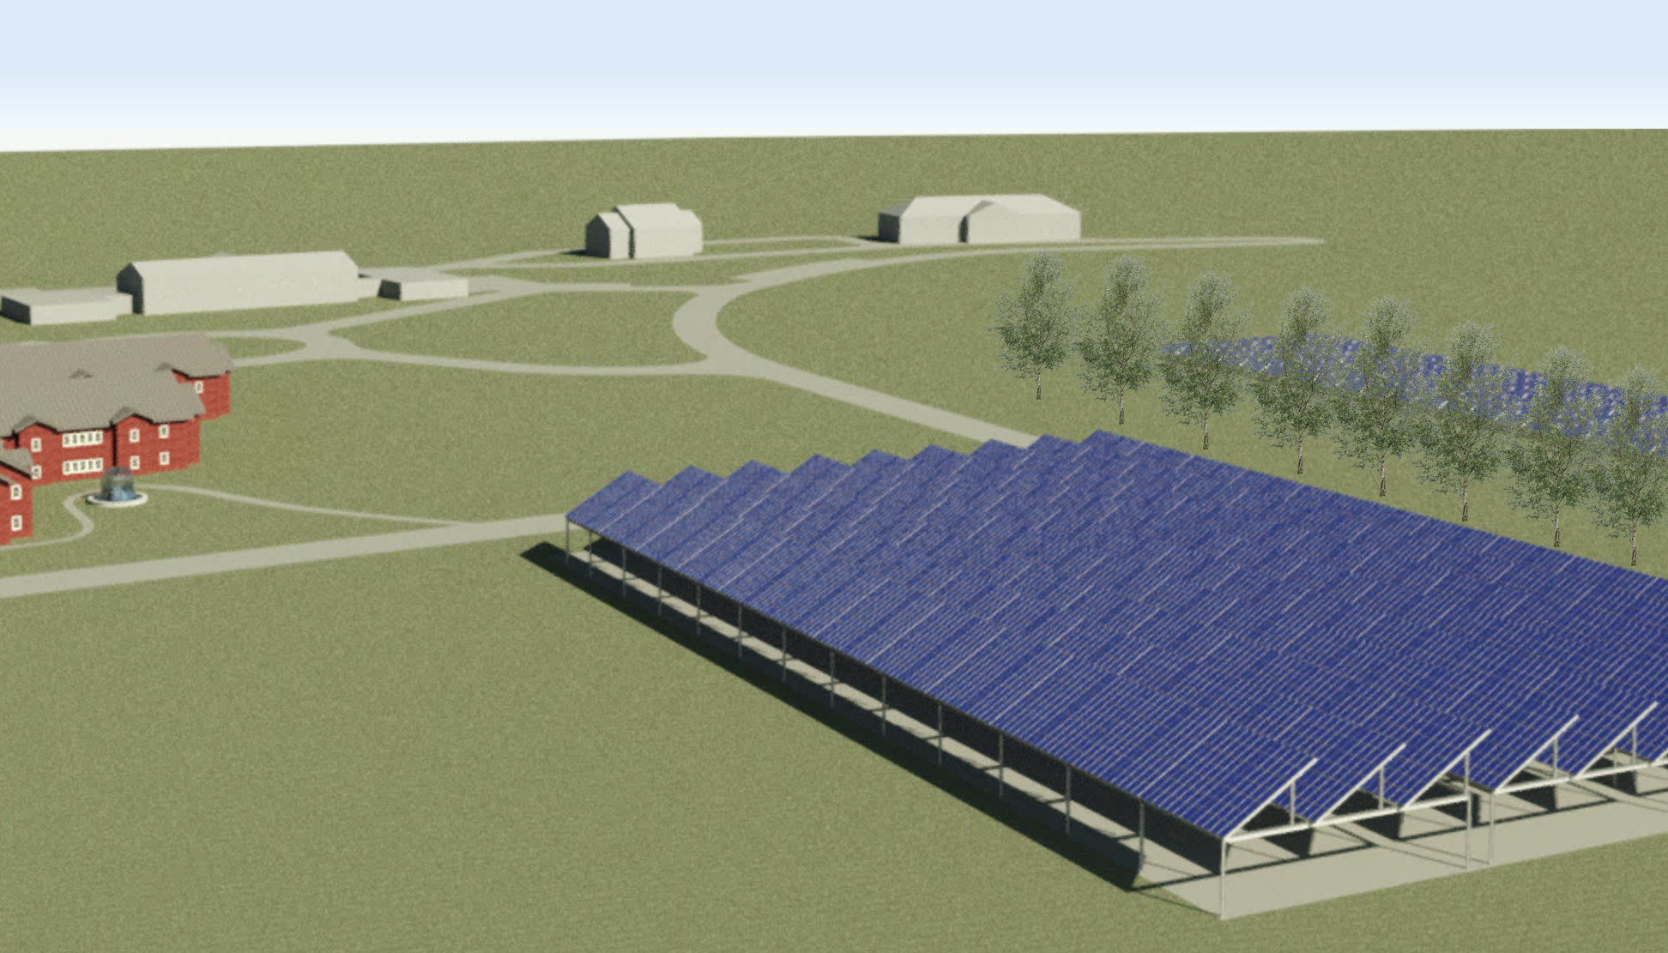
U.S. Department of Energy Solar Decathlon
Introduction
University of New Hampshire Departments of
Civil, Environmental, & Mechanical Engineering
Mechanical Systems
Overview
The Sununu Youth Services Center currently houses 10 individuals on average but has plans to be relocated to another site. The redesign of this facility will minimize both embodied and operational carbon by utilizing local materials within the surrounding economy. The team presented this design in the 2024 DOE Solar Decathlon Design Challenge in Golden, C0lorado.
Solar Decathlon Design Challenge
Annual collegiate competition, sponsored by the U.S. DOE, where teams from around the world are challenged to design high-performance, sustainable, low-carbon buildings that are powered by renewables. Each team is judged based off 10 contests addressing real word issues.
Design Goals
Net Zero Energy
Use photovoltaics and a geothermal system to maximize energy efficiency
Address educational, poverty, and mental health concerns
Set precedence for future retrofits of this scale
Ground Source Heat Pump
System Size: 460 tons
Will consist of 168, 500ft deep boreholes with high density polyethylene PE40 piping to cool R-410A refrigerant to a constant temperature of 55˚F
Provides heating/cooling with a reversible valve
Tanner Weeks, Anna Graham, Lilah Flynn, Gabriel Guertin, Timothy Barrett, Samuel Twarog, Brian Ascani
Architecture
Engineering
Envelope
Efficiency
Grid Interactivity
Life Cycle
Health
Market
Community
Presentation
Building HVAC
Multizone rooftop air conditioning system
Seasonal Energy Efficiency Ratio (SEER) = 14
Enthalpy heat recovery package that removes heat and humidity from the airflow.
Renovation Focus
Wing Floor
Elevation View
Environmental Impact
Greenhouse
Aluminum structure with glass panels, allowing for maximum light transmission
Provides hands-on learning
Algae production to make biodiesel fuel
Plant and vegetable growth
Architecture & Building Envelope
Historic Preservation
As a large portion of the structures date back to the 1800’s, it is paramount to maintain the external façade of the renovated buildings.
Follows guidelines of NH Division of Historical Resources
Outdoor Experience
Introducing outdoor classrooms, picnic areas, and gardens will promote a more interactive environment. New walking paths with artistic sculptures will also inspire creativity when at times of rest.
ADA Compliant
All elevators, doorways and entrances, and parking lots will follow the requirements of ADA.
Acoustics
Reverberation time for an empty classroom = 0.739 seconds
Minimize excess noise while maximizing speech intelligibility.
Reduction of Carbon Emissions
Retrofit vs. Construction – Significantly reduces carbon footprint
Locally sourced materials from companies in the community
  Utilizing TimberHP products, all insulation for this project will arrive on site with a negative carbon impact.
All components and systems were designed to be low-carbon emitting, with extended service periods.
Site Location
1056 River Road, Manchester, New Hampshire
Northwest side of the city
Lot Size: 150.7 Acres
Climate Zone 5A
Risk Category III
Next to the Merrimack River
Rainwater Harvesting
Significantly reduce the utilization of municipal water needs.
Repurpose the collected water for irrigation, flushing, and watering plants in the greenhouse.
Single Stud Walls
Existing solid masonry double wythe wall
Wood Fiber Insulation
8 in. thick exterior walls
Carbon neutral lumber
Double Pane Windows
With VIP
Passive solar use
Limits heat loss
100x more efficient than single paned
Energy Performance
LEED
Photovoltaics
Target EUI will be less than 54 kBtu/ft²yr
610-watt, 23.6% efficiency solar panels.
Fixed and dual axis tracking will cover about 2.75 acres of land.
To achieve net zero, the facility needs to generate 863,000 kWh/yr. To combat low solar gain periods, the system is designed to generate 1.06 million kWh/yr.
Net metering will allow any excess energy to be sold back to the grid.
Solar Canopy
Parking lot capacity: 204 Spaces
Total Square Footage: 60,480 sqft of PV collectors
Fixed axis panels positioned at 30˚
Optimized for greatest electricity generation on an annual basis
Reduces the heat island effect of the site
Supplement additional on-site energy generation
Passive Design
Double pane windows will be paired with vacuum insulating panels allowing for an increase in energy savings when rooms are unoccupied.
VIP Windows
Retractable insulated panels for after-hour energy savings
Upgraded double pane windows with vacuumed insulated panels save over 250% of heating energy
CO2 sensors to detect room use
LEED Gold for O&M of existing buildings
CO2 sensors and VIP shutters to limit energy consumption
Optimized water efficiency and energy performance
Acoustic calculations to enhance indoor comfort and air quality
R-35
R-60
Acknowledgements
Cost Analysis
Project Advisor: Felix DeVito
CEPS Dean’s Office
Civil, Environmental and Mechanical Engineering Departments
U.S. Department of Energy Solar Decathlon
 | Single | Double | Triple | VIP
Yearly Loss ($) | $1,580,000 | $13,000 | $6,500 | $160
Yearly Energy Loss (KBTU) | 48,500 | 400 | 200 | 5
References
Total Renovation Cost: $14,750,000
Payback Time: 8 Years
(1) EPA. “Data Access | National Centers for Environmental Information (NCEI).” Www.ncei.noaa.gov, www.ncei.noaa.gov/access/search/data-search/local-climatological-data-publication. Accessed 2 Apr. 2024.
(2) IECC. (2021). 2021 INTERNATIONAL ENERGY CONSERVATION CODE (IECC) | ICC CODES. Codes.iccsafe.org.
https://codes.iccsafe.org/content/IECC2021P2/chapter-3-ce-general-requirements
(3) NH Division of Historical Resources. Division of Historical Resources. (n.d.). https://www.nhdhr.dncr.nh.gov/
(4) NH Division for Children, Youth and Families (n.d.). DCYF Policy Manual. New Hampshire Department of Health and Human Services. https://www.dhhs.nh.gov/programs-services/child-protection-juvenile-justice/dcyf-policy-manual
(5) State Building Code Review Board. (July 1, 2022). NH State Building Code. New Hampshire Department of Safety. https://www.nh.gov/safety/boardsandcommissions/bldgcode/nhstatebldgcode.html

