Slide 1

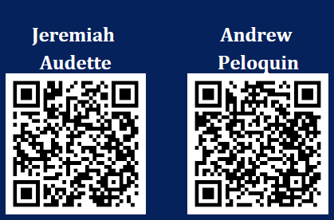
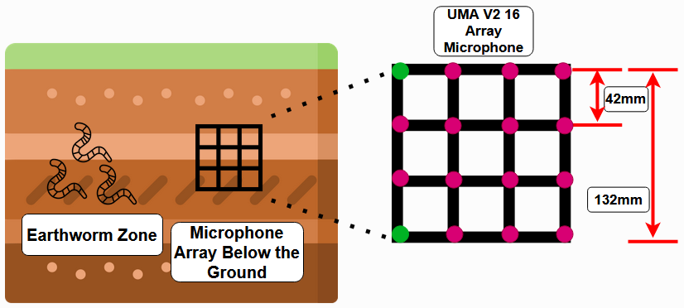
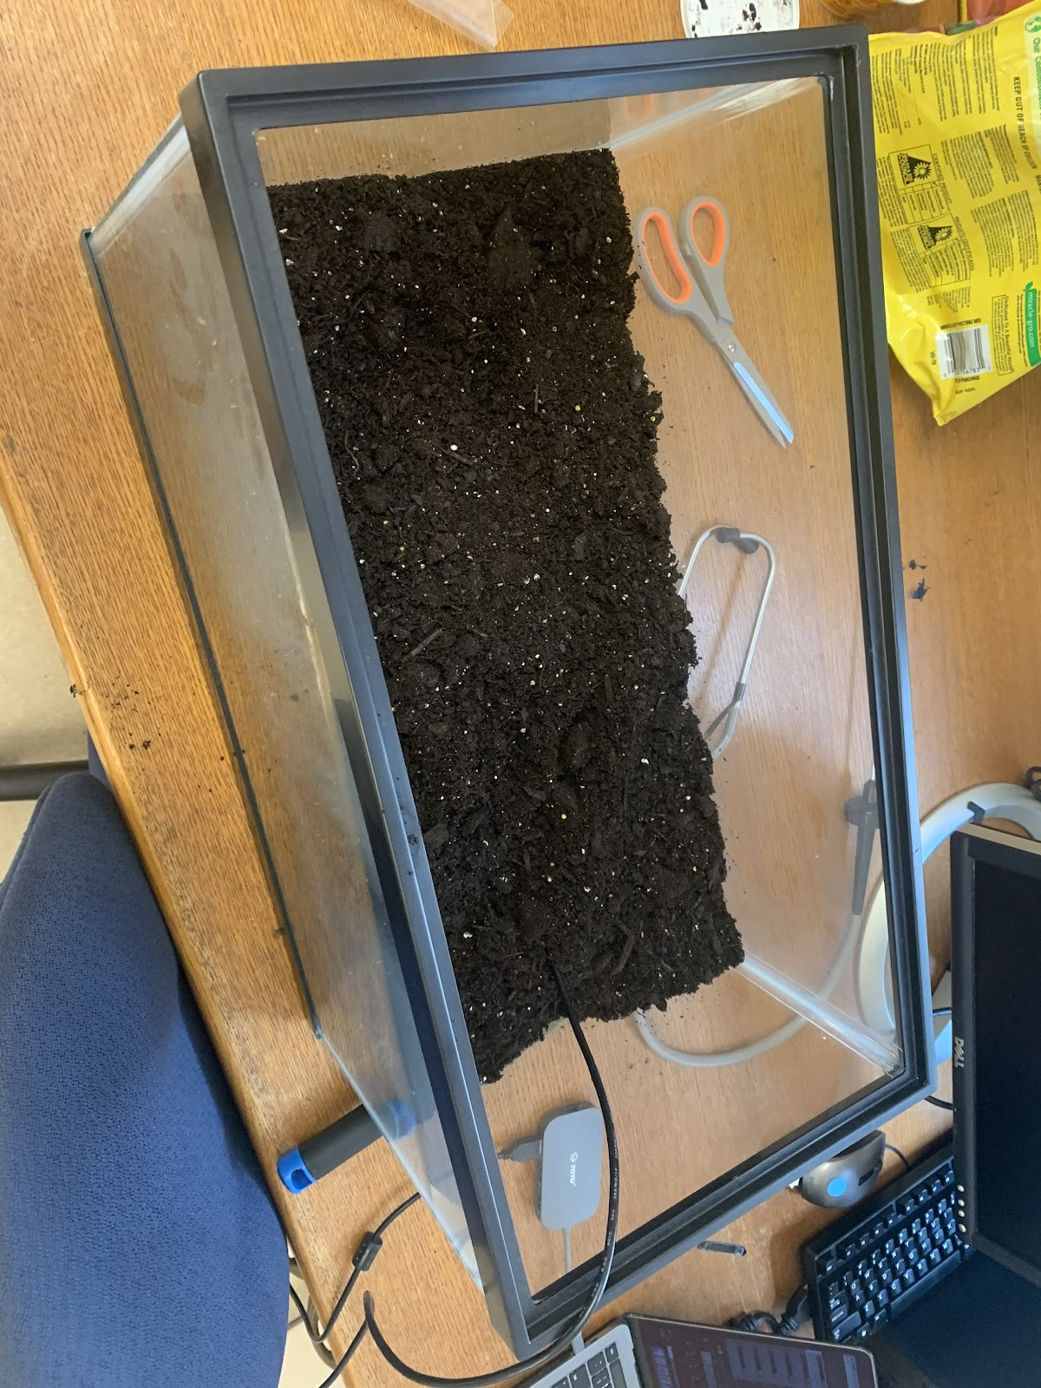
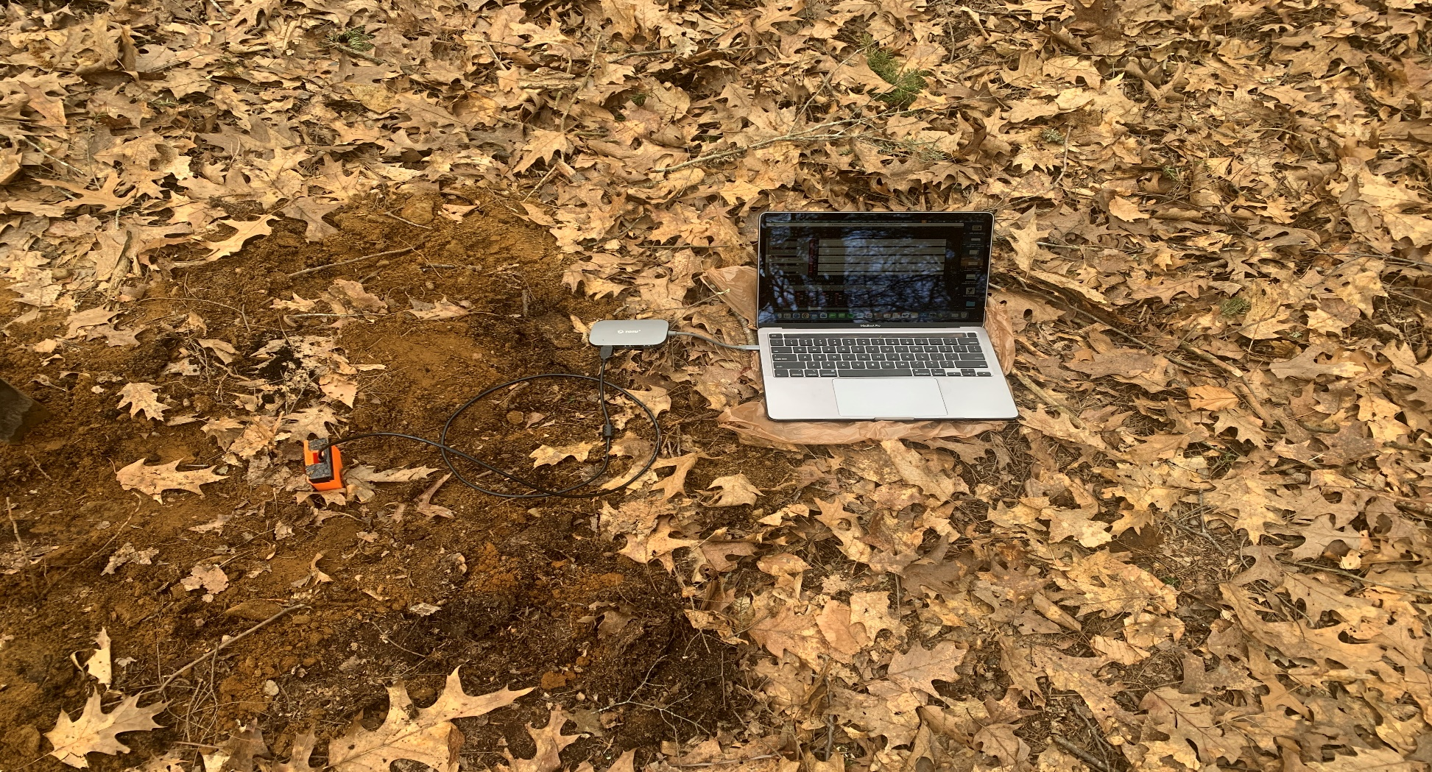
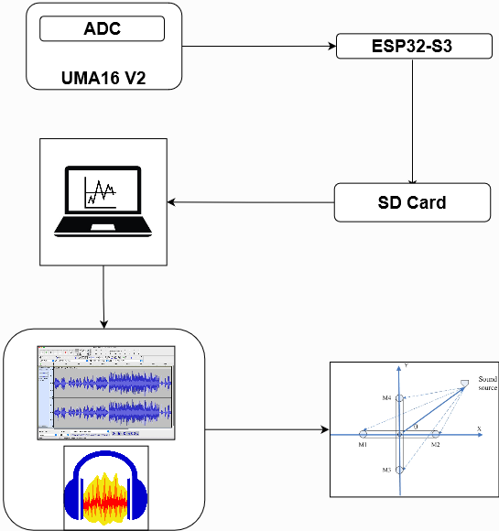
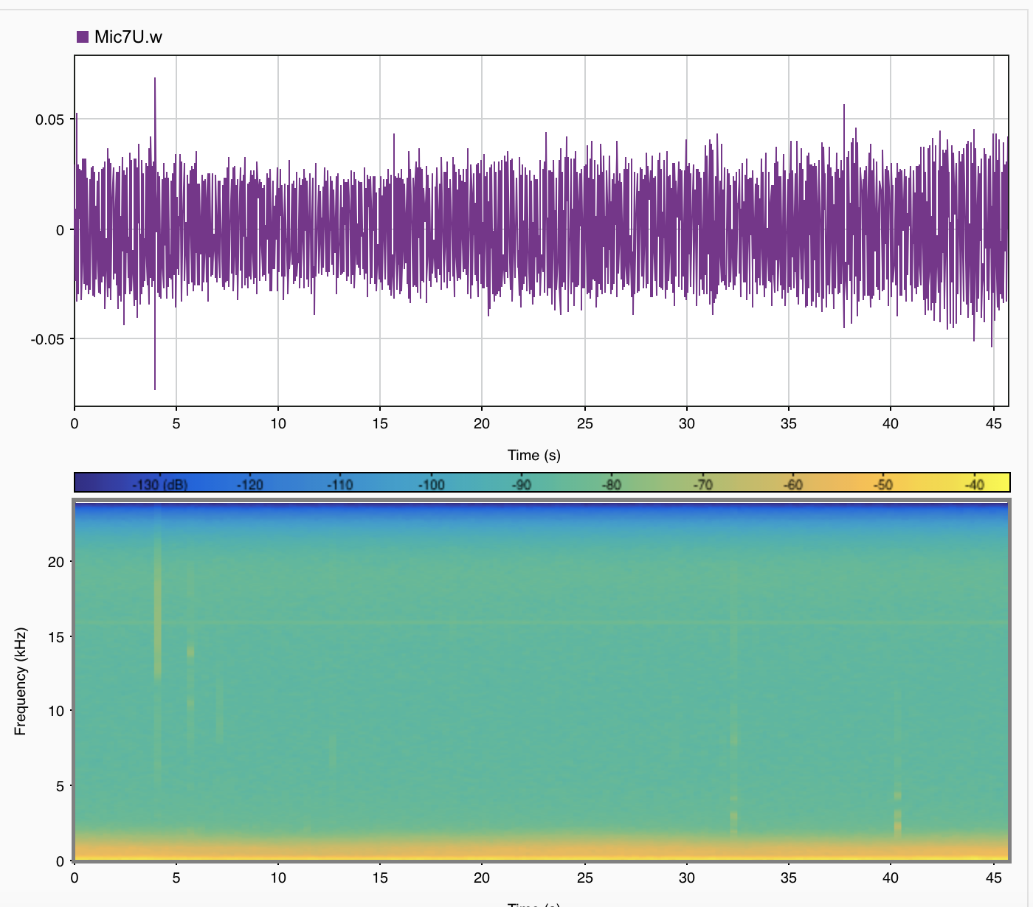
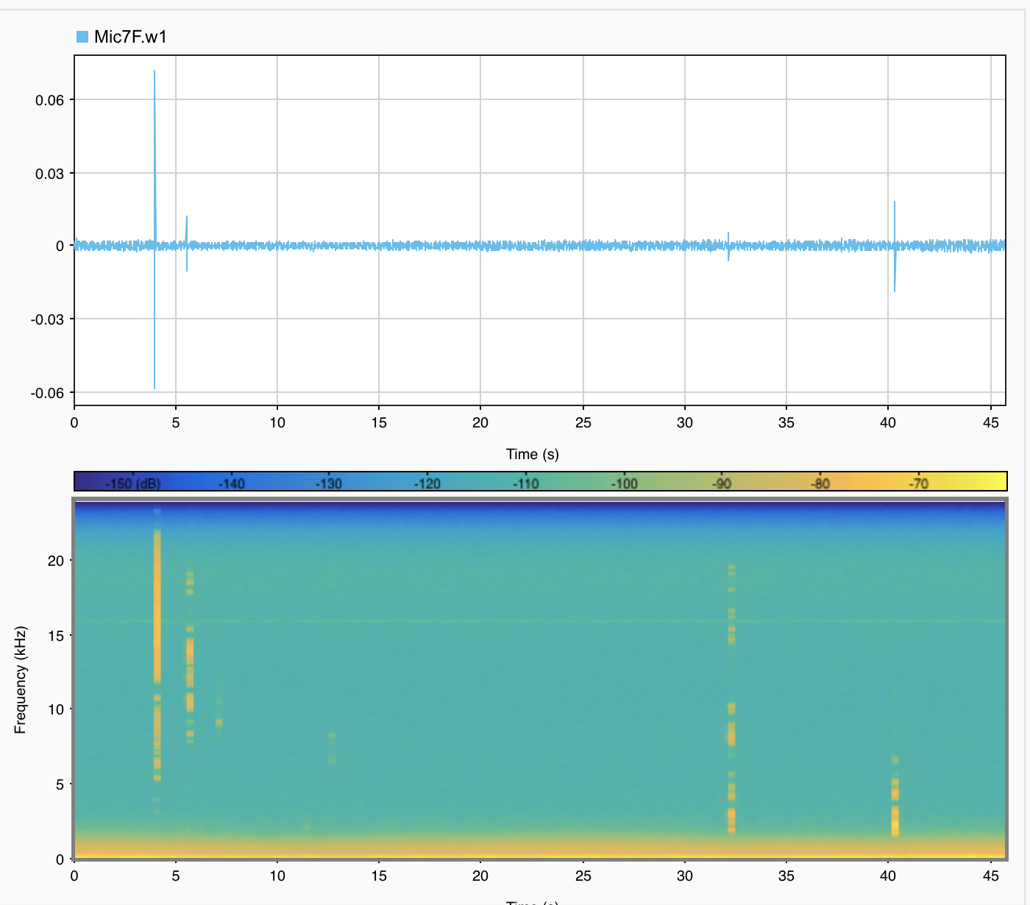
Bioacoustic Sensing and Subterranean Earthworm Mapping for Enhanced Pest Detection
Jeremiah Audette and Andrew Peloquin
Advised by Dr. MD Shaad Mahmud
Department of Electrical and Computer Engineering, University of New Hampshire, Durham, NH 03824
Background
Theory
Challenges
Trees and other plants are critical parts of Earth’s ecosystem but are perpetually attacked by pests.
Earthworms can be utilized to monitor a pest’s likely location. When a pest is nearby, earthworms tend to dig deeper into the ground and remain there until the pest departs. This behavior can be monitored using an earthworm’s audio cues.
Theoretical Functionality of the Deployed Sensor
Microphone Connection
  The UMA16 V2 Microphone array is not compatible with Windows machines
Measuring Miniscule Signals
  The actual audio signals coming from worms is so small it can only be heard when the audio clips are boosted
External Noise Interference
  Noises such as wind, planes, cars and footsteps can disrupt the signal data
Remote Connection
  The current microphone being used is unable to connect to the ESP32-S3
This diagram shows the theory behind how the angle of the sound-producing earth worm will be measured. Using a top and bottom microphone on the sensor, pictured in green, a sound’s angle of arrival can be calculated. This angle can be used to approximate the depth of earthworms.
Method and Design
There are several components of the project that work together to produce a desired output:
16-microphone array (UMA16 V2)
Noise reduction (Audacity)
Angular calculation script (MATLAB)
3D printed enclosure
ESP32-S3 Microcontroller
Before angular calculation is done, the audio must be cleaned up to remove unwanted sounds. These noises greatly affect the calculation, and the script would produce false results if not corrected.
Live Testing
Future Direction
In-Lab Testing
Field Testing
The future goals of this project include implementations of various automation features to allow for remote data collection and processing:
Remote connection to RSL (lab) server via ESP32-S3
Script designed to automatically calculate the direction of arrival for all saved data
Deploy multiple units fit with small form solar panels to allow for long term recording of data
This image shows the lab testing environment utilizing a terrarium, store bought soil and worms, as well as the UMA16 V2 Array.
This image shows the test conducted in the field where positive results involving sounds from earthworms were found.
Data Analysis
sTAMD Simulations
Power Spectra Analysis
Acknowledgements
Thank you Dr. MD Shaad Mahmud for supporting this project as well being the advisor and original proposer of the project.
This material is based upon work supported by the USDA #110378 and NHAES CREATE #11HL14.
References
Animals in the soil make noises. biologists are listening. (n.d.). https://knowablemagazine.org/article/living-world/2022/life-soil-was-thought-be-silent-what-if-it-isnt
Scola, Carlos Fernández and María Dolores Bolaños Ortega. “Direction of arrival estimation : A two microphones approach.” (2010).
The above figure shows the power spectra of a signal recorded in the field. The left figure shows the unfiltered signal in purple along with the power spectra, and the right figure shows the filtered signal and power spectra.

